Slide 1




Innovation Challenge:
Finalist Pitch Deck
Josh Everett, Vice President Strategic Partnerships & Innovation
John Garcia, Strategic Partnership & Innovation Intern
Dan Volk, Strategic Partnership & Innovation Intern

Slide 2
<Name of Idea>
<Short Description of Idea>
<Team Name/Innovator Name(s)>
Notes:
This ppt is intended to be a summary view of your idea. This should set the stage, describe the what, why, how, who, how much, and ultimately how this idea is a winner
This is a template. Change as you see fit. None of the slides are required. It is up to you to determine how to best pitch your idea to the growth board
Pitches should be able to be walked through and completed within 12 minutes for pitch, 5 minutes for q/a, 17 minutes. You will be timed and given visuals to drive your presentation to closure

Slide 3

Set the stage to make your idea real for the audience

Slide 4

Set the stage to what problem this is going to solve, how we can win

Slide 5







The Problem: <Problem your idea will solve>
Problem #1
Problem #2
Problem #3
Problem #4
Problem #5
Describe problem #1 and how addressing it creates positive impact; leverage to tell why we should execute on this idea
Describe problem #2 and how addressing it creates positive impact; leverage to tell why we should execute on this idea
Describe problem #3 and how addressing it creates positive impact; leverage to tell why we should execute on this idea
Describe problem #4 and how addressing it creates positive impact; leverage to tell why we should execute on this idea
Describe problem #5 and how addressing it creates positive impact; leverage to tell why we should execute on this idea
Notes:
<Insert your own points > Text in red ribbons should be your main points as to why this problem is prevalent and needs to be solved.
<Insert short description of points> briefly expand on your points, remember this should be short and to the point. Keep it easy to read.
USE YOUR EXECUTIVE OVERVIEW FOR REFERENCE – Proposal for action

Slide 6


Outcomes / how we win / how agents win / how consumers win
What are the potential outcomes?
What happens if this goes badly?
What happens if this goes really well?
Describe the outcomes that apply to consumers.
Describe the outcomes that apply to agents/brokers.
Describe the outcomes that apply to Ameritas.
Notes:
Refer to your executive overview document – solution overview to describe the cause for action and what’s in it for the consumer, the agent, Ameritas, others?

Slide 7

Did You Know?
Use this page to talk about top reasons your idea is prevalent in todays market
This can be similar information to your Solution Overview from your Executive Overview document
Use this slide to portray key stats or insights that make your idea appealing to execute
If other competitors or business models have done something like this, introduce the info to describe what the potential is
Notes:
< Describe the ‘Why?’. This should be background information on what is going on in the market right now that makes this a must develop idea or historical data that defends the need for your idea. Anything you think the judges need to know to grasp your idea>

Slide 8




Solution:
<Insert your solution>
<Briefly describe your solution>
Communicate
Engage
Win
Text to describe
Text to describe
Text to describe
Notes:
<Insert the key parts of your solution>
Pull from the Solution Overview section of your Executive Overview doc.

Slide 9




The How: <How will your idea be brought to market>
<Brief description about how your idea will be implemented>
Tested & proven
Engagement
Success
Growth
<how your idea has worked elsewhere>
<how will you get your idea off the ground with agents/customers/etc>
<What is Ameritas getting out of this>
<Other advantages to your proposed idea>
Notes:
<Expand on how your idea will be implemented, key points only>
REFERENCE YOUR EXECUTIVE OVERVIEW DOC. - implementation proposal section
Discuss what needs to happen to implement your solution.
Reference 3rd parties that will need to be engage

Slide 10
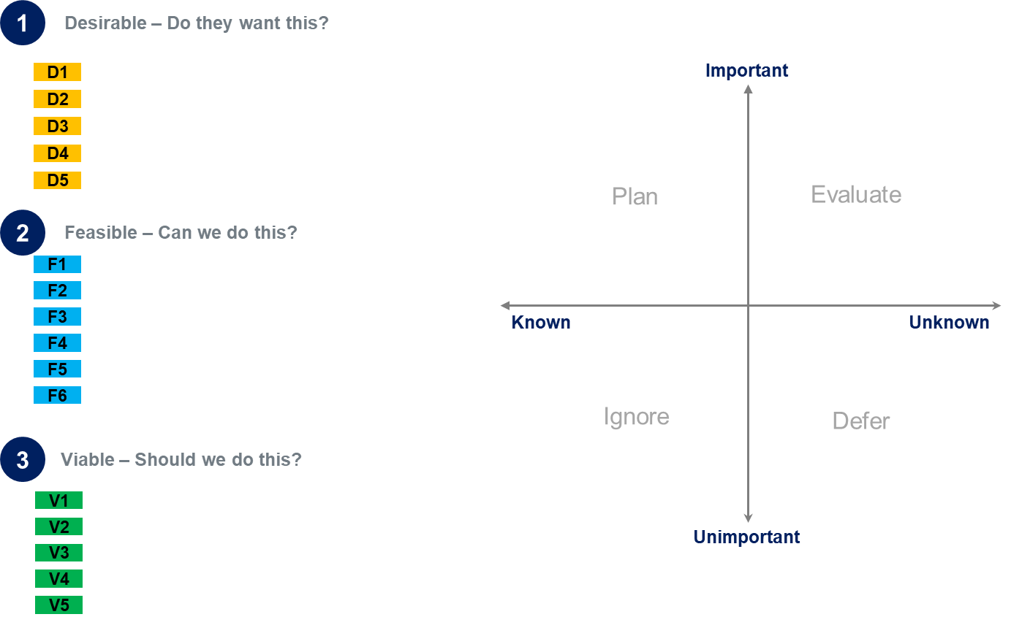
Assumptions Map
Key Assumptions:
  A
  B
  C
  D
Minor
Impact/
Value
More Complex/ More Expensive
Notes:
<Insert a picture of your assumptions map>
<Be prepared to talk about the key points and the most significant assumptions you have made>

Slide 11
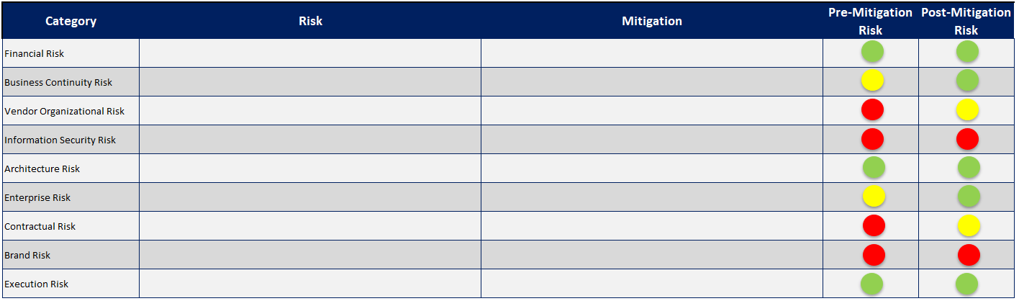
Risks & Mitigations
Most Significant Risks:
  A
  B
  C
  D
Notes:
<Insert a picture of your risk & mitigation plan
<Be prepared to talk about the key points and the most significant risks associated with your idea>

Slide 12
Funding
Category | 2019 | 2020 | 2021 | 2022 | 2023 | Total | % of Total
Cost A | $# | $# | $# | $# | $# | $## | #%
Cost B | $# | $# | $# | $# | $# | $## | #%
Cost C | $# | $# | $# | $# | $# | $## | #%
Cost D | $# | $# | $# | $# | $# | $## | #%
Cost E | $# | $# | $# | $# | $# | $## | #%
Cost F | $# | $# | $# | $# | $# | $## | #%
Total Cost | $## | $## | $## | $## | $## | $#### | 100%
Key External Cost Elements:
  A
  B
  C
  D
Notes:
Discuss the external costs needed to execute your idea
Make any call outs that may be risky, critical, or important to discuss

Slide 13
Internal Resourcing
Internal Hours | 2019 | 2020 | 2021 | 2022 | 2023 | Total | % of Total
Role 1 | # | # | # | # | # | ## | #%
Role 2 | # | # | # | # | # | ## | #%
Role 3 | # | # | # | # | # | ## | #%
Legal | # | # | # | # | # | ## | #%
Growth Board | # | # | # | # | # | ## | #%
Technology | # | # | # | # | # | ## | #%
Total Hours | # | # | # | # | # | #### | 100%
Key Resource Elements:
  A
  B
  C
  D
Notes:
<Insert your resource chart, be prepared to discuss key points>
Estimated internal Resource Profile tables from Executive Overview doc
Make any call outs that may be risky, critical, or important to discuss

Slide 14
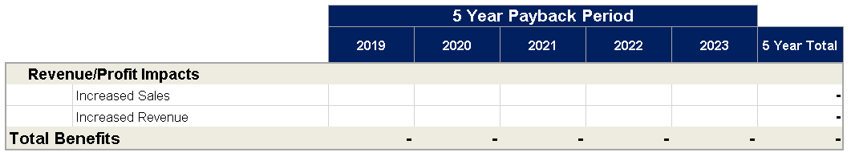
Success = Growth
These criteria will measure and determine success.
Describe the Growth Projections and numbers
<Describe the benefit profile of your solution. Provide context as to how these results will be achieved. ?
Describe what success looks like: “Success is…”
    Metric: Describe success criteria
    Metric: More than xx% of associates….
    Metric: More than xx% of Agents….
    Metric: ABC
    Metric: XYZ
Notes:
<Create Success Criteria>
How will we know if this went well, best case scenario what will Ameritas get from your idea? Think both financially and intangibles (market space, engagement, etc)

Slide 15
Recommended Next Steps
Describe what you feel are the immediate next steps to get started
    Step 1
    Step 2
    Step 3
    Step 4
Notes:
<Describe what the recommended next steps are to execute upon your idea

Slide 16

The Ask
Funding
<How much you need to chase this>
Resourcing
2019: <how many hours>
Executive support
What you need from others to help move on this
<Any Additional things you need to be able to effectively deploy your idea>
Notes:
Describe what you need to get moving.

Slide 17





Thank You
<Team Name>
<Individual Name>
<Phone Number>
<Email>
ameritas.com
Notes:
<Insert each team members information>

Slide 18
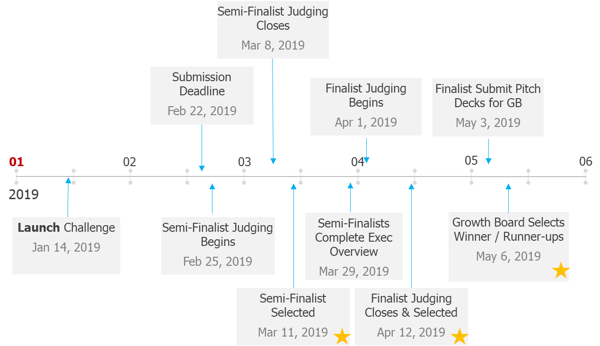

What’s Next?
Timeline of activities:
March 12, 14, and 19: Executive overview coaching sessions
March 11 – March 29: Executive overview completion
March 29 @ 7:00 PM: Executive Overviews must be submitted
April 1 – April 12: Finals judging to select the top 5
April 16 – May 3: Pitch deck completion
May 6: Final competition — winner and runners-up selected
Due at 7pm CST
Thomas Fink
Mike Gatliff
Josh Everett
Daniel Volk
John Garcia
Judges:
Chuck Huetter
Tabatha Riegler
Andrew Rinn
Jason Summers

