Slide 1
Innovating Distributed Embedded Energy Prize (InDEEP)
Introduction to Innovation Methods 3.0
September 19, 2024
Notes:
Bill

Slide 2
Webinar Logistics
Everyone is joined in listen-only mode
Audio Issues?—Try connecting over the phone
If that doesn’t work, visit the Zoom Help Center webpage
Q&A—Submit your questions using the chat box
Notes:
Brittany

Slide 3
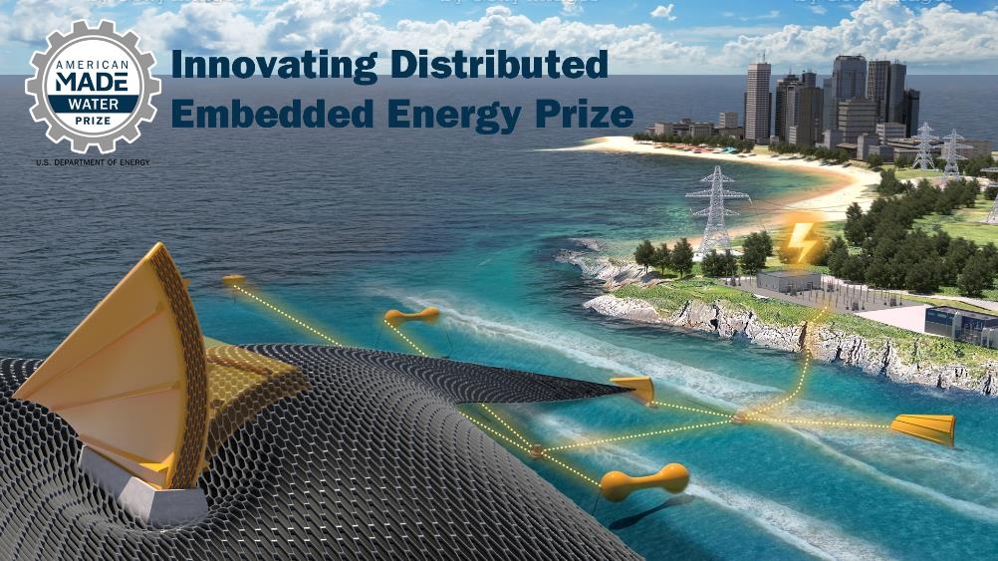
Innovating Distributed Embedded Energy Prize
$2.3M prize pool
Three phases over two years
Incentivize progress in early-stage research
Help solve technical challenges that could be applied to wave energy

Slide 4

Contributing to Leaderboard Scoring
For questions about the prize overall, view our recorded conversation and webinars
Participation in this webinar contributes to your final leaderboard score
WPTO’s desired outcome for InDEEP is an understanding of the landscape of innovators and
potential DEEC-Tec solutions that could be applied to wave energy devices.

Slide 5
Agenda 1.0
Agenda 2.0
Webinar 1. – May 10, 2023
Introductions
Innovation Process
TRIZ
TRIZ in Wave Energy
Q&A
Webinar 2. – January 24, 2024
Introductions & Context
Innovation Process
TRIZ
TRIZ in Wave Energy
TRIZ in Wave Energy – Example
Q&A

Slide 6
Agenda 1.0
Agenda 2.0
Agenda 3.0
Webinar 1. –
May 10, 2023
Introductions
Inno. Process
TRIZ
TRIZ in Wave
Energy
Q&A
Webinar 2. –
January 24, 2024
Introductions & Context
Innovation Process
TRIZ
TRIZ in Wave Energy
TRIZ in Wave Energy – Example
Q&A
Webinar 3. –
September 19, 2024
Introduction & Context
Innovation Process
TRIZ
Innovation Methods
Design Thinking
TRIZ in Wave Energy & Example
Innovation Methods Summary & Conclusions
Q&A

Slide 7
Introductions & Context

Slide 8
Presented by
Jochem Weber, National Renewable Energy Laboratory
Ronan Costello, Wave Venture
Notes:
Brittany

Slide 9

Guest presenter
Founder/CEO Wave Venture Ltd.
Wave energy consultancy
Engineering analysis
LCOE/Techno-economic analysis
Flexible material applications
Blue economy applications

Slide 10
Innovation Process

Slide 11
Innovation Process
Problem &
Opportunity
Statement
Ideation
Assessment
Development

Slide 12
Innovation Process
Problem & Opportunity Statement
Solution agnostic formulation
Functions/functional requirements
“What the system is to do”
Functional system
Functional hierarchy
Functional compatibility

Slide 13
Innovation Process
Ideation
Idea generation process
Driven by functional requirements
of the problem & opportunity statement
Application of different idea generation methods
Different application approaches of a given method
Generation of multiple concepts
Generation by multiple players/teams

Slide 14
Innovation Process
Assessment
Formulation and application of assessment methods and tools for technology concepts and technology designs
Driven and expressed by
Capabilities
“What the system is to be”
Identifying strengths & weaknesses
Prioritization
Merging
Down-selection
Improving

Slide 15
Innovation Process
Development
Improving technology performance
Improving technology maturity
Iteration
Continuation and relation of
  Problem & opportunity statement refinement
  Idea generation methods and application
  Assessment method, tools and application

Slide 16
System Engineering
Functional Requirements
meeting
Capabilities
Formulating Problem and Opportunity Statement
Innovation
driven by
Functions
Innovation
implemented by
TRIZ
Mission Statement
Delivering highest positive impact
Functional Requirements
meeting
Capabilities
Context
Stakeholders
Life Cycle Stages
Assessment
driven by
Capabilities
Assessment
implemented by
TPL
Capabilities & Impact
What the system needs to be
Iterate until
consistent
Capability & Impact
& Function Mapping
Determine measures to link capabilities & functions
Functions
What the system needs to do
Delivering highest positive impact
Delivering highest positive impact

Slide 17
System Engineering
Formulating Problem and Opportunity Statement
Innovation
driven by
Functions
Innovation
implemented by
TRIZ
Mission Statement
Delivering highest positive impact
Functional Requirements
meeting
Capabilities
Context
Stakeholders
Life Cycle Stages
Iteration of Innovation
Assessment
driven by
Capabilities
Assessment
implemented by
TPL
Capabilities & Impact
What the system needs to be
Iterate until
consistent
Capability & Impact
& Function Mapping
Determine measures to link capabilities & functions
Functions
What the system needs to do
Iteration to Stakeholders

Slide 18
System Engineering
Formulating Problem and Opportunity Statement
Innovation
driven by
Functions
Innovation
implemented by
TRIZ
Mission Statement
Delivering highest positive impact
Functional Requirements
meeting
Capabilities
Context
Stakeholders
Life Cycle Stages
Iteration of Innovation
Assessment
driven by
Capabilities
Assessment
implemented by
TPL
Capabilities & Impact
What the system needs to be
Iterate until
consistent
Capability & Impact
& Function Mapping
Determine measures to link capabilities & functions
Functions
What the system needs to do
Iteration to Stakeholders

Slide 19
TRIZ – Techniques of Inventive Problem Solving

Slide 20
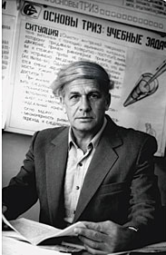
TRIZ – Background
TRIZ/TIPS
  “Teoriya Resheniya Izobreatatelskikh Zadatch” Russian acronym, TRIZ
  “Techniques of Inventive Problem Solving” TIPS
Genrich Altshuller, a patent officer in the Soviet Navy, examined 40,000 patents between 1945 and 1985 in order to identify a methodology of inventive problem solving based on evidence, data and pattern recognition rather than isolated spontaneous or intuitive creativity.

Slide 21
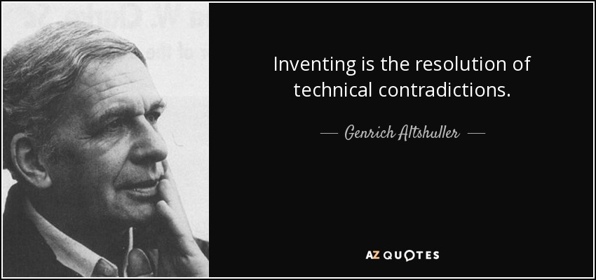
TRIZ – Background
Altshuller identified a finite set of reoccurring problem types and reoccurring inventive solution principles
Followers of Altshuller have subsequently examined 3 million patents and have confirmed Altshuller’s findings
Following a strong TRIZ movement
in the Soviet Union TRIZ emerged
in the West in 1990 after the
fall of the Soviet Union

Slide 22
TRIZ – Methodology
Fundamentals of the methodology in 3 steps
For a specific problem identify the associated typical problem in form of a root contradiction within 39 x 39 cases spanned up by 39 typical parameters
Apply a finite number (<40) of identified and proven inventive problem-solving techniques that have shown to deliver impactful solutions for this typical problem
Concretize the identified typical solution to find the sought specific solution

Slide 23
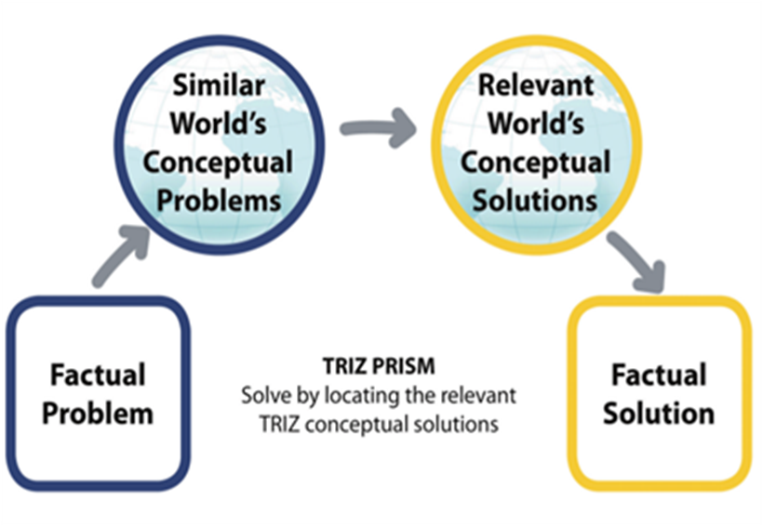
TRIZ – Methodology

Slide 24
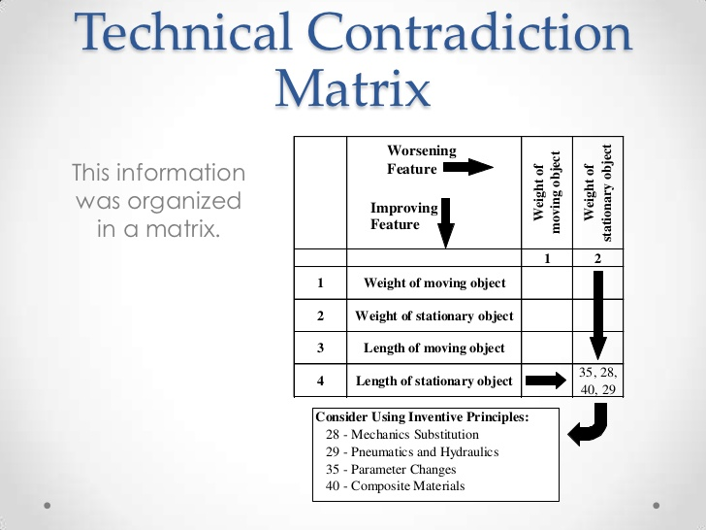
Contradiction Matrix

Slide 25
Contradiction Matrix

Slide 26
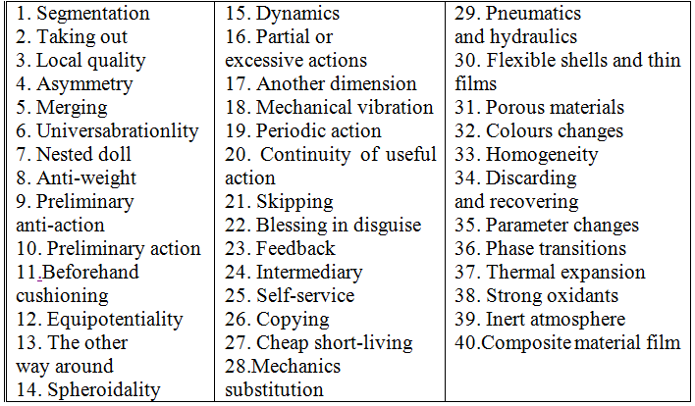
40 Inventive Principles

Slide 27
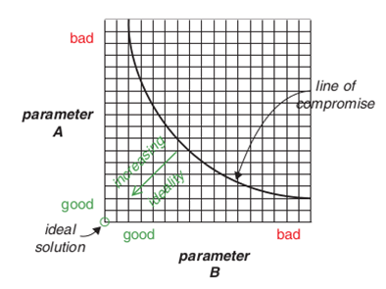
Dissolving Contradictions
Beyond the pareto frontier
Beyond optimization
Beyond compromise
Dissolving trade-offs

Slide 28
Reasons to use TRIZ
TRIZ is systematic, auditable and repeatable – Structured
TRIZ is based on proven successful patents – Experiential Evidence
TRIZ uses the world ’s technology deployment – Body of Knowledge
TRIZ closely targets and questions – Ideation Process
40 inventive principles for solving contradictions – Innovation Vectors
8 Trends of evolution of technology – Development Paths
Ideality – Unconstrained Thinking
Thinking in Time and Scale – Multi-dimensional/-parametric
13 Standard creativity triggers – Ideation Sparks

Slide 29
Innovation Methods

Slide 30
Innovation Methods
Innovation Methodologies:
  House of Quality & QFD
  Design Thinking
  TRIZ
Related Activities:
  Systems Engineering
  Stakeholder Identification/Analysis
  TPL

Slide 31
House of Quality & QFD
Room 3
ES Correlation Matrix
Stakeholder survey feedback
Room 2
Engineering Specifications (ES)
How
Room 1
Customer Requirements
(CRs)
&
Importance Rating
What
Room 4
CR-ES
Relationship Matrix
What related to How
Room 6
Benchmarking of Competing Products
Rating competitors on What
Room 5
ES Importance Rating
Room 7
ES -SubSub-Capability
Relationship Matrix
Room 8
SubCapability Importance Rating
Expert input

Slide 32
Design Thinking

Slide 33
Design Thinking
Design thinking is:
"a creative problem-solving approach“
"a systematic and collaborative approach for identifying and creatively solving problems“
“a human-centric approach”

Slide 34
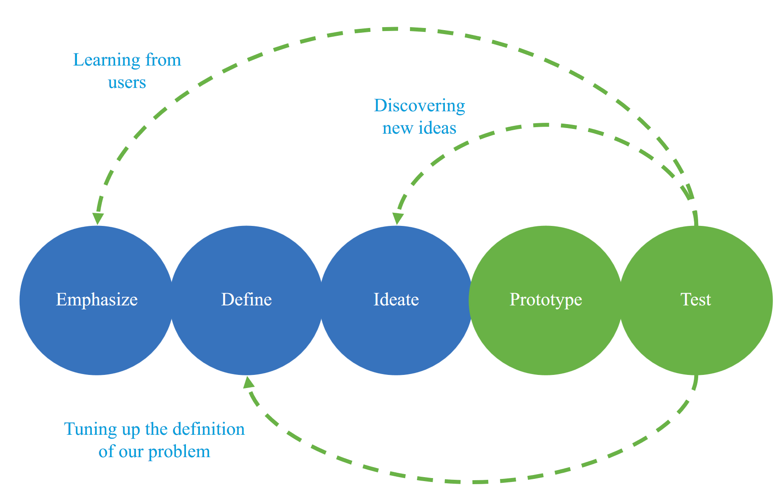
Design Thinking
Empathise

Slide 35
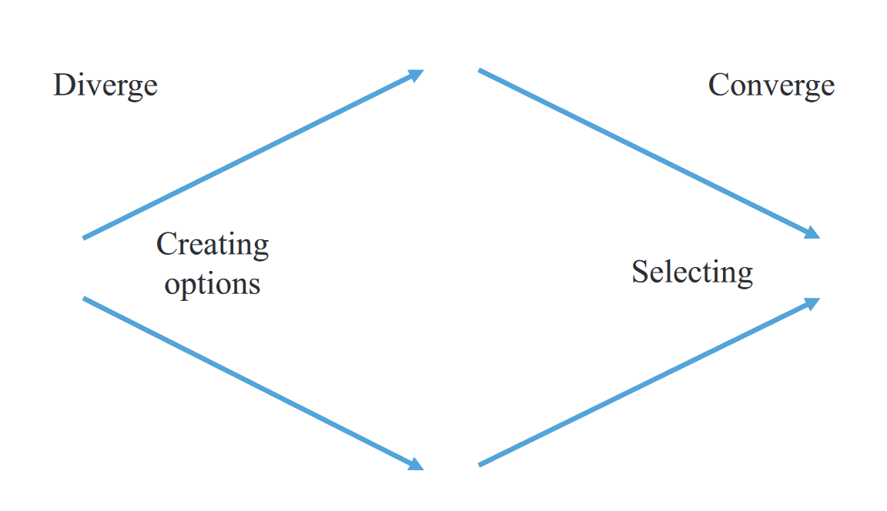
Design Thinking – Repeated Diverging & Converging

Slide 36
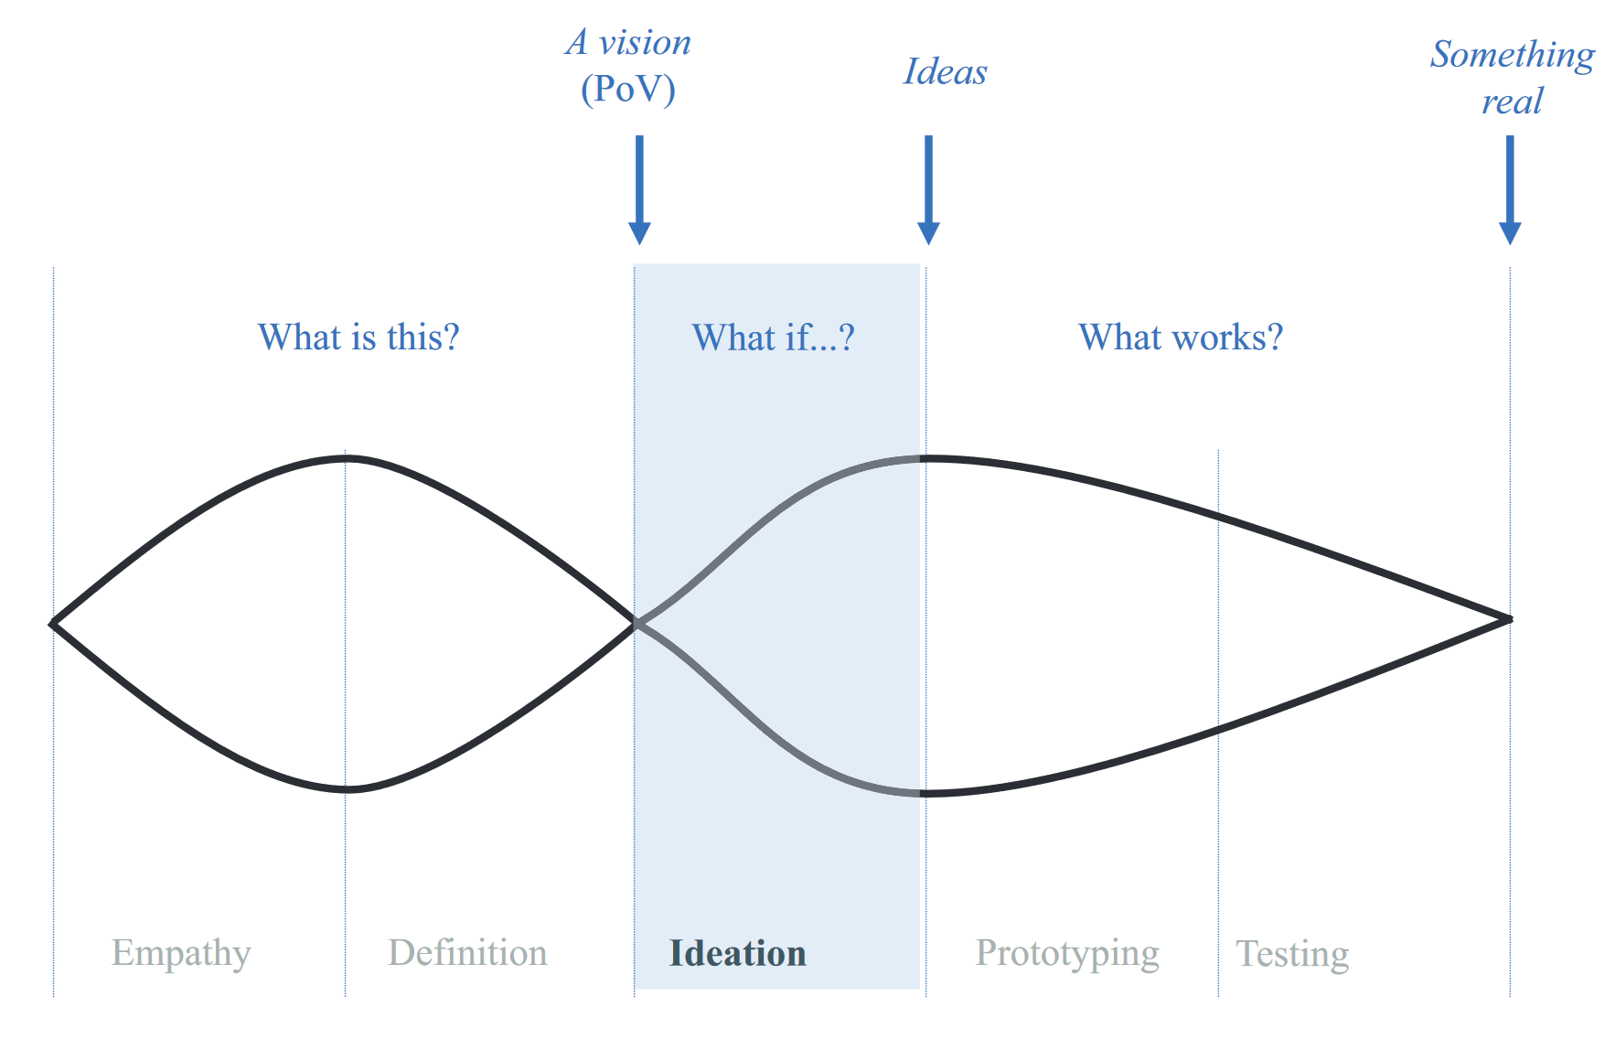
Design Thinking – Repeated Diverging & Converging
Notes:
The idealised DT iteration has two diverging and converging sequences.

Slide 37
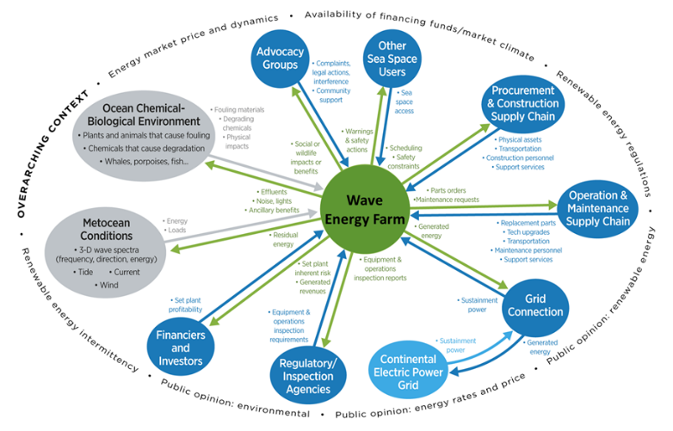
Design Thinking – Stakeholder Map

Slide 38
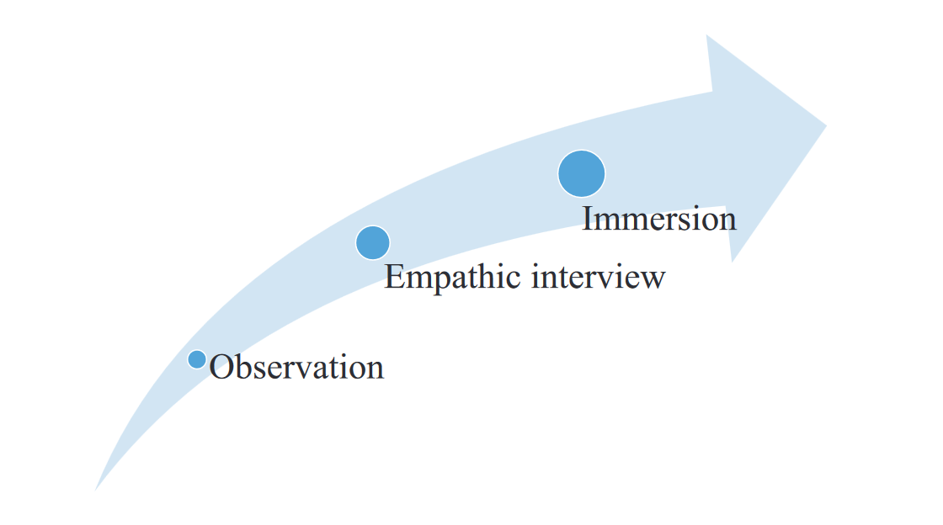
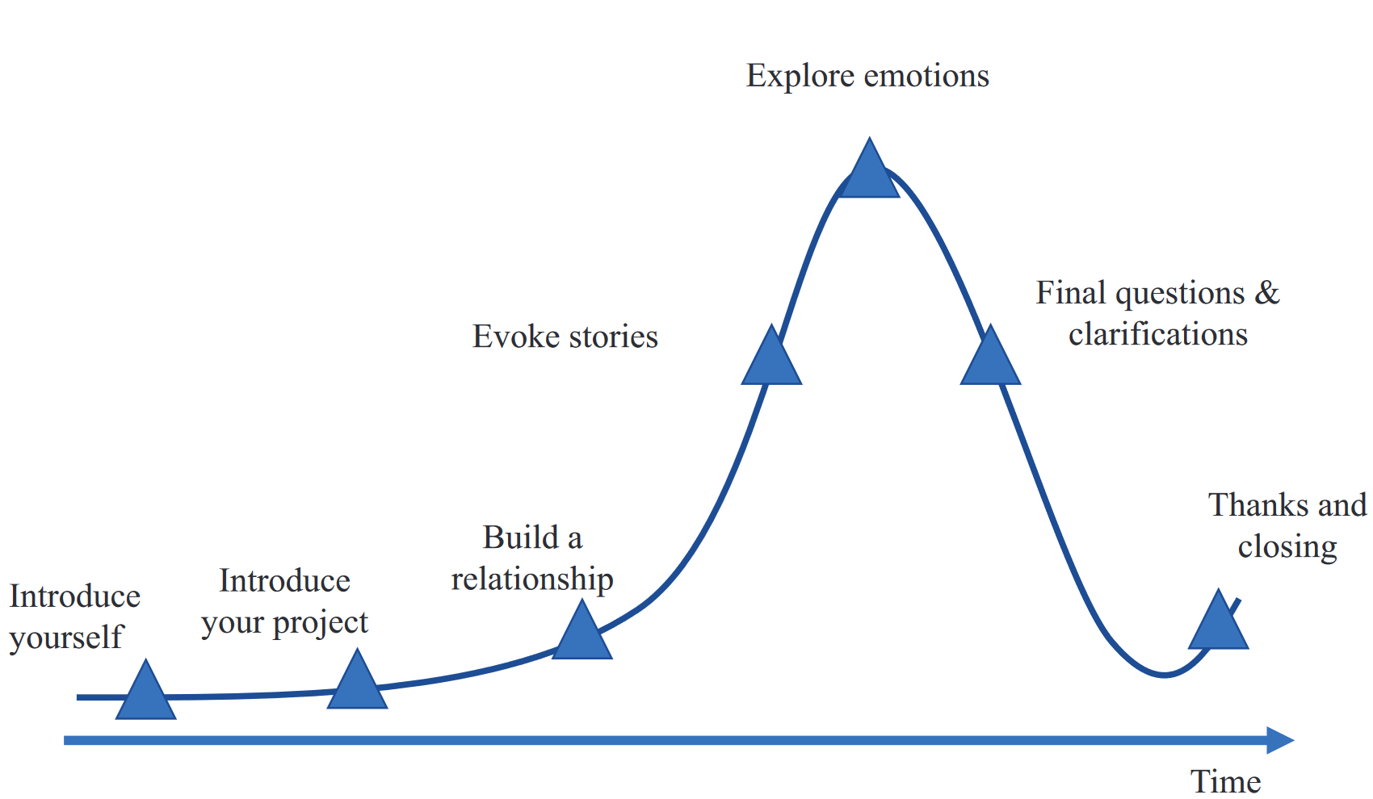
Design Thinking - Empathy

Slide 39
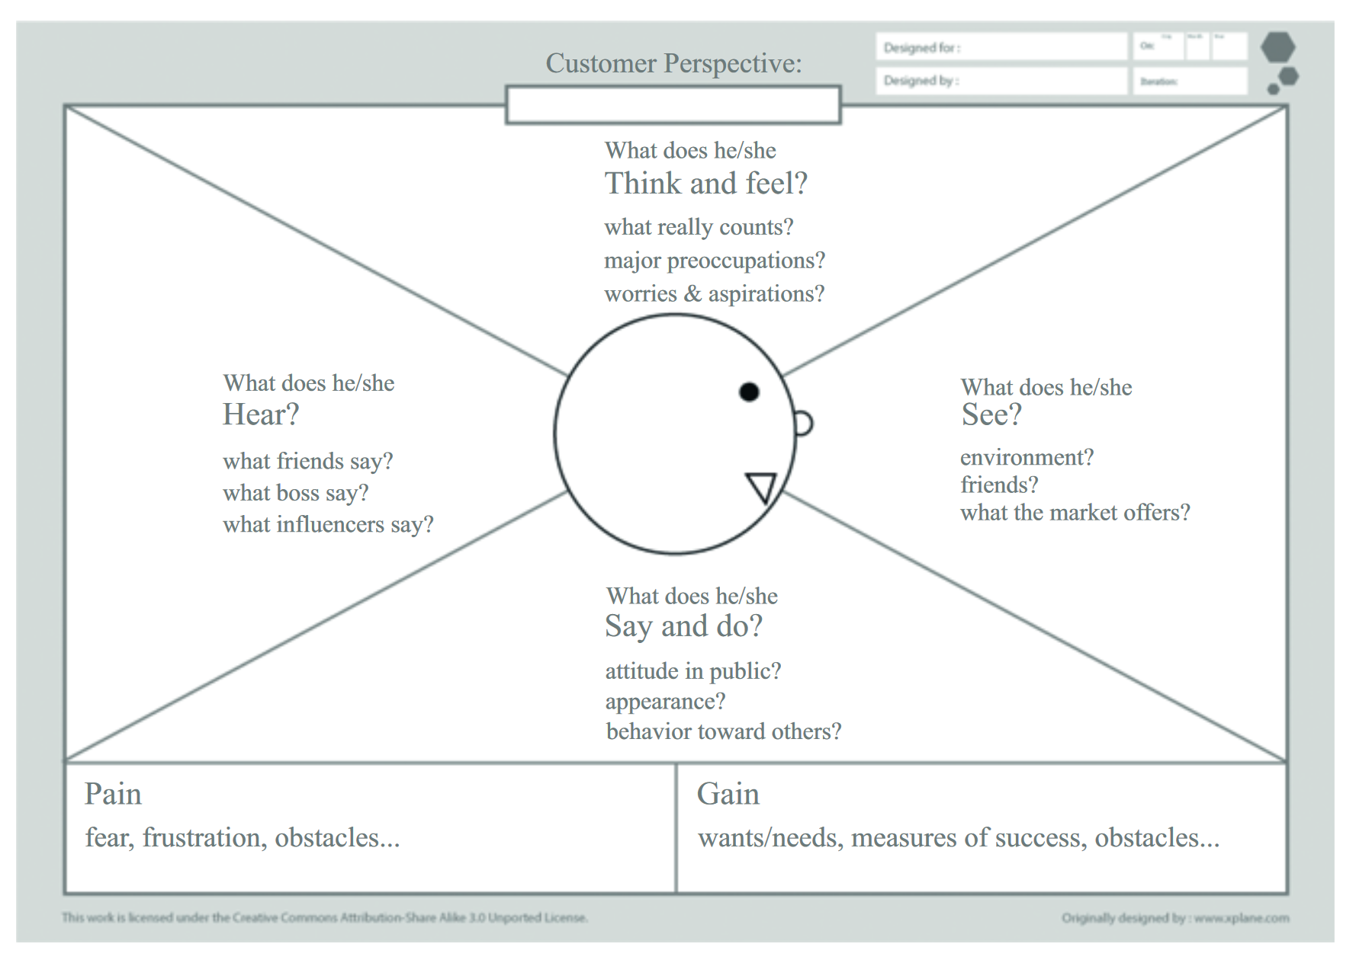
Design Thinking - Definition

Slide 40
Design Thinking – Definition – Point Of View
WHO?
WHAT is needed?
WHY? (insight)
Blue economy WEC developer
DEEC-Tec that lasts forever with no moving parts
Ultra-low cost and low maintenance solutions needed.

Slide 41
Design Thinking - Ideation
Active Brainstorming
SCAMPER
Reversed Brainstorming
Mind maps
Lotus Blossom Diagram

Slide 42
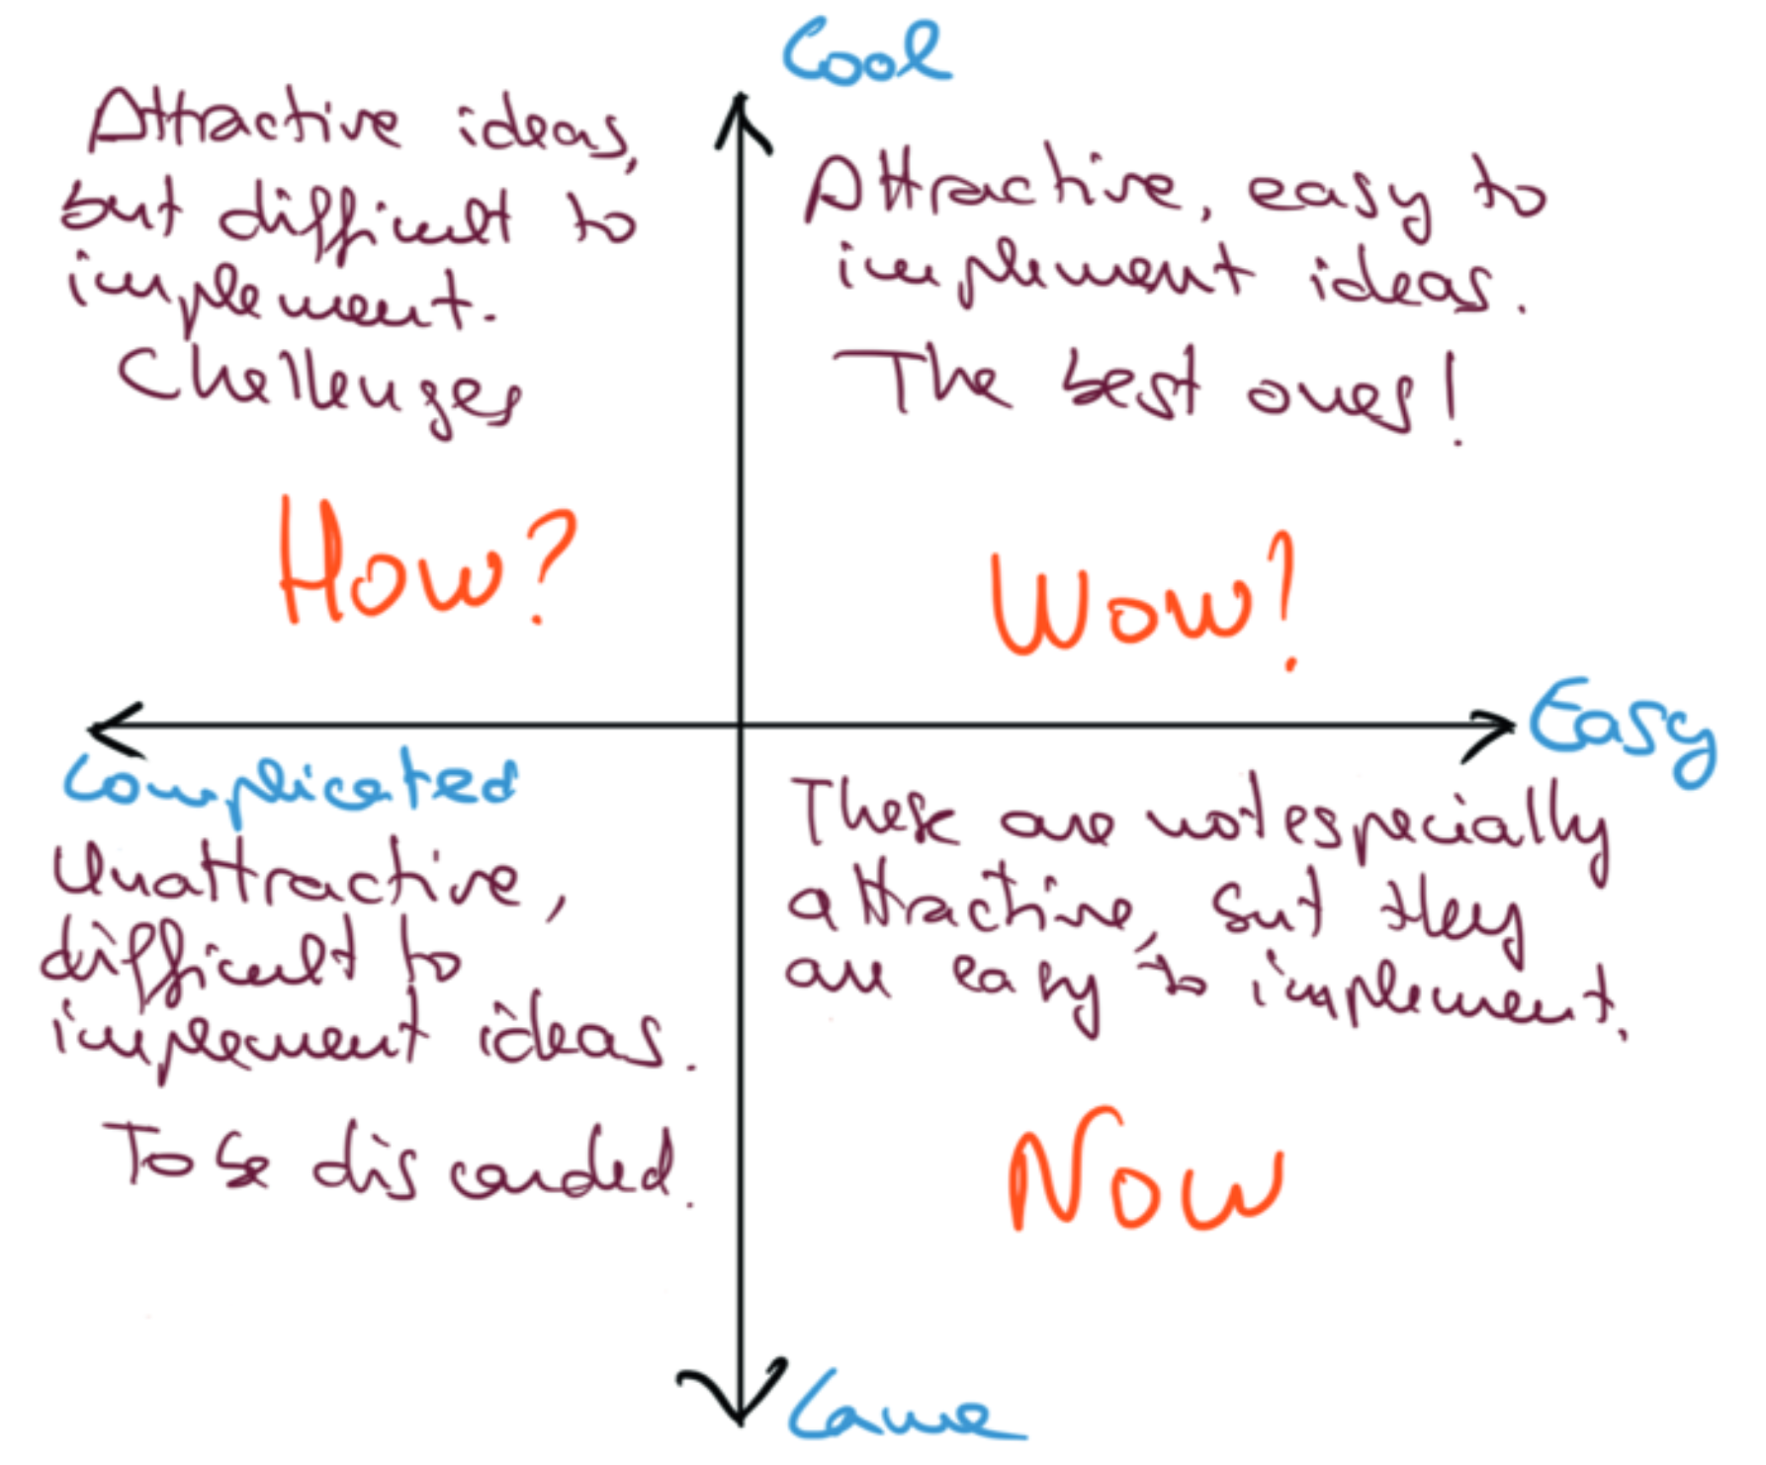
Design Thinking - Ideation

Slide 43
Design Thinking - Prototyping
In Design Thinking a ‘prototype’ is
anything that allows us to visualize the final system and reason about it.
Examples
Sketch
CAD model
Visualisation
Physics simulation
Bench top lab test
Mock up
Scale model (full/partial/non functional)
Working prototype

Slide 44
Design Thinking – Prototyping Principles
Start building something: if in doubt start with a sketch.
Do not get attached to the prototype.
Identify the relevant elements.
Do not complicate yourself unnecessarily.
Do not lose sight of the user.
Notes:
Sketch is a fast and efficient way to organize concepts and ideas. If the prototype is a simplified version of the final solution, the sketch would be a simplified version of the prototype.
Prototypes are preliminary.
They are just something to help advance towards the ultimate goal.
Prototypes are discarded once they have fulfilled their mission, so they cannot become a burden that conditions our subsequent work.
Be clear about what you want to show with the pro-totype. What actual questions do you have to answer? What specific part or functionality are we displaying with it?
The goal of a rapid prototype is not perfection - get something good enough to do its job.
It is not necessary to invest resources or time to go beyond that.
Having invested effort in stakeholder identification and needs analysis.
We must always keep in mind the people for whom we are designing our solution.
A prototype should always be tested with the target audience of the project in mind.

Slide 45
Design Thinking - Testing
Once the prototype has been made, we test it.
But not before carefully planning the test.

Slide 46
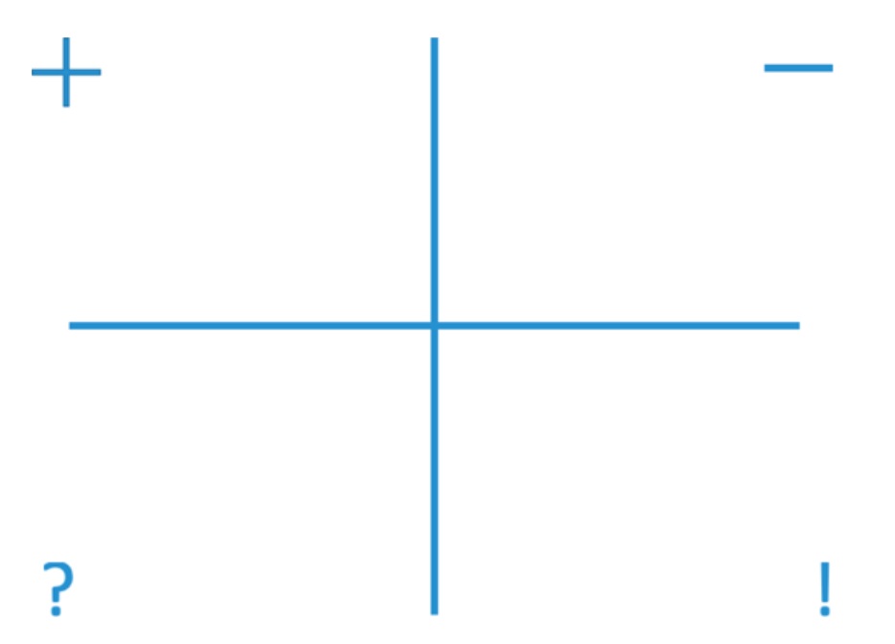
Design Thinking – Testing
Positives
Negatives
Questions
New Ideas

Slide 47
Design Thinking - Iteration
Refine the prototype to get even closer to the solution. Sometimes going back to the design board.
Identify previously unidentified problems.
Refine analysis of users/stakeholders needs.
Refine the point of view created during the definition phase.
Notes:
DT is iterative so the testing always feeds into the nature of the iteration.

Slide 48
Technology Development Framework
Technology Readiness Levels (TRL)
Technology Performance Levels (TPL)
Technology Development Map
TRL – TPL – Matrix
Technology Performance Levels (TPL)
Technology Readiness Levels (TRL)

Slide 49
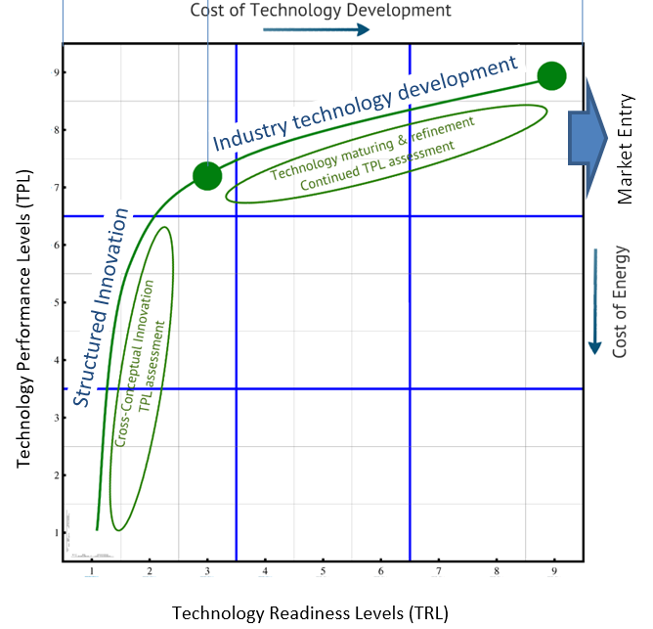
Technology Development Framework

Slide 50
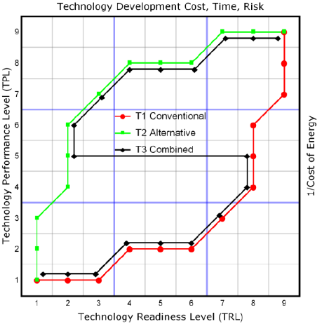
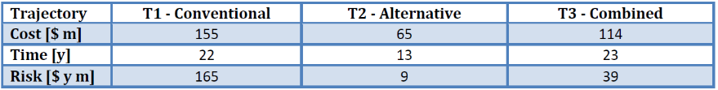
Technology Development Cost, Time and Risk

Slide 51
TRIZ Example

Slide 52
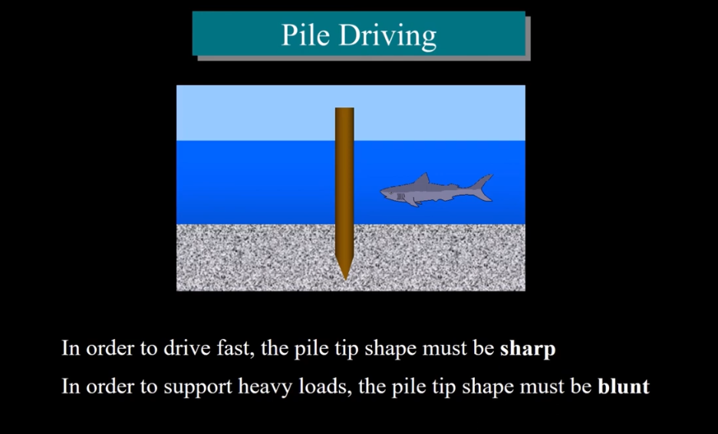
TRIZ

Slide 53
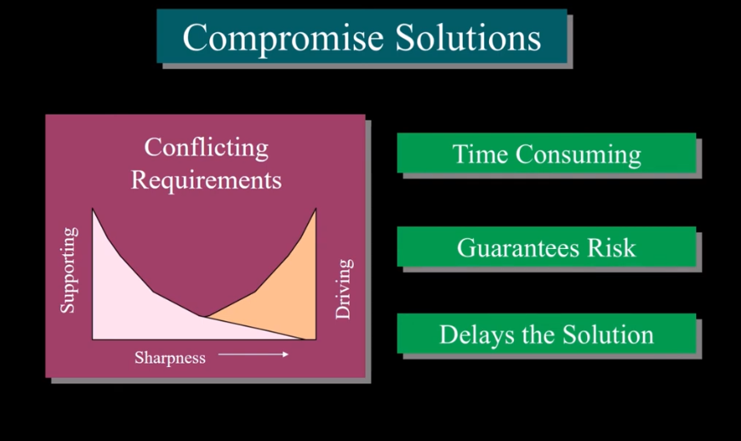
TRIZ

Slide 54
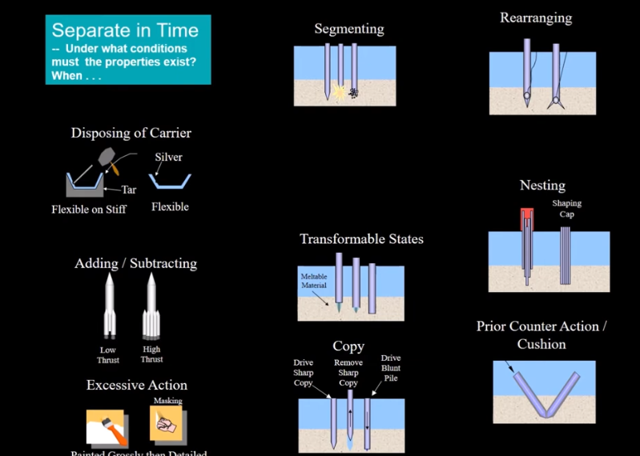
TRIZ

Slide 55
TRIZ in Wave Energy – Example

Slide 56
TRIZ has proven to work in wave energy
New technology concepts so far are high quality
Contradictions matrix ‘feels’ familiar to natural problem solvers
Contradictions matrix sometimes leads to known solutions as well as new solutions
Ideality concept & Ideality audit lead to auditable clarification of requirements & to new contradictions & to new ideas
Resolution of limiting contradictions on one WEC archetype led to invention other WEC archetype – jumping archetype boundaries

Slide 57
TRIZ in InDEEP
TRIZ is applicable al system levels
  WEC farm
  WEC unit
  WEC sub/sub/sub/system
  WEC component
  WEC operation process
InDEEP
  DEEC
  DEEC-Tec meta material
  (DEEC-Tec meta material enabled WEC)

Slide 58
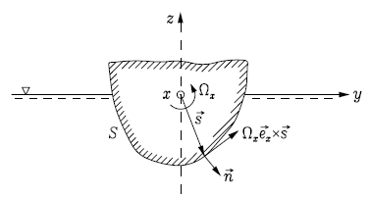
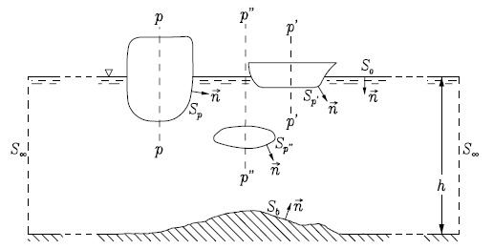
Forces on a Floating Body

Slide 59

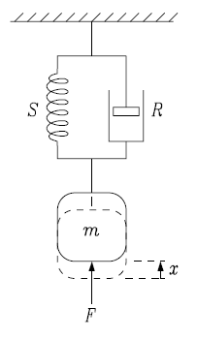
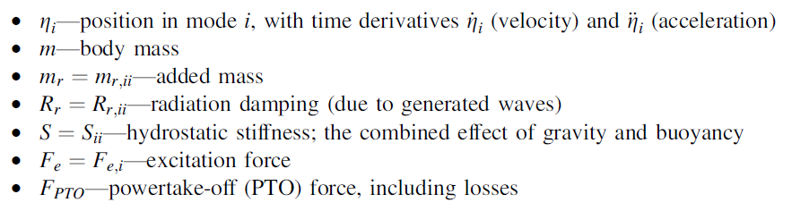
Forces on a Floating Body

Slide 60
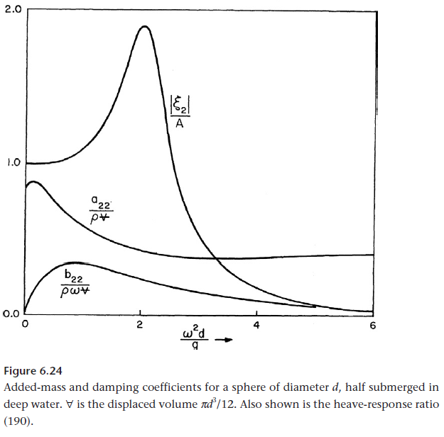
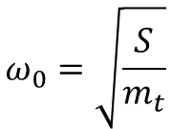
Natural Frequency & System Response
$$ω_{0}=\sqrt{\frac{S}{m_{t}}}$$
Natural Frequency
  Frequency of freely oscillating undamped system
Resonance Frequency
  Frequency of maximal response of damped and excited system
Newman, Marine Hydrodynamics, 1977

Slide 61
Natural Frequency & Design Criteria
Natural Response
  Mass
  Stiffness
  Volume
  Shape – Surface Piercing Area
Excited Response
  Mass
  Stiffness
  Volume
  Excitation
  Shape – Entire Shape

Slide 62
Design Criteria & System Performance
Natural Response
  Mass
  Stiffness
  Volume
  Shape – Surface Piercing Area
Excited Response
  Mass
  Stiffness
  Volume
  Excitation
  Shape – Entire Shape

Slide 63
Design Requirement Contradictions
Contradictions
  Large mass vs small stiffness
    Resonance frequency
  Large mass vs small surface piercing area
    High mass for inertia for low resonance frequency
    Small surface piercing area for low stiffness for low resonance frequency
  Large volume vs small surface piercing area
    Large mass linked via buoyancy to large volume for low resonance frequency
    Small surface piercing area for low stiffness linked to low volume for low resonance frequency
  Large surface piercing area vs small surface piercing area
    Small surface piercing area for low stiffness linked to low volume for low resonance frequency
    Large surface piercing area for large excitation for large wave energy input for large response and energy output
  Deep shape vs flat shape
    Deep shape for large volume for large mass for low resonance frequency
    Flat shape for large excitation for large wave energy input for large response and energy output
  Low mass vs large volume
    Large volume linked via buoyancy to large mass for low resonance frequency
    Low mass for effective and efficient control

Slide 64
TRIZ Contradictions
TRIZ Contradiction
  Large mass vs small volume

Slide 65
TRIZ Contradictions & Inventive Principles
TRIZ Contradiction
  Large mass vs small volume

Slide 66

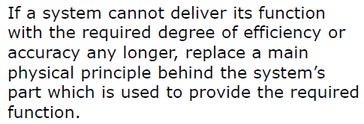
TRIZ Inventive Principle
Inventive Principles
7 Nesting
28 Replacement
29 Use of gas and fluids
40 Composite Structures

Slide 67

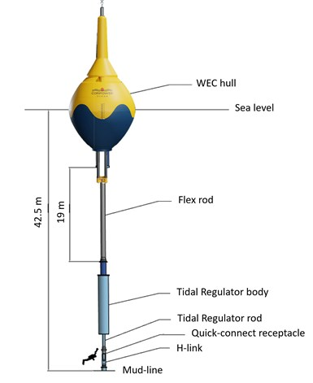
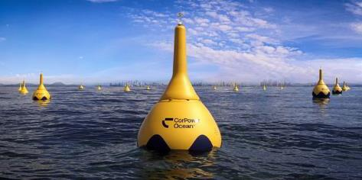
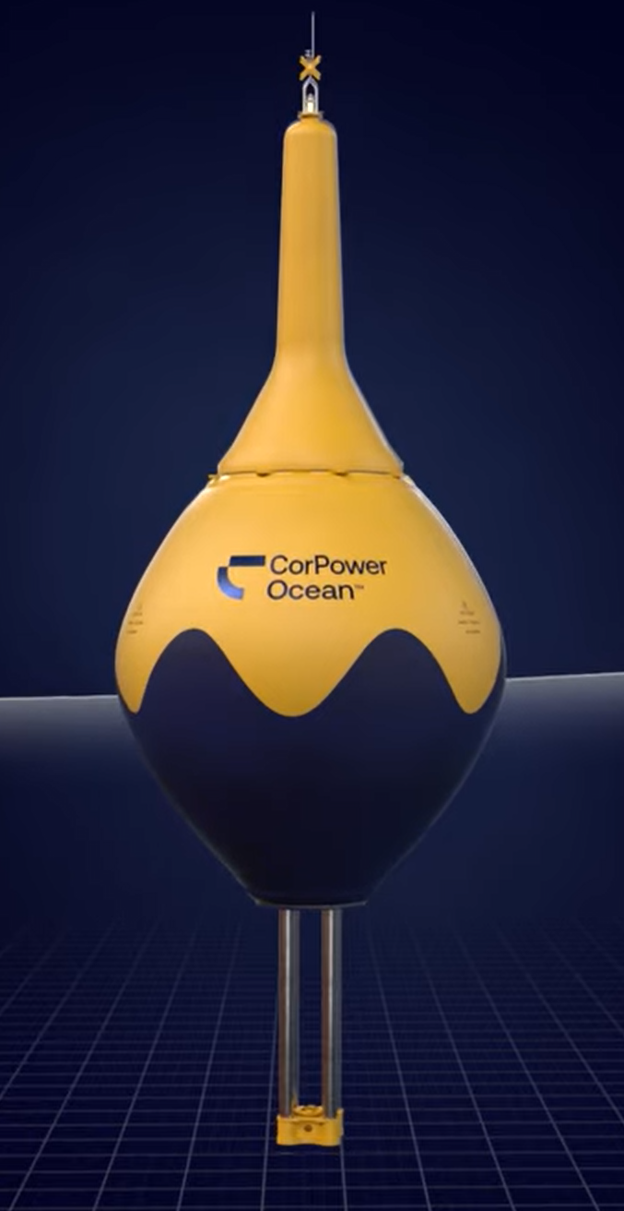
Solution Example - CorPower Ocean

Slide 68
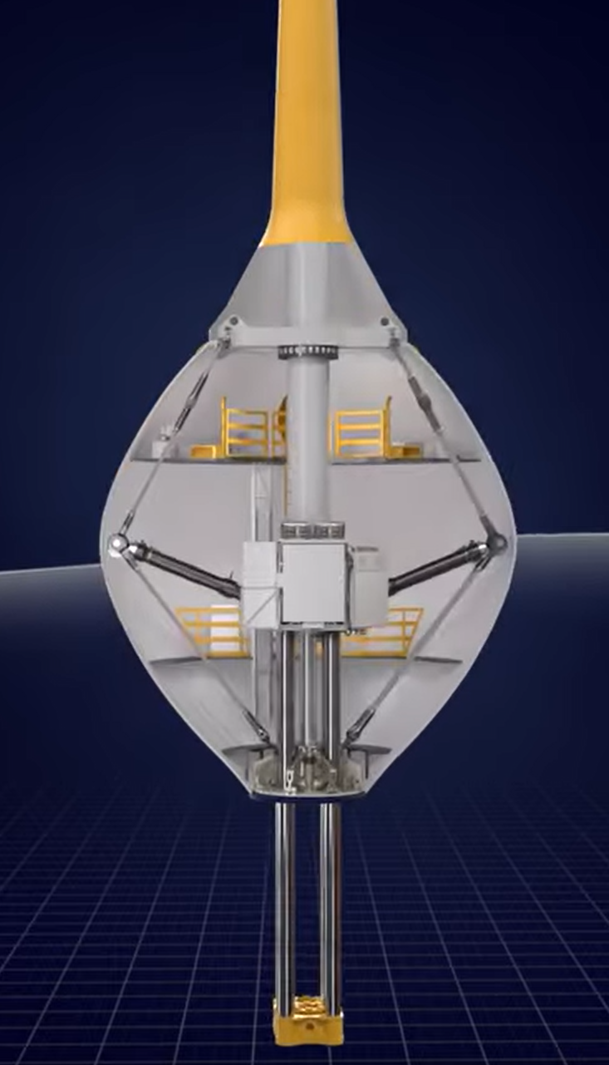
Separation of Restoring Force Providers - Hydrostatics & Mechanics
Hydrostatics
Mechanics

Slide 69
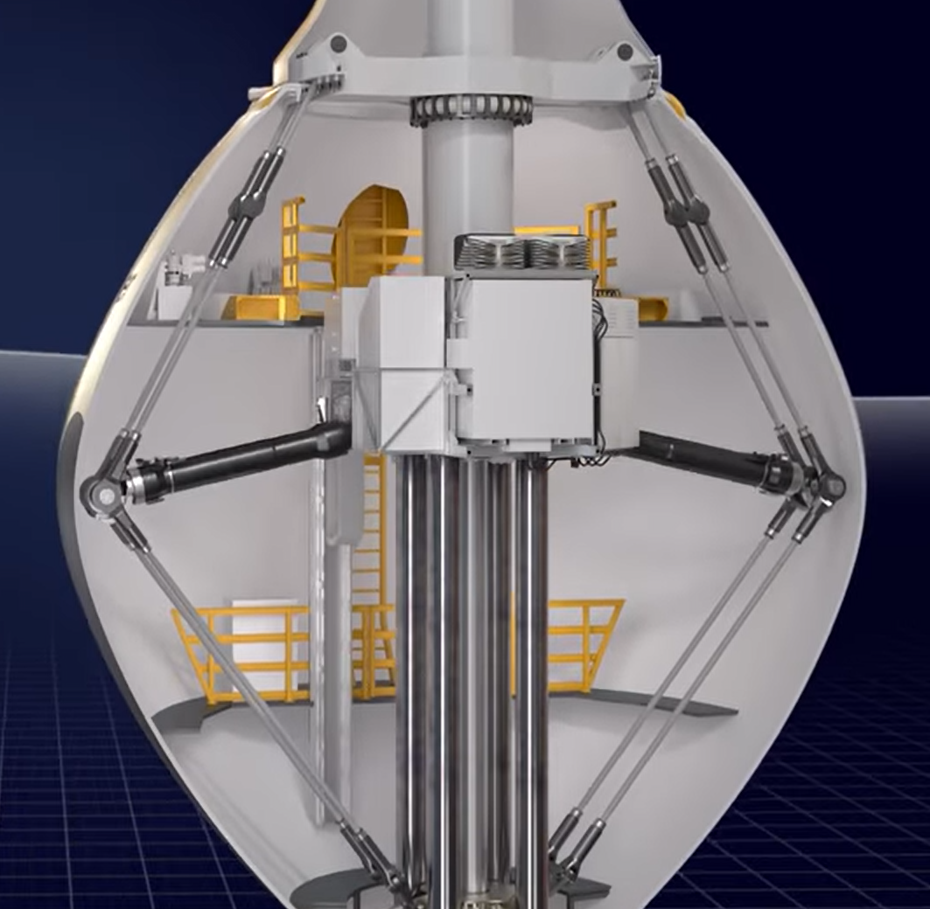
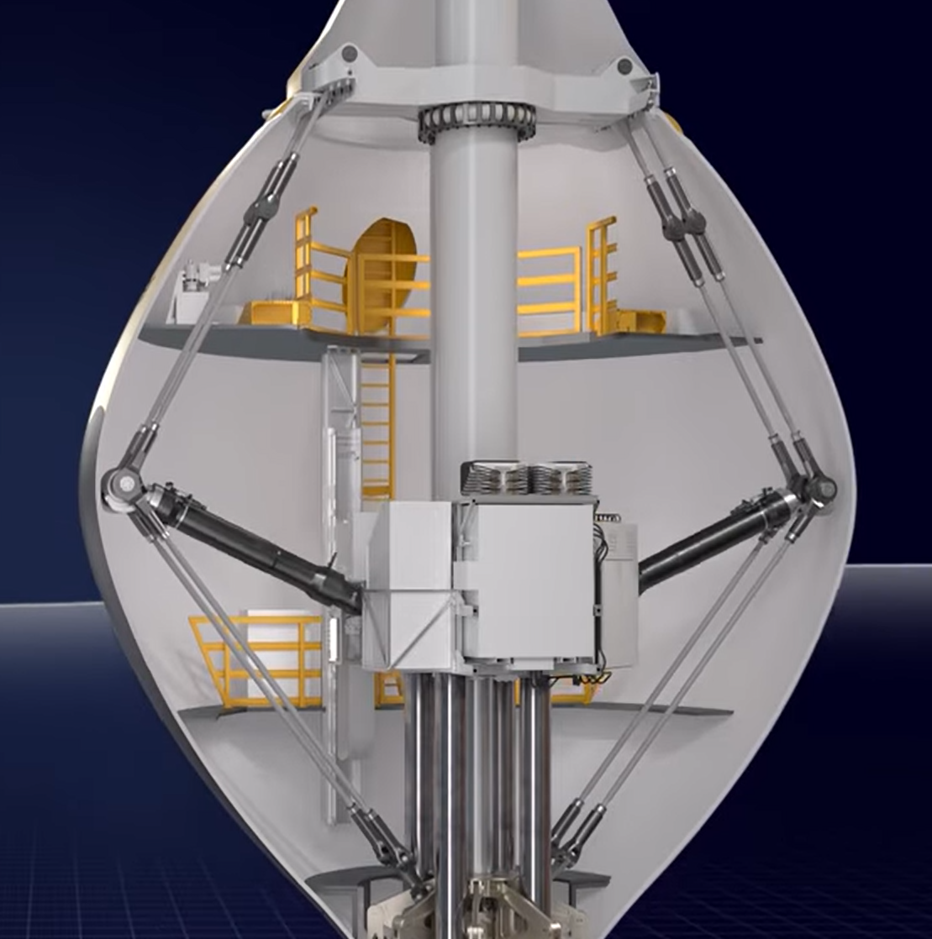
Negative Stiffness Spring

Slide 70
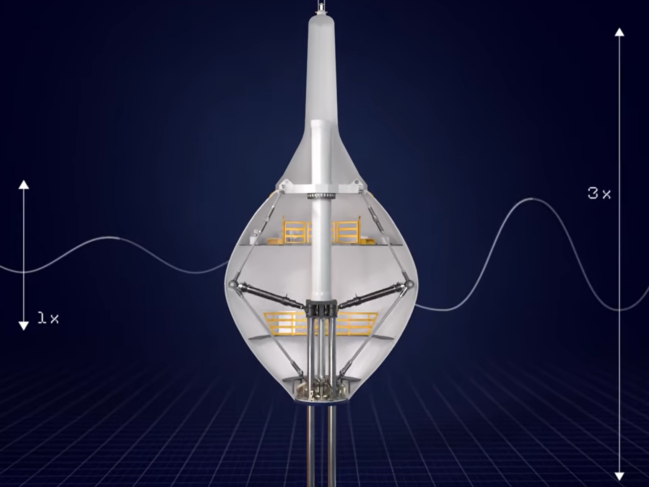
Resonance at Desired Wave Frequency

Slide 71
Improved Control – Inertial Reduction via Pretention Suspension

Slide 72
Innovation Methods Summary & Conclusions
Systems Engineering provides a professional overall structure for innovation.
Design Thinking provides powerful stakeholder analysis tools.
TRIZ provides the most detailed/deep ideation tools for high tech design.
TPL is the most appropriate/complete WEC assessment method.

Slide 73
Next up: TPL Assessment
Patrik Möller, CEO CorPower Ocean:
“The detailed feedback and thoughts on possible system improvements that you have contributed are very valuable to us. The questions asked in the TPL process triggers many useful discussions and thoughts across our team. Quite unique to be able to get this level of in-depth comments from an experienced team like yourself, that has seen many different design and system approaches through your TPL assessment program, and from previous wave development journeys. We find the overall TPL rating results exciting and very useful for us as a company, but most of all we appreciate the detailed feedback and technical discussions we have had. If probably took more efforts from all sides to get to this level of discussion and joint understanding of different questions (as it usually does..) and we want to thank you for spending that extra time on follow-up comments in several iterations that took us to a good depth.”

Slide 74
Questions and Answers
Thank you!

Slide 75
Wrap Up & Next Steps

Slide 76




Competitor Support Mechanisms
Save the Dates!
Upcoming Training Sessions:
  May 10: Innovation methods
  July 5: TPL assessment
Provide us feedback in the webinar poll to make sure upcoming sessions are useful
Teaming Platform
Submission Feedback
Mentorship in Innovation Methods and TPL Assessment
Resources linked in Appendix C of the Rules Document

Slide 77
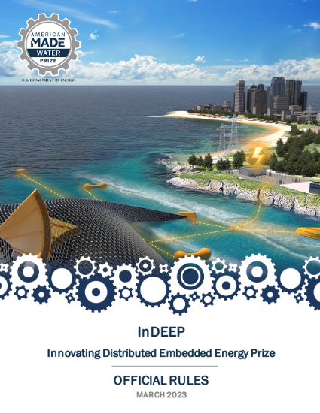
Read the Rules
For a more in-depth look at the prize overall where these topics will be applied, please read the rules document, available here:
https://americanmadechallenges.org/challenges/indeep/docs/InDEEP-Prize-Rules.pdf
SOLVER COMMUNITY
Notes:
Carrie

Slide 78
Questions?
Notes:
Carrie

Slide 79
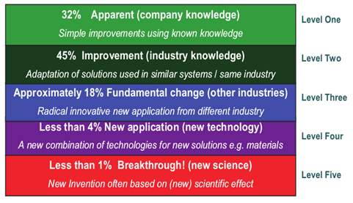
Innovation Impact Levels

Slide 80
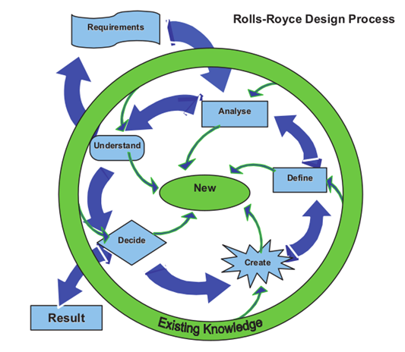
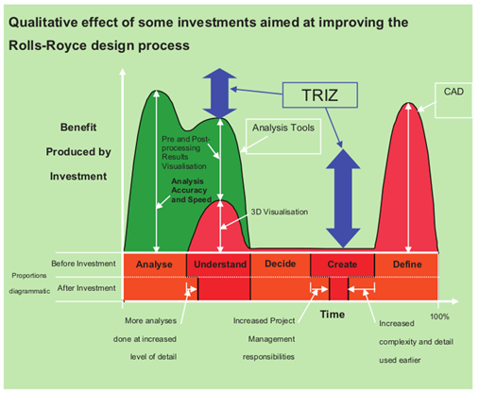
TRIZ – Benefits

