Slide 1
Innovating Distributed Embedded Energy Prize (InDEEP)
Phase III Technology Performance Level Assessment
September 23, 2024
Notes:
Bill/Carrie

Slide 2
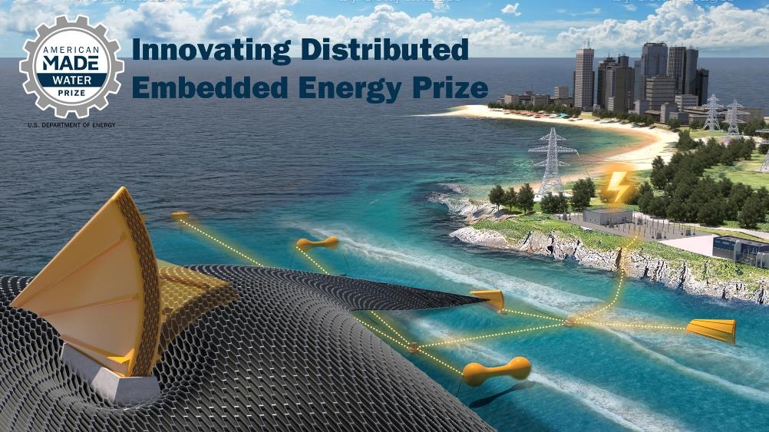
Innovating Distributed Embedded Energy Prize
$2.3M prize pool
Three phases over two years
15 awards made in Phase II
Incentivize progress in early-stage research
Help solve technical challenges that could be applied to wave energy
Notes:
Bill/Carrie

Slide 3

Prize Goals
Leverage WEC innovation to systematically develop DEEC-Tec concepts that could bring value to the ocean wave energy industry
Build a solver community by engaging and facilitating collaboration between diverse innovators in the marine energy industry and related DEEC-Tec disciplines
Encourage development of novel DEEC-Tec with high potential relevance to WECs by supporting an interdisciplinary set of competitors from ideation to design
Refine WEC innovation methods to incorporate ideas beyond the field of wave energy based on feedback from the prize
See the Official Rules Document Section 1.5
WPTO’s desired outcome for InDEEP is an understanding of the landscape of innovators and
potential DEEC-Tec solutions that could be applied to wave energy devices.
Notes:
Bill/Carrie

Slide 4
Contributing to Leaderboard Scoring
For questions about the prize overall, view the video recording and presentation slides from the 15 August 2024 InDEEP Phase III Kickoff Webinar
Participation in this webinar contributes to your final leaderboard score
Notes:
Bill/Carrie

Slide 5
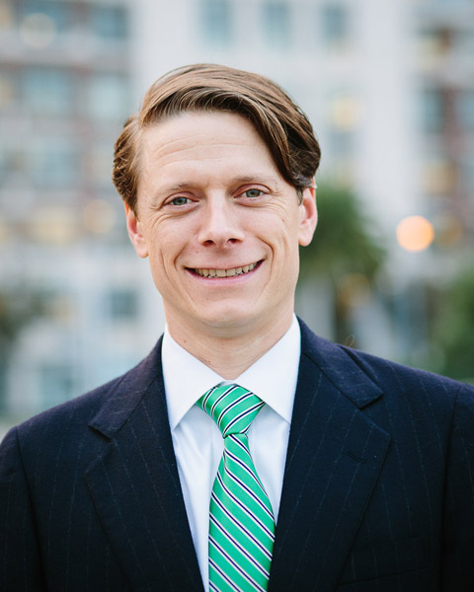
Guest presenter
President & Founder, Streamwise Development, LLC
Chair, International Electrotechnical Commission (IEC) Technical Committee (TC) 114, preparing international standards for marine energy conversion systems
Convener, Marine Energy Sector Working Group, The IEC System for Certification to Standards Relating to Equipment for Use in Renewable Energy Applications (IECRE)
Previously Director of Technology Performance, Verdant Power, Inc.
Jonathan A. Colby
Notes:
Nicole

Slide 6
Agenda
Introduction to Technology Performance Level (TPL)
InDEEP TPL submission requirement
InDEEP TPL topics
Broader overview of TPL tools and methodologies
TPL assessment service via TEAMER
Competitor support mechanisms
Q&A
Notes:
Nicole

Slide 7
Why TPL?
Technology Development Challenges:
Wave energy converter technology development currently has several main challenges:
  Still a multitude of widely diverse technologies being considered today
  No evidence of common convergence in key market segments
  High levelized cost of energy systems (projected)
  WEC technology development is:
    Expensive (> $100M to get to TRL 9)
    High risk (setbacks in prototype testing)
    Slow (10-15 years from TRL 1→9)
    Rigid (retain initial early concept idea)
Notes:
Jochem

Slide 8
TPL Metric Definitions
1 | 2 | 3 | 4 | 5 | 6 | 7 | 8 | 9
Low |  |  | Medium |  |  | High
Technology is not economically viable |  |  | Technology features some characteristics for potential economic viability under distinctive market and operational conditions. Technological or conceptual improvements may be required. |  |  | Technology is economically viable and competitive as a renewable energy form
Majority of key performance characteristics & cost drivers do not satisfy and present a barrier to potential economic viability | Some of key performance characteristics & cost drivers do not satisfy potential economic viability | Minority of key performance characteristics & cost drivers do not satisfy potential economic viability | In order to achieve economical viability under distinctive and favorable market and operational conditions some key technology implementation and fundamental conceptual improvements are required. | In order to achieve economical viability under distinctive and favorable market and operational conditions some key technology implementation improvements are required. | Majority of key performance characteristics & cost drivers satisfy potential economical viability under distinctive and favorable market and operational conditions | Competitive with other renewable energy sources given favorable support mechanism | Competitive with other energy sources given sustainable support mechanism | Competitive with other energy sources without special support mechanism
Notes:
Jochem

Slide 9
What is TPL?
Notes:
Jochem

Slide 10
What is TPL?
Notes:
Jochem

Slide 11
TRL – TPL matrix
Pre - Commercial Technology Development
WaveSPARC
Industry Technology Development
Technology Performance Levels (TPL)
Technology Readiness Levels (TRL)
Notes:
Jochem

Slide 12
Phase III Submission Requirements
Item | Description | Will Be Made Public | Scored Item | Due
Technical Narrative | Up to 5,000 words in length. Teams may also include up to 5 supporting drawings, images, or graphics. | No | Yes | At Phase III Close
Phase III TPL Assessment | Read, review, and complete a simplified version of the TPL Assessment focused on the DEEC-Tec metamaterial. | No | Yes | At Phase III Close
Test Report | A technical document that describes the test set- up needed to demonstrate DEEC-Tec metamaterial and including results from testing. This document should be updated to incorporate feedback received during Phase II. | No | Yes | At Phase III Close
Virtual Interview and Demonstration | Competitors will be required to attend a virtual meeting with the Prize Administrator demonstrating testing process and validating the test results in the Test Report and Technical Narrative. Unlike in Phase II, the prize administration team will evaluate this demonstration. | No | Yes | After Phase III Close, Prior to Final Event
Final Event Design Presentation | All competitors will present to an expert review panel, discussing how the TPL informed their decision in Phase III, changes identified from Phase II to Phase III TPL assessments and plans for further refining technologies after the conclusion of Phase III. | No | Yes | Slides (if applicable) due 1 week prior to Final Event
Final Event Poster | All competitors are invited to present a poster during the in-person Final Event. | Yes | No | 2 Weeks prior to Final Event
Notes:
Thomas

Slide 13
TPL Question Format
Given
Teams fill in
Question:
Assuming your concept has shown functionality during benchtop testing, what, if any, additional improvements will it need to function in the intended ocean deployment environment?
Question guidance:
This question is intended to motivate an appraisal of anticipated challenges in scaling up the technology to, ultimately, create an ocean wave energy converter. An understanding of the challenges and a plan to address them are sufficient at this stage.
Scoring guidance:
High: DEEC-Tec metamaterial can be designed to have safety margins for extreme load and motion conditions, and fatigue lives equaling or exceeding WEC design life, typically 20-25 years.
Med: DEEC-Tec metamaterial failures can be addressed by building in redundancy and/or designing components to be easily replaceable.
Low: Fundamental breakthroughs are required for DEEC-Tec metamaterial to be able to operate long term (20-25 years).
Score:
Choose an integer from 1 thru 9; 1 being the lowest and 9 the highest
Confidence:
Indicate how confident you are about the score you selected. Choose from high/medium/low.
Justification:
Provide justification or background information to support your score.
Notes:
Thomas

Slide 14
InDEEP TPL Questions - every question can be traced to one or more capabilities listed in “Systems Engineering Applied to the Development of a Wave Energy Farm”, https://www.osti.gov/biblio/1365534
Notes:
Thomas

Slide 15
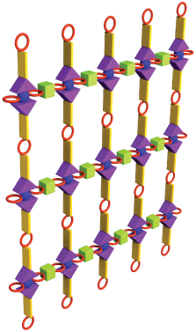
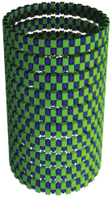
Metamaterial
A DEEC-Tec metamaterial is any arrangement (homogeneous or heterogeneous) of DEECs. It structurally connects individual DEECs and provides mechanisms for energy transfer between them, such as electrical or fluidic conductors.
In general, a metamaterial is an engineered material with unnatural properties, created through its structure rather than its composition. It is made of geometric structures arranged on a scale much smaller than the wavelength of the phenomena it interacts with or controls.
Notes:
Thomas

Slide 16
Energy Converter, Actuator (Qn# 14)
The primary role of DEEC-Tec metamaterial is to act as a framework for energy conversion (e.g., mechanical energy into electricity)
Capability to also act as actuator may be useful in some cases
Notes:
Thomas

Slide 17
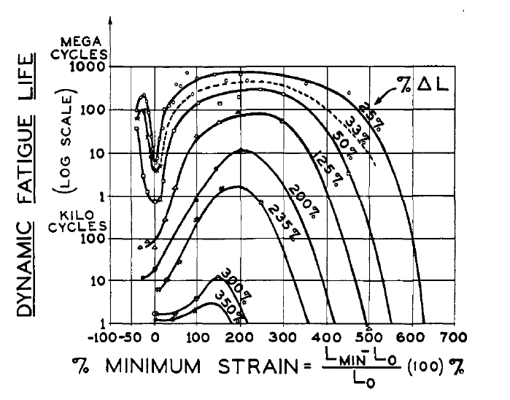
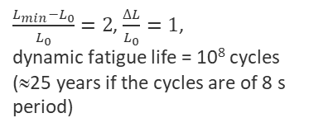
Design Loads (Qn# 1)
Extreme loads
Fatigue
$\frac{L_{min}−L_{0}}{L_{0}}=2$, $\frac{∆L}{L_{0}}=1$,
dynamic fatigue life = 10⁸ cycles (≈25 years if the cycles are of 8 s period)
Fatigue life of rubber. L is the length of the sample of initial length L₀. Life is plotted against minimum strain for various ranges of the strain excursion ΔL
F. J. M. Farley, R. C. T. Rainey, and J. R. Chaplin, “Rubber tubes in the sea”, Phil. Trans. R. Soc. A (2012) 370, 381–402, doi:10.1098/rsta.2011.0193
Notes:
Thomas

Slide 18
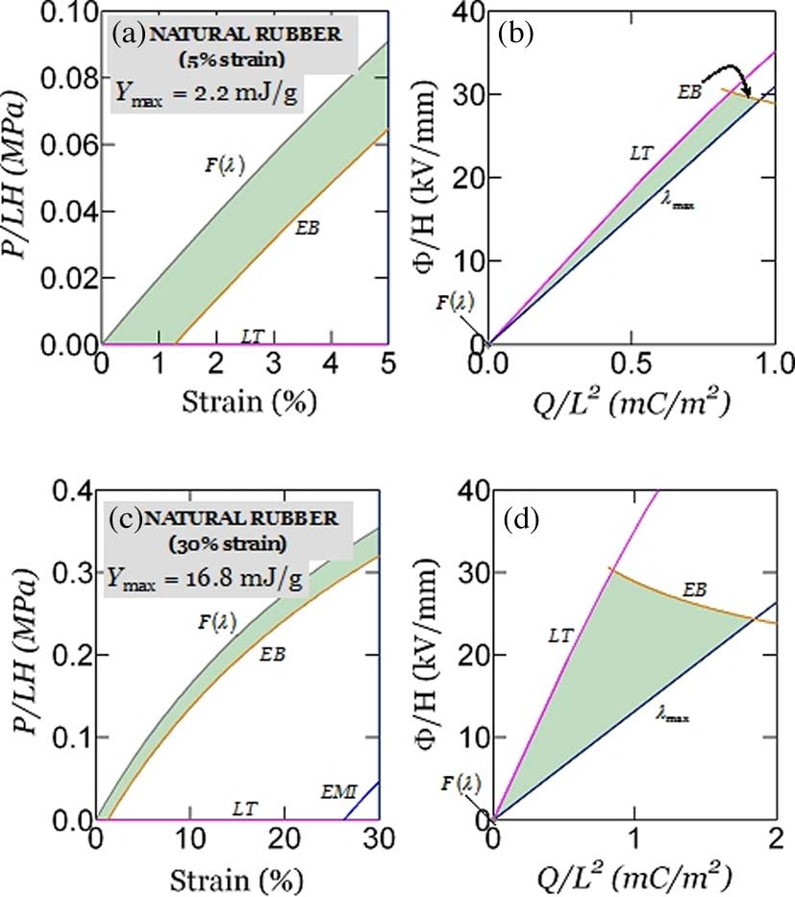
Performance (Qn# 3)
DEEC-Tec
Transduction
useful electrical energy
work done on WEC
captured mech energy
incident wave energy
Efficiency
  low efficiency doesn’t mean the technology can’t be viable;
  input wave energy is available freely and abundantly;
  even if we convert only a small fraction of it into useful electrical energy, it may still be viable provided we can do so safely/reliably/cheaply!
Energy density
Power density
energy radiated back to sea
viscous, friction losses
electrical losses
see Fig. 1 of C Jean-Mistral et al 2010 Smart Mater. Struct. 19 085012,
doi:10.1088/0964-1726/19/8/085012
Operation maps for natural rubber
when the maximum stretch is limited to 5% strain (a, b), or 30% strain (c, d)
Soo Jin Adrian Koh, Christoph Keplinger, Tiefeng Li, Siegfried Bauer, and Zhigang Suo, “Dielectric Elastomer Generators: How Much Energy Can Be Converted?”, IEEE/ASME TRANSACTIONS ON MECHATRONICS, VOL. 16, NO. 1, FEBRUARY 2011
Notes:
Thomas

Slide 19
Energy conversion (versus energy capture)
DEEC-Tec
Capture
Conversion
useful electrical energy
work done on WEC
captured mech energy
incident wave energy
energy radiated back to sea
viscous, friction losses
electrical losses
see Fig. 1 of C Jean-Mistral et al 2010 Smart Mater. Struct. 19 085012,
doi:10.1088/0964-1726/19/8/085012
Notes:
Thomas

Slide 20
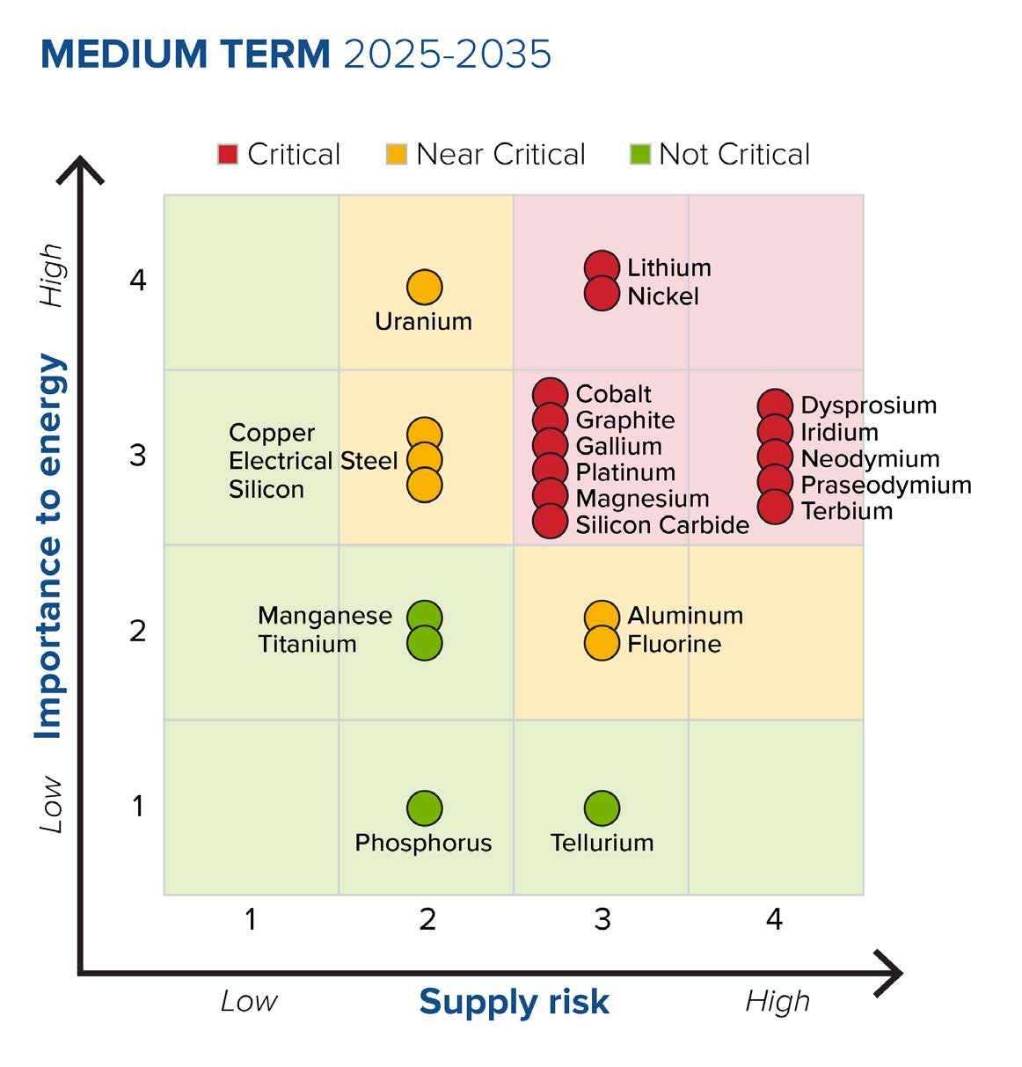
Materials (Qn# 2, 7)
Special material?
Expensive?
Hazardous?
Supply risk?
DOE Critical Materials Assessment, July 2023, https://www.energy.gov/eere/articles/us-department-energy-releases-2023-critical-materials-assessment-evaluate-supply
Share of top producing countries in total processing of selected minerals and fossil fuels, 2019
https://www.iea.org/reports/introducing-the-critical-minerals-policy-tracker/ensuring-supply-reliability-and-resiliency
Notes:
Thomas

Slide 21
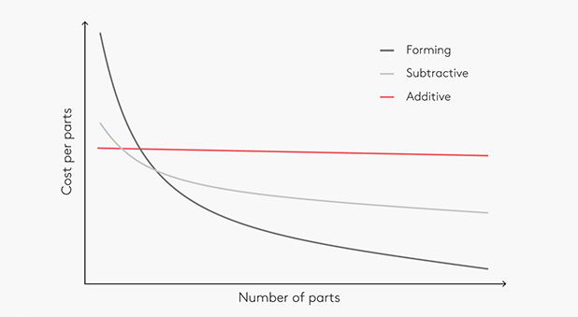
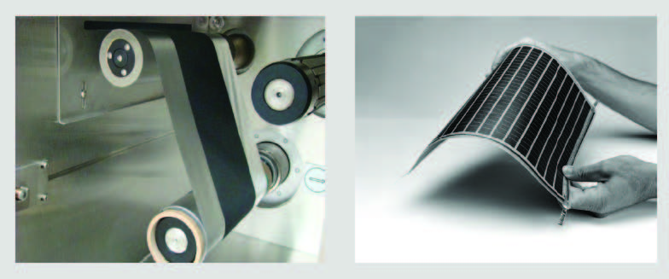
Manufacturing (Qn# 4, 5, 8)
COTS vs. custom parts
Can be mass produced cost-effectively, e. g. roll-to-roll
Need new manufacturing capabilities?
Require specialized skills or new workforce expertise?
Dangerous work conditions?
Hazardous materials?
https://www.dti.dk/specialists/introduction-to-3d-printing/learn-the-best-new-manufacturing-technology/40476
Examples of R2R Products: Battery Electrode (left)
and Thin Film Photovoltaic Module (right)
Innovating Clean Energy Technologies in Advanced Manufacturing,
DOE Quadrennial Technology Review 2015,
https://www.energy.gov/quadrennial-technology-review-2015
Notes:
Thomas

Slide 22
Durability, Reliability (Qn# 6)
WEC
WIND TURBINE
Ricardo Antonio Lopez-Chavez, “Reliability Analysis of Wave Energy Converters”, PhD Energy Systems, The University of Edinburgh, 2019, https://era.ed.ac.uk/handle/1842/38876
Berthold Hahn, Michael Durstewitz and Kurt Rohrig, “Reliability of Wind Turbines - Experiences of 15 years with 1,500 WTs”, Proceedings of the EUROMECH Colloquium 464b - Wind Energy, 2007, https://link.springer.com/book/10.1007/978-3-540-33866-6
Notes:
Thomas

Slide 23
Notes:
Thomas

Slide 24
Durability, Reliability (Qn# 6)
Failure modes
Failure rate, Mean time to fail (MTTF)
Consequences of DEEC failure: safety, environmental, economic?
Build redundancy
Make components easily replaceable
Notes:
Thomas

Slide 25
Safety (Qn# 10, 11)
Risk to people, property, and/or environment at any stage of the life cycle?
Hazardous material?
Exposure to high voltage?
Access to dangerous parts?
Adequate safety systems can be put in place?
All activities are well understood?
Safe operating procedures can be established?
Notes:
Thomas

Slide 26
External Power Input (Qn# 12)
Require external power input?
Risk of damage from an abrupt disconnection of external power input?
Local energy storage?
Notes:
Thomas

Slide 27
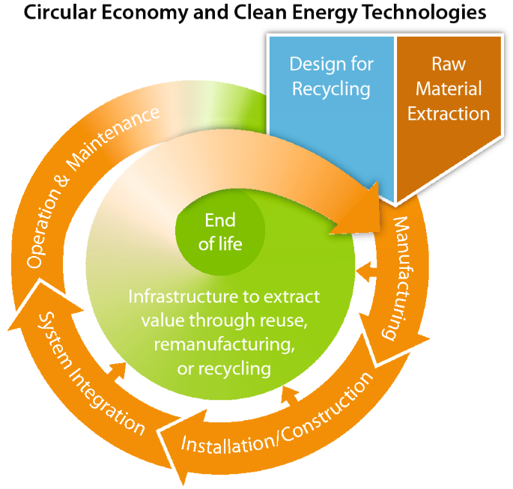
Recycling (Qn# 9)
Apply Design for Recycling (DfR) principles; may result in trade-offs between recyclability and product performance and cost
Material choice and ability to liberate separate materials are critical for recycling:
  Eliminate hazardous materials from product makeup
  Minimize hard-to-recycle materials
  Minimizing non-reversible adhesives or similar bonds, especially over whole surfaces and for dissimilar materials, can facilitate disassembly and material liberation
  Design for Disassembly (DfD)
  Design products to use recycled materials
Norgren, A., Carpenter, A. & Heath, G. Design for Recycling Principles Applicable to Selected Clean Energy Technologies: Crystalline-Silicon Photovoltaic Modules, Electric Vehicle Batteries, and Wind Turbine Blades. J. Sustain. Metall. 6, 761–774 (2020). https://doi.org/10.1007/s40831-020-00313-3
Notes:
Thomas

Slide 28

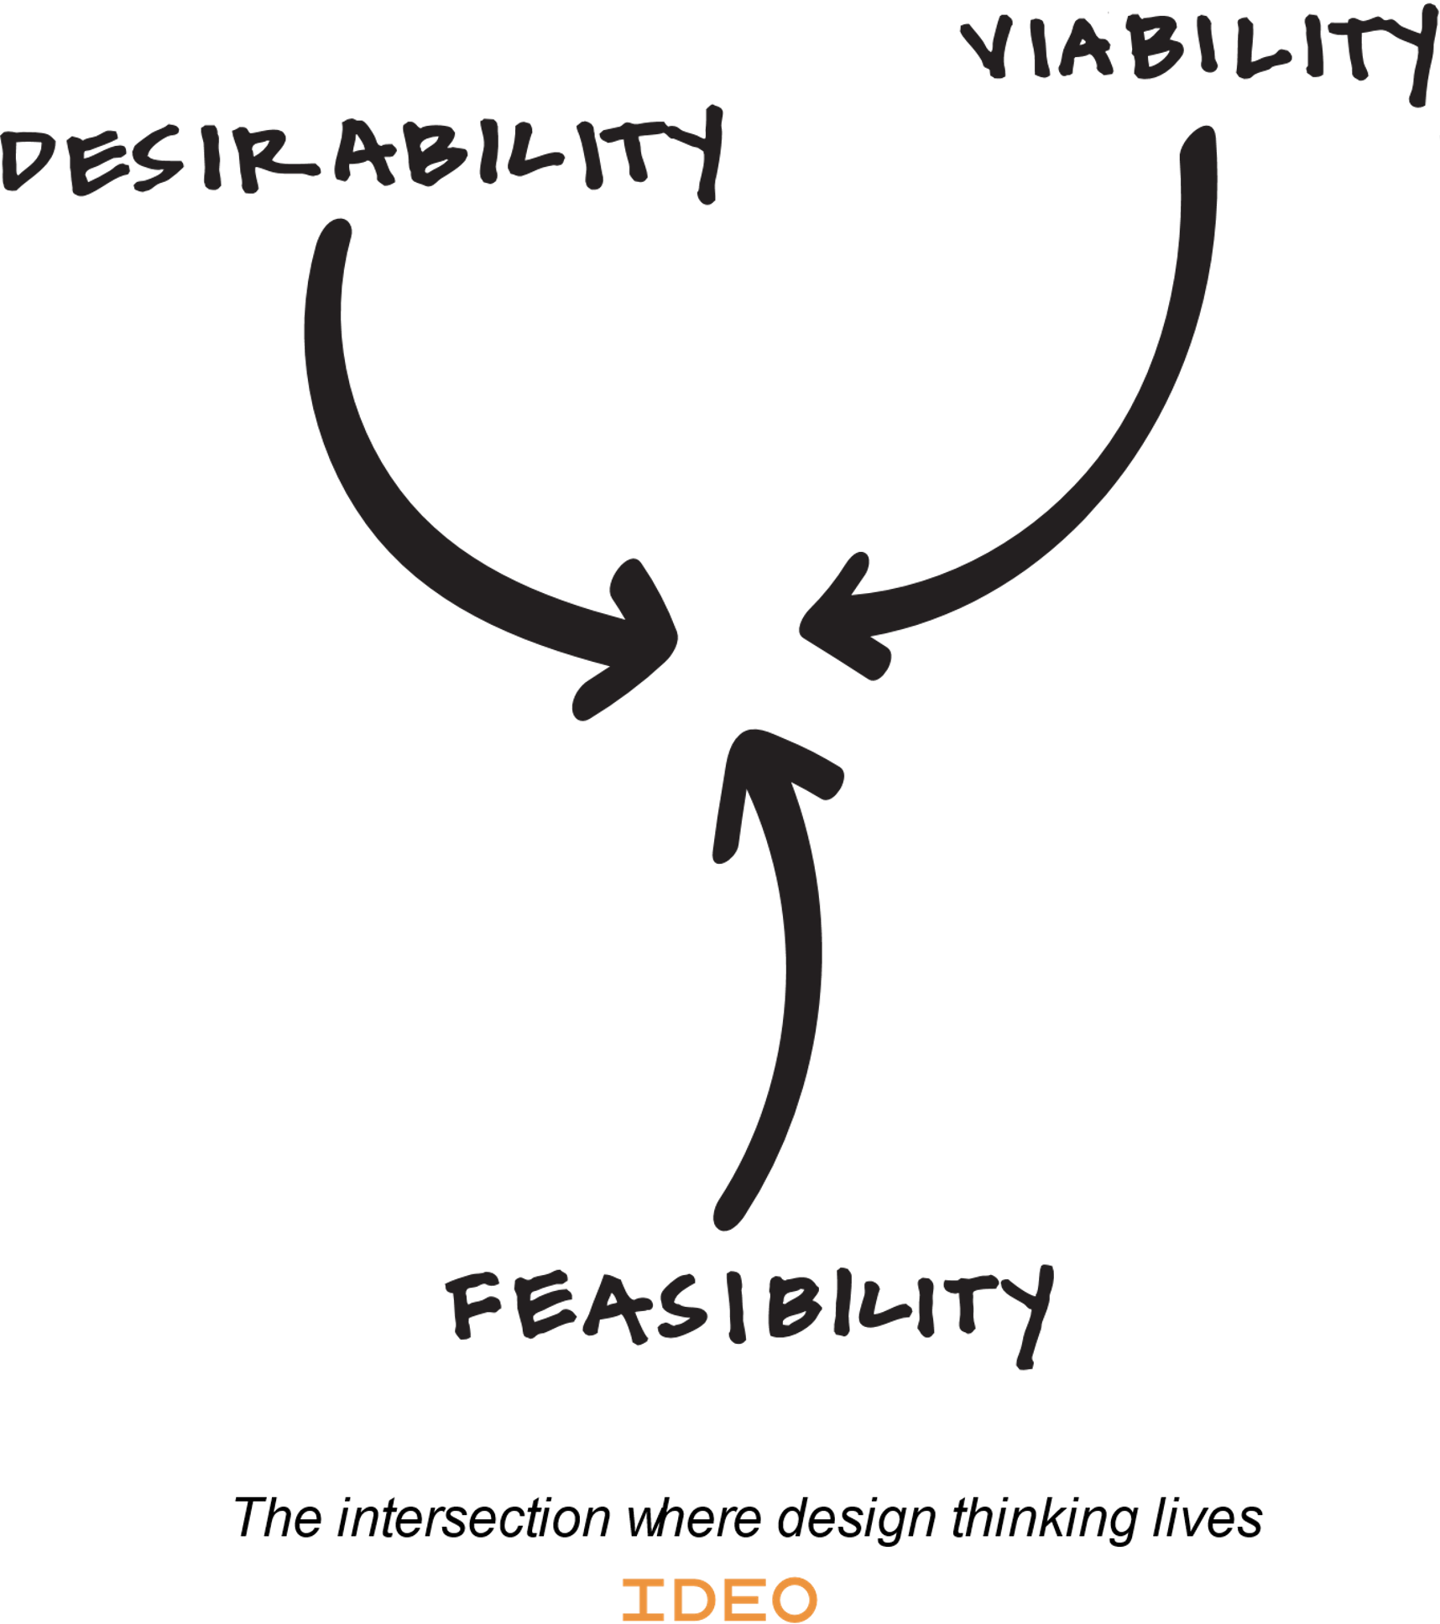
TPL & Design/Innovation Frameworks
Reality
Deal with practical constraints, compromise
 |  |  |  |  |  |  |  |  |  |  |  | IDEAL SYSTEM
 |  |  |  |  |  |  |  | TPL 9
 |  |  |  |  |  |  | TPL 8
 |  |  |  |  |  | TPL 7
 |  |  |  |  | TPL 6
 |  |  |  | TPL 5
 |  |  | TPL 4
 |  | TPL 3
 | TPL 2
TPL 1
Axiomatic design
Axiom 1: Maintain the independence of the functional elements.
Axiom 2: Minimize the information content.
Design thinking
TRIZ
Eliminate contradictions in a "win-win" way (no compromise)
Valeri Souchkov, “Glossary of TRIZ and TRIZ related terms”, Version 1.2, The International TRIZ Association - MATRIZ, 2018, https://www.xtriz.com/publications/TRIZGlossaryVersion1_2.pdf
Nam P. Suh, “Designing-in of Quality Through Axiomatic Design”, IEEE TRANSACIIONS ON RELIABILITY. VOL. 44. NO. 2. 1995 JUNE
Design Thinking Defined, https://designthinking.ideo.com/
Notes:
Thomas

Slide 29
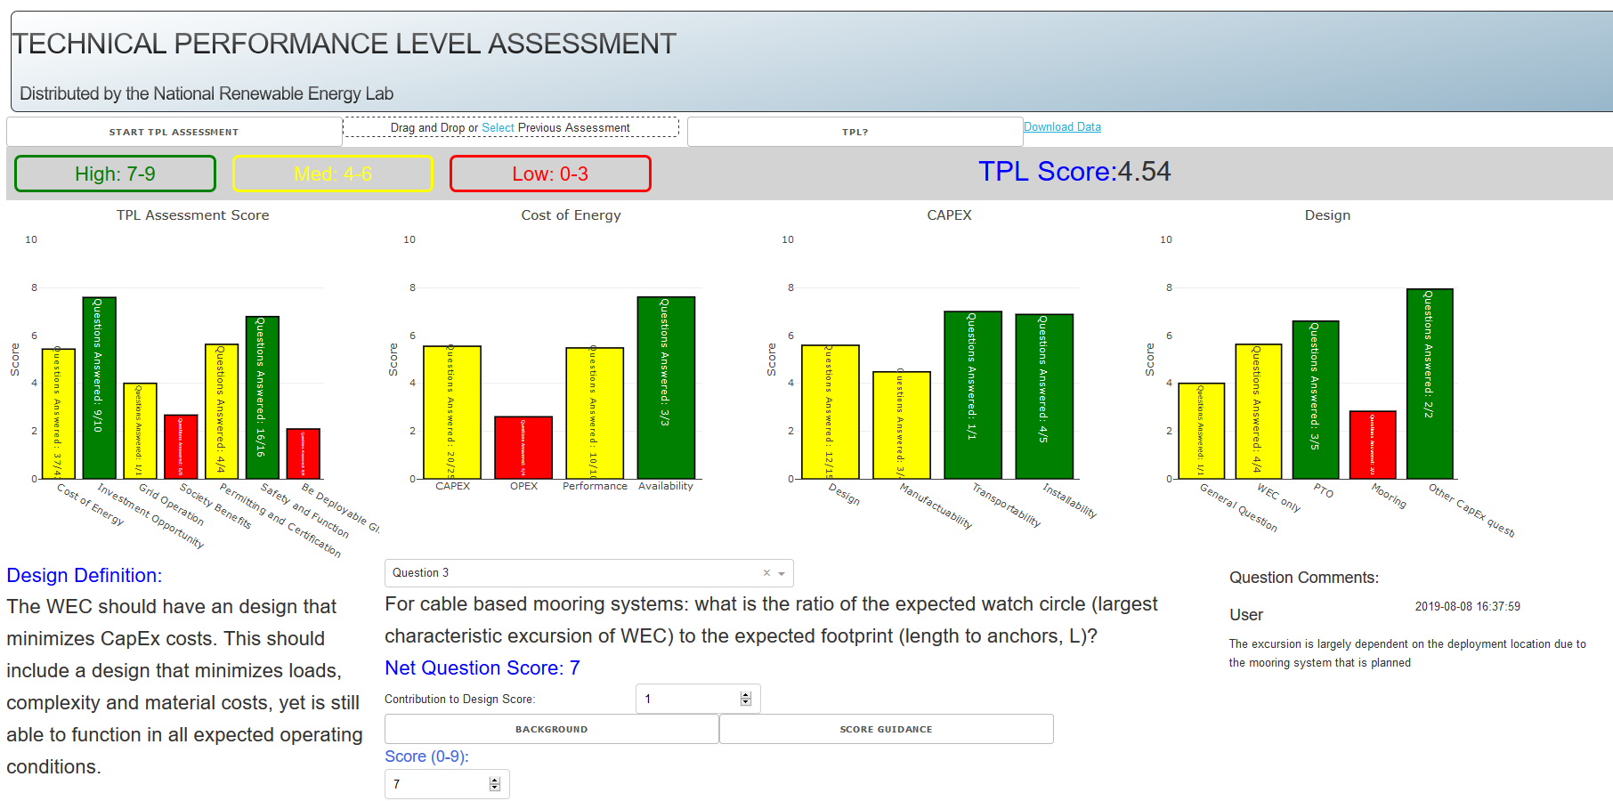
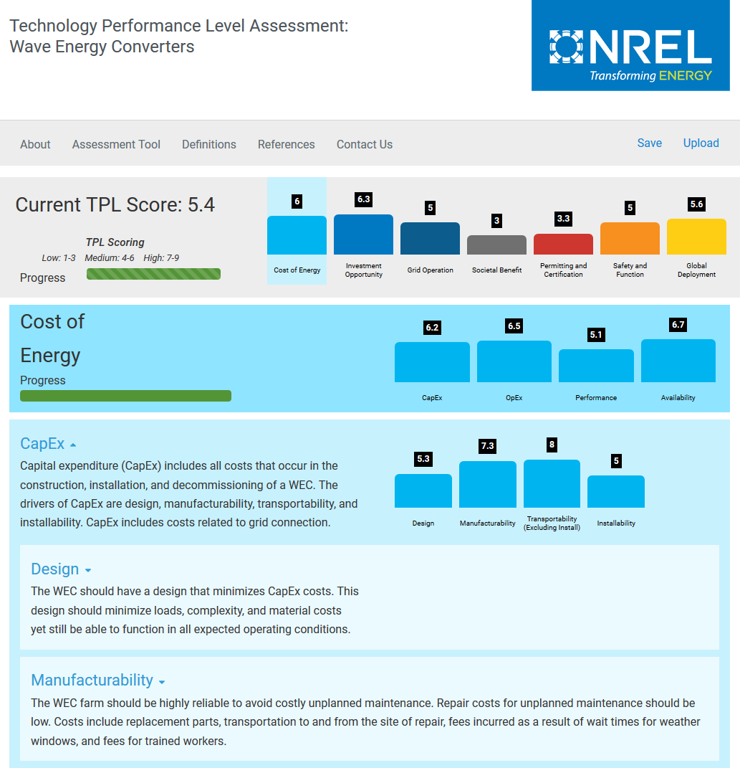
TPL Assessment - Implementation & Evolution
Version History - continuous assimilation of feedback, improvement, development, and release of TPL assessment tool
Version 6,
https://tpl.nrel.gov/
Version 2
Version 4
Version 5
Notes:
Jonathan

Slide 30
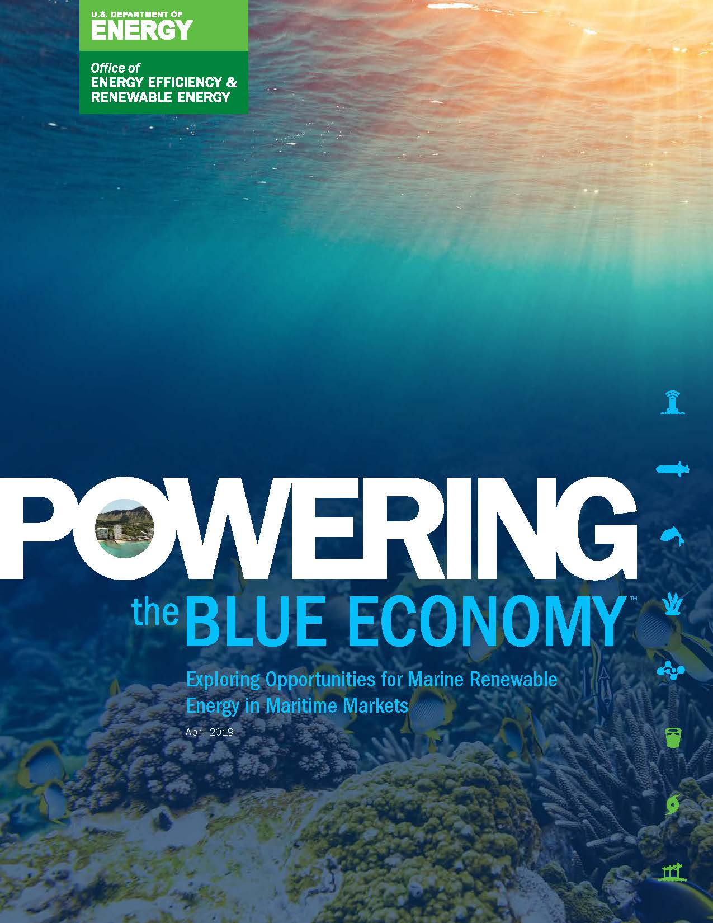
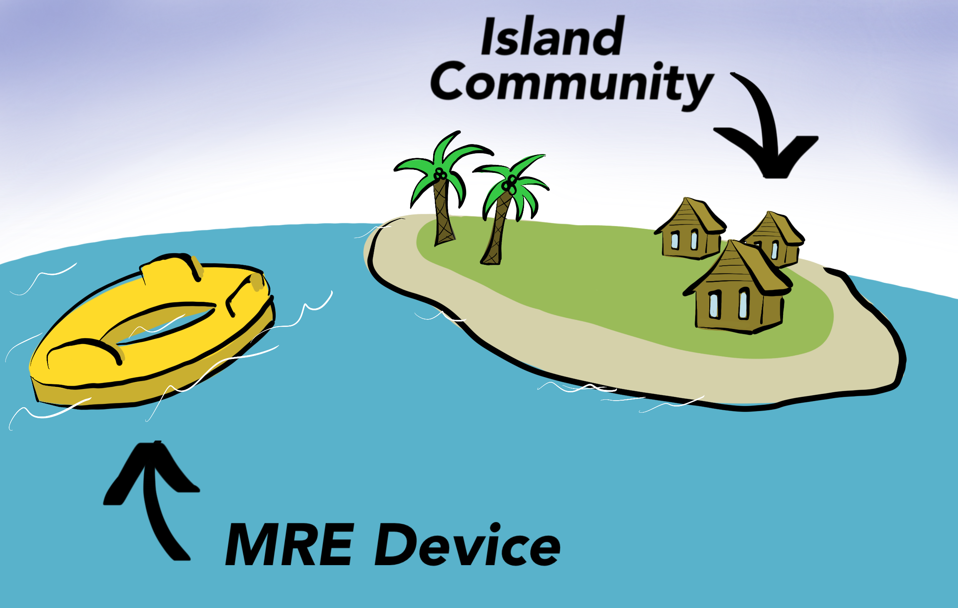
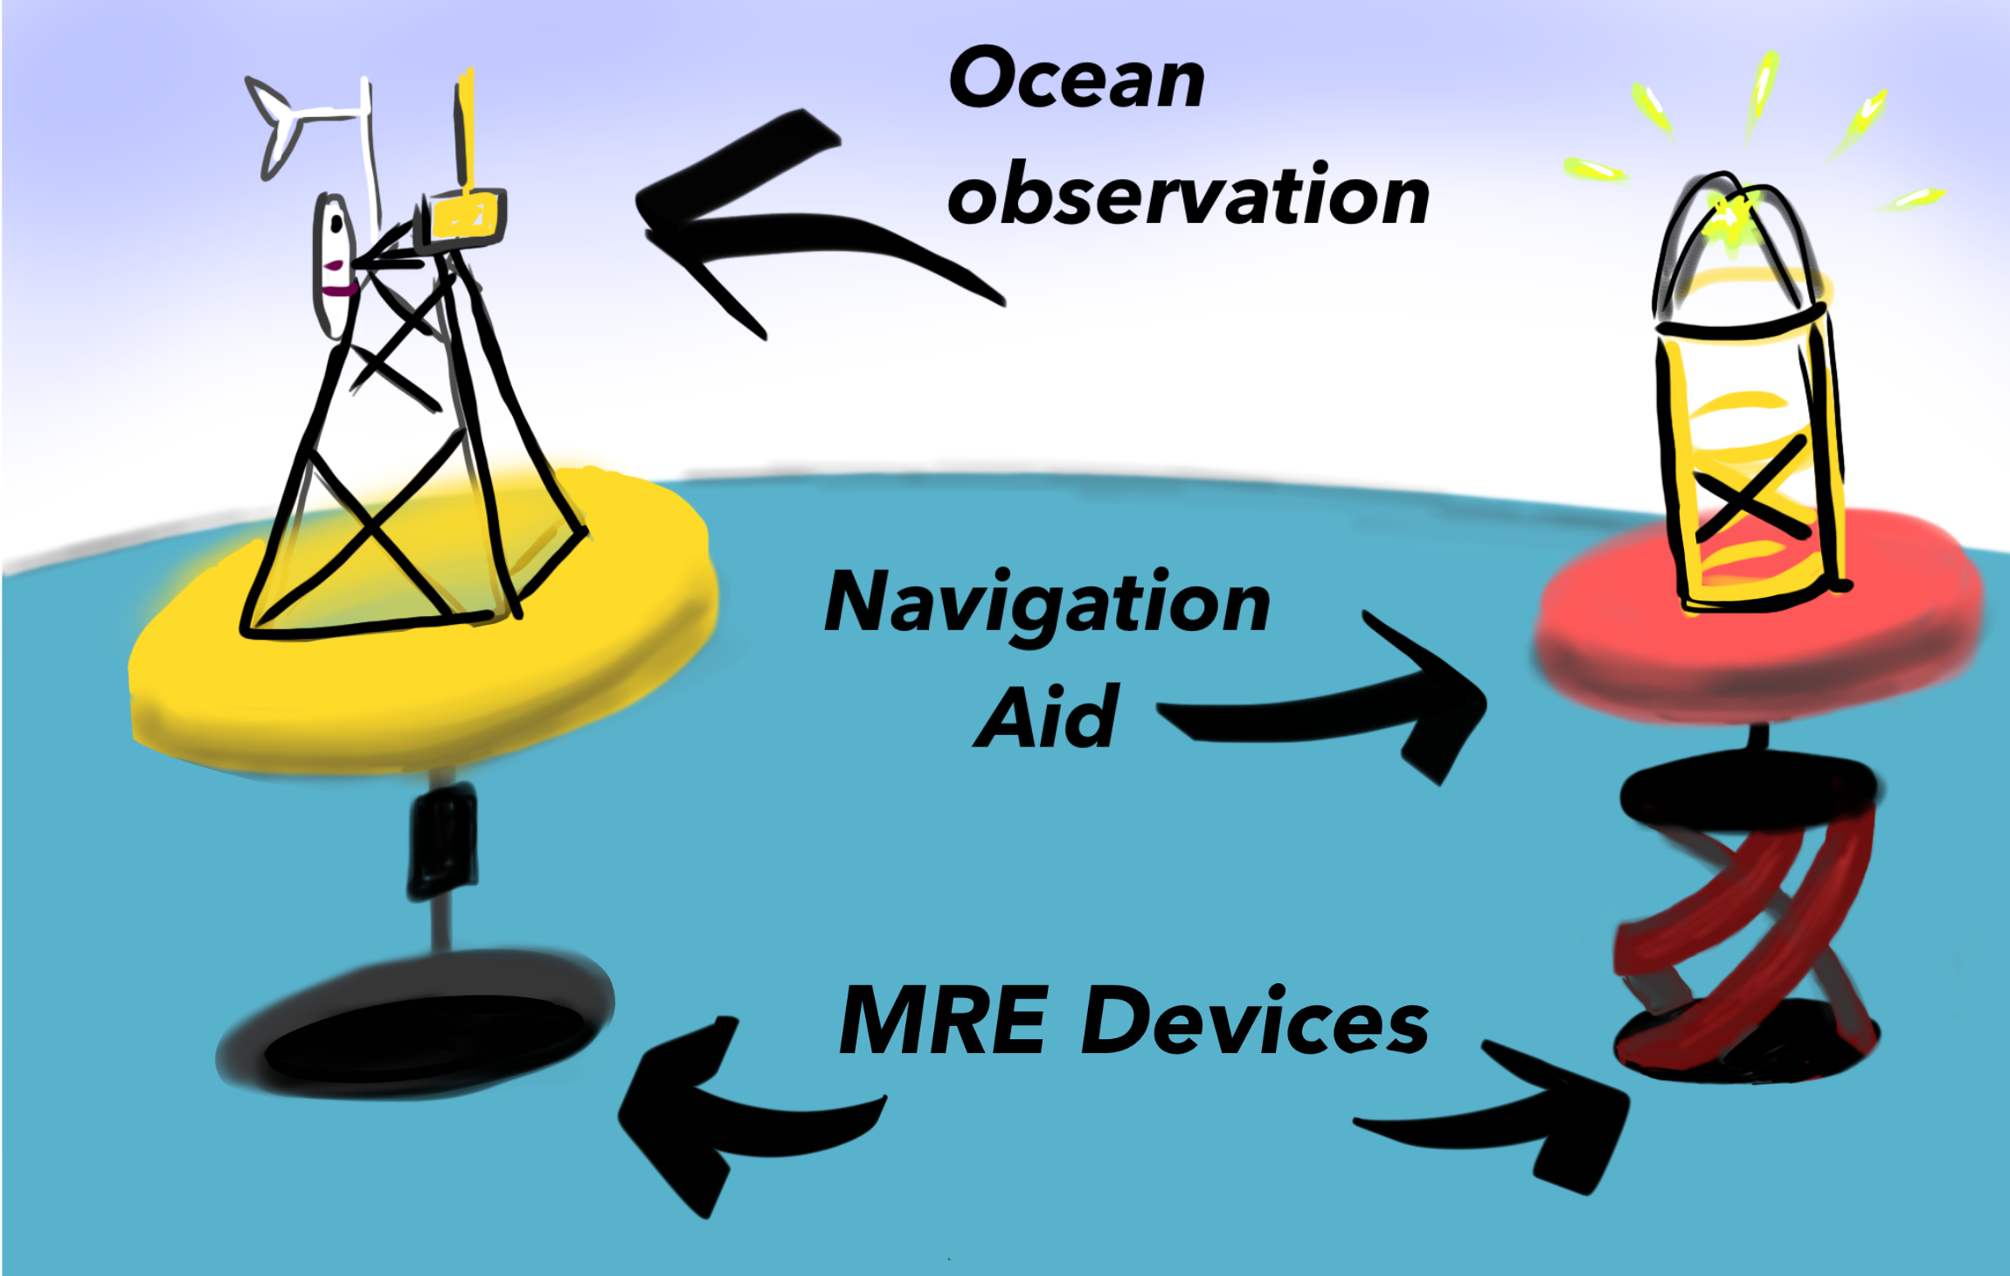
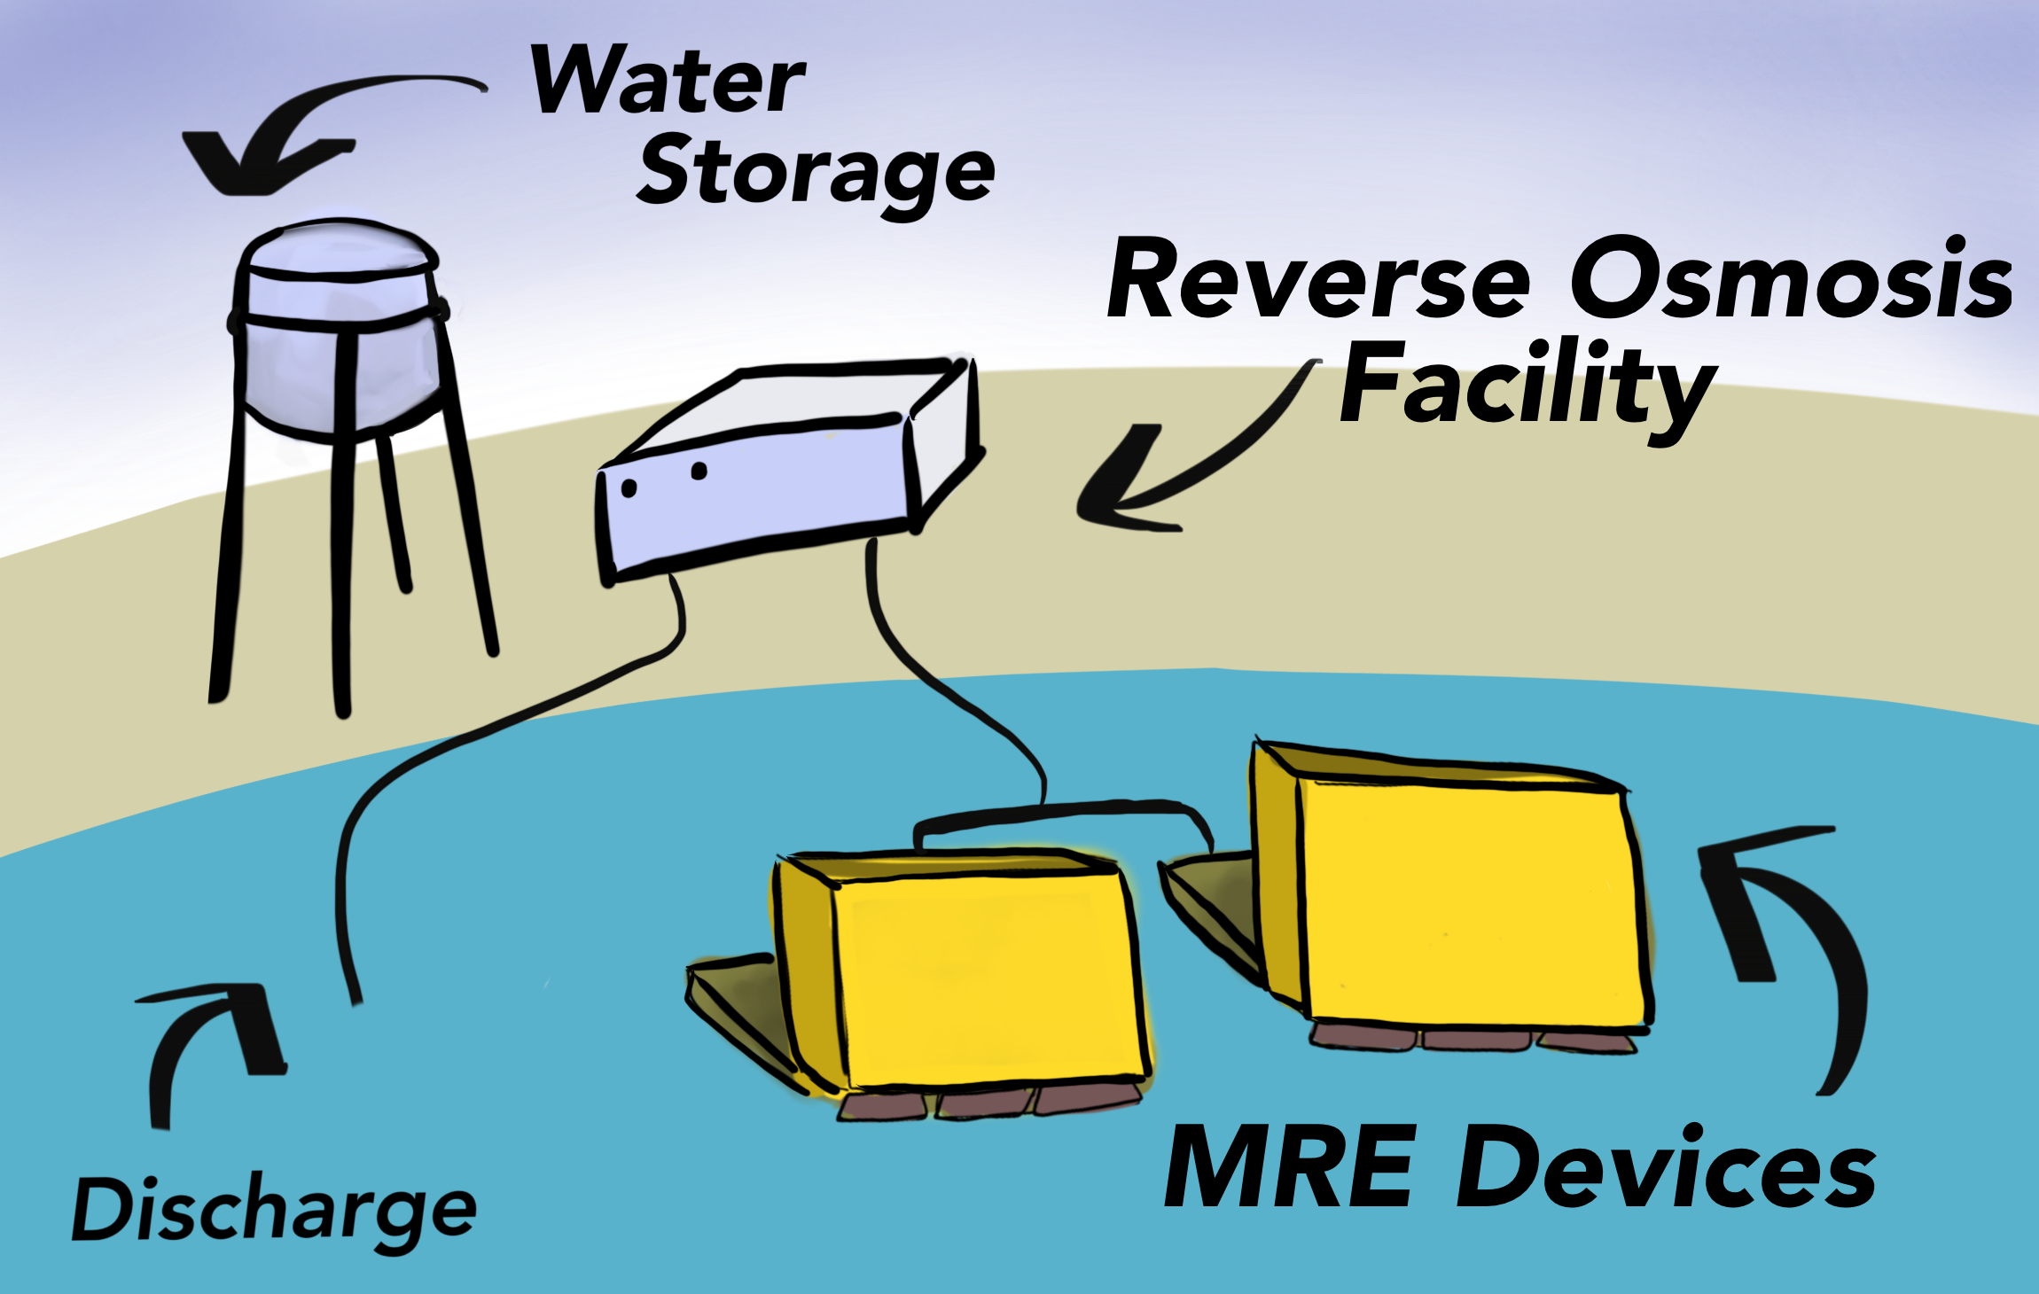
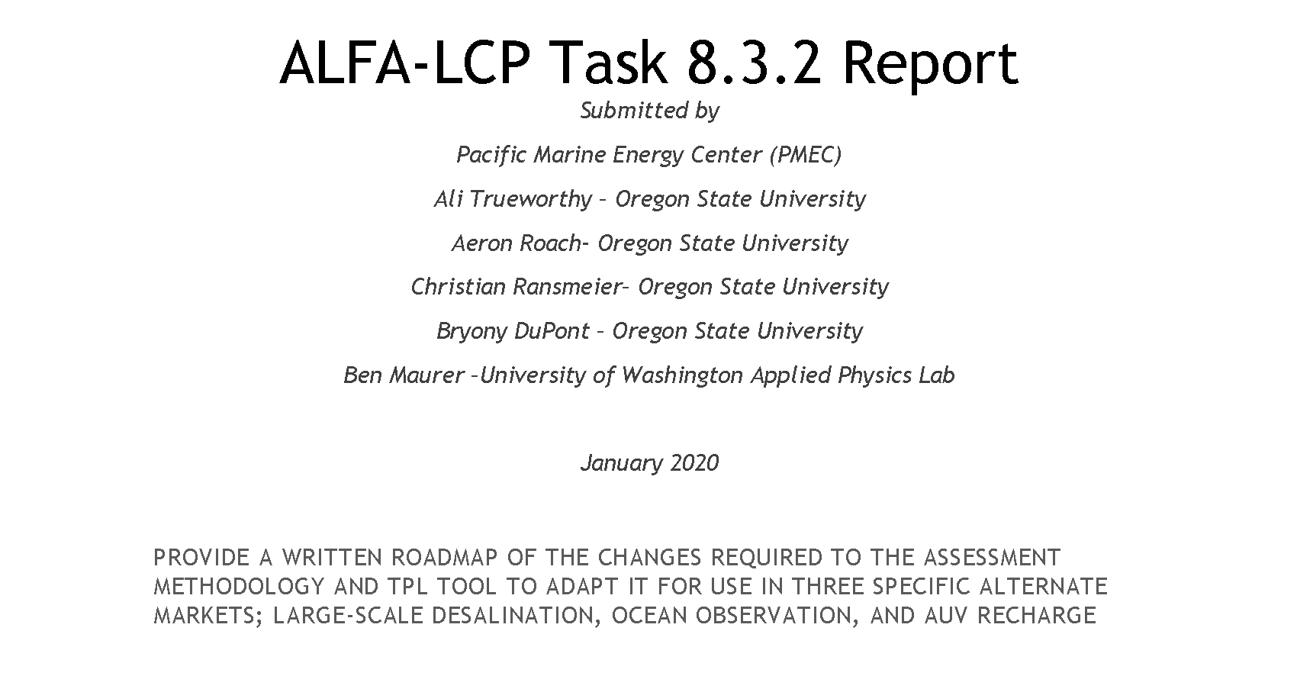
Modifying grid-scale to PBE applications
PBE markets have some overlapping functional requirements to grid applications.
The general approach (Quality Function Deployment) per PBE:
  1) Identify stakeholder, system, and sub-system requirements that remain relevant in the target application.
  2) Identify requirements novel to the target application.
  STAKEHOLDER SURVEYS
  3) For the areas adapted in 1), reword the question, scoring guidance, and instructions to reflect the new application.
  4) For the areas noted in 2), develop new questions, guidance, and instructions.
  5) Adjust weights in TPL calculation, weights are gathered through the House of Quality and stakeholder feedback
  6) Solicit feedback, iterate.
  PBE markets considered so far
1) Isolated community-scale microgrid
2) Ocean observation
3) Wave powered desalinations systems
graphics by Molly Grear, PNNL
Notes:
Jonathan
Outline of QFD (Quality Function Deployment. Should highlight that stakeholder feedback and a house of quality will be the two main adaptation tasks which the next few slides will focus on.
Each PBE market has a unique survey for stakeholders.
DOE Report (April 2019): https://www.energy.gov/sites/prod/files/2019/09/f66/73355-v2.pdf
PMEC Report (2020):
Advanced Laboratory and Field Arrays (ALFA) for Marine Energy and Lab Collaboration Project (LCP)
Authors: Pacific Marine Energy Center (PMEC) Ali Trueworthy – Oregon State University Aeron Roach- Oregon State University Christian Ransmeier– Oregon State University Bryony DuPont – Oregon State University Ben Maurer –University of Washington Applied Physics Lab

Slide 31
Adapting to CECs
Novel stakeholders identified:
CEC device developers and operators
CEC-specific component manufacturers/suppliers
CEC site-specific environmental and marine spatial planning stakeholders
Considerations for river, ocean, and tidal deployments are overlapping, but sufficiently unique that a distinct assessment tool was developed for each resource.
Ocean
Deep water
Meander
Long transmission distance
Salt water
Seasonal variation
Navigation
Predictable
Unidirectional
Grid scale cost of energy
Waves
Interconnection standards
Suspended Sediment
Fresh water
IO&M
Environmental Concerns
Flow control (dams)
Hourly variation
Commercial
Bidirectional
Ice
Depth constrained
Debris concerns
Slack
Area constrained
Tidal
River
Dominic D. Forbush, Jonathan A. Colby, Nicole Mendoza, “A comprehensive assessment tool for low-TRL current energy converters”, Proceedings of the 15th European Wave and Tidal Energy Conference, 3-7 September 2023, Bilbao, Spain
Notes:
Jonathan

Slide 32
Adapting to CECs
An “Ideal System” paradigm is used to assess multi-faceted aspects of performance over multiple questions to ensure promising innovations are rewarded in higher overall scores (Salamatov, 1999)
Are the CEC subsystems designed for the expected extreme loads and motion of the operational environment?
…
“An ideal power-take off system is one that, for no added cost or complexity, provides the most efficient power conversion.”
What is the cost of the system that converts mechanical power to power exported from the CEC?
…
What is the efficiency between the absorbing element of the prime mover and the component that produces transportable power?
Notes:
Jonathan
The “Ideal System” comes from the Theory of Innovative Problem Solving. In Russian, the acronym is TRIZ.
3 dots remind everyone that this is only a few examples, there are many, many more.
CITATION: Y. Salamatov. "TRIZ: The Right Solution at the Right Time: A Guide to Innovative Problem Solving.". Insytec B.V. (1999) ISBN 10: 9080468010.

Slide 33
Testimonials
CalWave, USA
“The TPL assessment greatly facilitated a holistic view of all the primary and secondary requirements of a wave energy power plant, array and larger farm during the early concept stages and ongoing. This approach ultimately leads to the lowest CAPEX and OPEX as well as highest Annual Energy Production of a wave energy farm.”
--Marcus Lehmann, CEO, CalWave
CorPower Ocean, Sweden
“The detailed feedback and thoughts on possible system improvements that you have contributed are very valuable to us. The questions asked in the TPL process triggers many useful discussions and thoughts across our team. Quite unique to be able to get this level of in-depth comments from an experienced team like yourself, that has seen many different design and system approaches through your TPL assessment program, and from previous wave development journeys.”
--Patrik Möller, CEO & Co-founder, CorPower Ocean
“The M4 development pathway has focused on innovation and design optimization via numerical simulations and experimentally at a reduced scale, thus achieving high TPL before advancing its TRL via larger-scale ocean deployments. Such an approach has been suggested by Weber (2012) for example.”
--Orszaghova, et al. (2022)
M4 WEC Project, Australia
Notes:
Jonathan

Slide 34

TPL assessment service
TPL can be used by
TPL used to date
technology developer to get design feedback, identify areas of improvement, and find fatal flaws early
investors and project developers to conduct due diligence
judges to assess wave energy converter technologies in competitions
reviewers to assess wave energy converter proposals and make funding decisions
researchers to landscape the domain to formulate R&D strategy
by technology developers for assessing their technologies
for internal lab work
by international research partners
in assessment of client’s technologies by labs
in prizes
for funding decision support
  Well over 1,000 technology assessments across over 200 technology concepts/designs have been made - guiding technologies to higher performance.
  TPL Assessment service for US and global industry is available via TEAMER
Notes:
Jochem

Slide 35
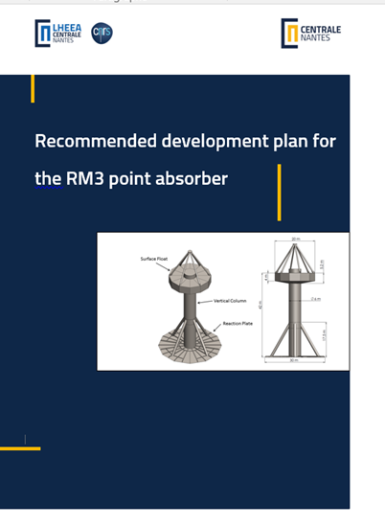
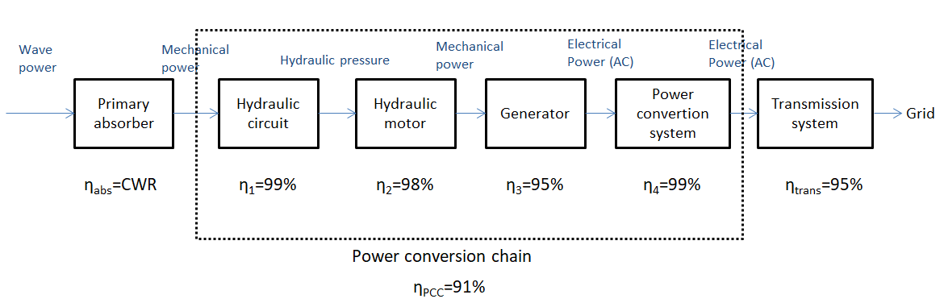
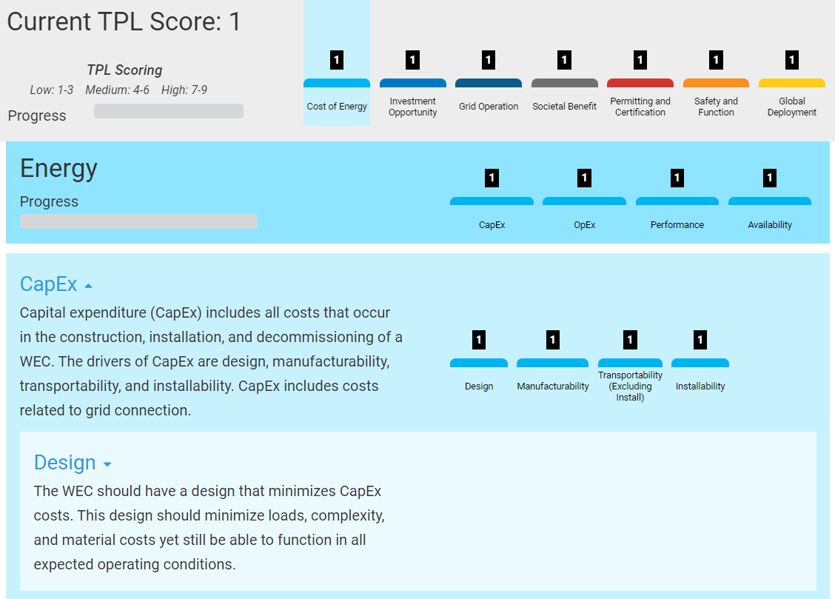
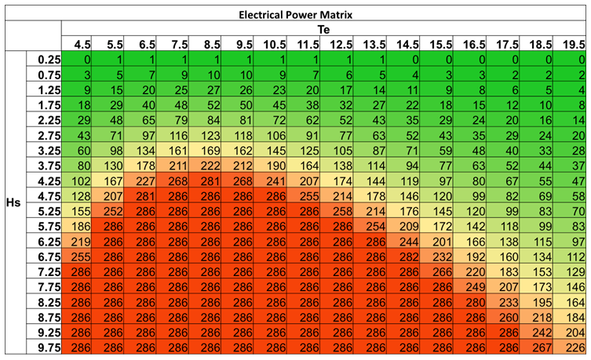
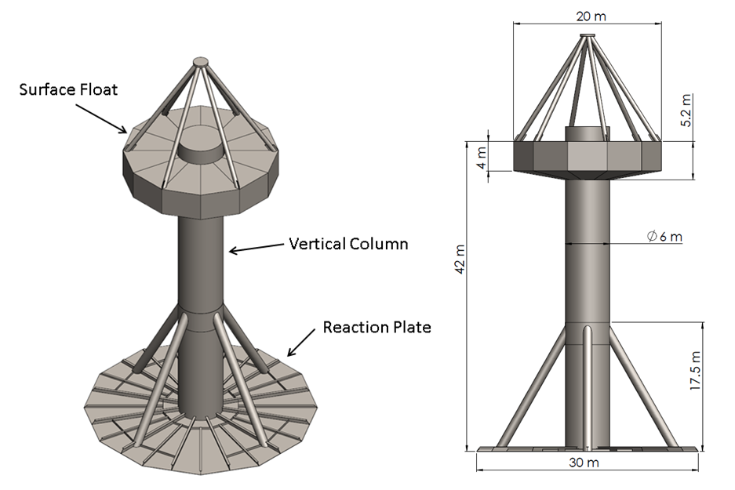
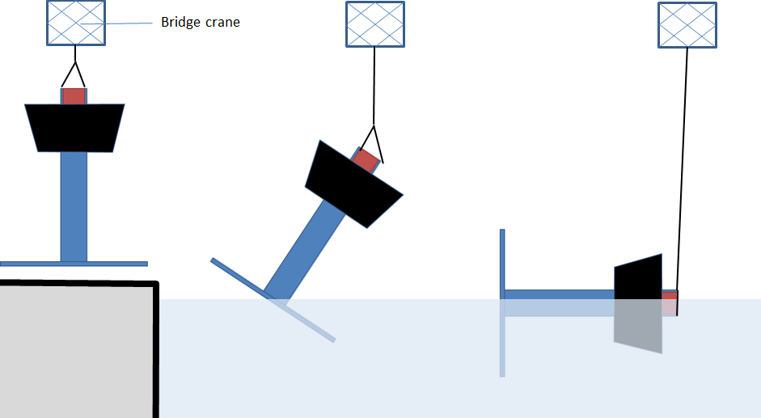
3-Step Methodology
Development plan
3
Technical Submission Request
Assessment - online tool
2
1
Notes:
Jochem

Slide 36
3-Step Methodology
Who is involved? Different scenarios
Technical Submission Request (TSR)
  The developer provides documents
  The assessor(s) analyse, synthesise, justify
  An external reviewer supports, settles disagreements
Assessment - online
  The assessor(s) assess and list most impactful scores
  The developer self-assesses
Development plan
  The assessor(s) advise, prioritise
  The developer reviews
1
2
3
Notes:
Jochem

Slide 37


Competitor Support Mechanisms
Webinars:
  15 August 2024: Phase III kickoff
  27 August 2024: Wave Energy 3.0
  12 September 2024: DEEC-Tec 3.0
  19 September 2024: Innovation Methods 3.0
  23 September 2024: TPL Assessment 3.0
Mentorship in Innovation Methods and TPL Assessment
(Ramboll and Wave Venture)
Forum and Resources available on HeroX
Additional resources linked in Appendix D of the Rules Document
Submission Feedback
TPL assessment service available via TEAMER after the prize
Notes:
Amanda

Slide 38
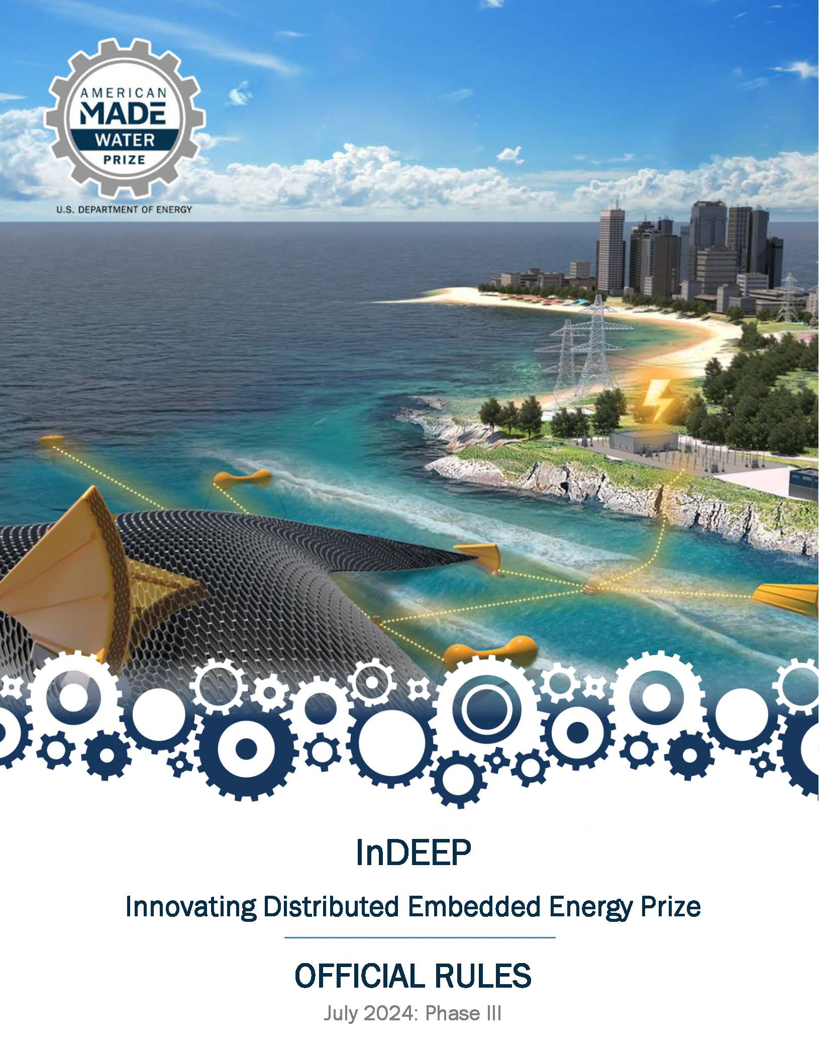
Read the Rules
For a more in-depth look at the prize overall where these topics will be applied, please read the rules document, available here:
https://americanmadechallenges.org/challenges/indeep/docs/InDEEP-Prize-Rules.pdf
Notes:
Amanda

Slide 39
Questions?
Notes:
Amanda

Slide 40
ADDITIONAL INFORMATION
Reference Materials

