Slide 1
Innovating Distributed Embedded Energy Prize (InDEEP)
Distributed Embedded Energy Conversion Technologies (DEEC-Tec) 3.0
Sept 12, 2024
Notes:
Blake

Slide 2
Webinar Logistics
Everyone is joined in listen-only mode
Audio Issues?—Try connecting over the phone
If that doesn’t work, visit the Zoom Help Center webpage
Q&A—Submit your questions using the chat box
Notes:
Blake

Slide 3
Agenda — Sections of the Webinar
Introductions — Prize and People
Distributed Embedded Energy Conversion Technologies
(DEEC-Tec); National Renewable Energy Laboratory
Direct Generation; Wave Energy Scotland
Q&A
Wrap Up
Notes:
Blake

Slide 4
Section 1) Introductions — Prize and People
Notes:
Jenny

Slide 5
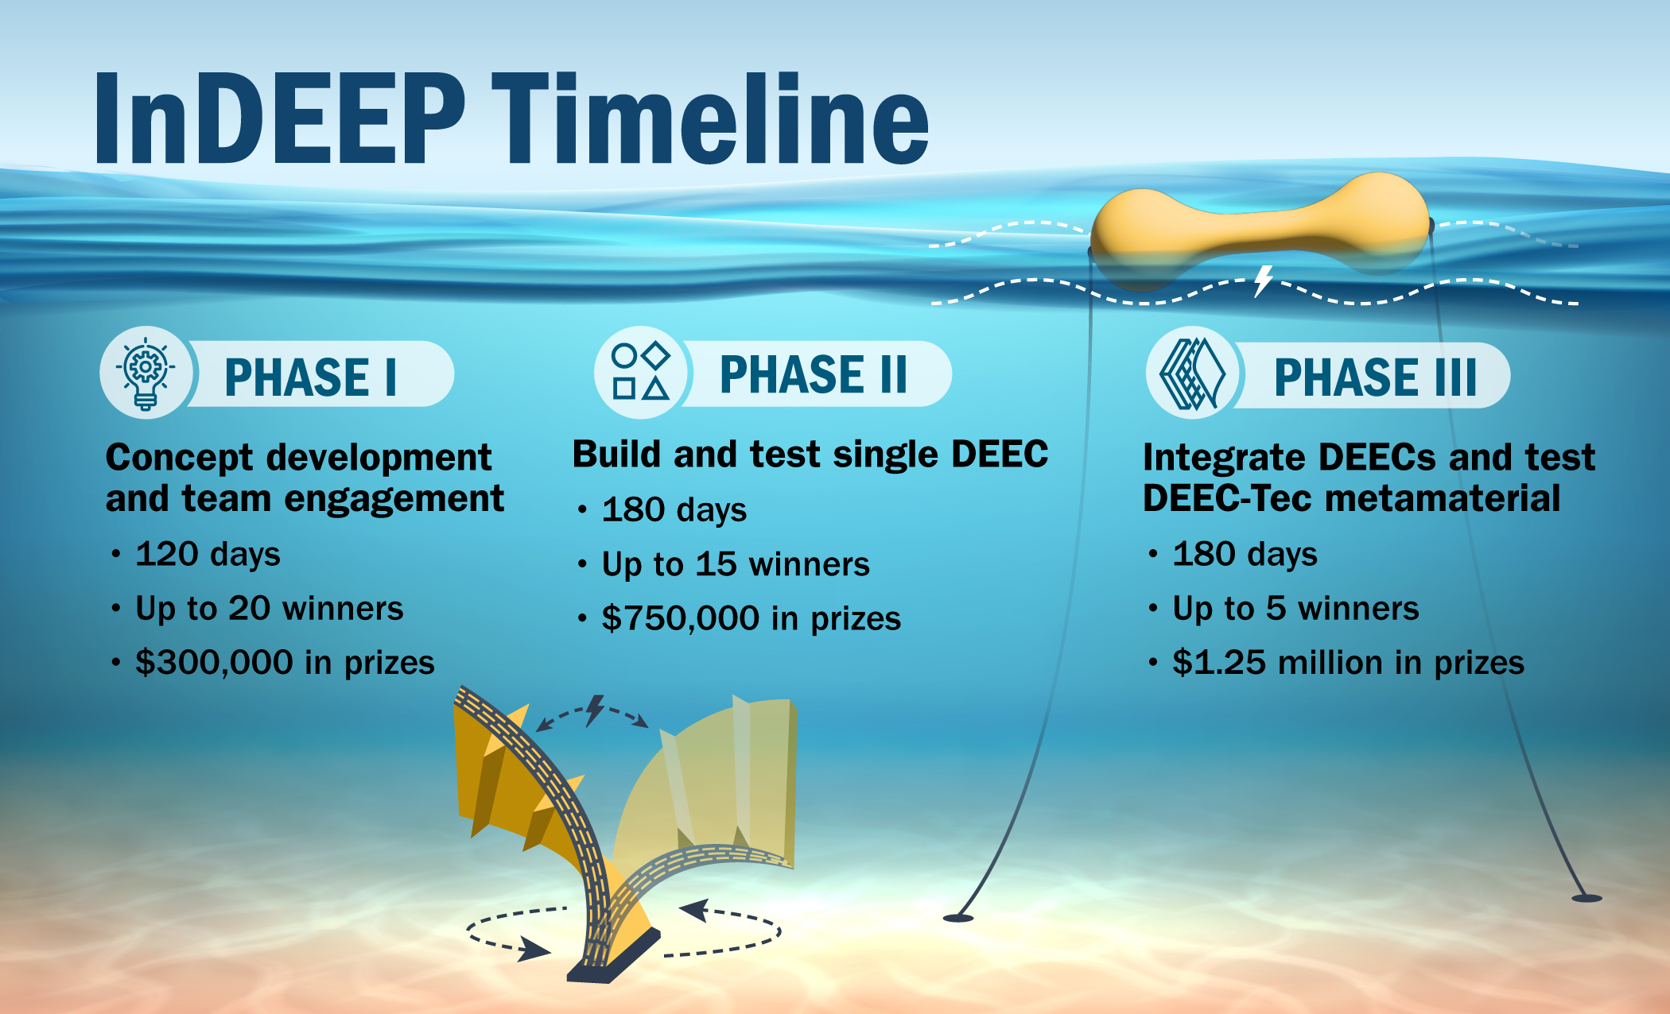
https://www.herox.com/indeep
Notes:
Blake

Slide 6
Personnel
DEEC-Tec; National Renewable Energy Laboratory
Blake Boren
Jochem Weber
Direct Generation; Wave Energy Scotland
Ieuan Collins
Jonathan Hodges
Notes:
Jenny

Slide 7
Section 2) Present Distributed Embedded Energy Conversion Technologies (DEEC-Tec)
Notes:
Blake

Slide 8
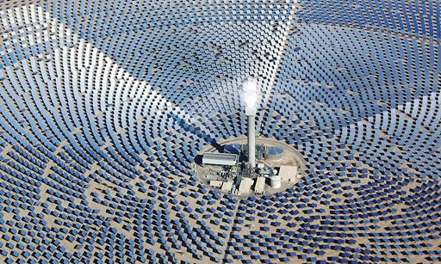
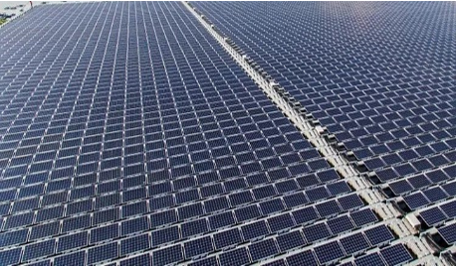

Setting the Stage: Example of Design Paradigm Shift
Concentrated Energy Conversion
Example: Thermal solar power
Energy field interception with direction to focus point for multi-stage & high load power conversion to electricity
Distributed Energy Conversion
Example: Photovoltaic solar power
Energy field interception with local conversion to high aggregation of electricity
Notes:
Jochem

Slide 9
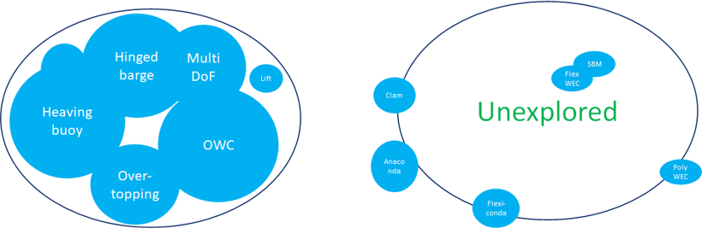
Marine Energy – Concentrated to Distributed
Paradigm Shift
Concentrated Energy Conversion
Conventional Technology Approach
Extensively explored Solution Space
Distributed Energy Conversion
Innovative Technology Approach
Underexplored Solution Space
Notes:
Jochem
Don’t be specific about companies, per se…just point out that there is a lot of underexplored space in the DEEC-Tec side of things.

Slide 10
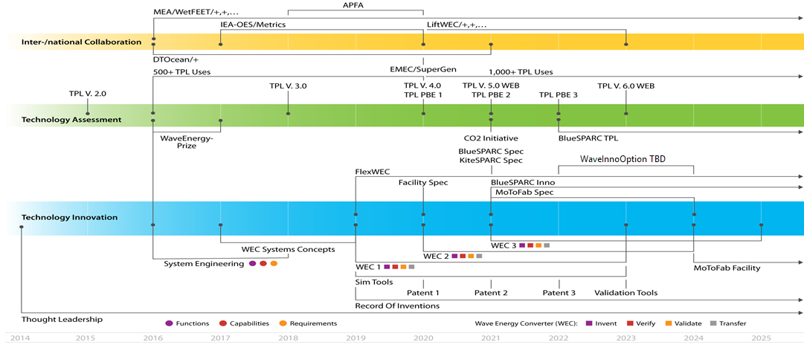
Historic Project Background: WaveSAPRC to DEEC-Tec
WaveSPARC
Structured Innovation
FlexWEC
DEEC-Tec
InDEEP
Notes:
Jochem
This shows continued growth in the area.

Slide 11
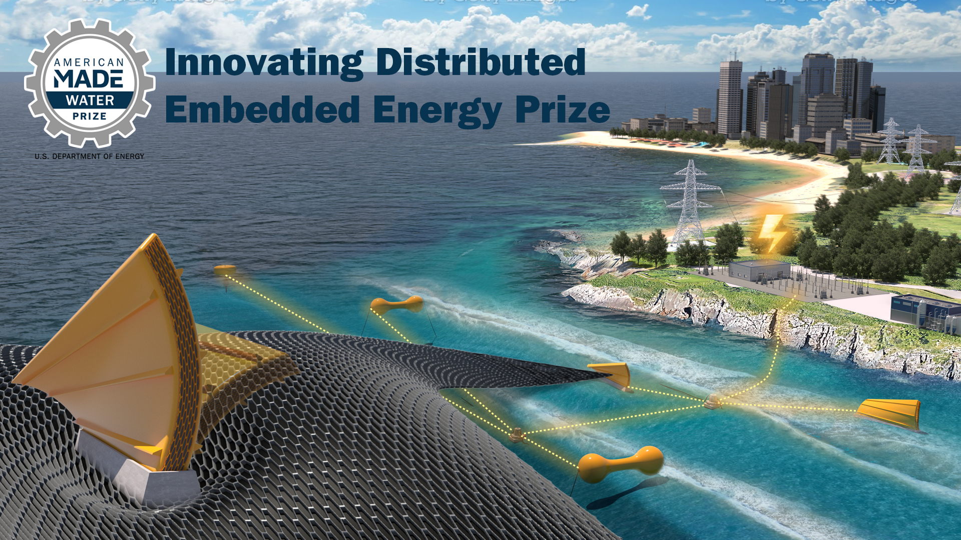
Describing DEEC-Tec — Levels of Hierarchy
Notes:
Blake

Slide 12
Describing DEEC-Tec — Levels of Hierarchy
Notes:
Blake

Slide 13
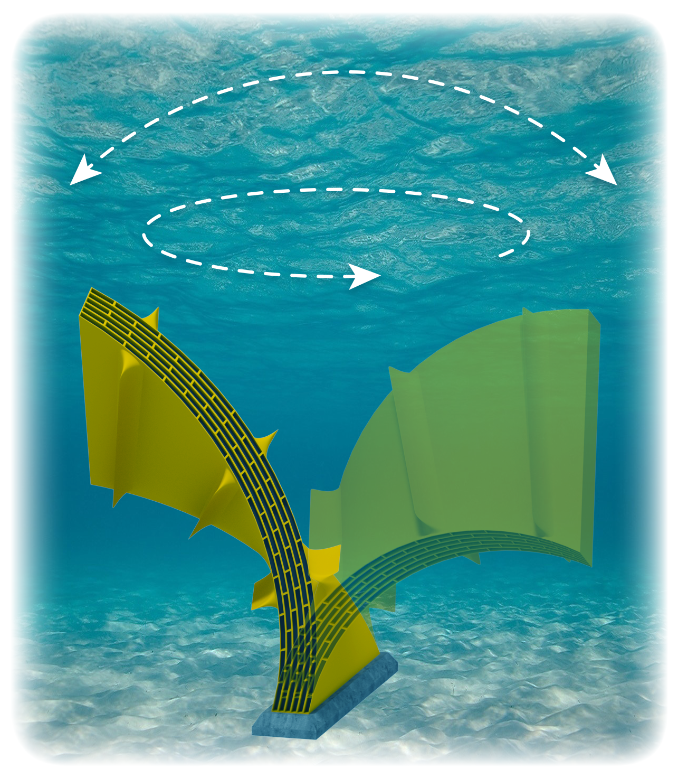
Section 2a)
Describing DEEC-Tec — Levels of Hierarchy
Bottom Fixed Surging FlexWEC

Slide 14
Describing DEEC-Tec — Levels of Hierarchy
This is just a reference.
Note, a Bottom Fixed Surging FlexWEC is just one out of many possible ocean wave energy converters that could be based upon DEEC-Tec.

Slide 15
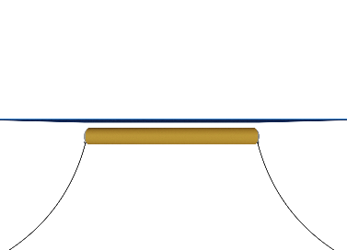
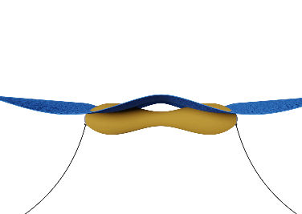
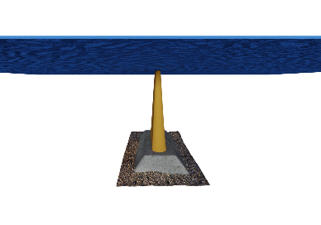
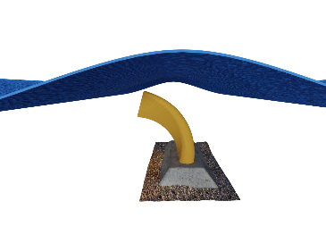
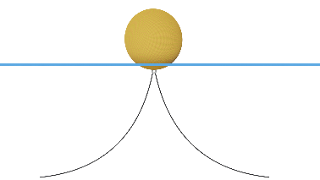
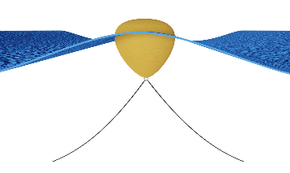
Describing DEEC-Tec — Levels of Hierarchy
No Waves
Nondeformed
Waves
Actively Deformed
Bulging
Line Absorber
Some other examples of ocean wave energy converters.
Three example WEC archetypes made from DEEC-Tec metamaterials.
Contracting/Bulging
Bottom Fixed Surging FlexWEC
Bending
Twisting
Distending
Point Absorber
Contorting
Distending
Notes:
Can talk more about the “other” example during Q&A as needed.

Slide 16
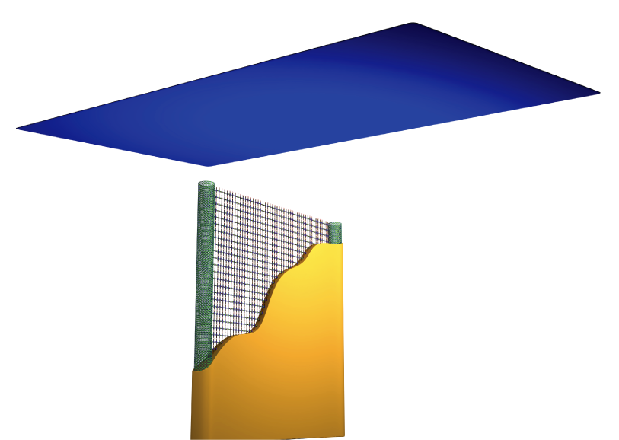

Describing DEEC-Tec — Levels of Hierarchy
Still Water; Ocean Surface
Leveraging a Bottom Fixed Surging FlexWEC as
a reference to describe DEEC-Tec’s Hierarchy Levels
Hierarchy Level 3
Complete Ocean Wave Energy Converter
This is the highest level and represents an overall actual ocean wave energy converting structure.
A Bottom Fixed Surging FlexWEC
Seafloor

Slide 17
Describing DEEC-Tec — Levels of Hierarchy

Slide 18
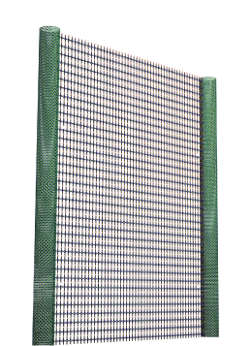
Describing DEEC-Tec — Levels of Hierarchy

Slide 19
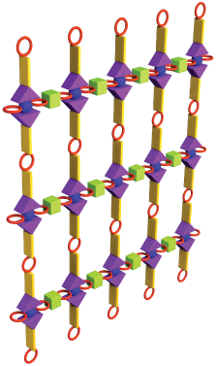
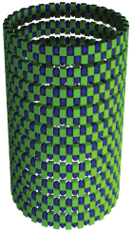
Describing DEEC-Tec — Levels of Hierarchy
Hierarchy Level 2
DEEC-Tec Metamaterials
This level represents the various DEEC-Tec “building materials/frameworks” used to create an overall energy converting structure.

Slide 20
Describing DEEC-Tec — Levels of Hierarchy
Hierarchy Level 2
DEEC-Tec Metamaterials
This level represents the various DEEC-Tec “building materials/frameworks” used to create an overall energy converting structure.
This converter is made from two varieties of DEEC-Tec Metamaterials

Slide 21

Describing DEEC-Tec — Levels of Hierarchy
Pictorial Representations of Individual Distributed Embedded Energy Converters
Hierarchy Level 1
Individual Distributed Embedded Energy Converters
This level represents base components – they are energy transducers capable of distribution and/or embedment with others to create DEEC-Tec metamaterials.
This converter is made from two varieties of DEEC-Tec Metamaterials

Slide 22
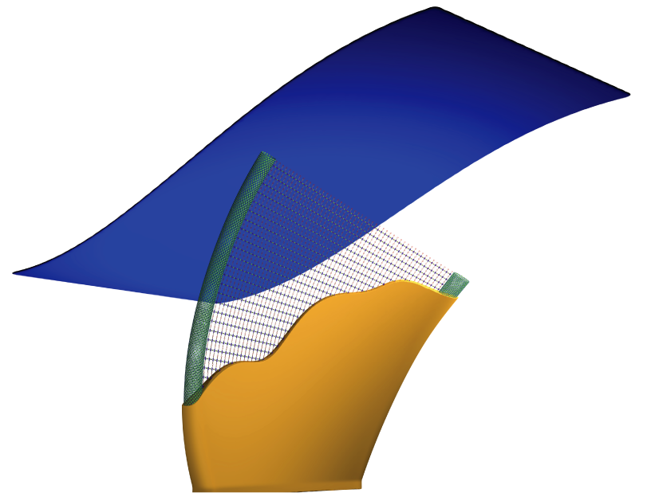
Describing DEEC-Tec — Levels of Hierarchy
Ocean Wave
Wave energy converting structure being dynamically deformed by ocean waves.

Slide 23
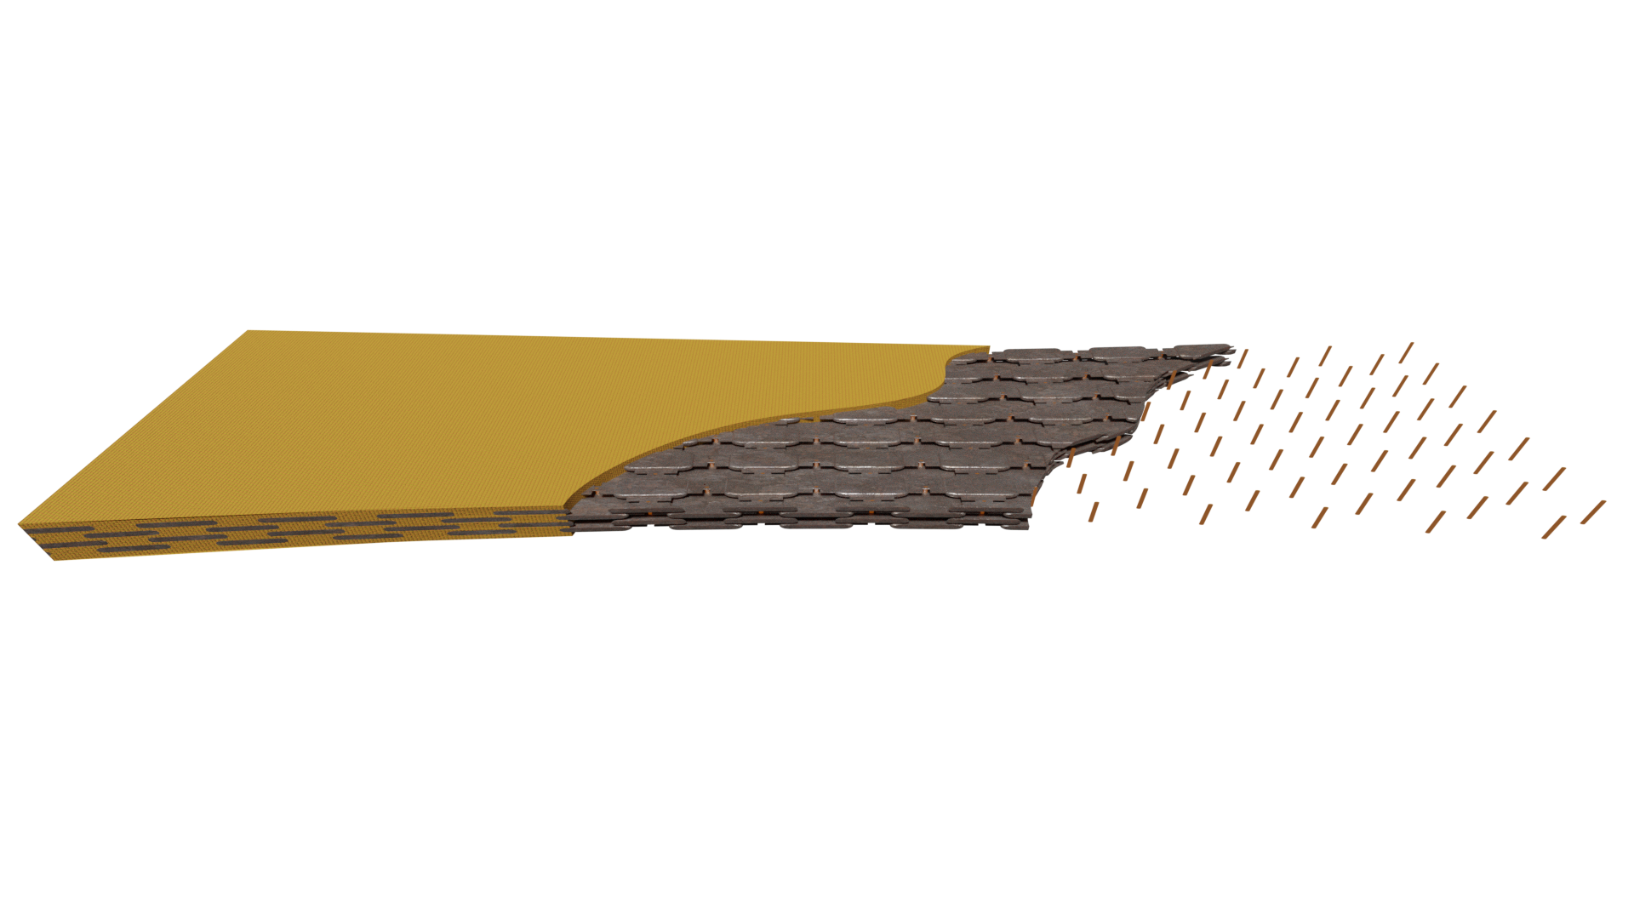
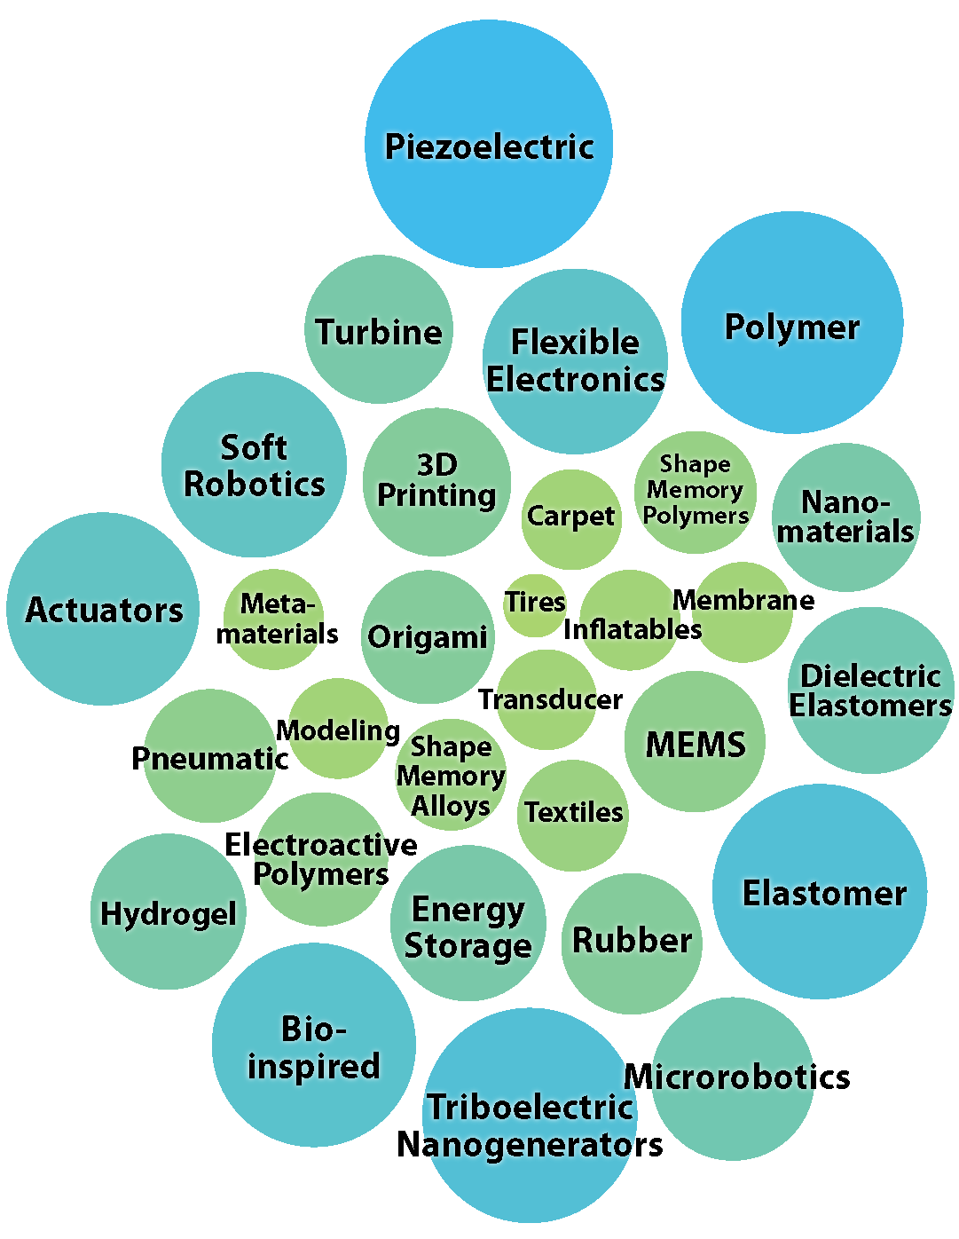
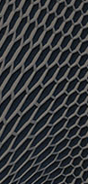
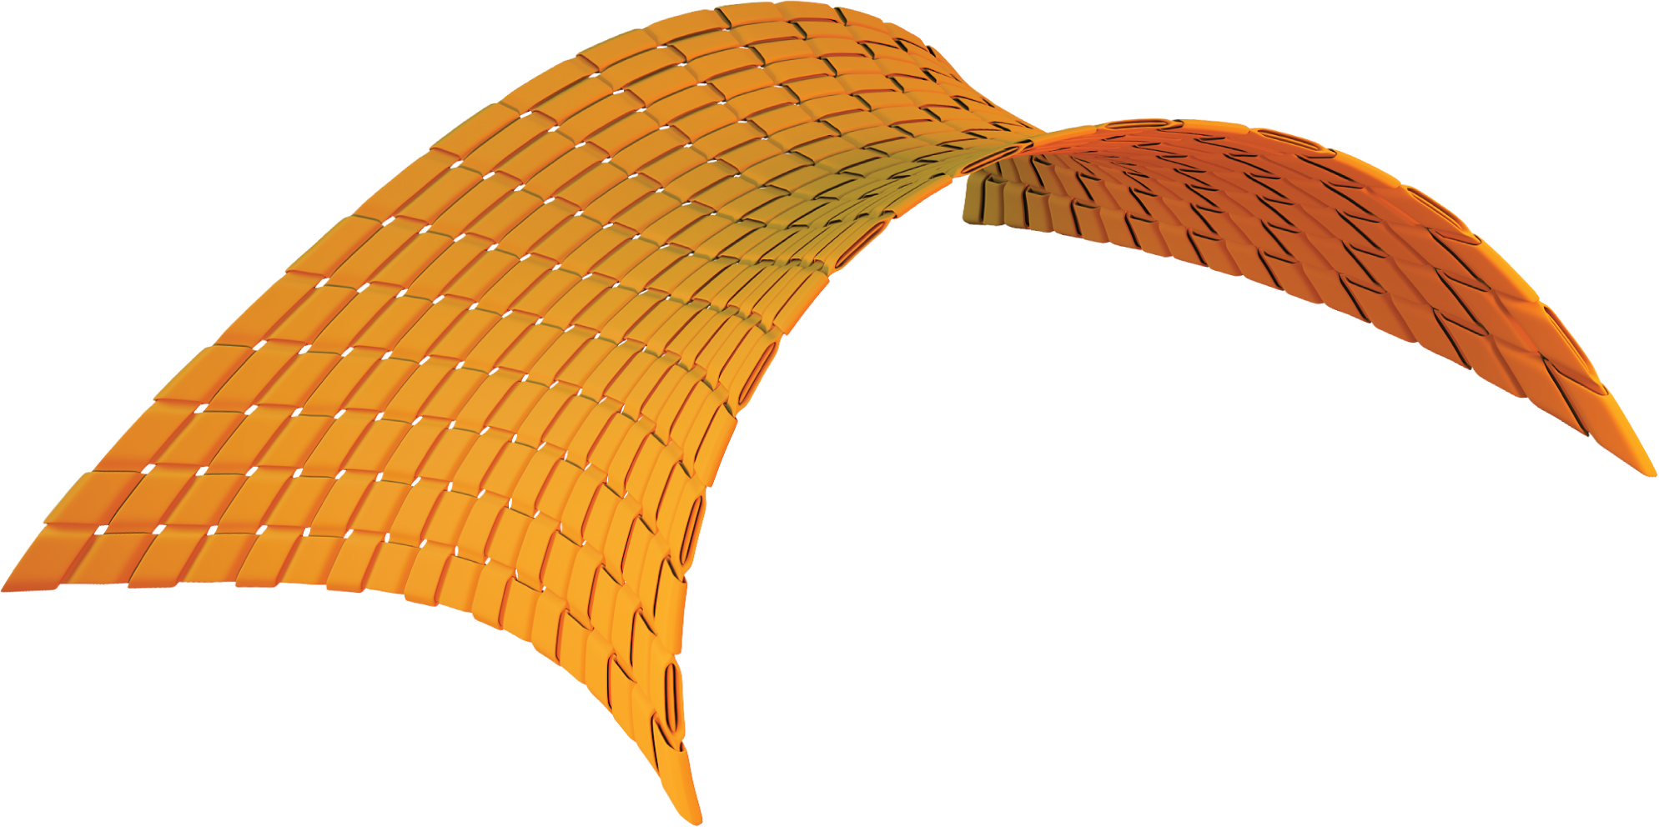
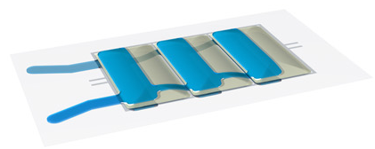
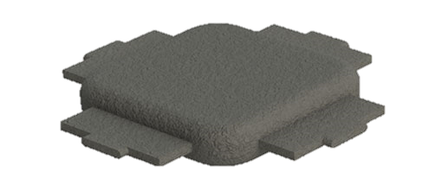
The DEEC - Tec Domain is Vast!
There are many unknown possibilities leveraging any number of technology domains—especially in terms innovating DEECs and DEEC-Tec metamaterials:
Your technology here?
?
Structural
Vibration
?
?
?
Magnetostriction
?
Variable
Capacitance
?
?
?
?
?
?
?
Faraday’s Law of Induction
Let’s De-Risk: InDEEP

Slide 24
DEEC-Tec: To Summarize
DEEC-Tec is the creation of larger energy converting structures by distributing, embedding, and interconnecting many smaller energy converting transducers together.
Notes:
Presenter: Blake
-If at any point anyone is wondering what’s going on…this is what’s going on.

Slide 25
DEEC-Tec: High-level Motivation
No concentration of forces into singular prime movers.
Inherently redundant.
Broader bandwidth of effective operation.
Expands the design space and possibilities of marine energy conversion and usage.
Notes:
Presenter: Blake
If at any point anyone is wondering what’s going on…this is what’s going on.

Slide 26
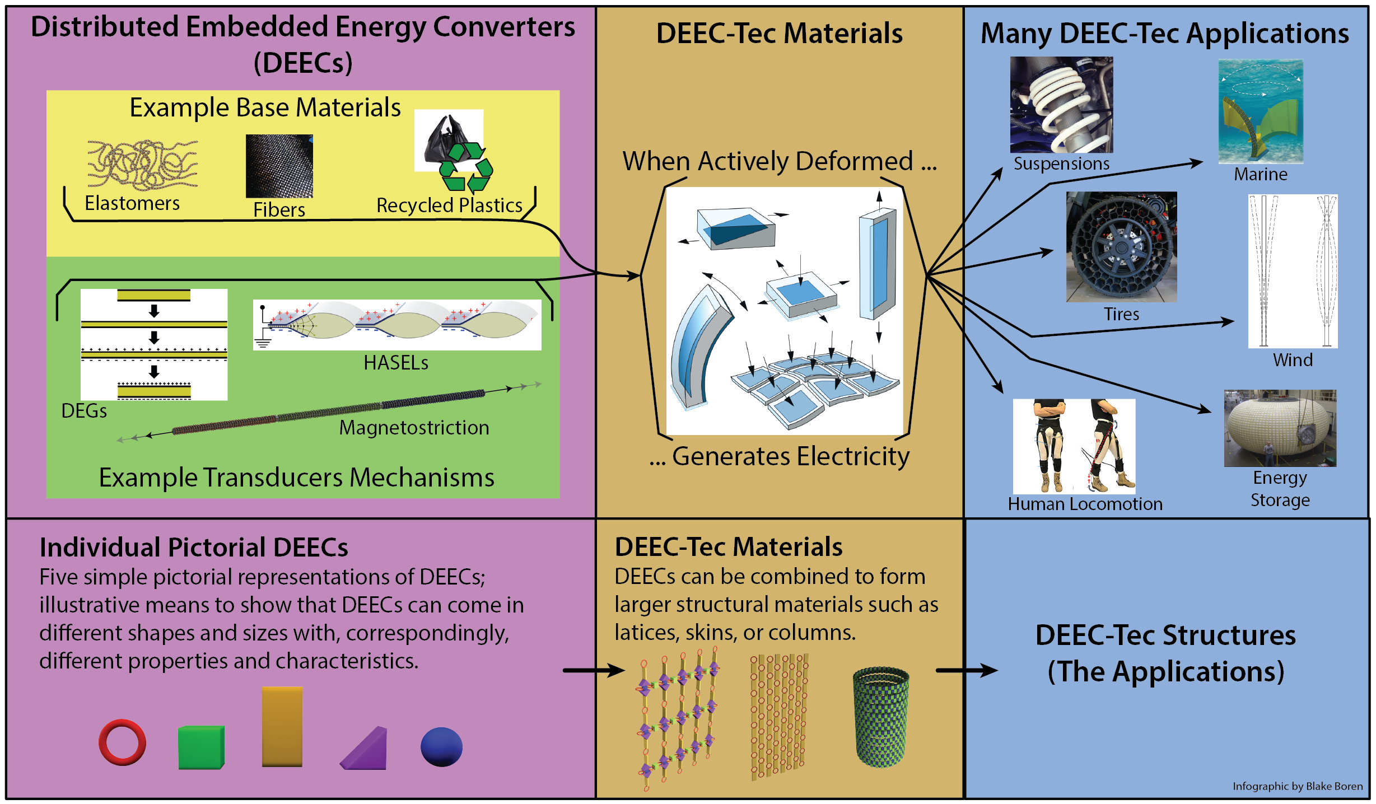
DEEC-Tec: High-level View of Applications
Notes:
Presenter: Blake

Slide 27
Possible Metrics for Success
Longevity
Power Density Per Wave Period
Ease of Manufacture
Controllability; Ability to Actuate
Sustainability
Ease of System Integration

Slide 28
Marine Energy – Concentrated to Distributed
Creating a Paradigm Shift in Innovation
Concentrated Energy Conversion
Conventional Technology Approach
Extensively explored Solution Space
Distributed Energy Conversion
Innovative Technology Approach
Underexplored Solution Space
Notes:
Blake
Don’t be specific about companies, per se…just point out that there is a lot of underexplored space in the DEEC-Tec side of things.

Slide 29
Wave Energy Scotland—Direct Generation
Notes:
Carrie

Slide 30
Direct Generation
Jonathan Hodges & Ieuan Collins
InDEEP Webinar
Notes:
Jonathan

Slide 31
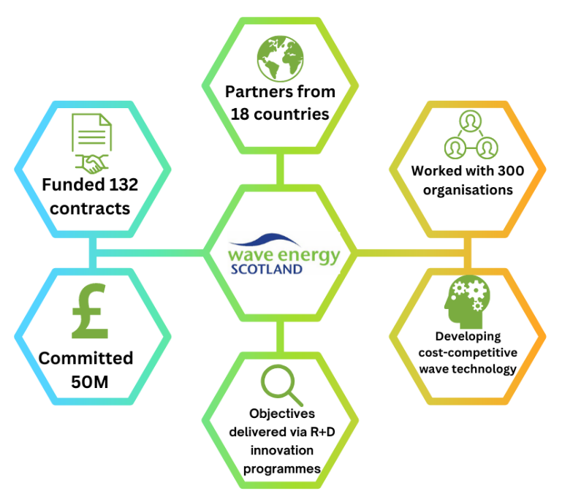
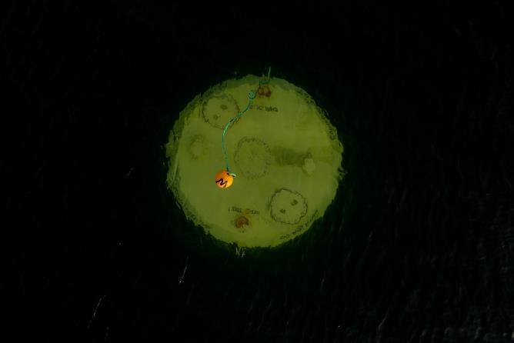
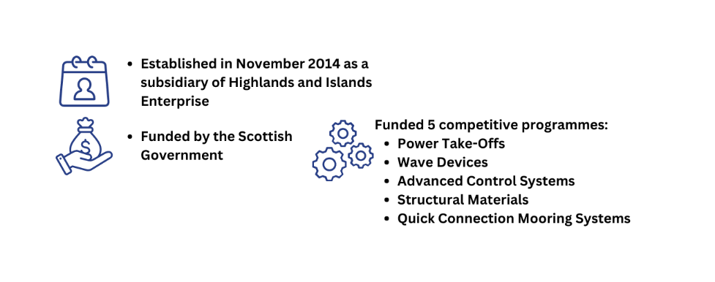
Wave Energy Scotland Introduction
Notes:
Jonathan

Slide 32

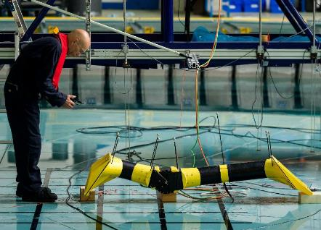
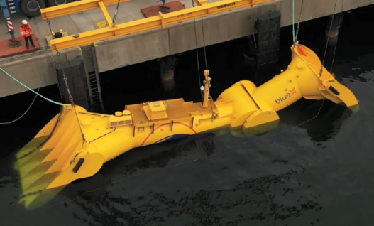
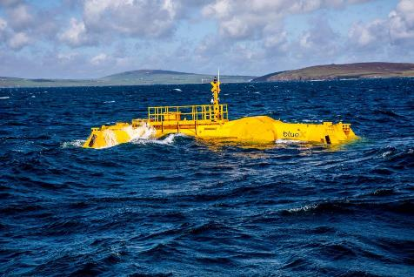
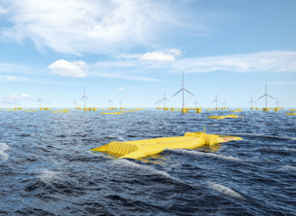
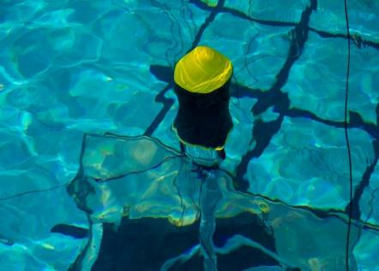
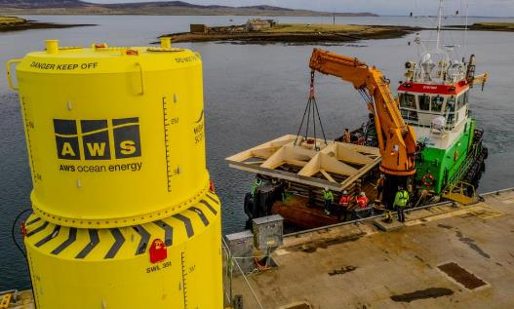
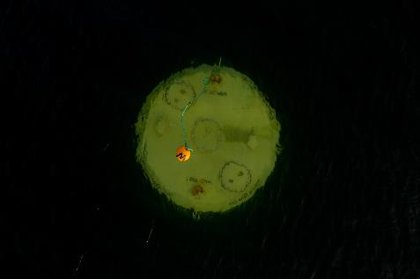
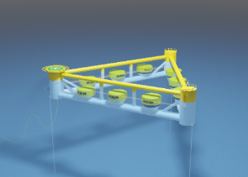

Technology Development & Innovation
Concept development
Large-scale demonstration
Proof-of-concept testing
Commercialisation
Enabling and supporting technologies
Notes:
Jonathan

Slide 33
Programmes Overview
2015
2016
2017
2018
2019
2020
2021
2022
2023
Power Take-Offs
Call
PTO 1
SG
Today
DEG
PTO 2
SG
DEG
PTO 3
Call
NWEC 1
SG
Novel Wave Energy Converters
Flex
NWEC 2
SG
Flex
NWEC 3
Structural Materials
Call
Materials 1
Flex
SG
Materials 2
SG
Flex
Materials 3
Flex
Control Systems
Call
CS1
SG
DEG
CS 2
SG
CS3
Quick Connection Systems
Call
QC 1
SG
QC 2
SG
QC 3
Europe Wave
Call
EW 1
PG
EW 2
PG
Notes:
Jonathan

Slide 34
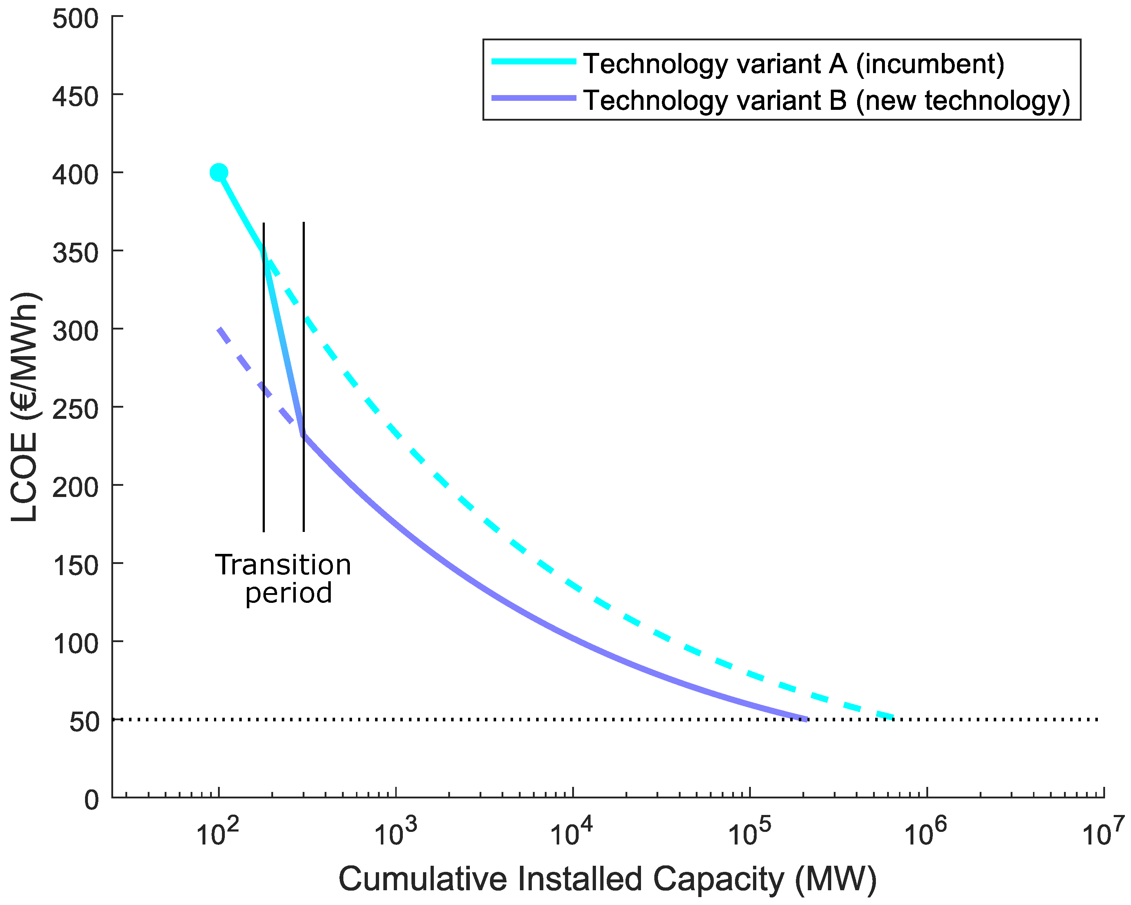
Radical Innovation
Enables
  Step change LCOE
  Higher learning rates
  Reduced learning investment
Longer-term cost reduction potential
Kerr, P.; Noble, D.R.; Hodges, J.; Jeffrey, H. Implementing Radical Innovation in Renewable Energy Experience Curves. Energies 2021, 14, 2364. https://doi.org/10.3390/en14092364
Notes:
Jonathan

Slide 35


Seeking Radical Innovation
Frazer-Nash Landscaping Study – “Alternative Generation”
Project SEAWEED – “what-if xxxx were possible?”
Paul Kerr - University of Edinburgh PhD Candidate
  “Radical innovation for the wave energy sector, an investigation of the potential of direct conversion as an enabling technology”
Alternative Generation down selection:
  Dielectric Elastomer Generators (DEGs)
  Dielectric Fluid Generators (DFGs)
Direct generation processes:
  Variable capacitance process
  Electrostatic energy transformation
Notes:
Jonathan

Slide 36
Collaboration – Scotland & USA
Varied topics
  Evaluation techniques
  Technology development guidance
  Structured innovation methods including concept design
  Radical innovation in power conversion technology
Benefits
  Ability to cover a wider scope
  Compare and contrast different approaches
  Knowledge sharing leading to mutual benefit
  Avoidance of repetition in funding activities
Notes:
Jonathan

Slide 37
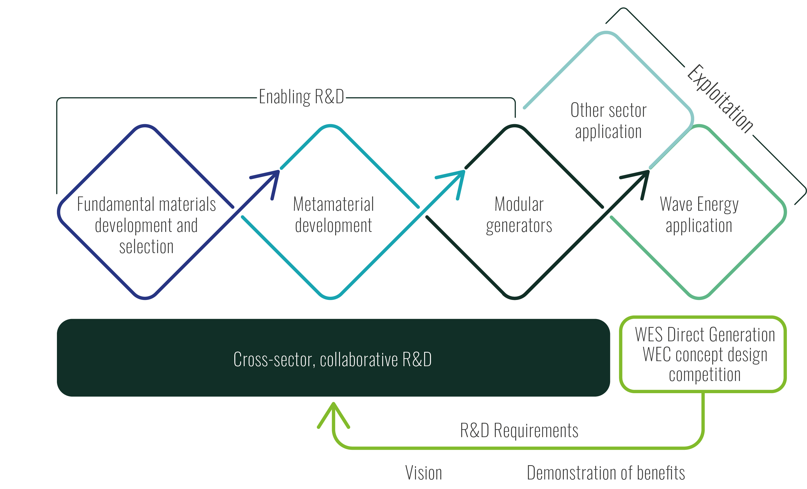

















WES Strategy
2 Postdocs and a PhD
Round 1 Complete
Notes:
Ieuan
How has WES sought to investigate DG?
WES strategy has been to use a design competition:
- Demonstrate the benefits and feasibility,
- Inform and guide a cross-sector R&D program
- Rd1 finished in Feb and Rd2 commenced in June.
SuperGen projects started at the beginning of the summer and a PhD is set to start in September
We are now at stage where we’ve filled in some of these blocks of this diagram with a healthy cohort of developers, manufacturers and academics focussed on investigating DG

Slide 38
Outcomes of Round 1 DG Design Competition
Vision of concept
Wave energy converter concepts based specifically on direct generation technologies
Design and Evaluation Process
Repeatable design and evaluation feedback loop processes
Community of expertise
Knowledge and expertise in wave energy, elastomers and electrostatic energy generation
Enabling R&D
Increased clarity on the priority R&D requirements associated with DG technologies
Notes:
Ieuan
To summarise the outcomes on round 1:
- Developed a community of expertise with knowledge in both wave energy and electrostatic energy generation
- We have a much better idea on what is possible with DG technologies with hard numbers to backup designs
- In terms of enabling r&d, an increased clarity on the r&d requirements for dgs and how this feeds into the cross-sector r&d programme
- We have clearer idea on how to evaluate these technologies and ensure we are realising all the benefits unique to dg to drive the technology forwards in the right direction.

Slide 39
Outcomes of Round 1 DG Design Competition
Vision of concept
Wave energy converter concepts based specifically on direct generation technologies
Design and Evaluation Process
Repeatable design and evaluation feedback loop processes
Community of expertise
Knowledge and expertise in wave energy, elastomers and electrostatic energy generation
Enabling R&D
Increased clarity on the priority R&D requirements associated with DG technologies
Conclusions
Potential in the application of DG technology in wave energy
Still not sufficiently mature for a full-scale DG WEC development process
Further enabling R&D is required to deliver that maturity, readiness, evidence and confidence.
Notes:
Ieuan
DG shows great promise in wave energy, however we are still at too low a technology readiness level for full-scale DG WEC development
We have a better understanding of the R&D resulting in
Research agenda
Evaluation and guidance framework
Further R&D is required to get to the point of maturity, readiness, evidence and confidence.

Slide 40
Programme timeline development
Jan 2024 | 2025 | 2026 | 2027
When are we ready?
Round 1 Concept Design Projects
Round 2 Concept Design Projects
WES DG WEC development
WES DG Module development
Supergen FlexFund DG metamaterial/module
Drive cross-sector, collaborative, enabling R&D
Notes:
Ieuan
In terms of a timeline,
We have finished round 1, with the supergen projects just starting which is feeding into out cross-sector, collaborative r&d programme
We want to get to point of large-scale WEC development but we are not level of maturity to do that currently
Therefore we need a project which bridges this gap which is the round 2 concept design competition

Slide 41

Project Teams
R&D Projects
Origami DFG
Stretchable electrode DEG
DEG/ DFG electromechanical fatigue
‘Eliminated’ team partners potentially plays a new role in collaborating with Round 2 teams or cross-sector R&D
Round 1
4c Engineering
TTI Marine Renewables
AWS Ocean Energy
Southampton and UTC
WaveX
2 DEGs October 2023-February 2024
1 DFGs £50k each
2 Both
Project Lead
Knowledge exchange
Round 2
4c Engineering
TTI Marine Renewables
1 DEG June 2024-March 2025
1 DFG £200k each
Project Lead
Other partners TBC
Notes:
Ieuan
An overview of the project teams so far:
5 project teams in Rd1, lasting 14 weeks with a budget of £50k each
Evaluation in Feb, Rd2 invited teams from Rd1 to apply with 4cE and TTI being the successful applicants
Higher budget of £200k each over 9 month period, commencing in June
Alongside the competition, start of FlexFund R&D projects which will aim to be exchange of information between Rd2 and R&D projects
Ideally, we don’t want to lose all the Rd1 cohort of expertise, so we are quietly encouraging involvement in either Rd2 or R&D projects.

Slide 42

Supporting R&D Project Summaries
DFG
DEG
University of Manchester (Postdoc)
Aim: To develop a flexible electrode solution and overcome the limitations of bonded elastomer electrodes, i.e., delamination, non-flexibility etc.
Plan: Layer-to-layer decomposition of conductive elastomer nanocomposites. Down-selection of silicone-based elastomers using mechanical and electro-mechanical tests. Deposition of carbon nanotubes.
University of Oxford (Postdoc)
Aim: To develop a DFG module utilising origami-inspired structures, enabling for electrodes to experience only rigid-body motion
Plan: Design mock-ups to make a desktop demonstrator illustrating the deformation modes of a unit cell. Modelling of unit cells to allow for an understanding of the capacitance change, informing the design decisions.
Swansea University (PhD)
Aim: Investigate the electro-mechanical fatigue of DEG and DFG units along with synthesis of materials with conductive fillers.
Plan: Comprehensive experimental campaign involving material optimisation, biaxial fatigue with electrical properties measured before and after. Develop 3D printed DEG/DFG metamaterial concepts based on the findings from the experimental characterisation study.
Notes:
Ieuan

Slide 43
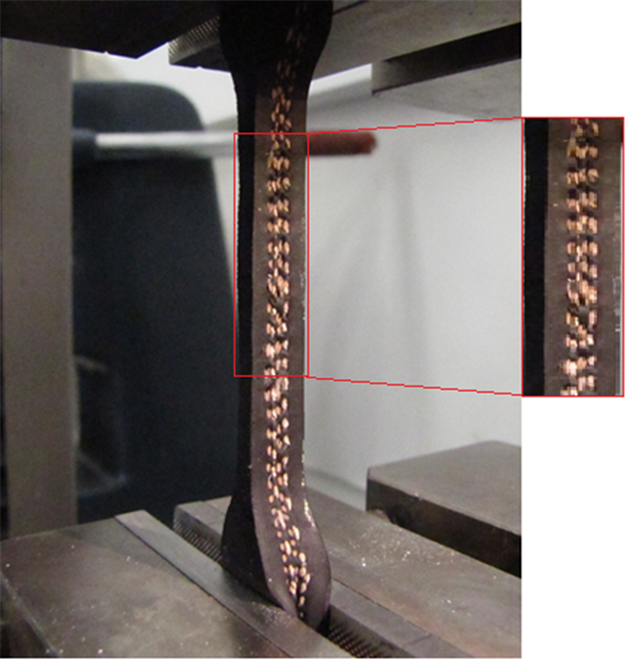
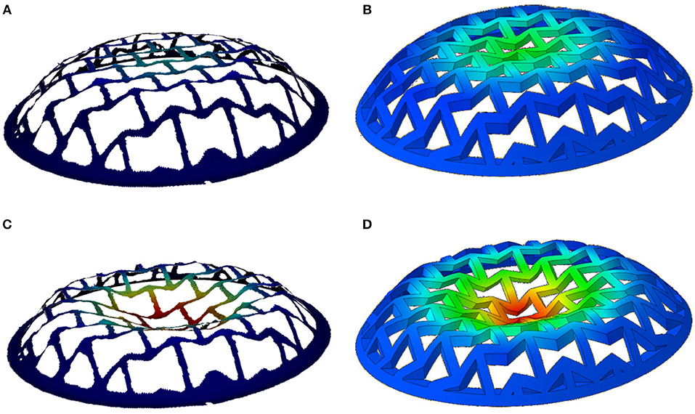

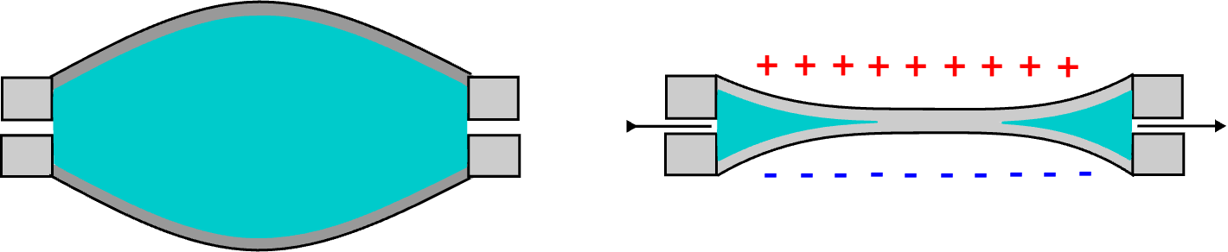
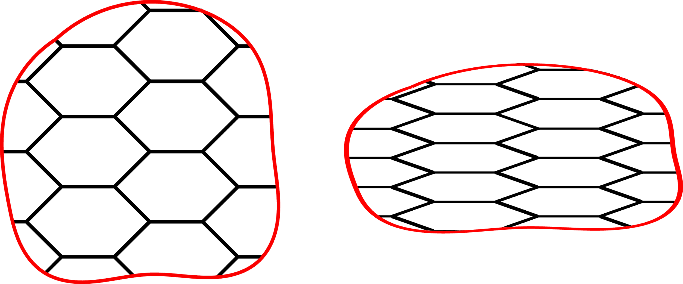
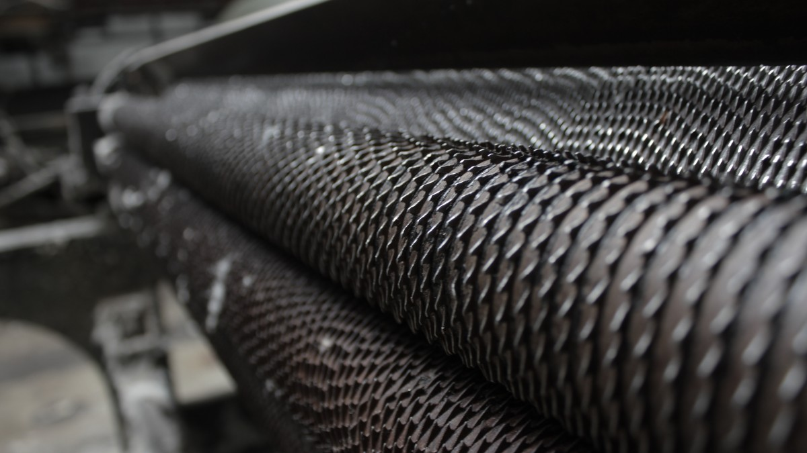
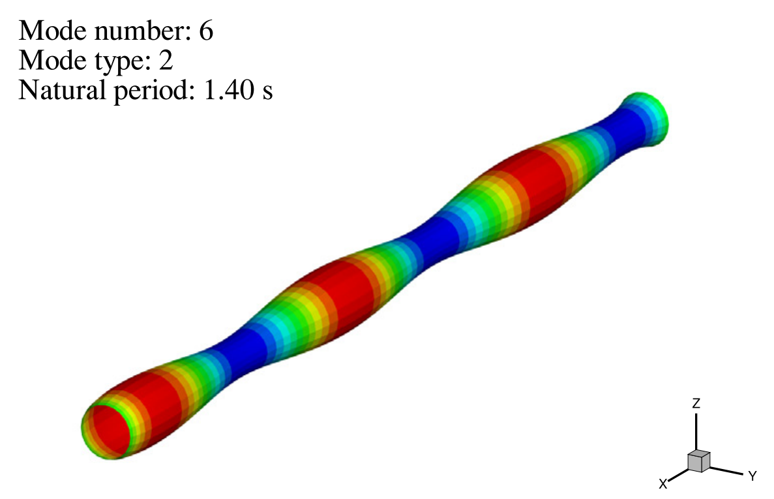
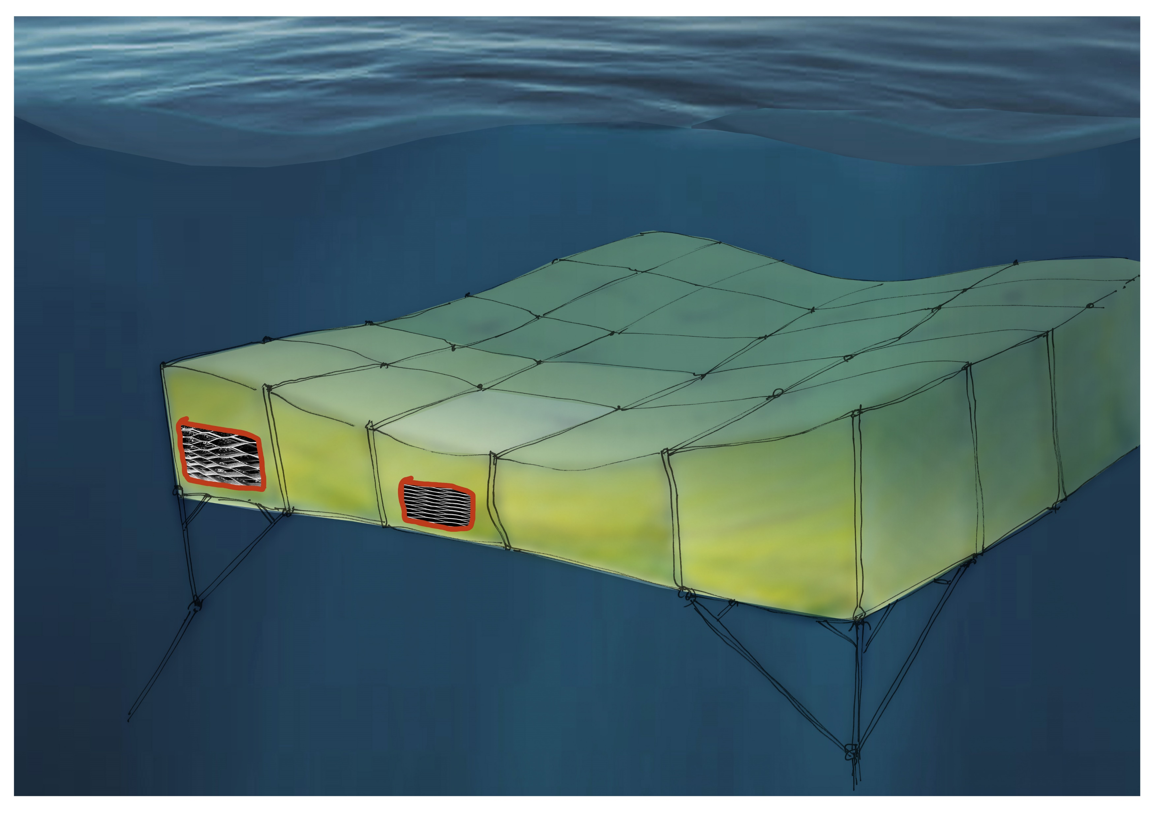
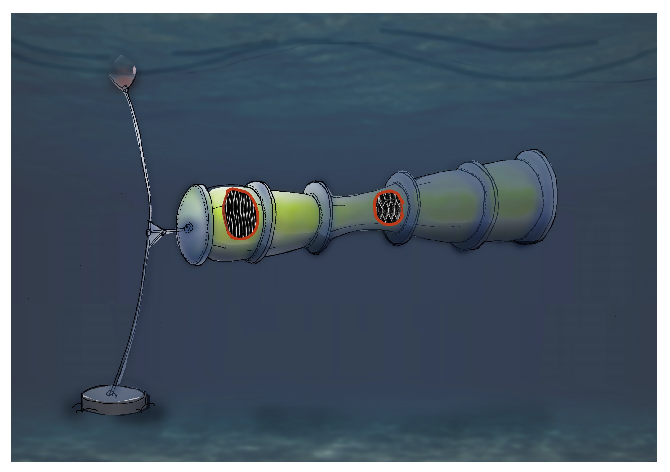
Outputs: R&D Agenda
Scale (m)
10⁻¹
DEG/DFG
10⁰
Cellular Metamaterial
10¹
Wave Energy Converter
Notes:
Ieuan
Summarised all the findings of the projects in an R&D agenda which is largely broken down into 4 different themes:
Material/metamaterial characterisation
Module design and development
Manufacturing and process integration development
WEC architecture development
Within each of these areas there are a series of subtasks which need to be achieved. Currently monitoring the progress of our R&D portfolio and DG design competition

Slide 44
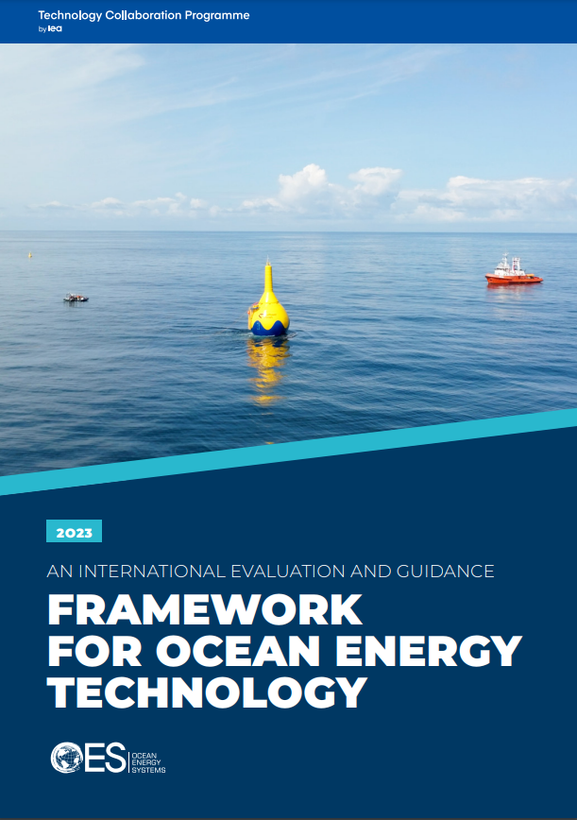
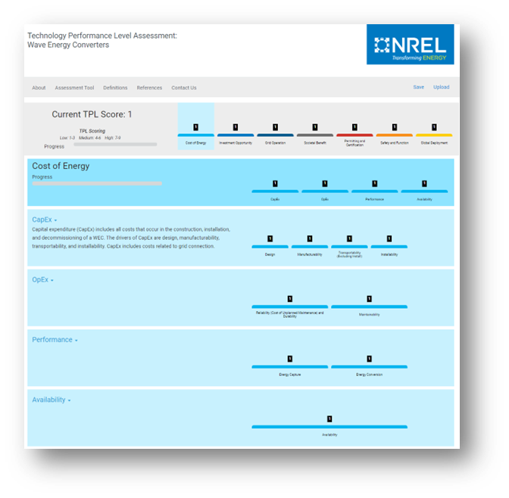
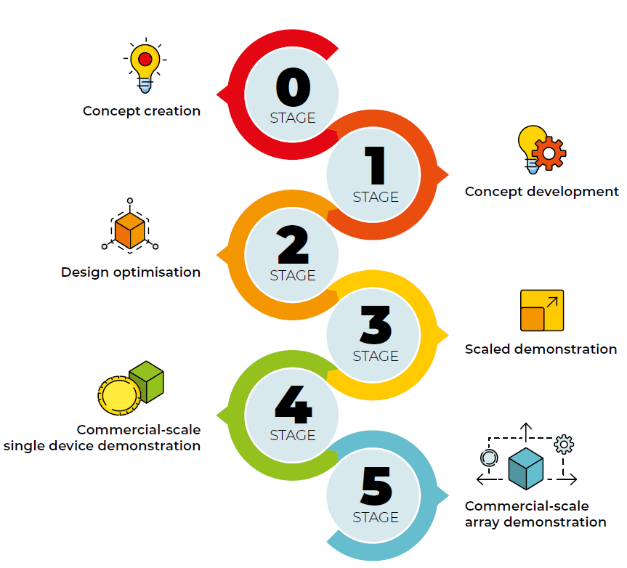
Outputs: Evaluation and Guidance
Direct Generation Evaluation Areas
Power Density
Mass
Spatial
Cost of Energy
Structural
Total
Longevity
Fatigue
Reliability
Survivability
Practicalities
Manufacturability
Deployability
Maintainability
Sustainability
Environmental Acceptability
Recyclability
Established evaluation frameworks (IEA-OES/TPL)
Our target evaluation area
Wide spectrum of questions that can be difficult to quantify at low TRL
Streamlined evaluation for Direct Generation
Easy to quantify metrics at low TRL
Evaluation framework which incentivises developers to realise all the benefits unique to Direct Generation, e.g.,
  Flexibility and foldability
  Modularity
  Self-healing capability
Notes:
Ieuan
IEA-OES covers all TRL for WEC development – but we are only interested in stage 0 and 1 for direct generation
TPL is a gamified qualitative approach
Wide spectrum of questions with large range of scoring – hard to quantify at this stage
We need a targeted set of streamlined metrics for direct generation
Optimised for low TRL where there is hard to access empirical data
It in incentivises developers to incorporate the unique benefits of flexible materials and distributed energy harvesters at a concept creation level
And ensures developers prioritsie the right metrics

Slide 45


Outputs: Evaluation and Guidance
Direct Generation Evaluation Areas
Power Density
Cost of Energy
Structural
Total
Longevity
Fatigue
Reliability
Survivability
Practicalities
Manufacturability
Deployability
Maintainability
Sustainability
Environmental Acceptability
Recyclability
Spatial
Mass
Combining metrics may result in good balancing across different aspects of design
Through-life energy density:
$$\frac{Power Generated during lifetime (MJ)}{Mass (kg)}$$
Power Density
Longevity
Finds a good compromise between power capture and operational life
Notes:
Ieuan
Combining metrics could allow for good balancing across different aspects of design
For example, maximising for power density may result in poor longevity, working out the power generated during lifetime over the density could find a good comprise between power capture and operational life

Slide 46
Thanks for listening

Slide 47
Questions and Answers
Notes:
Carrie

Slide 48
Wrap Up & What’s Next for InDEEP
Notes:
Carrie

Slide 49




Competitor Support Mechanisms
Provide us feedback in the webinar
Submission Feedback
Mentorship in Innovation Methods and TPL Assessment
Resources linked in Appendix C of the Rules Document
Notes:
Carrie

Slide 50
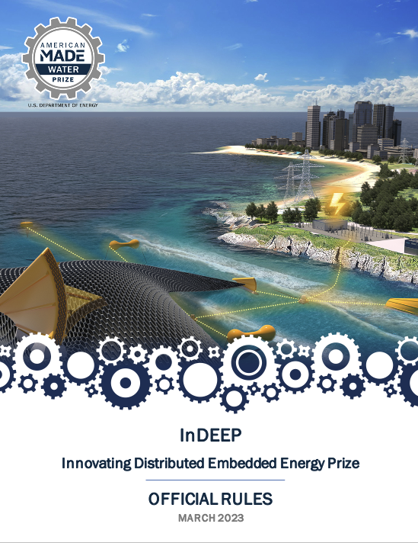
Read the Rules
For a more in-depth look at the prize overall where these topics will be applied, please read the rules document, available here:
https://americanmadechallenges.org/challenges/indeep/docs/InDEEP-Prize-Rules.pdf
SOLVER COMMUNITY
Notes:
Carrie

