Slide 1
Innovating Distributed Embedded Energy Prize (InDEEP)
Introduction to Wave Energy 3.0
August 27, 2024
Notes:
Bill

Slide 2
Webinar Logistics
Everyone is joined in listen-only mode
Audio Issues?—Try connecting over the phone
If that doesn’t work, visit the Zoom Help Center webpage
Q&A—Submit your questions using the chat box
Notes:
Brittany

Slide 3
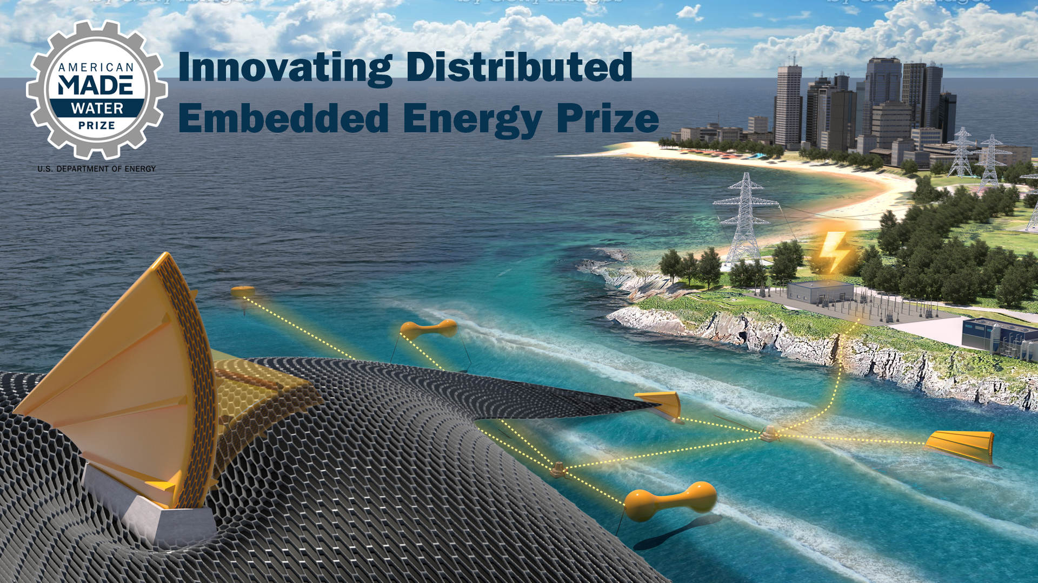
Innovating Distributed Embedded Energy Prize
$2.3M prize pool
Three phases over two years
Incentivize progress in early-stage research
Help solve technical challenges that could be applied to wave energy

Slide 4

Contributing to Leaderboard Scoring
For questions about the prize overall, view our recorded conversation on April 12
Participation in this webinar contributes to your final leaderboard score
Make sure to complete the Leaderboard Eligibility Form to receive points for your participation
If you haven’t done this yet, do so now: https://www.herox.com/indeep
WPTO’s desired outcome for InDEEP is an understanding of the landscape of innovators and
potential DEEC-Tec solutions that could be applied to wave energy devices.

Slide 5
Agenda 1.0
Agenda 2.0
Webinar 1. – April 26, 2023
Introductions
Ocean Waves
Wave Energy
Technology
Challenge & Motivation
Q&A
Webinar 2. – January 10, 2024
Introductions
Wave – Body Interaction
Wave Energy Conversion
Technology Development Methods
Technology Development History
Challenge & Motivation & Solution
Q&A

Slide 6
Introductions
Notes:
Brittany

Slide 7
Presented by
Jochem Weber, National Renewable Energy Laboratory (NREL)
Matt Folley, Applied Renewables Research (ARR)
Daniel, Gaebele, Sandia National Laboratories (SNL)
Notes:
Brittany

Slide 8
Agenda 1.0
Agenda 2.0
Agenda 3.0
Webinar 1. –
April 26, 2023
Introductions
Ocean Waves
Wave Energy
Technology
Challenge &
Motivation
Q&A
Webinar 2. –
January 10, 2024
Introductions
Wave – Body Interaction
Wave Energy Conversion
Technology Dev. Methods
Technology Dev. History
Challenge &
Motivation & Solution
Q&A
Webinar 3. –
August 27, 2024
Introductions
Wave – Energy – Conversion
Technology Dev. Methods
Challenge & Motivation & Solution
Tuning, Bandwidth, Constraints
Conversion Chain Control Co-Design
Overall Objective
Q&A

Slide 9
Ocean Waves

Slide 10
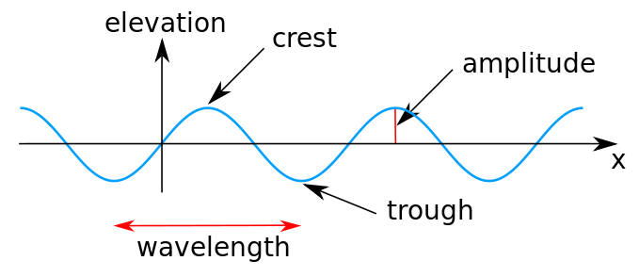
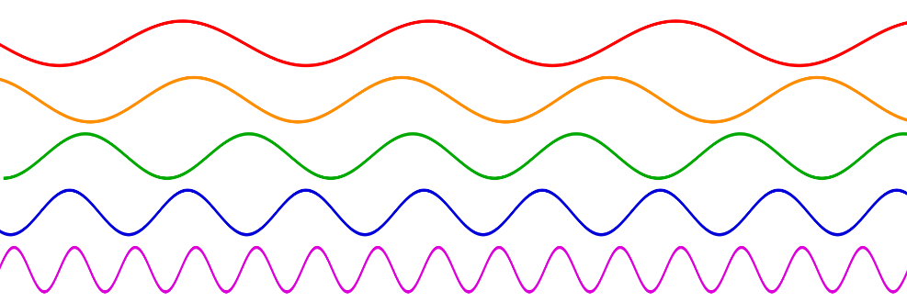
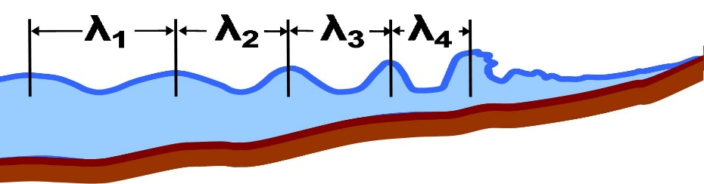
Ocean Waves – Key Geometric Parameters
wave height
"Sine wave amplitude" by Kraaiennest - Own work
Licensed under CC BY-SA 3.0 via Commons
"Sine waves different frequencies" LucasVB. . Own work assumed
.. Licensed under Public Domain via Commons
"Local wavelength" by Brews ohare - Own work
Licensed under CC BY-SA 3.0 via Commons

Slide 11
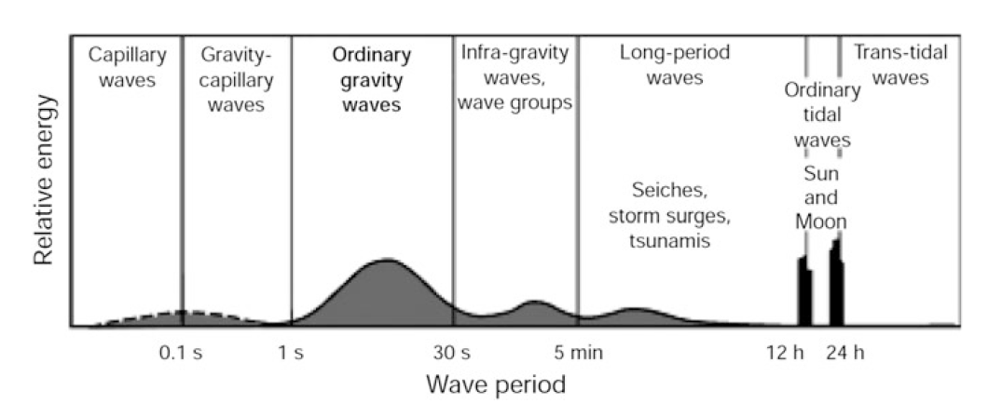
Ocean Waves – Key Temporal Parameter
Types of waves in the ocean by wave period
World Meteorological Organisation: Guide to wave analysis and forecasting (WMO 702), 2nd
edn. WMO (1998)

Slide 12
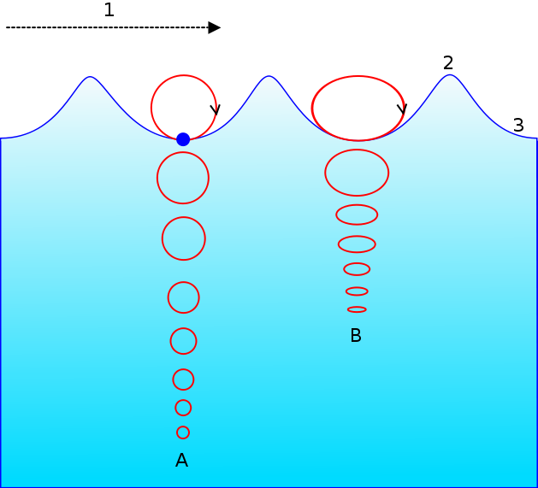
Ocean Waves – Visualization of Dynamics
Motion of a particle in an ocean wave.
A = At deep water.
B = At shallow water
1 = Propagation direction.
2 = Wave crest.
3 = Wave trough.
Wikipedia
"Wave motion-i18n-mod" by Original uploader was Vargklo at en.Wikipedia
Licensed under CC BY-SA 3.0 via Commons

Slide 13
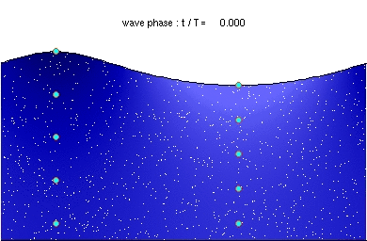
Ocean Waves – Visualization of Dynamics
“Deep water wave” by Kraaiennest – Own work.
Licensed under GFDL via Commons
Notes:
Brittany

Slide 14

Ocean Waves – Visualization of Dynamics
“Deep water wave” by Kraaiennest – Own work.
Licensed under GFDL via Commons
Notes:
Brittany

Slide 15
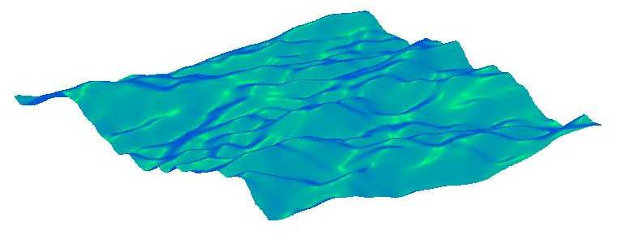
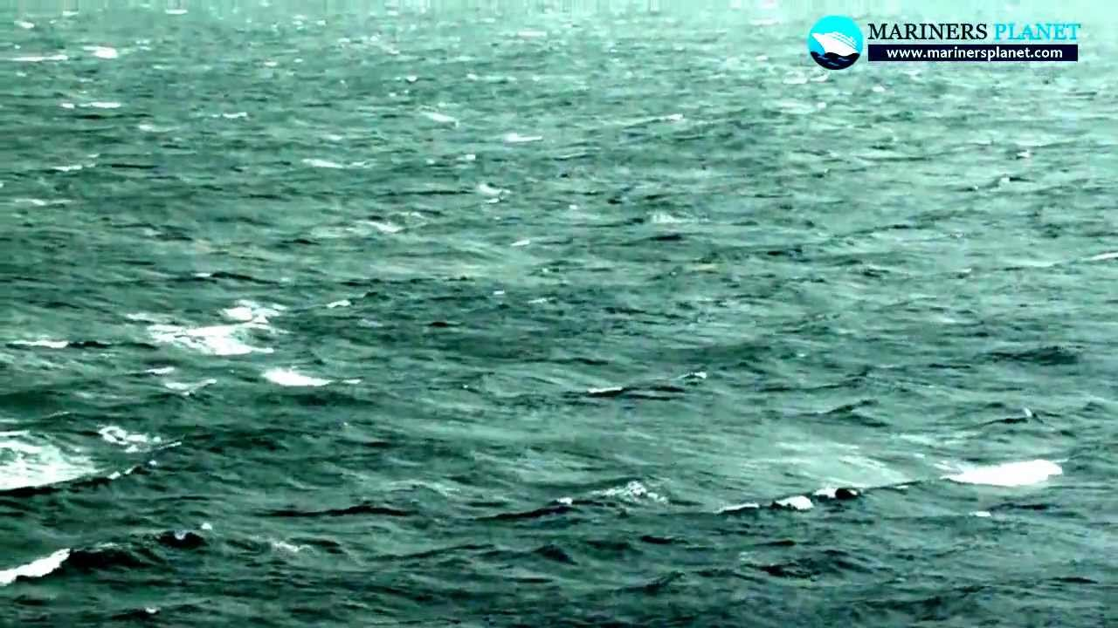
Ocean Waves – Three Dimensions
From WAFO

Slide 16
Wave Energy

Slide 17
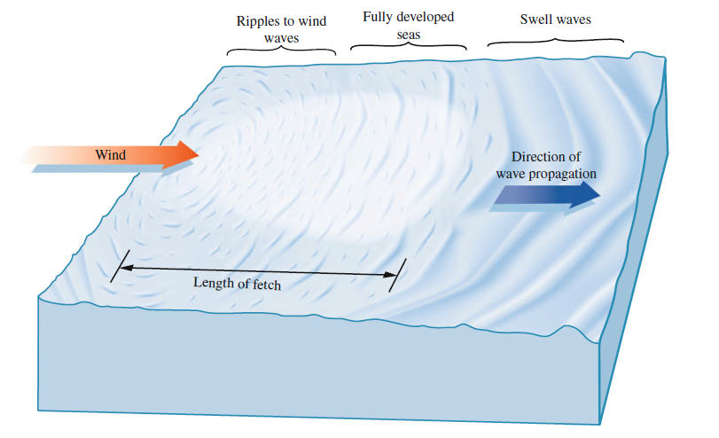
Wave Energy – Propagation
Energy Flux
[kW/m]
Incident Power
Garrison, T.S.: Oceanography: An Invitation to Marine Science, 7th edn. Brooks/Cole,
Belmont, USA (2010)

Slide 18
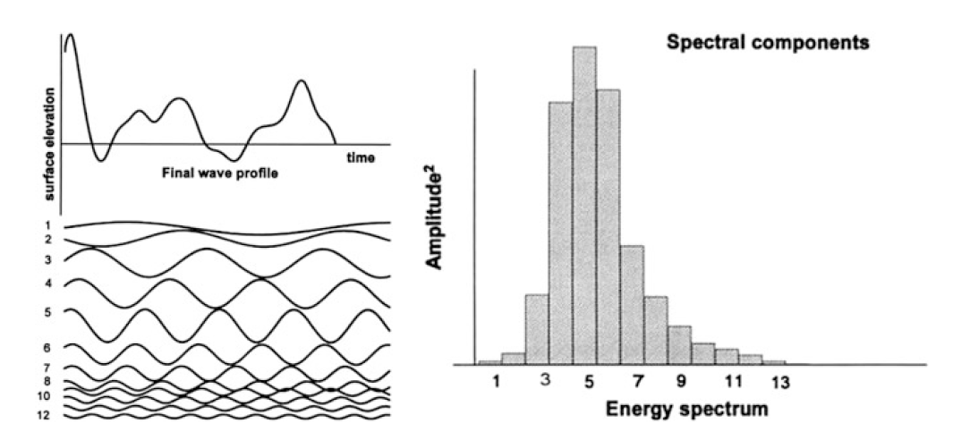
Wave Energy – Time and Frequency Domain
Super-positioning of waves (corresponding to spectral components) to create water
surface elevation (left) and the resulting spectrum (right)
Massel, S.R.: Ocean Surface Waves: Their Physics and Prediction, 2nd edn. World Scientific
Publishing, Singapore (2013)

Slide 19
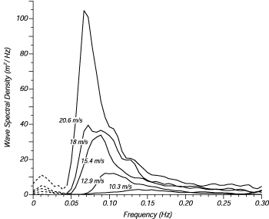
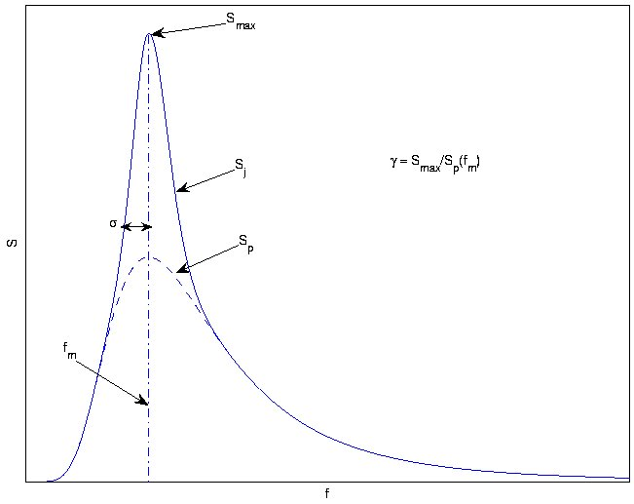
Wave Energy – Spectral Representation
Real spectra (left) and parameterized (right) spectral representation
(JONSWAP and Pierson-Moskowitz spectra) – defining sea states
https://wikiwaves.org/Ocean-Wave_Spectra

Slide 20
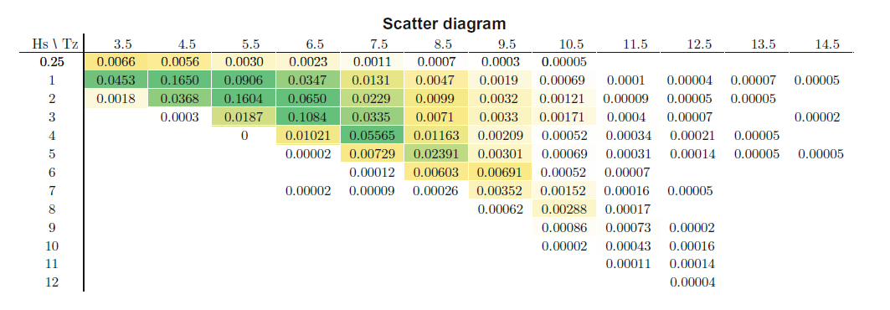
Wave Energy – Distribution of Spectra
Matt Folley

Slide 21
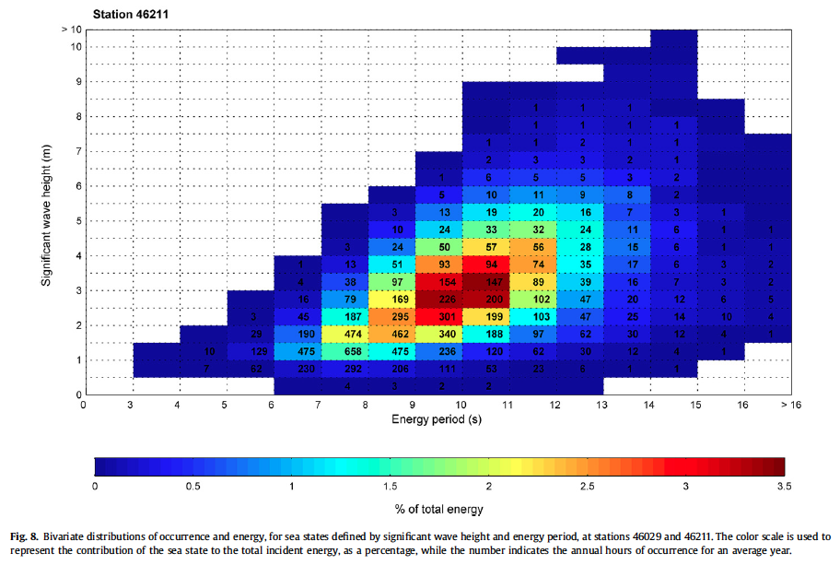
Wave Energy – Distribution of Spectra

Slide 22
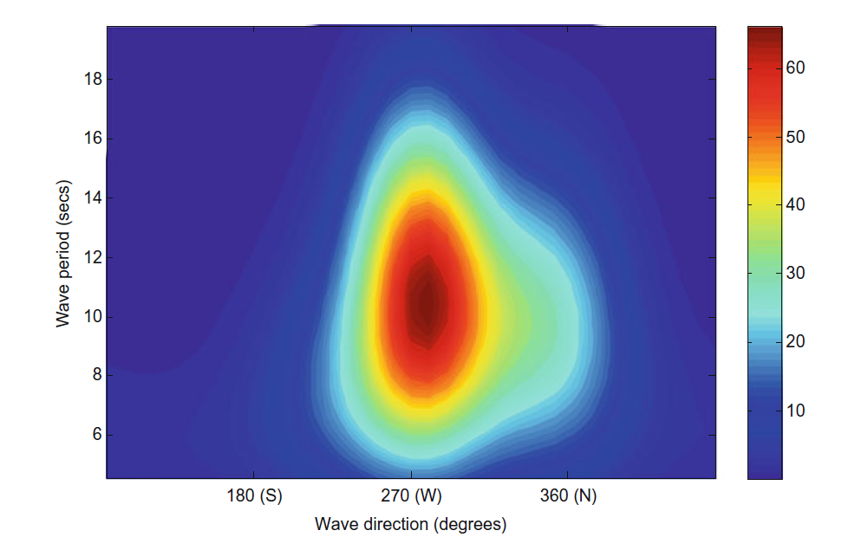
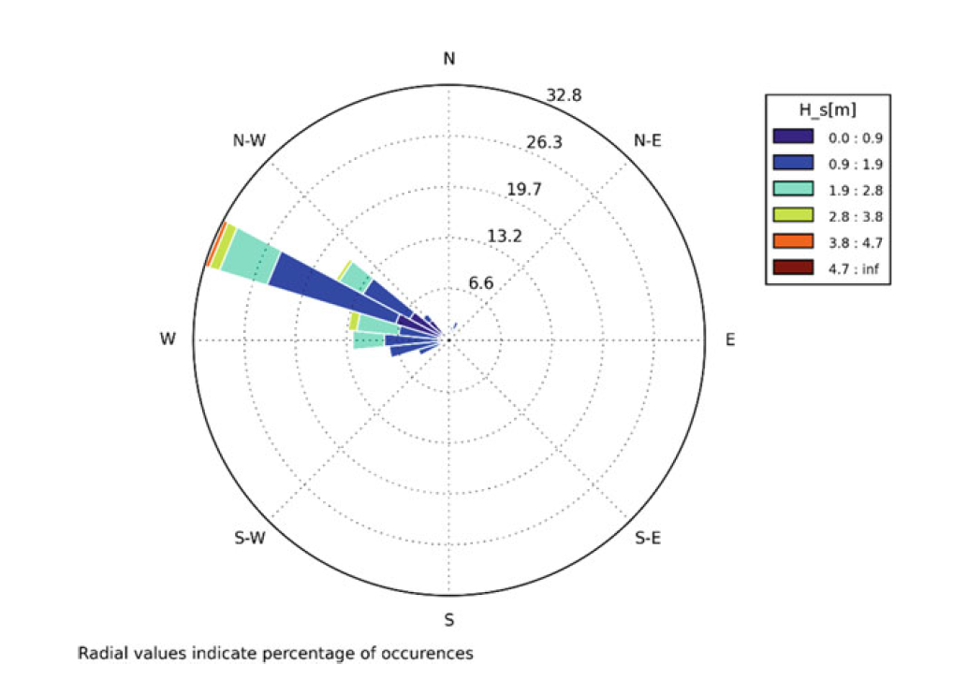
Wave Energy – Distribution of Orientation/Direction
Average directional spectral variance density (m2/Hz/rad) at the European Marine Energy, Centre, Orkney, Scotland
Matt Folley
Matt Folley

Slide 23
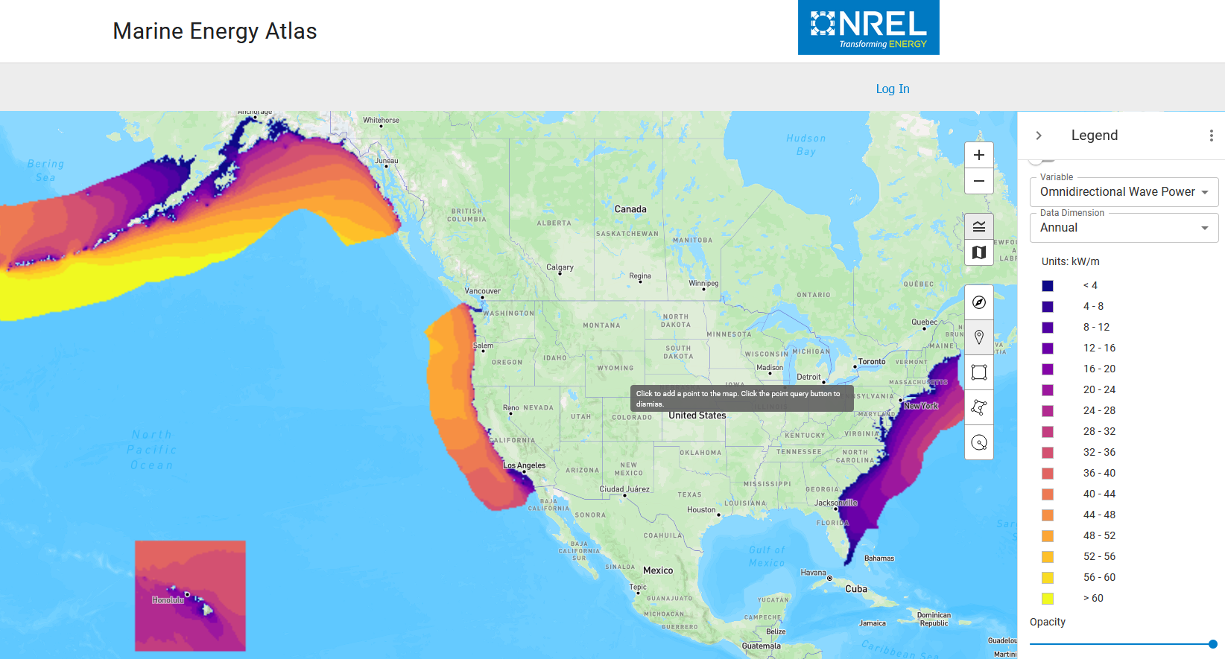
Wave Energy – Resource
https://maps.nrel.gov/marine-energy-atlas/

Slide 24

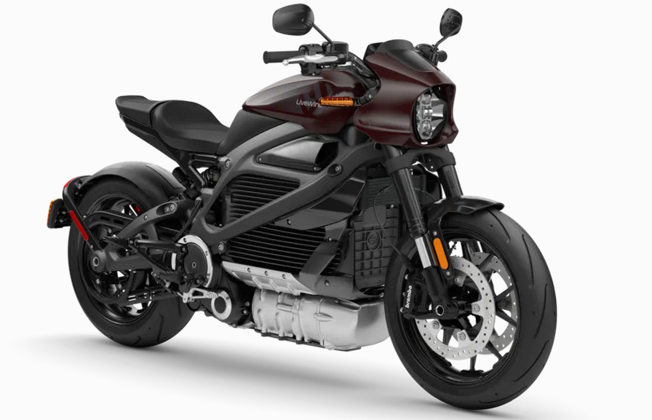
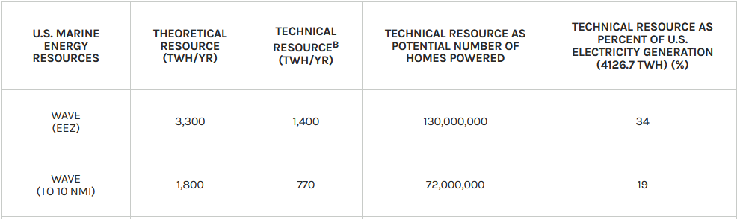
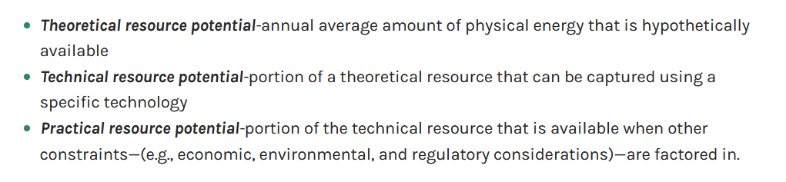
Wave Energy – Resource
33 kW/m =
/(2 m)
https://maps.nrel.gov/marine-energy-atlas/

Slide 25
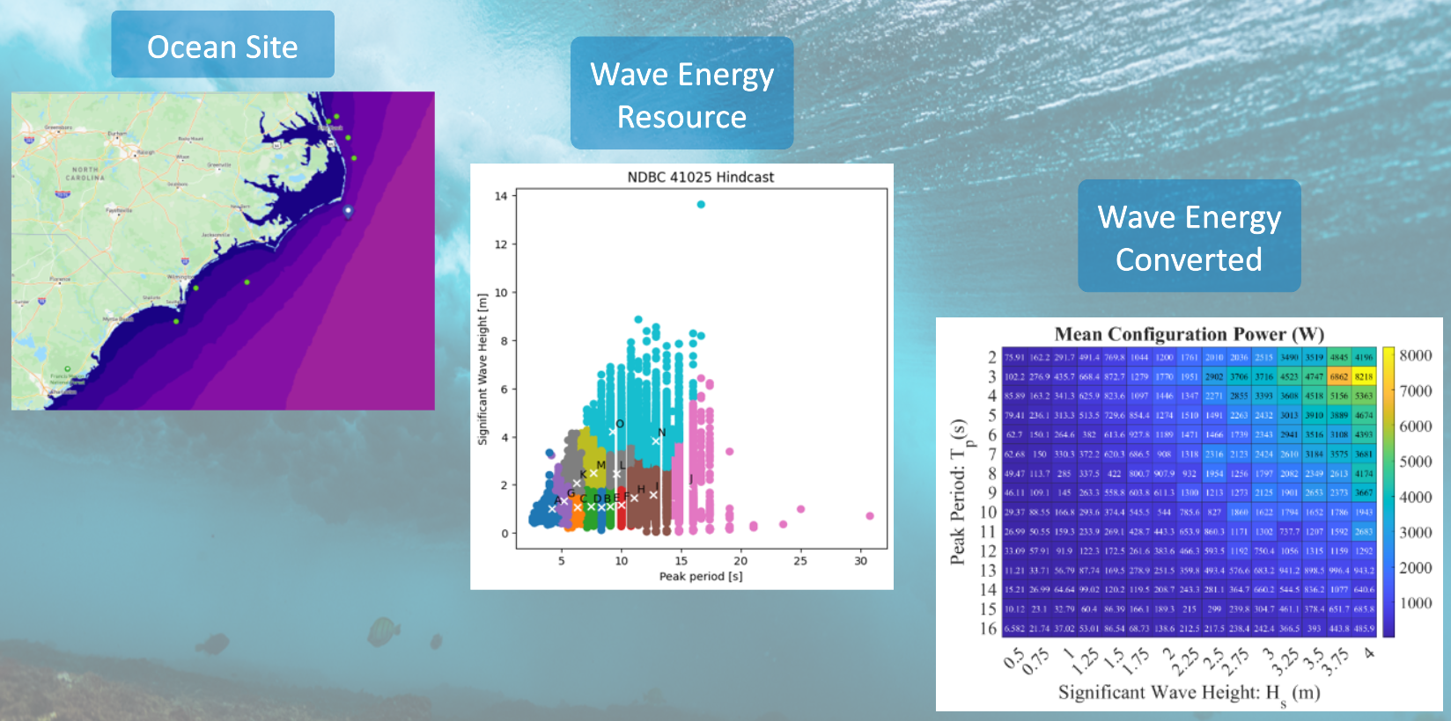
From Wave Power to Power Matrix

Slide 26
Wave – Body Interaction

Slide 27
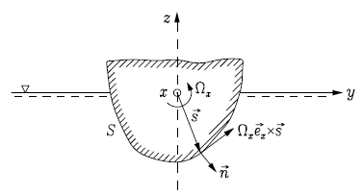
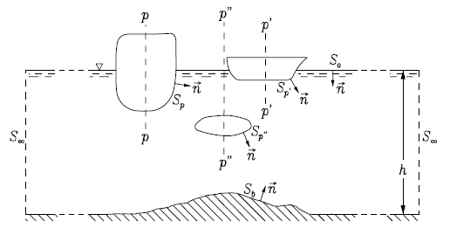
Forces on a Floating Body

Slide 28

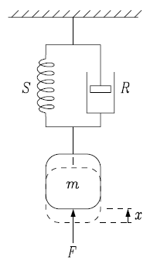
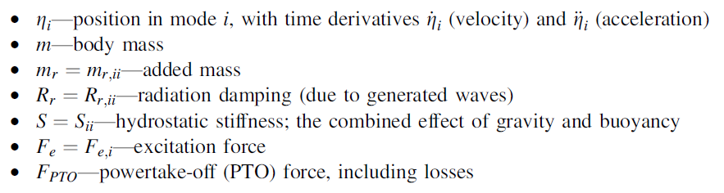
Forces on a Floating Body

Slide 29
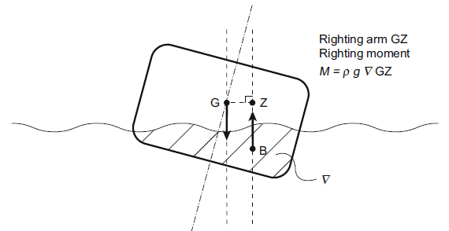
Hydrostatics – Restoring Force
Force as a Function of Displacement
Degrees of Freedom
  Heave – driven by water plane area
  Pitch – driven by water plane area, center of buoyancy and center of gravity
  Surge – Not occurring, neutral
Stability

Slide 30
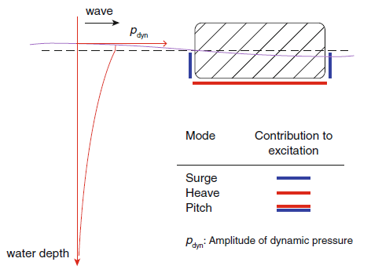
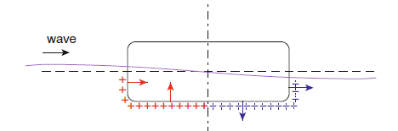
Wave Diffraction – Excitation Force
Force in the body due to the presence of the wave
Incident wave
  Froude Krylov Force
Scattered wave
Diffraction = Incident + scattered wave
  Excitation Force
Degrees of Freedom

Slide 31
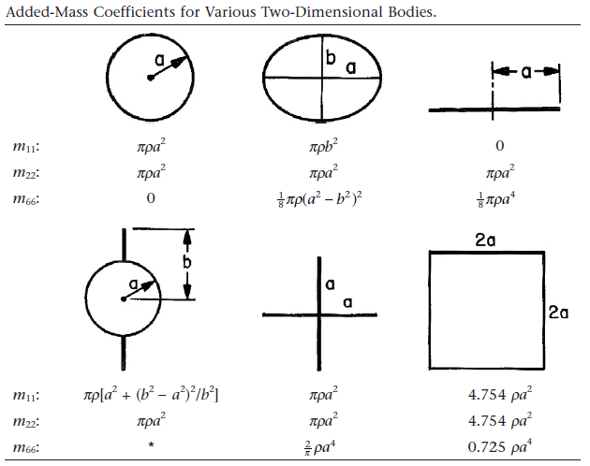
Added Mass – Hydrodynamic Inertia
Force as a function of acceleration
Represents the inertia of the accelerated water mass
Frequency independent when body is deeply submerged
Frequency dependent when body is near water surface
Cross coupling effects between different degrees of freedom
Cross coupling effects between degrees of freedom of different bodies
Newman, Marine Hydrodynamics, 1977

Slide 32
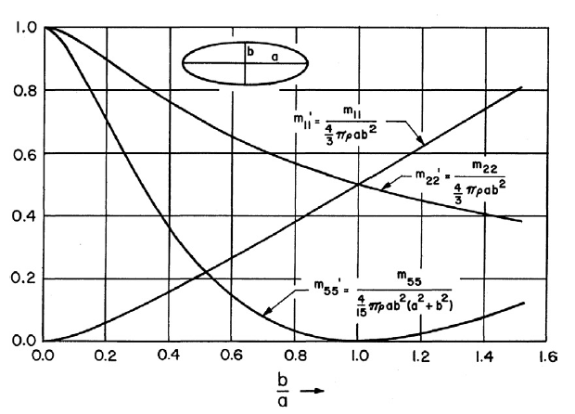
Added Mass – Hydrodynamic Inertia
Force as a function of acceleration
Represents the inertia of the accelerated water mass
Frequency independent when body is deeply submerged
Frequency dependent when body is near water surface
Cross coupling effects between different degrees of freedom
Cross coupling effects between degrees of freedom of different bodies
Newman, Marine Hydrodynamics, 1977

Slide 33
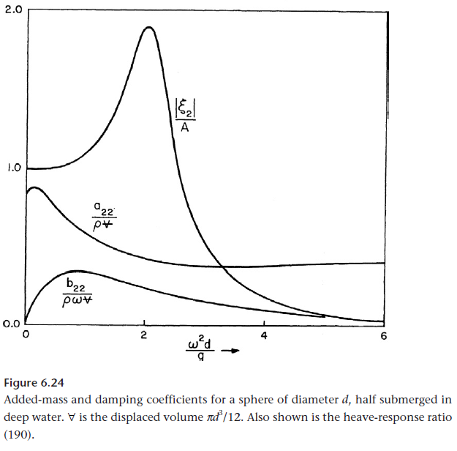
Wave Radiation – Hydrodynamic Damping
Force as a function of velocity
Represents the energy consuming damping due to the radiation of a wave
Frequency dependent
Zero when body is deeply submerged
Cross coupling effects between different degrees of freedom
Cross coupling effects between degrees of freedom of different bodies
Newman, Marine Hydrodynamics, 1977

Slide 34
Wave Energy Conversion

Slide 35
Energy Distribution
Single Mode Sea-State
Bi-Modal Sea-State

Slide 36
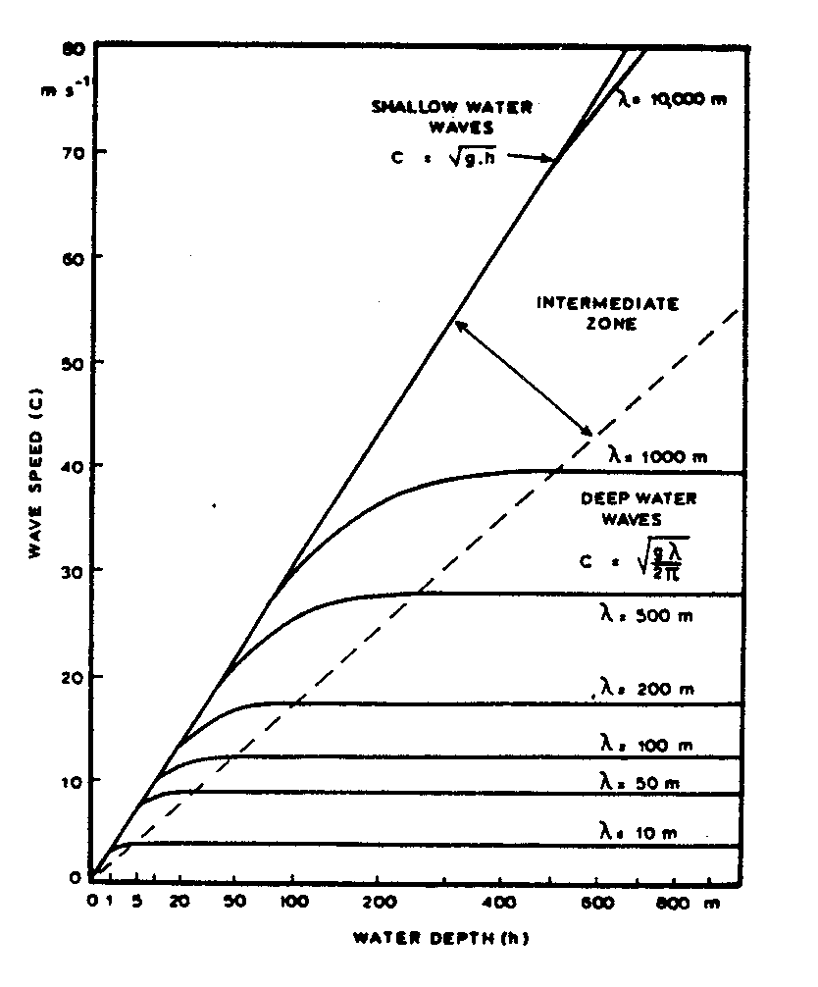
Ocean Wave Dynamics – Dispersion Relation
Quick explanation
Formular
Graph
Meaning
Ref: https://folk.ntnu.no/oivarn/hercules_ntnu/LWTcourse/indexA.htm

Slide 37
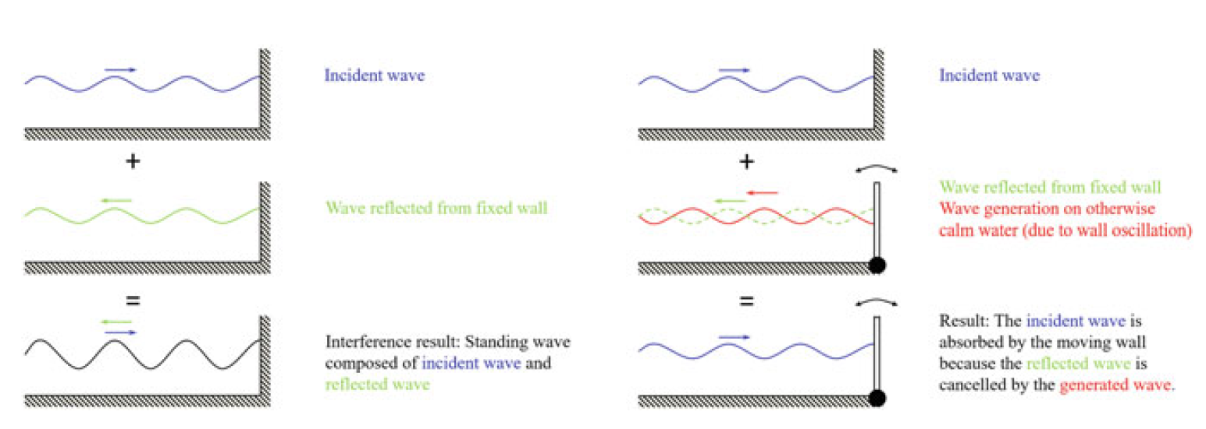
Wave Energy Absorption
Jorgen Hals

Slide 38
Power Takeoff – Damping & Restoring
Power Take-Off Functions
  Provide interaction with the wave absorbers to extract energy from ocean waves and convert to other secondary energy form (e.g., mechanical)
  Convert the secondary energy form to the desired energy form (e.g., electrical)
Power Take-Off Capabilities
  Energy conversion through damping force – in phase with velocity
  Energy storage through restoring force – in phase with displacement

Slide 39
Technology

Slide 40
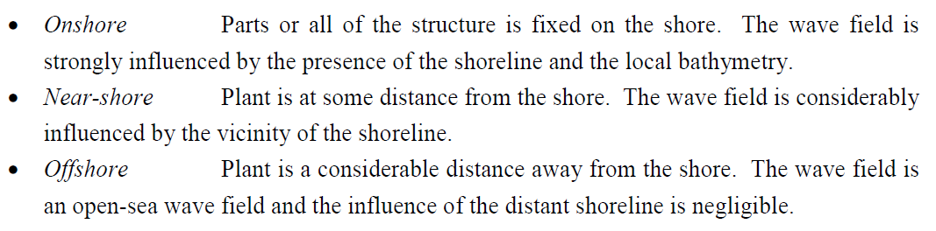
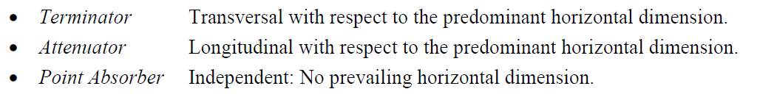
Technology – Concept Classification
Location
Orientation

Slide 41
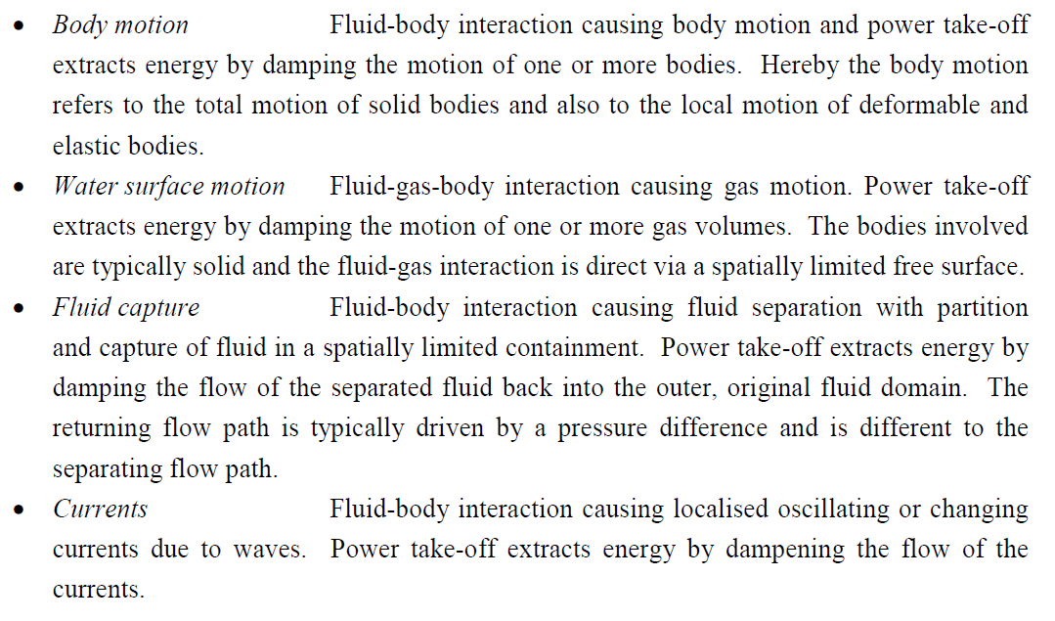
Technology – Concept Classification
Mechanism of Extraction

Slide 42
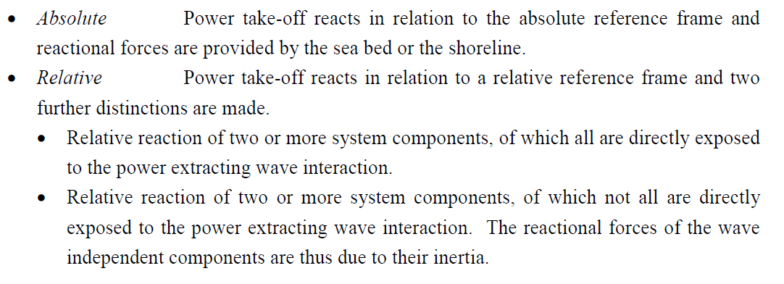
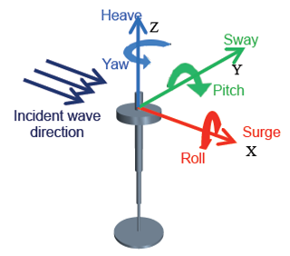
Technology – Concept Classification
Reactional Reference
Motion Degrees of Freedom in Coordinate System

Slide 43
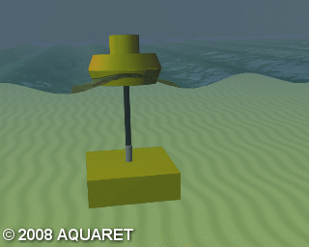
Technology – Concepts – Heaving Point Absorber

Slide 44
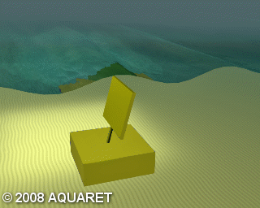
Technology – Concepts – Surging Bottom Hinged Flap

Slide 45
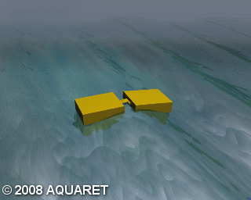
Technology – Concepts – Hinged Barges

Slide 46
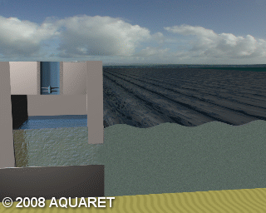
Technology – Concepts – Oscillating Water Column

Slide 47
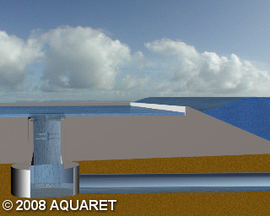
Technology – Concepts – Overtopping Device

Slide 48
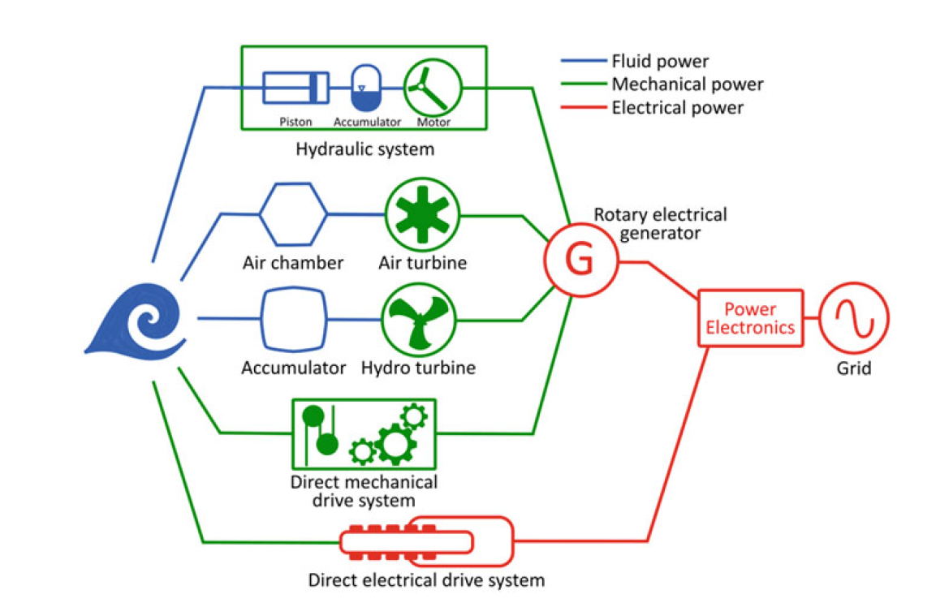
Technology – Energy Conversion Chain – Power Take-Off
Different paths for wave energy to electricity conversion
A. Têtu

Slide 49
Benchmark Studies

Slide 50
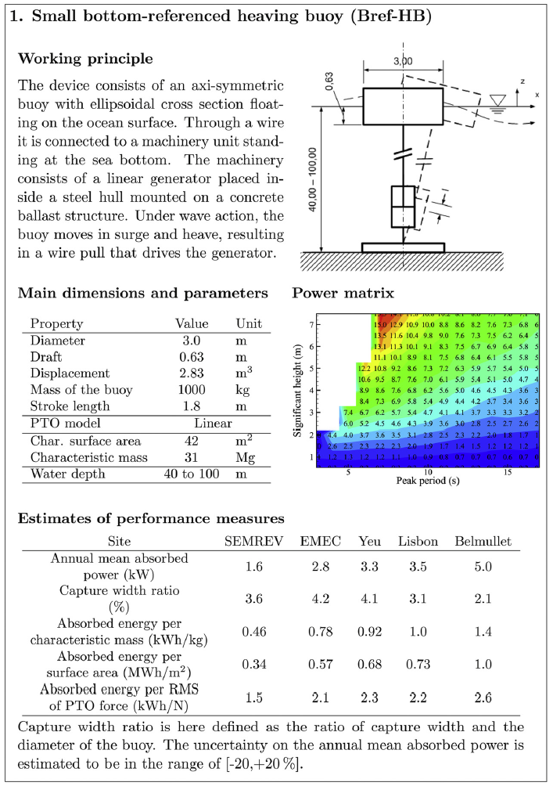
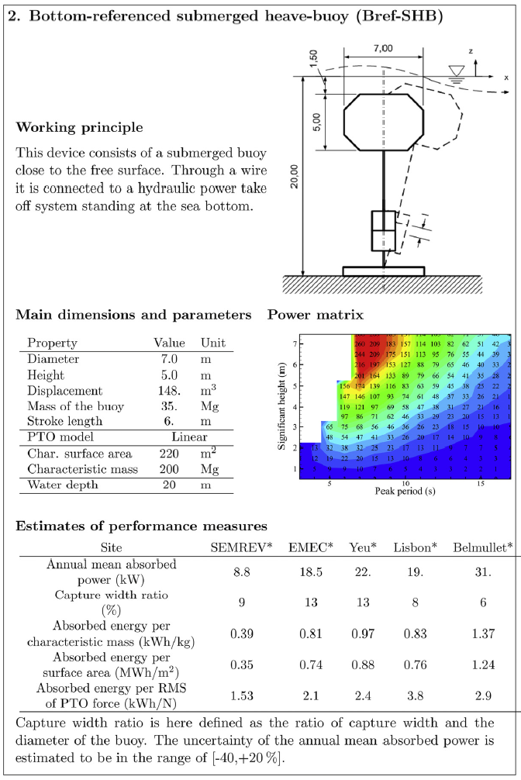
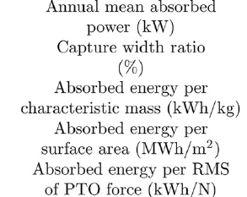
Wave Energy Absorption – Benchmark Study
Quantities of Interest
Performance Metrics

Slide 51
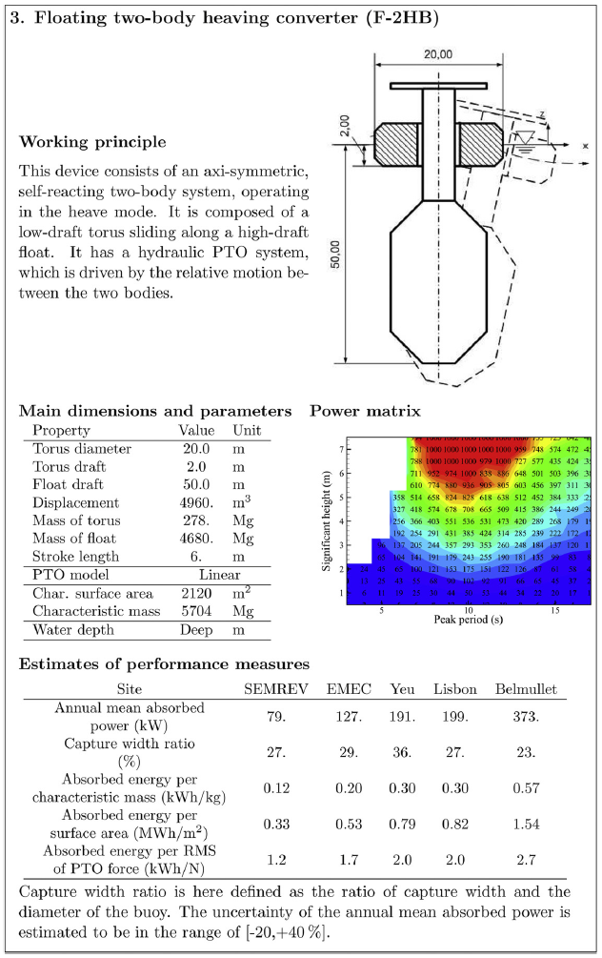
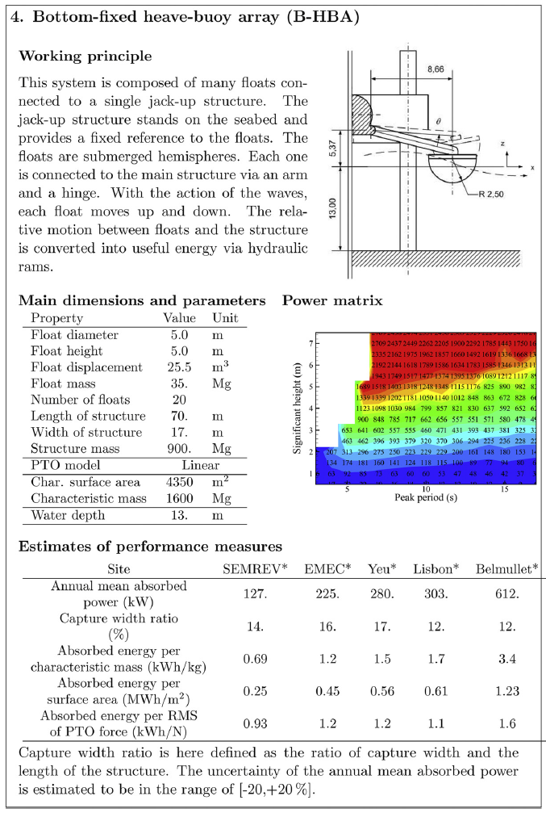

Wave Energy Absorption – Benchmark Study

Slide 52



Wave Energy Absorption – Benchmark Study

Slide 53

Wave Energy Absorption – Benchmark Study

Slide 54
Technology Development Methods

Slide 55




System Modelling and Simulation
Wide variety of system models and simulation tools to be selected for use case
More to come …

Slide 56



Wave Basin Testing and Validation
Fundamental Concept
Survival Testing
Advanced Control Testing
Sophisticated Direct Generation Power Take-Off
Power Absorption Code Validation

Slide 57



Bench and Laboratory Testing and Characterization

Slide 58


Open Water Demonstration – Test Sites
US: Hawaii & Pacific Coast
EU

Slide 59
Technology Development History

Slide 60


Early Developments
First patent is reported to have been filed as early as 1799 by Girard and since then patent numbers are well in the thousands
Early developments in the US include 1898 patent by Wright
First oscillating water column designed by Palme in 1920

Slide 61

Early Developments
First commercial application of wave energy:
In 1940s, Japanese inventor, Yoshio Masuda, lead substantial research and invented, designed and build floating of oscillating water column device to generate power for navigation buoys.
Commercialization in large numbers in Japan from 1965 and later in USA.

Slide 62



Oscillating Water Column Devices

Slide 63



Oscillating Water Column Devices

Slide 64



Oscillating Water Column Devices

Slide 65




Floating Oscillating Water Column Devices

Slide 66




Oscillating Water Column Devices Turbines

Slide 67


Salter Duck

Slide 68


Salter Duck
Survivability
Ref: Salter, S. Wave energy: Nostalgic Ramblings, future hopes and heretical suggestions. J. Ocean Eng. Mar. Energy 2, 399–428 (2016). https://doi.org/10.1007/s40722-016-0057-3

Slide 69



Salter Duck

Slide 70



Salter Duck … Weptos

Slide 71



Pelamis

Slide 72



Pelamis

Slide 73





Pelamis

Slide 74
Challenges & Motivation & Solutions

Slide 75

Technology – Development Challenges: Cost

Slide 76

Technology – Development Challenges: Risk

Slide 77

Technology – Development Challenges: Time

Slide 78

Technology – Development Challenges: Innovation

Slide 79
Challenges & Motivation & Solutions

Slide 80
Technological Evolution vs Intelligent Design
Technological Evolution
Intelligent Design
Wind Energy
Wave Energy
• Early convergence of concepts,
• Technical feasibility, industrial production and market opportunity at all and growing scales,
• Availability of technological knowhow & experience in theory, design, production & operation of very similar industrial applications,
• Cheap and easy access (onshore) to operating system, allowing gradual failure rate reduction during commercial operations.
• Large spectrum of different converter system concepts,
• Strongly decreased market opportunity at reduced scales,
• Limited transferability of technological experience, design, production and operation of similar industrial applications,
• Expensive and delayed access to operating system (offshore), prohibiting high failure rates from the onset of commercial operations.

Slide 81
Learnings, Methods and Tools to Solutions
Technology Development Strategy, Methods and Tools
  Development Protocols
  Cost, Time and Risk Reduction
Techno-Economic Assessment
Significant improvement in Modelling, Simulation of Dynamics, Loads and Stresses
System Optimization & Co-Design
Marine Operations Modelling
Novel Power Conversion Systems
Advanced Manufacturing Methods
Identification of Alternative Markets
  Blue Economy
  High Impact Applications
Design Paradigm Shifts

Slide 82





Technology – Possibility for Paradigm Shift?
Pelamis
SBM Offshore

Slide 83
Tuning Wave Energy Converters &
Design of Oscillating Wave Surge Converters

Slide 84
Developing Understanding
Tuning
Motion
Constraints
Natural
Bandwidth

Slide 85

Tuning
x5
Obtaining resonance is critical for good performance

Slide 86
Tuning and Motion Constraints
Increasing motion
constraints
Increasing motion
constraints
Motion constraints
for narrow-banded WEC
Motion constraints
for broad-banded WEC

Slide 87
Natural Bandwidth

Slide 88
WEC Control Value Matrix
Low
Heaving buoy
Increasing benefit
of advanced control
Constraint
OWSC
High
Wide
Narrow
Natural Bandwidth

Slide 89


Designing an Oscillating Wave Surge Converter
A preliminary investigation

Slide 90



Oyster 1

Slide 91



Oyster 800

Slide 92
Wave Torque
Torque
Velocity
Power

Slide 93
Effect of Water Depth

Slide 94
Effect of Water Depth

Slide 95
Effect of Water Depth

Slide 96
Effect of Water Depth

Slide 97
Effect of Flap Submergence
12.0 m

Slide 98
Effect of Flap Submergence
0.1 m
12.0 m

Slide 99
Effect of Flap Submergence
0.2 m
12.0 m

Slide 100
Effect of Flap Submergence
0.5 m
12.0 m

Slide 101
Effect of Water Width

Slide 102
Tuning
Torque
Velocity
Power

Slide 103
OSWC Tuning & Buoyancy
Flap submerged
12.0 m Water depth
3.0 m Hinge height
2.0 m Flap thickness
300 kg/m³ Flap density
10.0 sec Natural period
Flap surface-piercing

Slide 104
Effect of Tuning & Motion Constraints
Unconstrained
12.0 m wide submerged flap
7.4 m high flap
2.0 m thick flap
10.0 sec. natural period
1.0 m wave amplitude

Slide 105
Effect of Tuning & Motion Constraints
Constrained
12.0 m wide submerged flap
7.4 m high flap
2.0 m thick flap
10.0 sec. natural period
1.0 m wave amplitude
30 deg. max. rotation

Slide 106

OSWC Design Space - Tuned
Narrow surface-piercing flap
Small wave torque
Motion constrained
Wide submerged flap
Small wave torque
Motion constrained
Flap on a stalk
Large structural task
High buoyancy force

Slide 107
Untuned OWSC
18.0 m wide surface-piercing flap
2.0 m thick section
12.0 m water depth
Optimum damping
1.0 m wave amplitude
30 deg max. rotation

Slide 108
Tuned vs Untuned OSWCs
Tuned
Higher theoretical power capture
Untuned
Lower theoretical power capture
Complexity
Simplicity
High wave forces
High buoyancy forces

Slide 109
Alternative OWSC Configuration
How may this change our perspective?
Wave force
Motion constraints
Natural bandwidth
Tuning
Power capture

Slide 110
Conversion Chain Control Co-Design
Notes:
Brittany

Slide 111





System Optimization & Power Flows
“Classical” approach Falnes et. al, 1980s
Absorbed power
$$Z_{i}$$
$$v$$
$$+$$
Useful power
$$F_{e}$$
$$Z_{PTO}$$
Hydro-mechanical body
Power take off
Load (Controller)
losses

Slide 112






System Optimization & Power Flows
“Classical” approach Falnes et. al, 1980s
Power take off dynamics
Hydro-mechanical body
Load (Controller)
Expanded framework
losses
Power in
Power out
Bi-conjugate
impedance matching as framework for concurrent
PTO & control design
→ WEC control co-design
$$Z_{i}$$
$$v$$
$$Z_{PTO}$$
Impedance matching network
$$+$$
$$F_{e}$$
$$Z_{L}$$

Slide 113










System Optimization & Power Flows
$$Z_{i}$$
Impedance matching network
$$v$$
$$Z_{PTO}$$
$$+$$
$$Z_{L}$$
$$F_{e}$$
Power in
Power put
Wave-body interactions
Load

Slide 114













System Optimization & Power Flows
Load (Controller)
Load (Controller)
Input (well) matched
$$Z_{i}$$
Absorbed power
$$Z_{i}$$
Mech power
Elec power
$$v$$
$$v$$
$$Z_{PTO}$$
$$+$$
$$Z_{PTO}$$
$$+$$
$$Z_{L}$$
$$F_{e}$$
$$F_{e}$$

Slide 115
Overall Objective
Notes:
Brittany

Slide 116
System Optimization Technology & Farm Operations
Wave Energy Converter
&
Farm System Models

Slide 117
Questions
Notes:
Carrie

