Slide 1
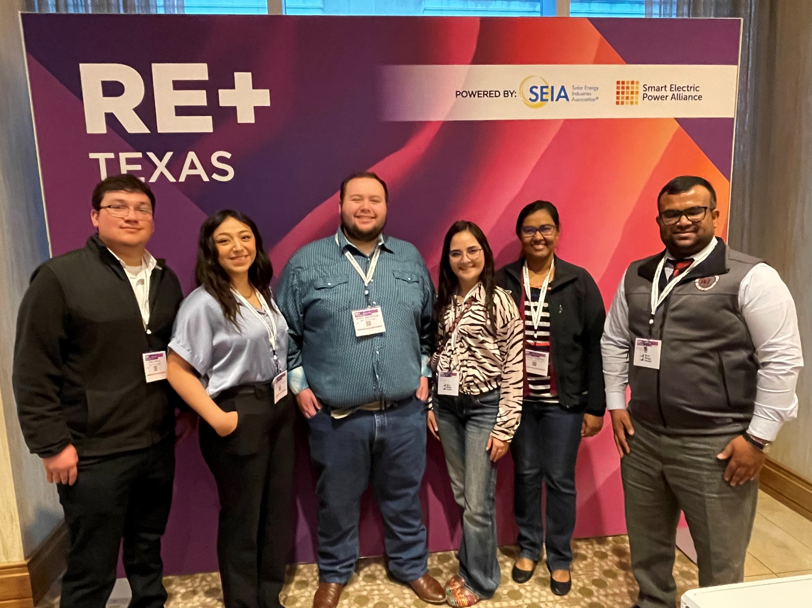
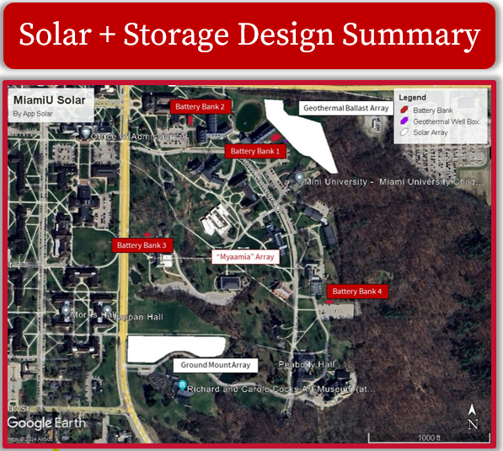
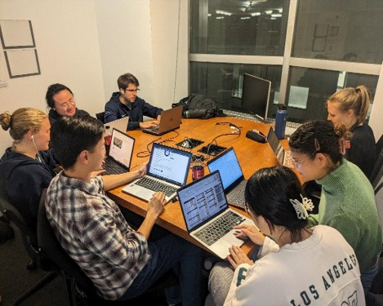
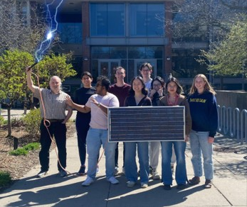

Why compete in the U.S. Department of Energy Solar District Cup?
Students in this competition:
Design solar PV energy systems for a real campus or district—with financial, resilience, and energy equity elements
Gain training and mentoring from solar industry
Design and analyze with industry-leading tools
Attend an optional RE+ conference
Pay no cost to compete.
(Excerpt from Appalachian State University’s Class of ’24 project pitch)
“I was able to accept a position that I love at a top commercial solar company because of the things I learned here. The real-world experience is unmatched and has put me ten steps ahead in the career I am pursuing. It's great to take my Solar District Cup knowledge and see these projects come to life.” —Solar District Cup Competitor
Class of 2024–2025 Registration is open!
Visit HeroX.com/SolarDistrictCup to register a team by Sept. 26, 2024.
West Texas A&M University, Class of ‘23 (top); Columbia University, Class of ’24; and Macalester College, Class of‘24

