Slide 1
Innovating Distributed Embedded Energy Prize (InDEEP)
Introduction to Innovation Methods 2.0
January 24, 2024
Notes:
Bill

Slide 2
Webinar Logistics
Everyone is joined in listen-only mode
Audio Issues?—Try connecting over the phone
If that doesn’t work, visit the Zoom Help Center webpage
Q&A—Submit your questions using the chat box
Notes:
Brittany

Slide 3
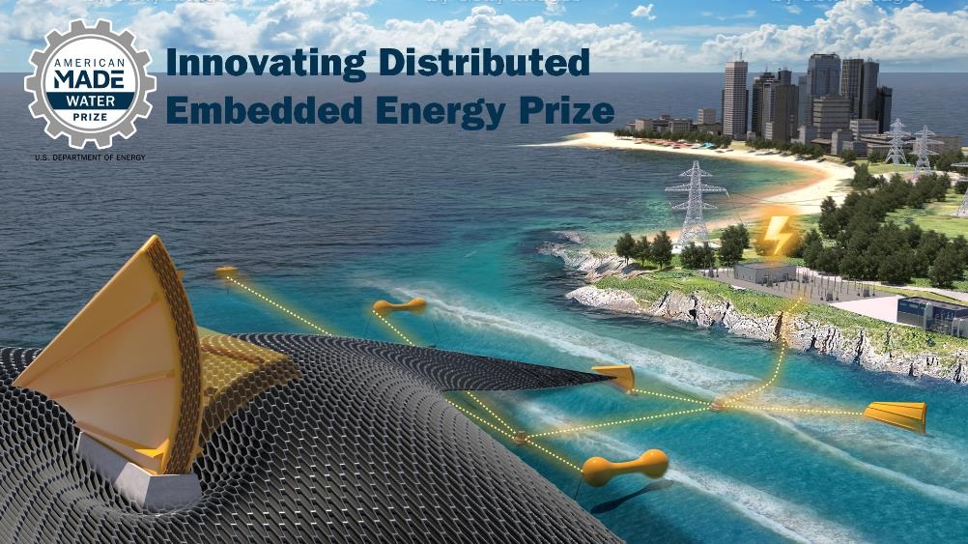
Innovating Distributed Embedded Energy Prize
$2.3M prize pool
Three phases over two years
Incentivize progress in early-stage research
Help solve technical challenges that could be applied to wave energy

Slide 4

Contributing to Leaderboard Scoring
For questions about the prize overall, view our recorded conversation and webinars
Participation in this webinar contributes to your final leaderboard score
Make sure to complete the Leaderboard Eligibility Form to receive points for your participation
If you haven’t done this yet, do so now: https://www.herox.com/indeep
WPTO’s desired outcome for InDEEP is an understanding of the landscape of innovators and
potential DEEC-Tec solutions that could be applied to wave energy devices.

Slide 5
Agenda 1.0
Agenda 2.0
Webinar 1. – May 10, 2023
Introductions
Innovation Process
TRIZ
TRIZ in Wave Energy
Q&A
Webinar 2. – January 24, 2024
Introductions & Context
Innovation Process
TRIZ
TRIZ in Wave Energy
TRIZ in Wave Energy – Example
Q&A

Slide 6
Introductions & Context

Slide 7
Innovation Process

Slide 8
Innovation Process
Problem &
Opportunity
Statement
Ideation
Assessment
Development

Slide 9
Innovation Process
Problem & Opportunity Statement
  Solution agnostic formulation
  Functions/functional requirements
  “What the system is to do”
  Functional system
  Functional hierarchy
  Functional compatibility

Slide 10
Innovation Process
Ideation
  Idea generation process
  Driven by functional requirements
  of the problem & opportunity statement
  Application of different idea generation methods
  Different application approaches of a given method
  Generation of multiple concepts
  Generation by multiple players/teams

Slide 11
Innovation Process
Assessment
  Formulation and application of assessment methods and tools for technology concepts and technology designs
  Driven and expressed by
  Capabilities
  “What the system is to be”
  Identifying strengths & weaknesses
  Prioritization
  Merging
  Down-selection
  Improving

Slide 12
Innovation Process
Development
  Improving technology performance
  Improving technology maturity
  Iteration
  Continuation and relation of
    Problem & opportunity statement refinement
    Idea generation methods and application
    Assessment method, tools and application

Slide 13
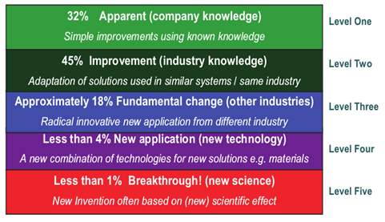
Innovation Impact Levels

Slide 14
TRIZ – Techniques of Inventive Problem Solving

Slide 15
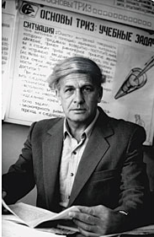
TRIZ – Background
TRIZ/TIPS
  “Teoriya Resheniya Izobreatatelskikh Zadatch” Russian acronym, TRIZ
  “Techniques of Inventive Problem Solving” TIPS
Genrich Altshuller, a patent officer in the Soviet Navy, examined 40,000 patents between 1945 and 1985 in order to identify a methodology of inventive problem solving based on evidence, data and pattern recognition rather than isolated spontaneous or intuitive creativity.

Slide 16
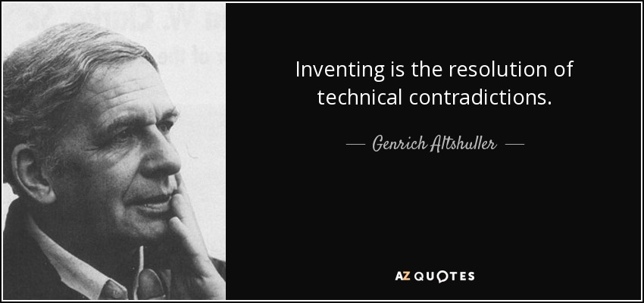
TRIZ – Background
Altshuller identified a finite set of reoccurring problem types and reoccurring inventive solution principles
Followers of Altshuller have subsequently examined 3 million patents and have confirmed Altshuller’s findings
Following a strong TRIZ movement
in the Soviet Union TRIZ emerged
in the West in 1990 after the
fall of the Soviet Union

Slide 17
TRIZ – Methodology
Fundamentals of the methodology in 3 steps
For a specific problem identify the associated typical problem in form of a root contradiction within 39 x 39 cases spanned up by 39 typical parameters
Apply a finite number (<40) of identified and proven inventive problem-solving techniques that have shown to deliver impactful solutions for this typical problem
Concretize the identified typical solution to find the sought specific solution

Slide 18
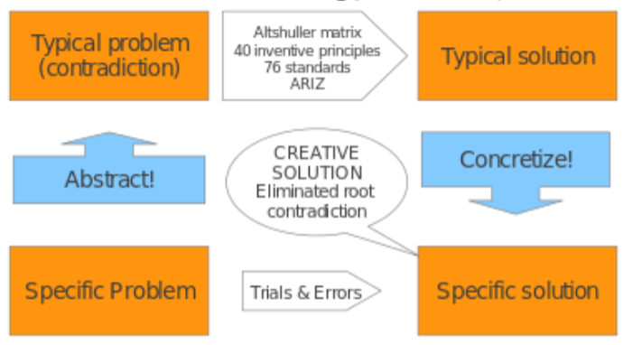
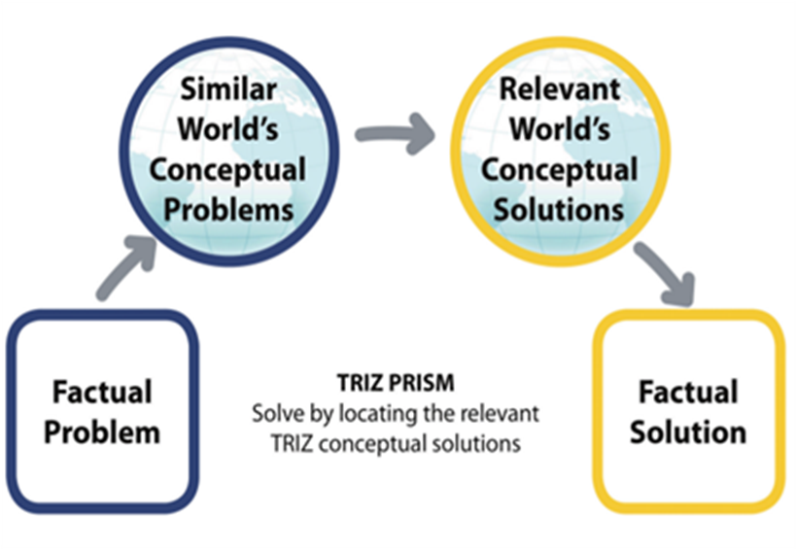
TRIZ – Methodology

Slide 19
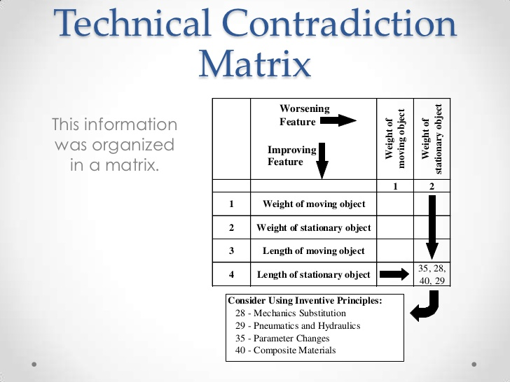
Contradiction Matrix

Slide 20
Contradiction Matrix

Slide 21
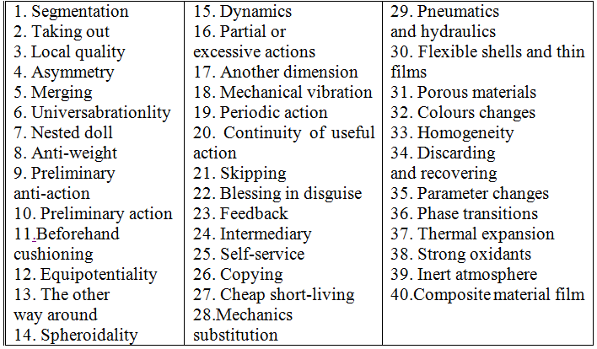
40 Inventive Principles

Slide 22
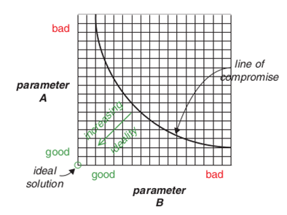
Dissolving Contradictions
Beyond the pareto frontier
Beyond optimization
Beyond compromise
Dissolving trade-offs

Slide 23
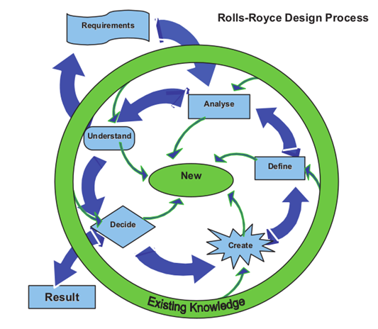
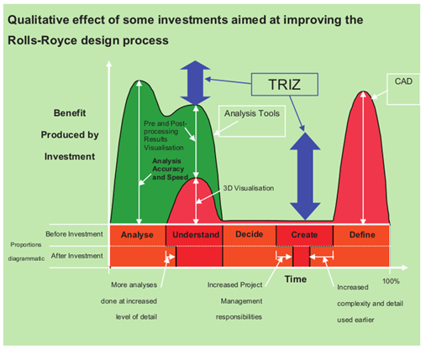
TRIZ – Benefits

Slide 24
Reasons to use TRIZ
TRIZ is systematic, auditable and repeatable
TRIZ is based on proven successful patents
TRIZ uses the world ’s knowledge (systematic rather than random way)
TRIZ closely targets and initiates the ideation process
40 inventive principles for solving contradictions
8 Trends of evolution of technology
Ideality
Thinking in Time and Scale
13 Standard creativity triggers

Slide 25
TRIZ in Wave Energy

Slide 26
Technology Development Framework
Technology Readiness Levels (TRL)
Technology Performance Levels (TPL)
Technology Development Map
TRL – TPL – Matrix
Technology Performance Levels (TPL)
Technology Readiness Levels (TRL)

Slide 27
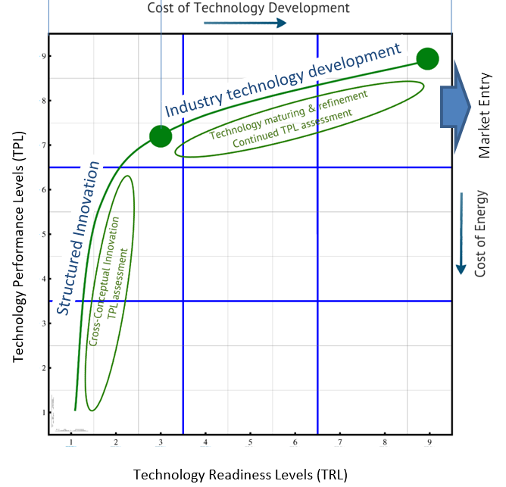
Technology Development Framework

Slide 28
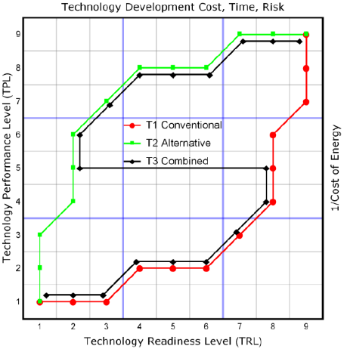
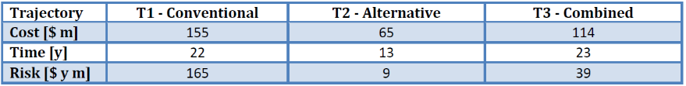
Technology Development Cost, Time and Risk

Slide 29
TRIZ has proven to work in wave energy
New technology concepts so far are high quality
Contradictions matrix ‘feels’ familiar to natural problem solvers
Contradictions matrix sometimes leads to known solutions as well as new solutions
Ideality concept & Ideality audit lead to auditable clarification of requirements & to new contradictions & to new ideas
Resolution of limiting contradictions on one WEC archetype led to invention other WEC archetype – jumping archetype boundaries

Slide 30
TRIZ in InDEEP
TRIZ is applicable al system levels
  WEC farm
  WEC unit
  WEC sub/sub/sub/system
  WEC component
  WEC operation process
InDEEP
  DEEC
  DEEC-Tec meta material
  (DEEC-Tec meta material enabled WEC)

Slide 31
TRIZ in Wave Energy – Example

Slide 32
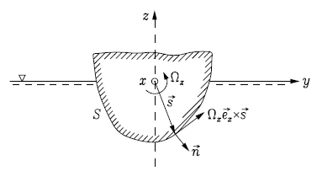
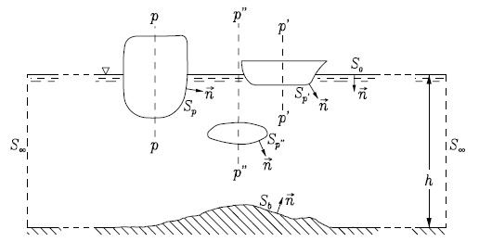
Forces on a Floating Body

Slide 33

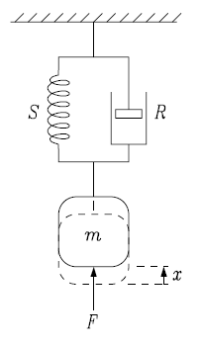
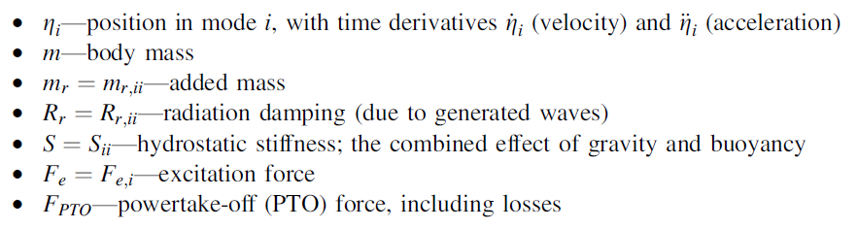
Forces on a Floating Body

Slide 34
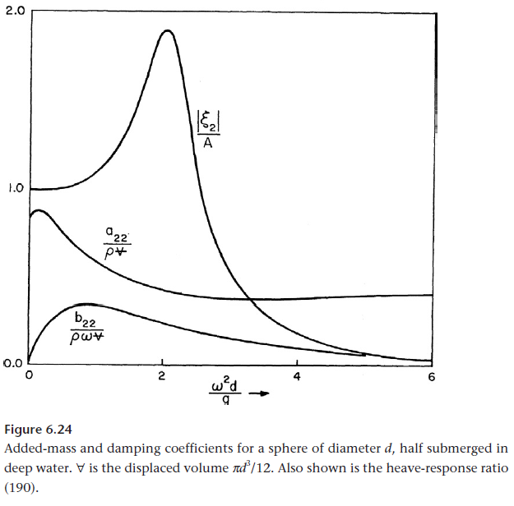
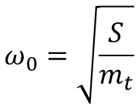
Natural Frequency & System Response
$$ω_{0}=\sqrt{\frac{S}{m_{t}}}$$
Natural Frequency
  Frequency of freely oscillating undamped system
Resonance Frequency
  Frequency of maximal response of damped and excited system
Newman, Marine Hydrodynamics, 1977

Slide 35
Natural Frequency & Design Criteria
Natural Response
  Mass
  Stiffness
  Volume
  Shape – Surface Piercing Area
Excited Response
  Mass
  Stiffness
  Volume
  Excitation
  Shape – Entire Shape

Slide 36
Design Criteria & System Performance
Natural Response
  Mass
  Stiffness
  Volume
  Shape – Surface Piercing Area
Excited Response
  Mass
  Stiffness
  Volume
  Excitation
  Shape – Entire Shape

Slide 37
Design Requirement Contradictions
Contradictions
  Large mass vs small stiffness
    Resonance frequency
  Large mass vs small surface piercing area
    High mass for inertia for low resonance frequency
    Small surface piercing area for low stiffness for low resonance frequency
  Large volume vs small surface piercing area
    Large mass linked via buoyancy to large volume for low resonance frequency
    Small surface piercing area for low stiffness linked to low volume for low resonance frequency
  Large surface piercing area vs small surface piercing area
    Small surface piercing area for low stiffness linked to low volume for low resonance frequency
    Large surface piercing area for large excitation for large wave energy input for large response and energy output
  Deep shape vs flat shape
    Deep shape for large volume for large mass for low resonance frequency
    Flat shape for large excitation for large wave energy input for large response and energy output
  Low mass vs large volume
    Large volume linked via buoyancy to large mass for low resonance frequency
    Low mass for effective and efficient control

Slide 38
TRIZ Contradictions
TRIZ Contradiction
  Large mass vs small volume

Slide 39
TRIZ Contradictions & Inventive Principles
TRIZ Contradiction
  Large mass vs small volume

Slide 40

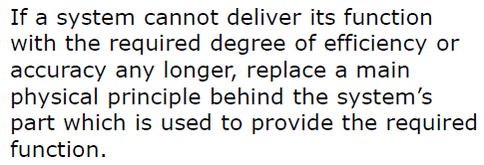
TRIZ Inventive Principle
Inventive Principles
7 Nesting
28 Replacement
29 Use of gas and fluids
40 Composite Structures

Slide 41

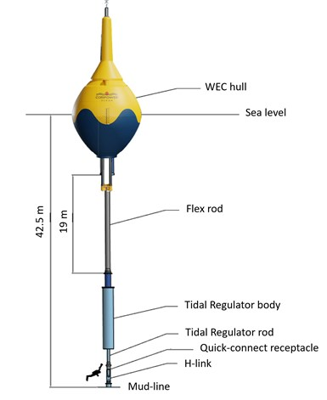
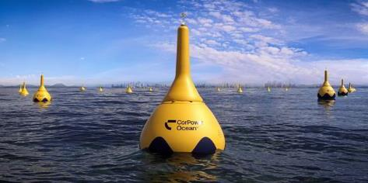
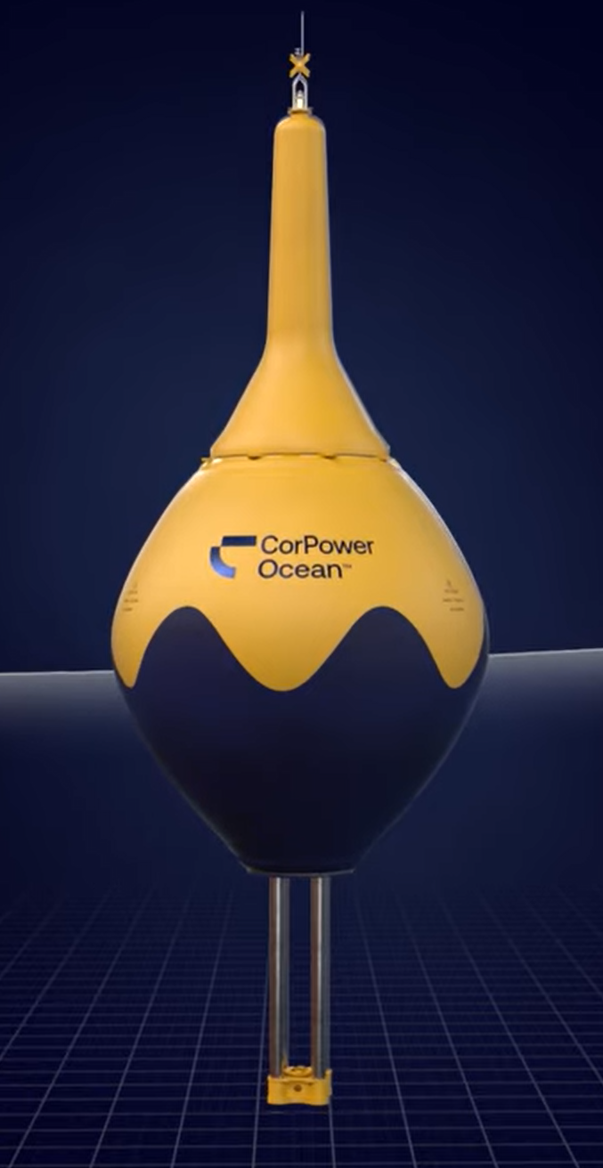
Solution Example - CorPower Ocean

Slide 42
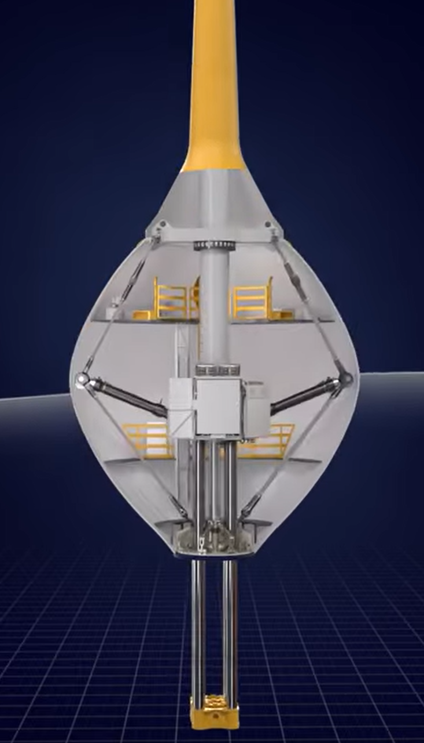
Separation of Restoring Force Providers - Hydrostatics & Mechanics
Hydrostatics
Mechanics

Slide 43
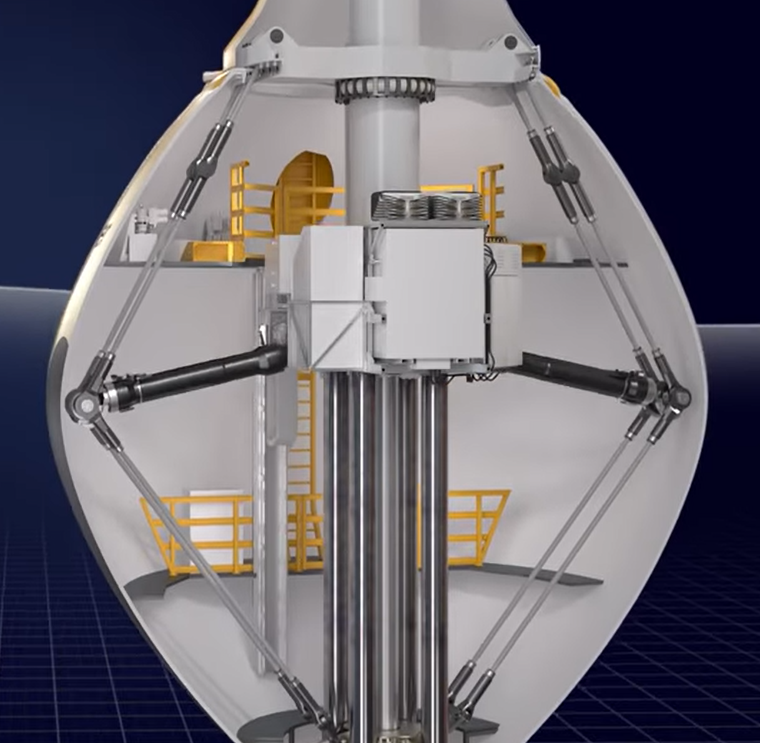
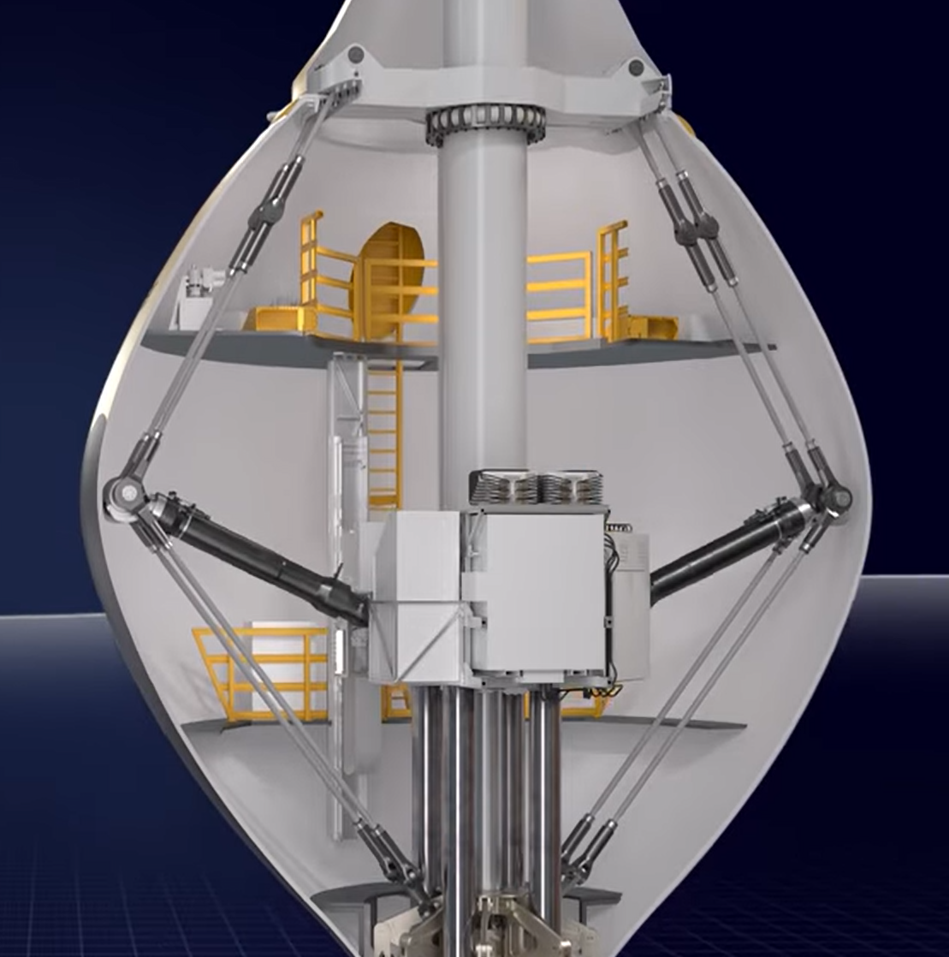
Negative Stiffness Spring

Slide 44
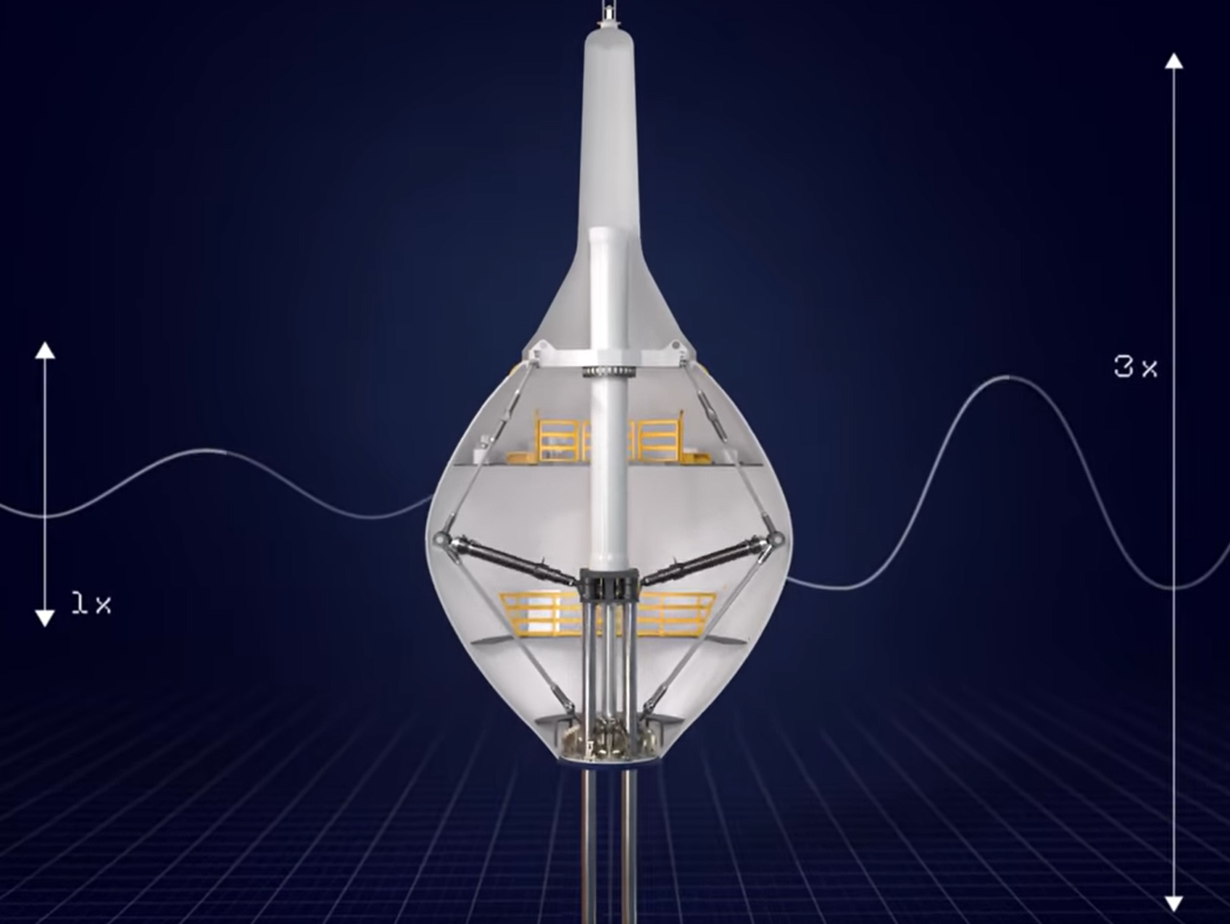
Resonance at Desired Wave Frequency

Slide 45
Improved Control – Inertial Reduction via Pretention Suspension

Slide 46
Next up: TPL Assessment
Patrik Möller, CEO CorPower Ocean:
“The detailed feedback and thoughts on possible system improvements that you have contributed are very valuable to us. The questions asked in the TPL process triggers many useful discussions and thoughts across our team. Quite unique to be able to get this level of in-depth comments from an experienced team like yourself, that has seen many different design and system approaches through your TPL assessment program, and from previous wave development journeys. We find the overall TPL rating results exciting and very useful for us as a company, but most of all we appreciate the detailed feedback and technical discussions we have had. If probably took more efforts from all sides to get to this level of discussion and joint understanding of different questions (as it usually does..) and we want to thank you for spending that extra time on follow-up comments in several iterations that took us to a good depth.”

Slide 47
Questions and Answers
Thank you!

Slide 48
Wrap Up & Next Steps

Slide 49




Competitor Support Mechanisms
Save the Dates!
Upcoming Training Sessions:
  May 10: Innovation methods
  July 5: TPL assessment
Provide us feedback in the webinar poll to make sure upcoming sessions are useful
Teaming Platform
Submission Feedback
Mentorship in Innovation Methods and TPL Assessment
Resources linked in Appendix C of the Rules Document

Slide 50
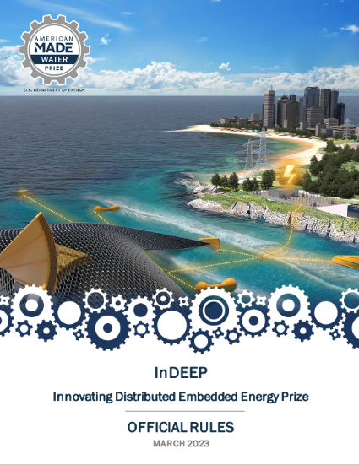
Read the Rules
For a more in-depth look at the prize overall where these topics will be applied, please read the rules document, available here:
https://americanmadechallenges.org/challenges/indeep/docs/InDEEP-Prize-Rules.pdf
SOLVER COMMUNITY
Notes:
Carrie

Slide 51
Questions?
Notes:
Carrie

