Slide 1
Innovating Distributed Embedded Energy Prize (InDEEP)
Phase II Technology Performance Level Assessment
January 31, 2024
Notes:
Bill

Slide 2
Agenda
Introduction to the Prize
Why Technology Performance Levels (TPL)?
What is TPL?
TPL methodology
How is TPL used in InDEEP?
TPL question topics covered in InDEEP​
Competitor support mechanisms​
Q&A​

Slide 3
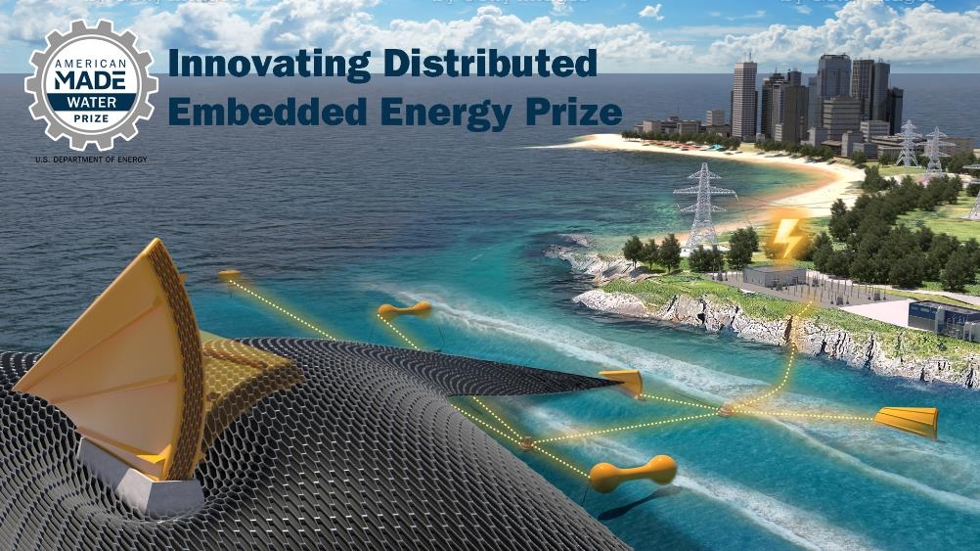
Innovating Distributed Embedded Energy Prize
$2.3M prize pool
Three phases over two years
19 awards made in Phase I
Incentivize progress in early-stage research
Help solve technical challenges that could be applied to wave energy

Slide 4

Prize Goals
Leverage WEC innovation to systematically develop DEEC-Tec concepts that could bring value to the ocean wave energy industry
Build a solver community by engaging and facilitating collaboration between diverse innovators in the marine energy industry and related DEEC-Tec disciplines
Encourage development of novel DEEC-Tec with high potential relevance to WECs by supporting an interdisciplinary set of competitors from ideation to design
Refine WEC innovation methods to incorporate ideas beyond the field of wave energy based on feedback from the prize
See the Official Rules Document Section 1.5
WPTO’s desired outcome for InDEEP is an understanding of the landscape of innovators and
potential DEEC-Tec solutions that could be applied to wave energy devices.
Notes:
Carrie

Slide 5
Contributing to Leaderboard Scoring
For questions about the prize overall, view the video recording and presentation slides from the 14 November 2023 InDEEP Phase II Kickoff Webinar
Participation in this webinar contributes to your final leaderboard score
Make sure to complete the Leaderboard Eligibility Form to receive points for your participation
If you haven’t done this yet, do so now: https://www.herox.com/indeep

Slide 6
Why TPL?
Technology Development Challenges:
Wave energy converter technology development currently has several main challenges:
  Still a multitude of widely diverse technologies being considered today
  No evidence of common convergence in key market segments
  High levelized cost of energy systems (projected)
  WEC technology development is:
    Expensive (> $100M to get to TRL 9)
    High risk (setbacks in prototype testing)
    Slow (10-15 years from TRL 1→9)
    Rigid (retain initial early concept idea)
Notes:
Jochem

Slide 7
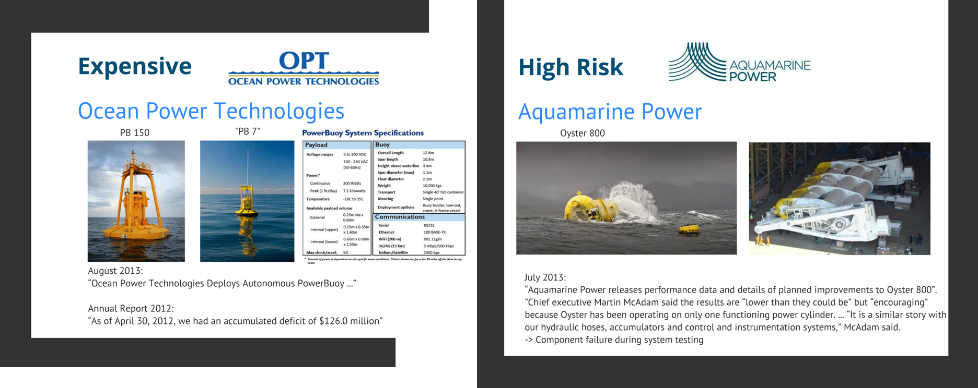
Why TPL?

Slide 8
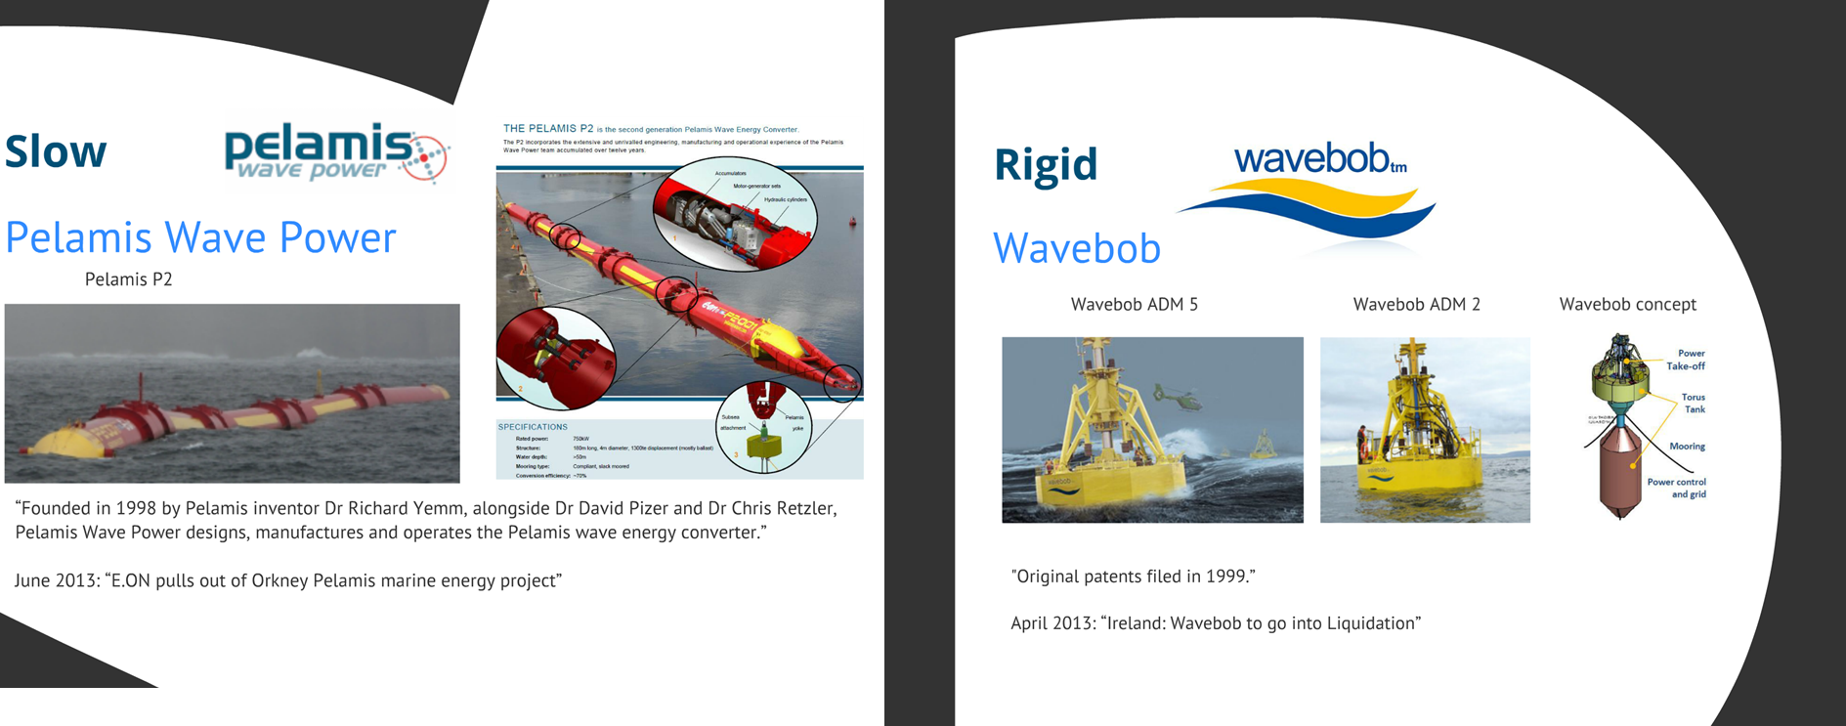
Why TPL?

Slide 9
TPL Development
Concept introduction @ ICOE (Weber)
First
use cases
NI/LS
TPL version 2.0 used in DOE Wave Energy
First version of utility-scale TPL tool released
Extension to CECs,
PBE markets, industry workshops,
etc.
EWTEC
paper
EWTEC
paper
2012 2014 2016 2018 2020 2022
TPL
Defined
TPL Version 1.0
TPL Version 2.0
TPL Version 3.0
TPL Version 4.0
TPL Version 5.0 – web app

Slide 10
What is TPL?

Slide 11
What is TPL?

Slide 12
TRL – TPL matrix
Pre - Commercial Technology Development
WaveSPARC
Industry Technology Development
Technology Performance Levels (TPL)
Technology Readiness Levels (TRL)

Slide 13
TPL Metric Definitions
1 | 2 | 3 | 4 | 5 | 6 | 7 | 8 | 9
Low |  |  | Medium |  |  | High
Technology is not economically viable |  |  | Technology features some characteristics for potential economic viability under distinctive market and operational conditions. Technological or conceptual improvements may be required. |  |  | Technology is economically viable and competitive as a renewable energy form
Majority of key performance characteristics & cost drivers do not satisfy and present a barrier to potential economic viability | Some of key performance characteristics & cost drivers do not satisfy potential economic viability | Minority of key performance characteristics & cost drivers do not satisfy potential economic viability | In order to achieve economical viability under distinctive and favorable market and operational conditions some key technology implementation and fundamental conceptual improvements are required. | In order to achieve economical viability under distinctive and favorable market and operational conditions some key technology implementation improvements are required. | Majority of key performance characteristics & cost drivers satisfy potential economical viability under distinctive and favorable market and operational conditions | Competitive with other renewable energy sources given favorable support mechanism | Competitive with other energy sources given sustainable support mechanism | Competitive with other energy sources without special support mechanism

Slide 14
TPL Methodology
Innovation
driven by
Functions
Innovation
implemented by
TRIZ
Mission Statement
Delivering highest positive impact
Functional Requirements
meeting
Capabilities
Context
Stakeholders
Life Cycle Stages
Assessment
driven by
Capabilities
Assessment
implemented by
TPL
Capabilities & Impact
What the system needs to be
Iterate until
consistent
Capability & Impact
& Function Mapping
Determine measures to link capabilities & functions
Functions
What the system needs to do

Slide 15
TPL Implementation
Quantifiable and Scorable Questions
Question and Category Weights
Mathematical expressions
Question wording
Score guidance
Add/remove questions
Question weights
Category and sub-category weights
Geometric mean
Arithmetic mean
Harmonic mean
Additional Considerations:
Extensive stakeholder interviews are conducted to generate meaningful weights for the capability hierarchy and questions using the House of Quality/Quality Functional Deployment methodology
Care was taken to make methodology technology-agnostic and site-agnostic
Can directly incorporate LCA and TEA results into quantifiable questions
Notes:
Nicole

Slide 16
TPL vs TEA vs LCA
Technology Performance Level (TPL) is an integrated techno-economic technology assessment framework that quantifies the performance potential and economic, environmental, social, and safety impacts of a technology (combined indicator, MCDA)
TPL
Techno-Economic Assessment (TEA) quantifies the economic viability of a technology by comparing its figure of merit against its lifecycle costs
Cost of Energy
Life Cycle Assessment (LCA) quantifies the environmental impacts of a technology over its lifecycle
Global Deployability
Investment Risk
Social
Benefits
Safety & Survivability
Grid Compatibility
Permitting &
Certification
Social
Impacts

Slide 17
TPL for other marine energy applications
Wave powered
desal
Cost of Water
Global Deployability
Investment Risk
Isolated
micro grid
Continental
grid
Safety & Survivability
Cost of Energy
Cost of Energy
Water Integration
Global Deployability
Investment Risk
Global Deployability
Investment Risk
Permitting &
Certification
Social
Impacts
Safety & Survivability
Grid
Operation
Safety & Survivability
Grid Compatibility
Ocean
Obs
Cost of Energy
Permitting &
Certification
Social
Impacts
Permitting &
Certification
Social
Impacts
Global Deployability
Investment Risk
Safety & Survivability
Use
Integration
Permitting &
Certification
Social
Impacts

Slide 18
Agenda
Introduction to the Prize
Why Technology Performance Levels (TPL)?
What is TPL?
TPL methodology
How is TPL used in InDEEP?
TPL question topics covered in InDEEP​
Competitor support mechanisms​
Q&A​
Notes:
Thomas

Slide 19
Phase II Submission Requirements
Item | Description | Will Be Made Public | Scored Item
Summary Slide | Individual slide representing public-facing concept and team description | Yes | No
Phase II TPL Assessment | Read, review, and complete a simplified version of the TPL Assessment (12 questions) | No | Yes
Technical Narrative | Up to 5,000 words in length. Teams may also include up to 5 supporting drawings, images, or graphics | No | Yes
Leaderboard Submissions | Continuous engagement activities scored for application period. Opportunities provided on HeroX platform | Yes | Yes
Test Report | A test report the competitor has completed that includes sufficient detail to replicate the work | No | Yes
Live Virtual DEEC Demonstration | Competitors will be required to attend a virtual meeting with the Prize Administrator demonstrating testing process and validating the test results in the Test Report and Technical Narrative | No | Yes

Slide 20
TPL Question Format
Given
Teams fill in
Question:
Assuming your concept has shown functionality during benchtop testing, what, if any, additional improvements will it need to function in the intended ocean deployment environment?
Question guidance:
This question is intended to motivate an appraisal of anticipated challenges in scaling up the technology to, ultimately, create an ocean wave energy converter. An understanding of the challenges and a plan to address them are sufficient at this stage.
Scoring guidance:
High: DEECs can be designed to have safety margins for extreme load and motion conditions, and fatigue lives equaling or exceeding WEC design life, typically 20-25 years.
Med: DEEC failures can be addressed by building in redundancy and/or designing components to be easily replaceable.
Low: Fundamental breakthroughs are required for DEECs to be able to operate long term (20-25 years).
Score:
Choose an integer from 1 thru 9; 1 being the lowest and 9 the highest
Confidence:
Indicate how confident you are about the score you selected. Choose from high/medium/low.
Justification:
Provide justification or background information to support your score.

Slide 21
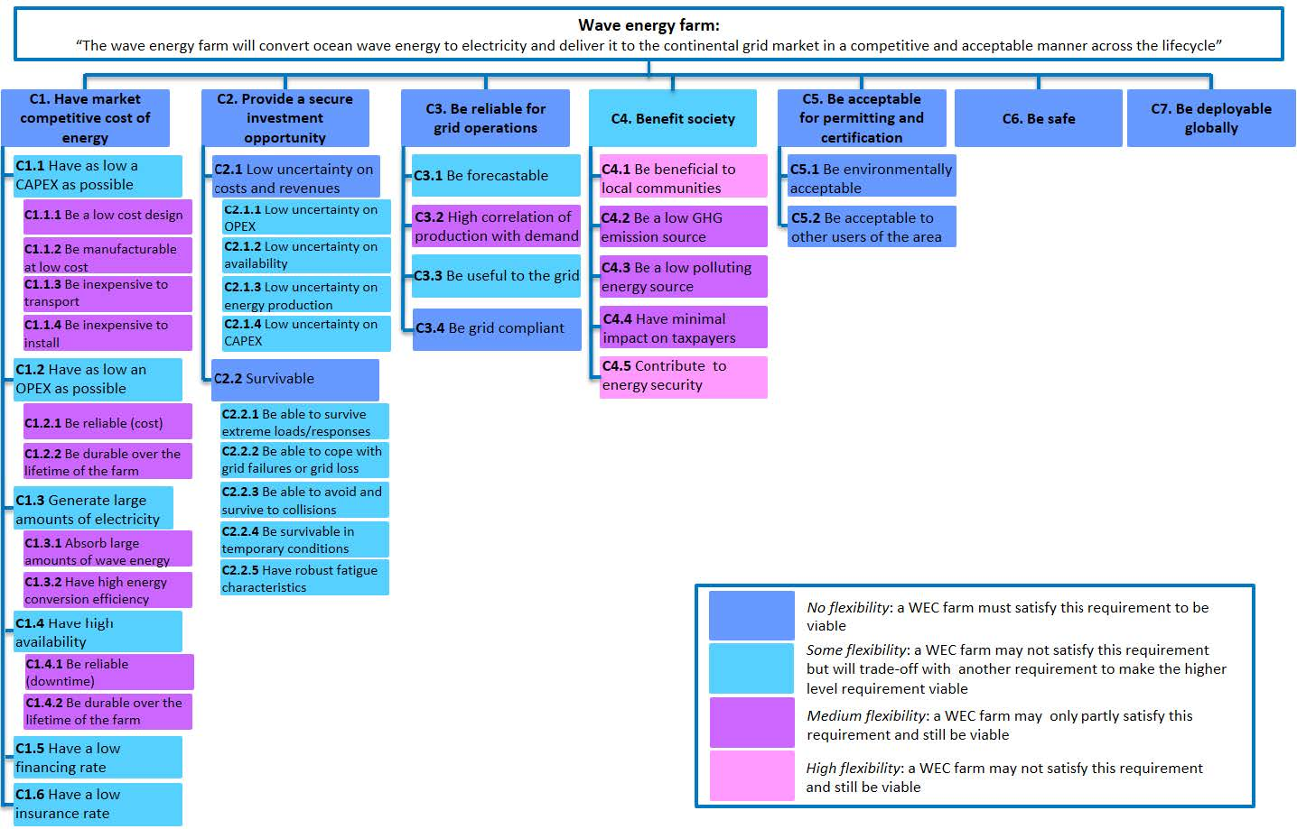
Systems Engineering Applied to the Development of a Wave Energy Farm (https://www.osti.gov/biblio/1365534)

Slide 22
Phase 1 TPL questions

Slide 23
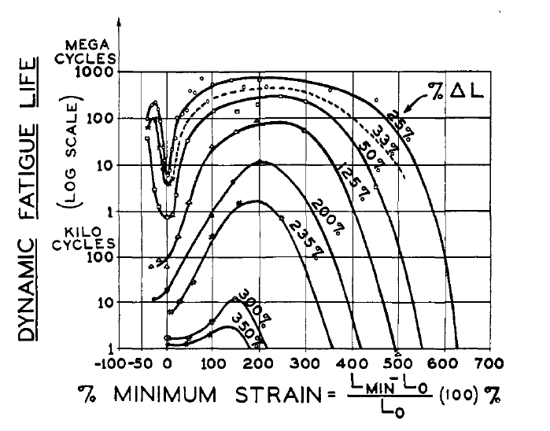
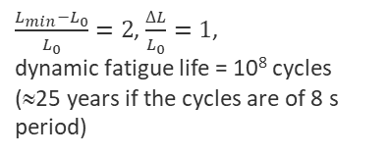
Design Loads (Qn# 1)
Extreme loads
Fatigue
$\frac{L_{min}−L_{0}}{L_{0}}=2$, $\frac{∆L}{L_{0}}=1$,
dynamic fatigue life = 10⁸ cycles (≈25 years if the cycles are of 8 s period)
Fatigue life of rubber. L is the length of the sample of initial length L₀. Life is plotted against minimum strain for various ranges of the strain excursion ΔL
F. J. M. Farley, R. C. T. Rainey, and J. R. Chaplin, “Rubber tubes in the sea”, Phil. Trans. R. Soc. A (2012) 370, 381–402, doi:10.1098/rsta.2011.0193

Slide 24
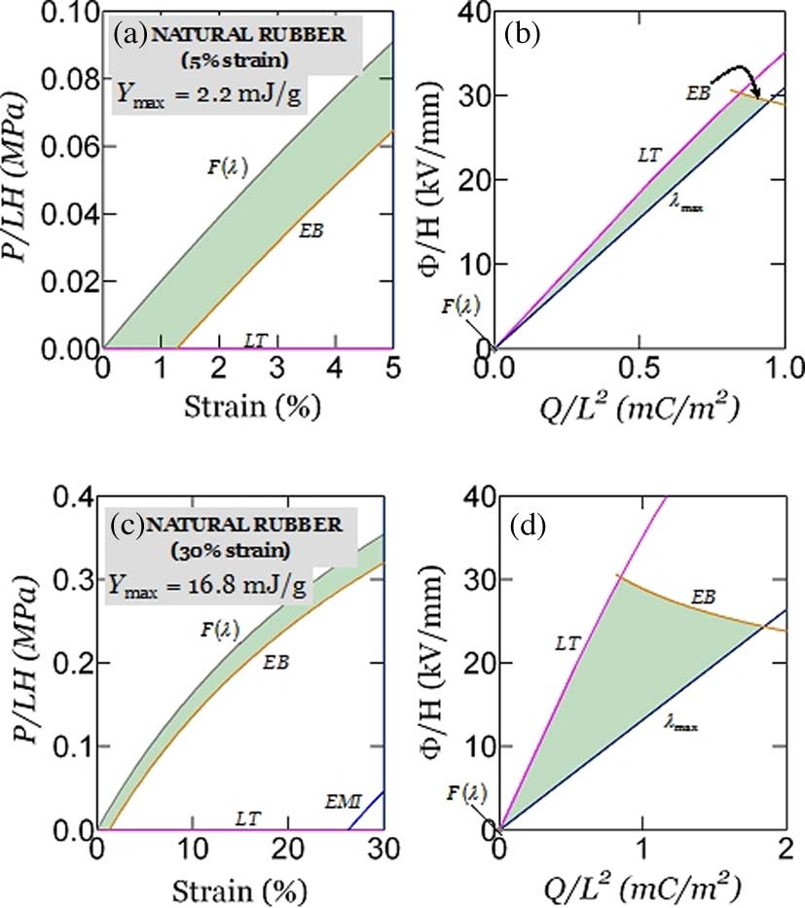
Performance (Qn# 3)
DEEC
Transduction
useful electrical energy
work done on WEC
captured mech energy
incident wave energy
Efficiency
  low efficiency doesn’t mean the technology can’t be viable;
  input wave energy is available freely and abundantly;
  even if we convert only a small fraction of it into useful electrical energy, it may still be viable provided we can do so safely/reliably/cheaply!
Energy density
Power density
energy radiated back to sea
viscous, friction losses
electrical losses
see Fig. 1 of C Jean-Mistral et al 2010 Smart Mater. Struct. 19 085012,
doi:10.1088/0964-1726/19/8/085012
Operation maps for natural rubber
when the maximum stretch is limited to 5% strain (a, b), or 30% strain (c, d)
Soo Jin Adrian Koh, Christoph Keplinger, Tiefeng Li, Siegfried Bauer, and Zhigang Suo, “Dielectric Elastomer Generators: How Much Energy Can Be Converted?”, IEEE/ASME TRANSACTIONS ON MECHATRONICS, VOL. 16, NO. 1, FEBRUARY 2011

Slide 25
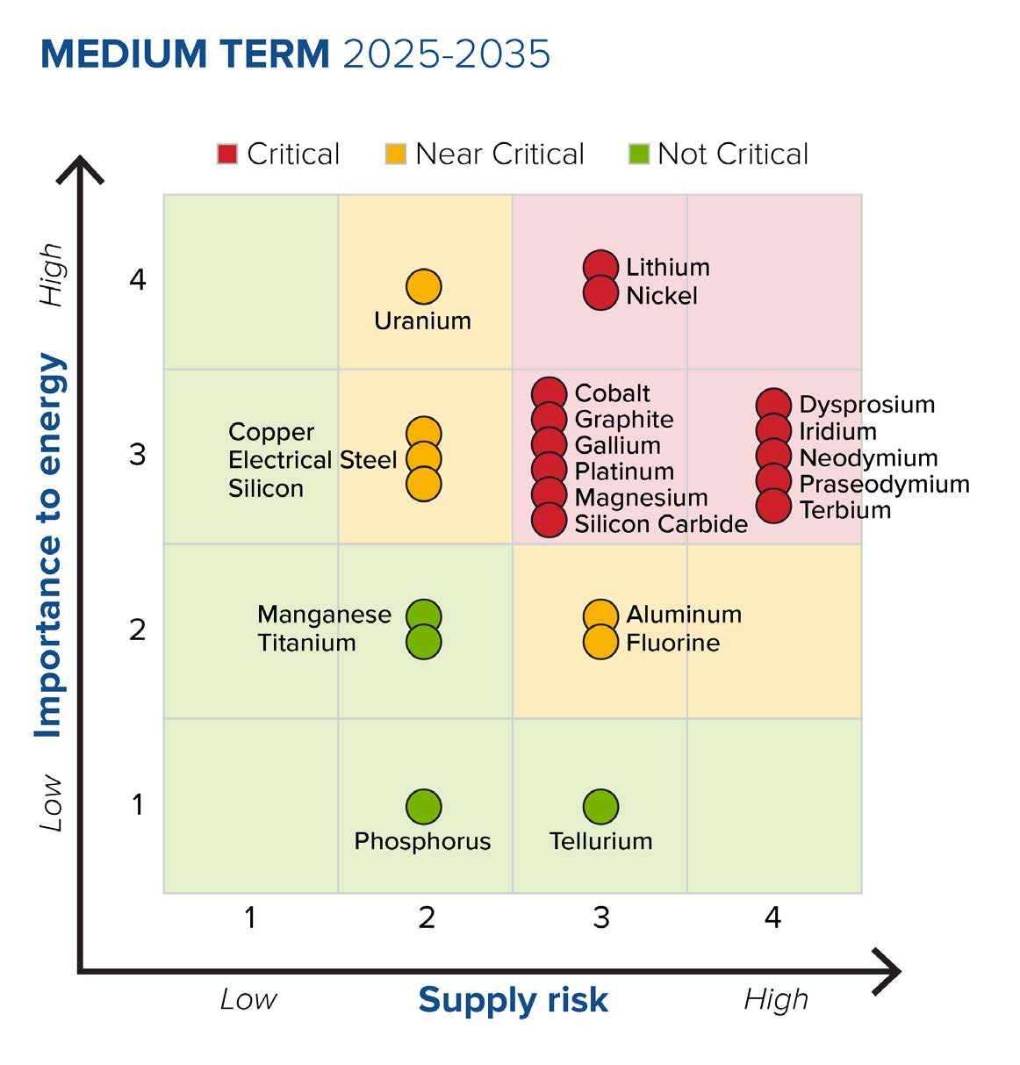
Materials (Qn# 2, 7)
Special material?
Expensive?
Hazardous?
Supply risk?
DOE Critical Materials Assessment, July 2023, https://www.energy.gov/eere/articles/us-department-energy-releases-2023-critical-materials-assessment-evaluate-supply
Share of top producing countries in total processing of selected minerals and fossil fuels, 2019
https://www.iea.org/reports/introducing-the-critical-minerals-policy-tracker/ensuring-supply-reliability-and-resiliency

Slide 26
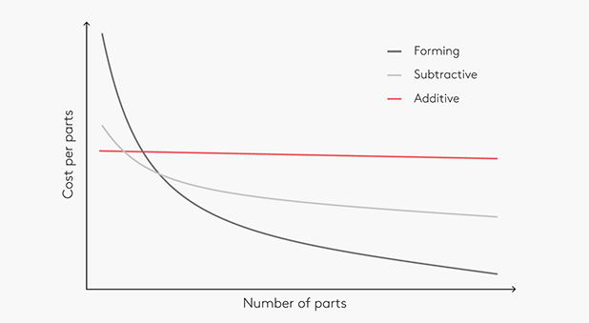
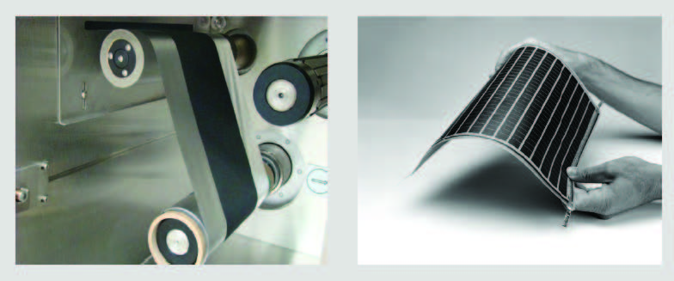
Manufacturing (Qn# 4, 5, 8)
COTS vs. custom parts
Can be mass produced cost-effectively, e. g. roll-to-roll
Need new manufacturing capabilities?
Require specialized skills or new workforce expertise?
Dangerous work conditions?
Hazardous materials?
https://www.dti.dk/specialists/introduction-to-3d-printing/learn-the-best-new-manufacturing-technology/40476
Examples of R2R Products: Battery Electrode (left)
and Thin Film Photovoltaic Module (right)
Innovating Clean Energy Technologies in Advanced Manufacturing,
DOE Quadrennial Technology Review 2015,
https://www.energy.gov/quadrennial-technology-review-2015

Slide 27
Durability, Reliability (Qn# 6)
Failure modes
Failure rate, Mean time to fail (MTTF)
Consequences of DEEC failure: safety, environmental, economic?
Build redundancy
Make components easily replaceable
Failure rates (failures/unit/year) of WEC subsystems: structure, PTO, auxiliary
Table 17 of Reliability Analysis of Wave Energy Converters, Ricardo Antonio Lopez-Chavez, PhD Energy Systems, The University of Edinburgh, 2019, https://era.ed.ac.uk/handle/1842/38876

Slide 28
Safety (Qn# 10, 11)
Risk to people, property, and/or environment at any stage of the life cycle?
Hazardous material?
Exposure to high voltage?
Access to dangerous parts?
Adequate safety systems can be put in place?
All activities are well understood?
Safe operating procedures can be established?

Slide 29
External Power Input (Qn# 12)
Require external power input?
Risk of damage from an abrupt disconnection of external power input?
Local energy storage?

Slide 30
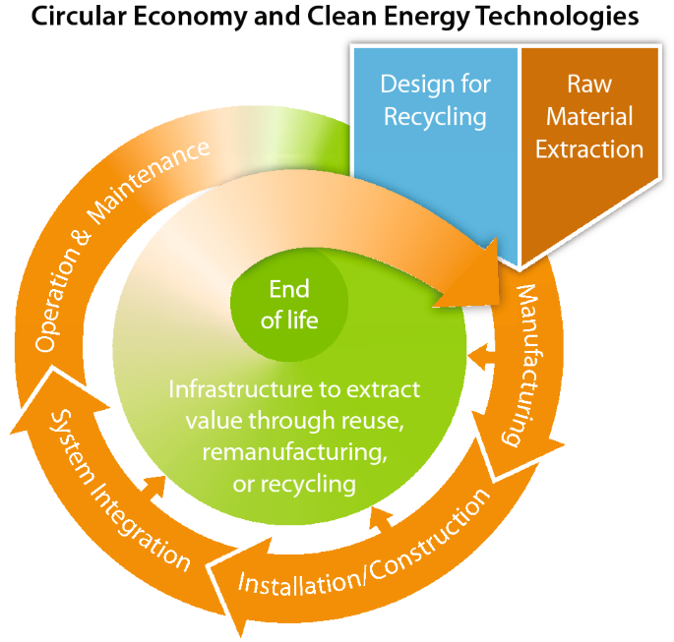
Recycling (Qn# 9)
Apply Design for Recycling (DfR) principles; may result in trade-offs between recyclability and product performance and cost
Material choice and ability to liberate separate materials are critical for recycling:
  Eliminate hazardous materials from product makeup
  Minimize hard-to-recycle materials
  Minimizing non-reversible adhesives or similar bonds, especially over whole surfaces and for dissimilar materials, can facilitate disassembly and material liberation
  Design for Disassembly (DfD)
  Design products to use recycled materials
Norgren, A., Carpenter, A. & Heath, G. Design for Recycling Principles Applicable to Selected Clean Energy Technologies: Crystalline-Silicon Photovoltaic Modules, Electric Vehicle Batteries, and Wind Turbine Blades. J. Sustain. Metall. 6, 761–774 (2020). https://doi.org/10.1007/s40831-020-00313-3

Slide 31




Competitor Support Mechanisms
Training Sessions:
  10 January 2024: Wave Energy 2.0 (1.0 recording available)
  17 January 2024: DEEC-Tec 2.0 (1.0 recording available)
  24 January 2024: Innovation Methods 2.0 (1.0 recording available)
  31 January 2024: TPL Assessment 2.0 (1.0 recording available)
  February 2024: Prize Team Demonstration Example
Mentorship in Innovation Methods and TPL Assessment
(Ramboll and Wave Venture)
Forum and Resources available on HeroX
Additional resources linked in Appendix C of the Rules Document
Submission Feedback
Patent Search (EFN)
TPL assessment service available via TEAMER after the prize
Notes:
Amanda

Slide 32
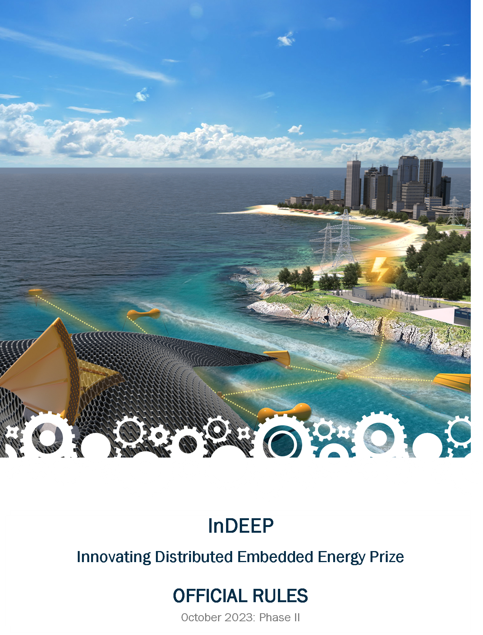
Read the Rules
For a more in-depth look at the prize overall where these topics will be applied, please read the rules document, available here:
https://americanmadechallenges.org/challenges/indeep/docs/InDEEP-Prize-Rules.pdf

Slide 33

Questions?

Slide 34
ADDITIONAL INFORMATION
Reference Materials

Slide 35
Phase 1 TPL questions
Q# | TPL Question | Capability
1 | Assuming your concept has shown functionality during benchtop testing, what, if any, additional changes will it need to function in the intended ocean deployment environment? | Cost of Energy, Investment Opportunity, Safety and Function
2 | How difficult are the components to source? Are they made of specialty material (e.g., very high cost, unknown properties for use/environment, or specially made/ordered)? | Cost of Energy
3 | How many conversion steps are there within the DEEC? How many times is the form of the energy significantly changed? What is the design average combined energy conversion efficiency? What are the energy densities, power densities, etc.? | Cost of Energy
4 | Are components custom-manufactured outside of expected or common practices? This could include custom parts, nontypical manufacturing processes, and non-commercial-off-the-shelf components where commercial-off-the-shelf components are common. | Cost of Energy
5 | What expertise is needed from the workforce (dependent on material type, level of tolerances that must be achieved, specialized safety, customized molds)? | Cost of Energy
6 | What are the known failure modes and frequency of failure for DEECs and their components? What is the level of confidence for failure modes and frequency? What are the consequences of failure? | Cost of Energy, Investment Opportunity
Cost of Energy
Investment Opportunity
Social Impacts & Benefits
Safety & Function

Slide 36
Phase 1 TPL questions
Q# | TPL Question | Capability
7 | Are any material types used rare or located only in particular parts of the world? What material types are vulnerable to price fluctuations? | Investment Opportunity
8 | Are new manufacturing capabilities or new workforce expertise needed to manufacture the DEECs? | Investment Opportunity
9 | Are the components recyclable? | Beneficial to Society
10 | Has a safety philosophy been incorporated into the design process? | Safety and Function
11 | Is there a threat to human health and safety during any life cycle stage? | Safety and Function
12 | Will an abrupt disconnection of the external power input put the DEECs at risk of damage? | Safety and Function
Cost of Energy
Investment Opportunity
Social Impacts & Benefits
Safety & Function

Slide 37
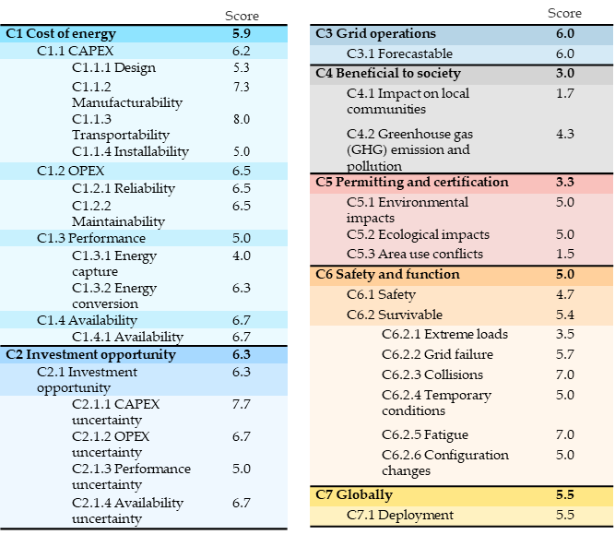
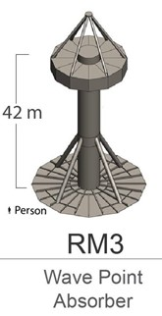
TPL Example
Capabilities:
Cost of Energy
Grid Operations
Safety & Function
Investment Opportunity
Permitting & Certification
Social Impacts & Benefits
Globally Deployable
TPL: 5.4

Slide 38
TPL Benefits
TPL offers the following benefits:
Single, easy-to-understand metric
  Universal language
Accounts for hard-to-define, qualitative design drivers and requirements
Combines TPL and TRL score to obtain a wholistic assessment of a technology's potential
Supports developers by highlighting potentially problematic areas early
Identifies best technology development trajectory – best ROI
Aids funders and investors in deciding which technologies to fund/invest in
Builds upon existing LCA and TEA work, and incorporates results
Creates universal, easy-to-understand language for communicating results
Provides a holistic assessment of technology’s potential
Quantifies trade-offs between economic and environmental metrics
Identifies areas for improvement and best development trajectory
Includes all technology life cycle stages

Slide 39
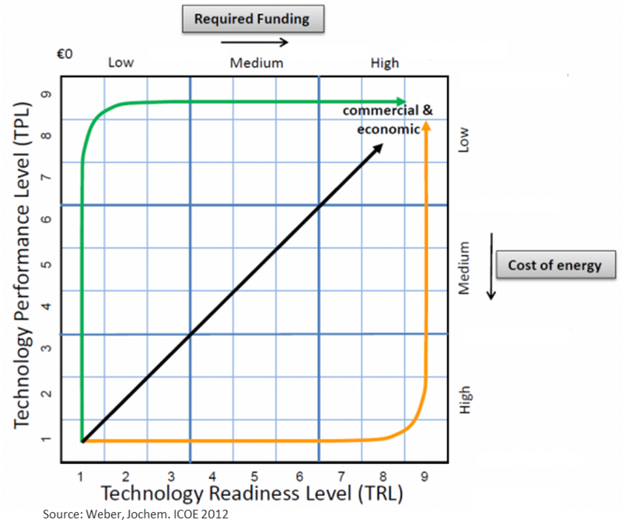
TPL Potential
Development Trajectory:
TPL supports developers by identifying potentially problematic areas early
TPL helps identify the best technology development trajectory
  Which design drivers should be invested in to yield the highest value, performance, or ROI?
  Where should you spend your money?
  Which R&D activities will lead to the best performance trajectory?
As a result, TPL can aid funders and investors in deciding which technologies to fund/invest in

Slide 40
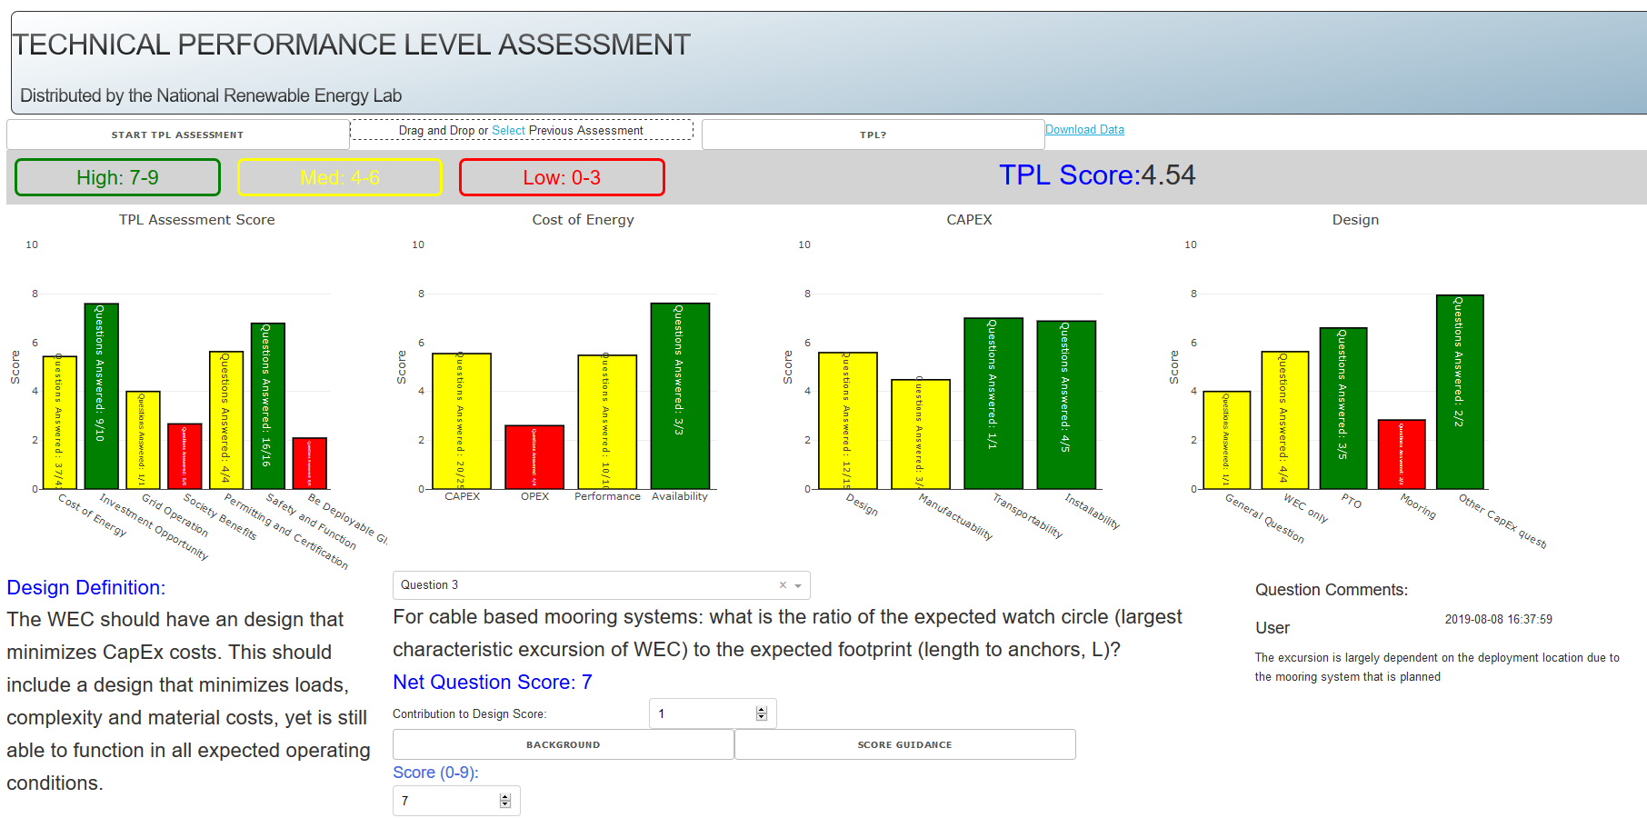
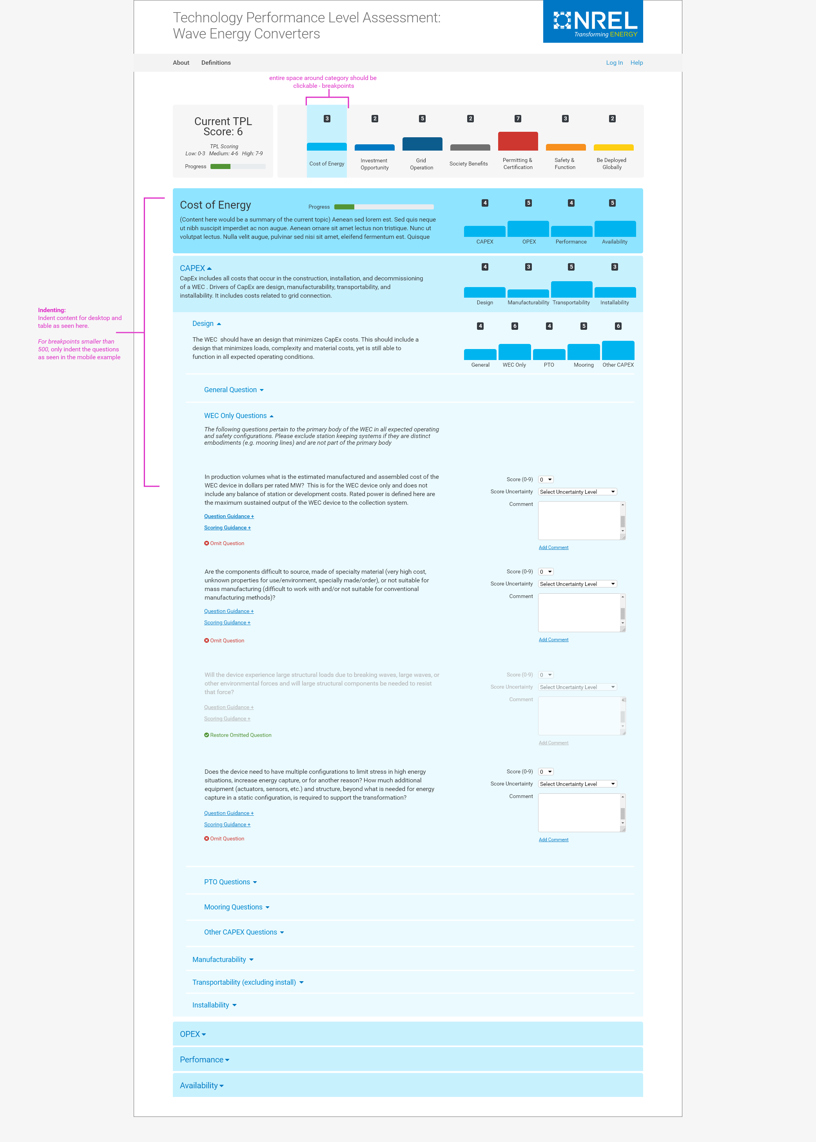
Technology Assessment
Development and Application
Continuous improvement development and release for TPL assessment tool
TPL Assessment: Versions 1.0 to 4.0 over 500 use cases of over 100 technologies
Free TPL Assessments for US and global industry & Internal use in AOP & FOA projects
Version 2.0
Version 4.0
Version 5.0
Version 6.0 – Web based

