Slide 1
Innovating Distributed Embedded Energy Prize (InDEEP)
Introduction to Distributed Embedded Energy Conversion Technologies (DEEC-Tec) 2.0
Jan. 17, 2023
Notes:
Ryan

Slide 2
Webinar Logistics
Everyone is joined in listen-only mode
Audio Issues?—Try connecting over the phone
If that doesn’t work, visit the Zoom Help Center webpage
Q&A—Submit your questions using the chat box
Notes:
Ryan

Slide 3
Agenda — Sections of the Webinar
Introductions — Prize and People
Present Distributed Embedded Energy Conversion Technologies (DEEC-Tec)
Q&A
Wrap Up
Notes:
Blake

Slide 4
Section 1) Introductions — Prize and People
Notes:
Blake

Slide 5
Innovating Distributed Embedded Energy Prize ← Promoting The Prize
$2.3M prize pool
Three phases over two years
Incentivize progress in early-stage research
Help solve technical challenges that could be applied to wave energy
Notes:
Blake

Slide 6
Contributing to Leaderboard Scoring
If you haven’t done this yet, do so now: https://www.herox.com/indeep
WPTO’s desired outcome for InDEEP is an understanding of the landscape of innovators and potential DEEC-Tec solutions that could be applied to wave energy devices.
Notes:
Blake

Slide 7
InDEEP Personnel
Amanda Morton
Sam Cuneo
Carrie Schmaus
Nicole Mendoza
Bill McShane
Jochem Weber
Thomas Mathai
Ryan Ingwersen
Jesse Roberts
Blake Boren
Notes:
Blake

Slide 8
Section 2) Present Distributed Embedded Energy Conversion Technologies (DEEC-Tec)
Notes:
Blake

Slide 9
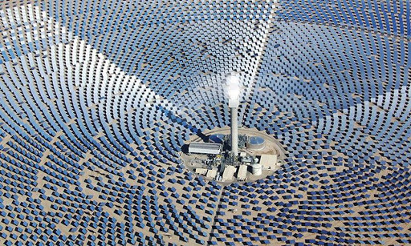
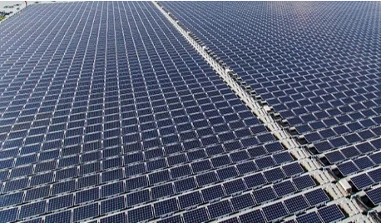
Setting the Stage: A Design Paradigm Shift
Concentrated Energy Conversion
Example: Thermal solar power
Energy field interception with direction to focus point for multi-stage & high load power conversion to electricity
Distributed Energy Conversion
Example: Photovoltaic solar power
Energy field interception with local conversion to high aggregation of electricity
Notes:
Jochem

Slide 10
Overview of DEEC-Tec Ethos
Distribute & embed the act of energy conversion.
Aiming towards high-resolution ‘homogeneity’ of individual energy converters to create DEEC-Tec structures rather than coarsely discretizing individual energy converters to create DEEC-Tec structures.
Trying to avoid classical challenges associated with rigid bodies, joint constraints, residual forces, end stops, single points of failure.
Notes:
Jochem

Slide 11
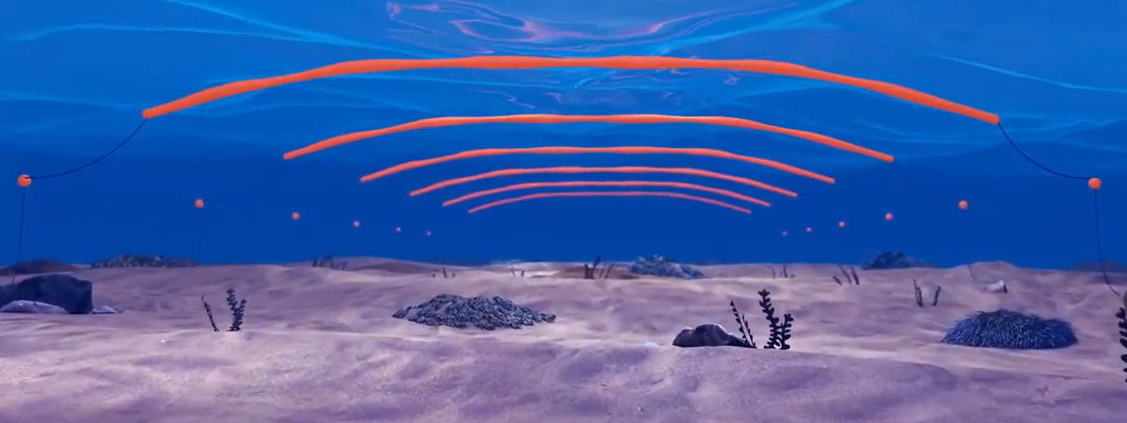
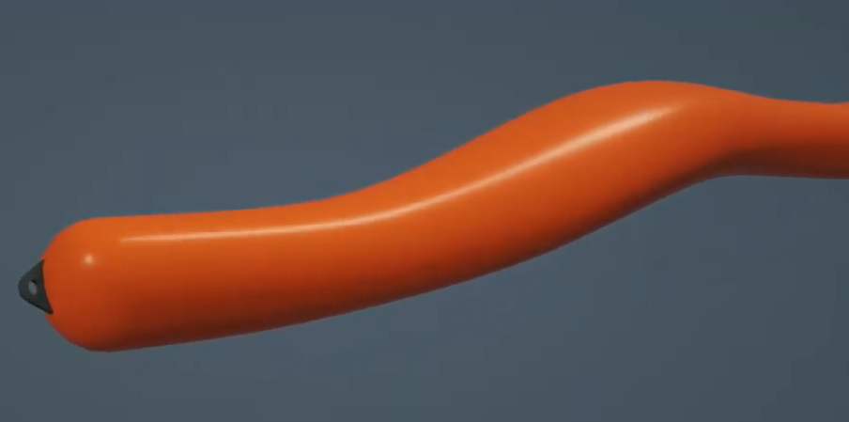
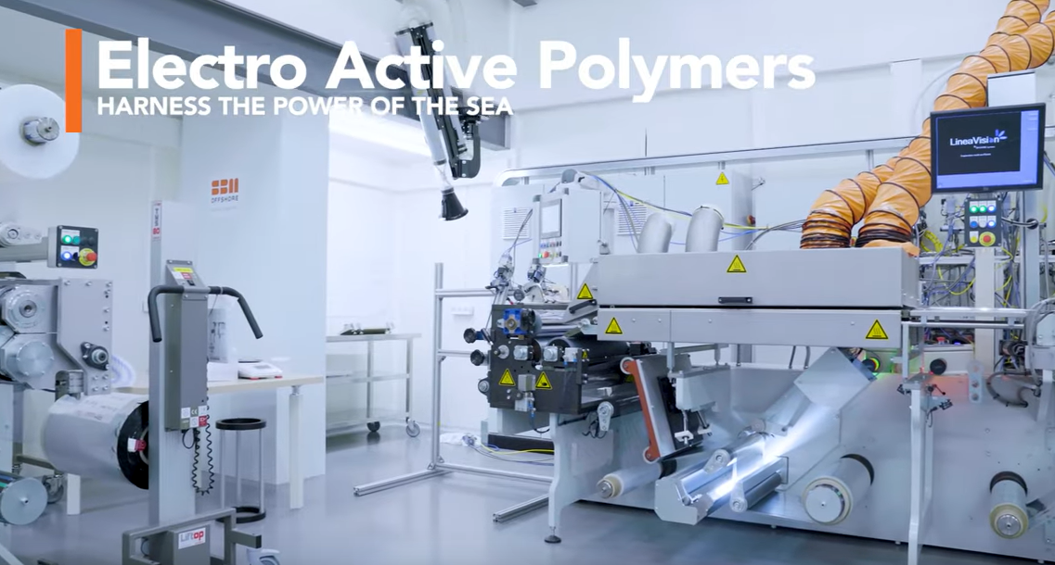
Technology – Possibility for Paradigm Shift?
Pelamis
SBM Offshore
Notes:
Jochem

Slide 12
Describing DEEC-Tec — Levels of Hierarchy
Notes:
Blake

Slide 13
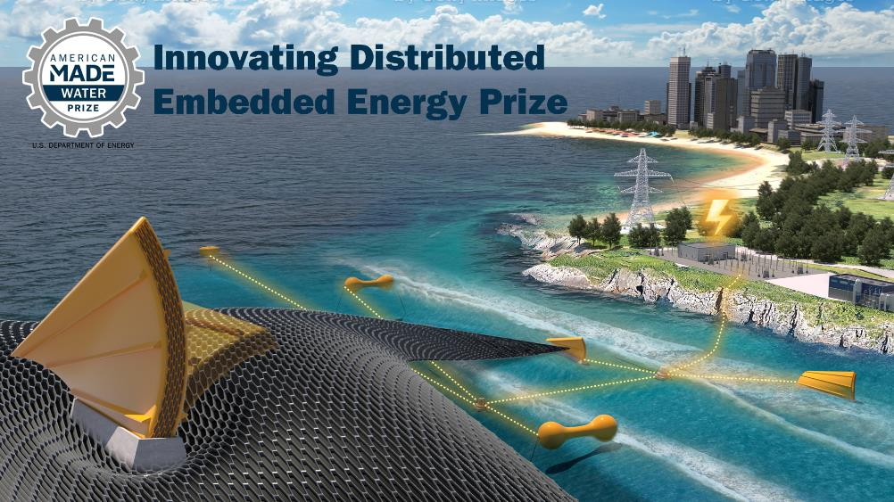
Describing DEEC-Tec — Levels of Hierarchy
Notes:
Blake

Slide 14
Section 2a) Describing DEEC-Tec — Levels of Hierarchy
Bottom Fixed Surging FlexWEC

Slide 15
Describing DEEC-Tec — Levels of Hierarchy
This is just a reference.
Note, a Bottom Fixed Surging FlexWEC is just one out of many possible ocean wave energy converters that could be based upon DEEC-Tec.

Slide 16
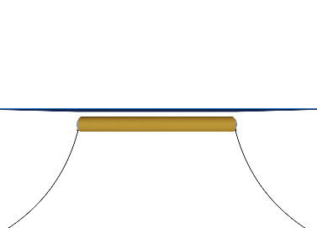
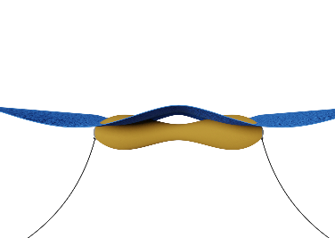
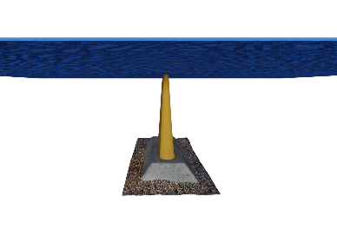
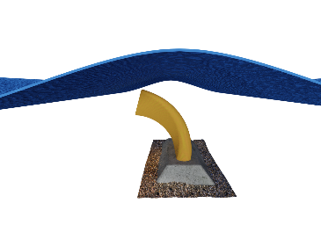
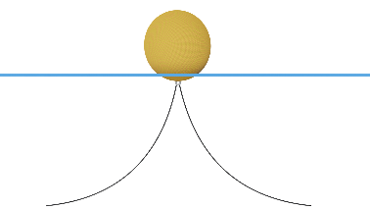
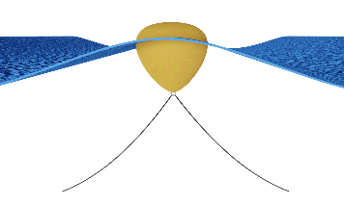
Describing DEEC-Tec — Levels of Hierarchy
No Waves Nondeformed
Waves Actively Deformed
Bulging Line Absorber
Some other examples of ocean wave energy converters.
Three example WEC archetypes made from DEEC-Tec metamaterials.
Contracting/Bulging
Bottom Fixed Surging FlexWEC
Bending
Twisting
Distending Point Absorber
Contorting
Distending
Notes:
Can talk more about the “other” example during Q&A as needed.

Slide 17
Describing DEEC-Tec — Levels of Hierarchy
Still Water; Ocean Surface
Leveraging a Bottom Fixed Surging FlexWEC as a reference to describe DEEC-Tec’s Hierarchy Levels
Hierarchy Level 3 Complete Ocean Wave Energy Converter
This is the highest level and represents an overall actual ocean wave energy converting structure.
A Bottom Fixed Surging FlexWEC
Seafloor

Slide 18
Describing DEEC-Tec — Levels of Hierarchy

Slide 19
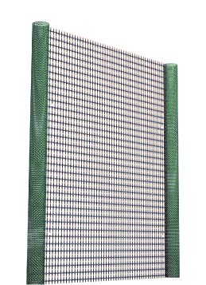
Describing DEEC-Tec — Levels of Hierarchy

Slide 20
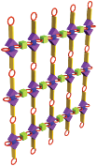
Describing DEEC-Tec — Levels of Hierarchy
Hierarchy Level 2 DEEC-Tec Metamaterials
This level represents the various DEEC-Tec “building materials/frameworks” used to create an overall energy converting structure.

Slide 21
Describing DEEC-Tec — Levels of Hierarchy
Hierarchy Level 2 DEEC-Tec Metamaterials
This level represents the various DEEC-Tec “building materials/frameworks” used to create an overall energy converting structure.
This converter is made from two varieties of DEEC-Tec Metamaterials

Slide 22
Describing DEEC-Tec — Levels of Hierarchy
Pictorial Representations of Individual Distributed Embedded Energy Converters
Hierarchy Level 1 Individual Distributed Embedded Energy Converters
This level represents base components – they are energy transducers capable of distribution and/or embedment with others to create DEEC-Tec metamaterials.
This converter is made from two varieties of DEEC-Tec Metamaterials

Slide 23
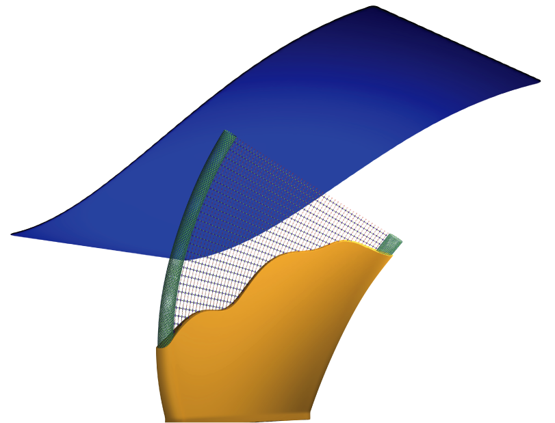
Describing DEEC-Tec — Levels of Hierarchy
Ocean Wave
Wave energy converting structure being dynamically deformed by ocean waves.

Slide 24
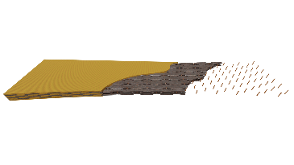
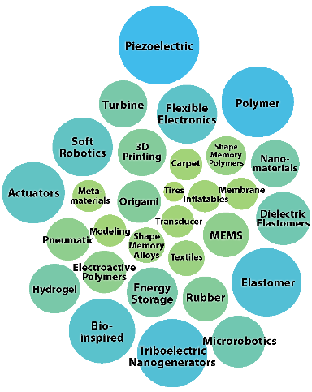
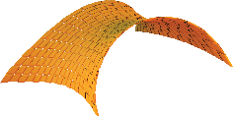
The DEEC - Tec Domain is Vast!
There are many unknown possibilities leveraging any number of technology domains—especially in terms innovating DEECs and DEEC-Tec metamaterials:
Your technology here?
?
Structural Vibration
?
?
?
Magnetostriction
?
Variable Capacitance
?
?
?
?
?
?
?
Faraday’s Law of Induction
Let’s De-Risk: InDEEP

Slide 25
Distributed Embedded Energy Converter Technologies DEEC-Tec
WECs can be Made from DEEC-Tec Metamaterials
WECs can be constructed and fabricated through the assemblage of one or several DEEC-Tec metamaterials types
Has multiple degrees of freedom enabling an inherent compliant interaction with the various frequencies of ocean waves
Prize, however, only gives focus to:
The innovating of individual DEECs
The innovating of corresponding DEEC-Tec Metamaterials
DEEC-Tec Metamaterials
Structural frameworks that are made from the interconnections and combining of many DEECs
Frameworks making up the metamaterials could be made of different configurations of DEECs; latices, weaves, layers, etc.
Distributed Embedded Energy Converter (DEEC)
Small energy transducer with ability to interconnect with others; often has characteristic lengths of a few centimeters
Could leverage any number of physical phenomena for energy conversion; e.g., variable capacitance, Faraday’s Law of Induction, piezoelectric effect, hydraulics, pneumatics
Notes:
@Blake

Slide 26
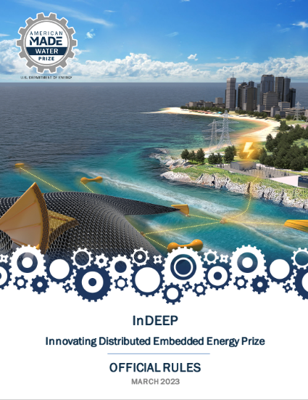
Read the Rules
For a more in-depth look at the prize overall where these topics will be applied, please read the rules document, available here:
https://americanmadechallenges.org/challenges/indeep/docs/InDEEP-Prize-Rules.pdf
SOLVER COMMUNITY
Notes:
Carrie

Slide 27
Questions and Answers
Notes:
Carrie

Slide 28
Wrap Up & What’s Next for InDEEP

Slide 29
Competitor Support Mechanisms
Save the Dates! Upcoming Training Sessions:
May 10: Innovation methods
July 5: TPL assessment
Provide us feedback in the webinar poll to make sure upcoming sessions are useful
Teaming Platform
Submission Feedback
Mentorship in Innovation Methods and TPL Assessment
Resources linked in Appendix C of the Rules Document

