Slide 1
Innovating Distributed Embedded Energy Prize (InDEEP)
Introduction to Wave Energy 2.0
January 10, 2024
Notes:
Bill

Slide 2
Webinar Logistics
Everyone is joined in listen-only mode
Audio Issues?—Try connecting over the phone
If that doesn’t work, visit the Zoom Help Center webpage
Q&A—Submit your questions using the chat box
Notes:
Brittany

Slide 3
Agenda 1.0
Agenda 2.0
Webinar 1. – April 26, 2023
Introductions
Ocean Waves
Wave Energy
Technology
Challenge & Motivation
Q&A
Webinar 2. – January 10, 2024
Introductions
Wave – Body Interaction
Wave Energy Conversion
Technology Development Methods
Technology Development History
Challenge & Motivation & Solution
Q&A

Slide 4
Introductions
Notes:
Brittany

Slide 5
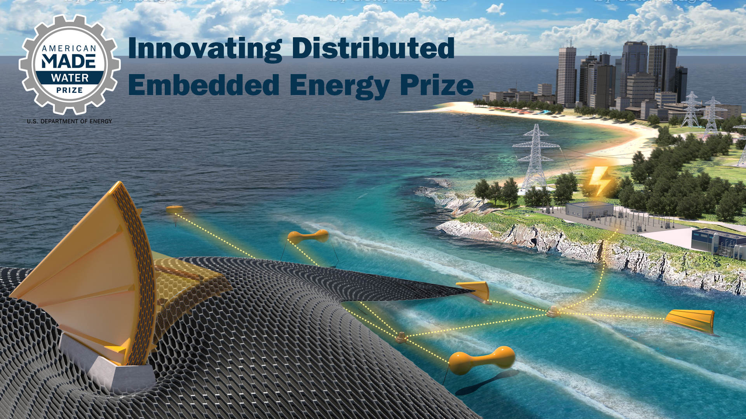
Innovating Distributed Embedded Energy Prize
$2.3M prize pool
Three phases over two years
Incentivize progress in early-stage research
Help solve technical challenges that could be applied to wave energy

Slide 6

Contributing to Leaderboard Scoring
For questions about the prize overall, view our recorded conversation on April 12 2023
Participation in this webinar contributes to your final leaderboard score
Make sure to complete the Leaderboard Eligibility Form to receive points for your participation
If you haven’t done this yet, do so now: https://www.herox.com/indeep
WPTO’s desired outcome for InDEEP is an understanding of the landscape of innovators and
potential DEEC-Tec solutions that could be applied to wave energy devices.

Slide 7
Ocean Waves

Slide 8
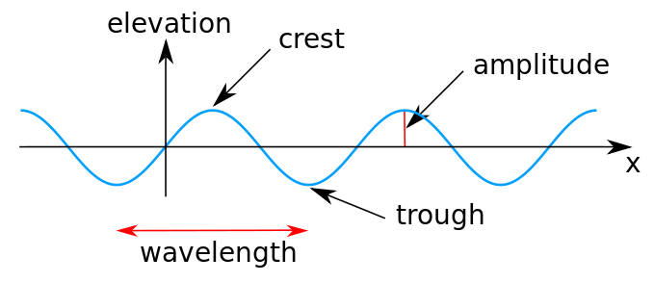
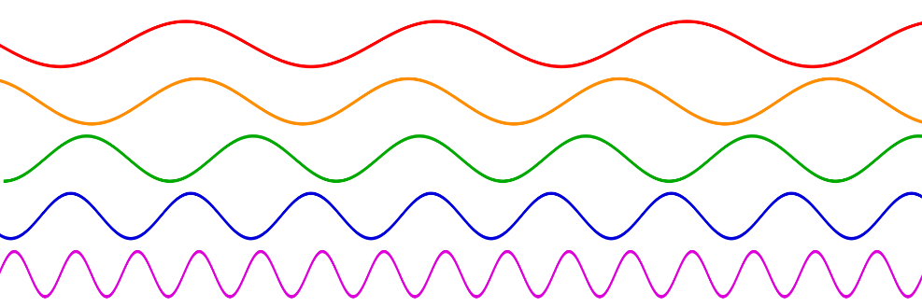
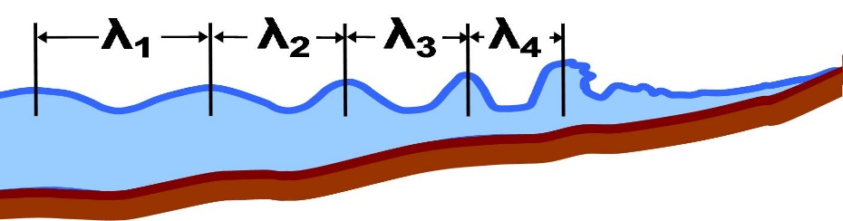
Ocean Waves – Key Geometric Parameters
wave height
"Sine wave amplitude" by Kraaiennest - Own work
Licensed under CC BY-SA 3.0 via Commons
"Sine waves different frequencies" LucasVB. . Own work assumed
.. Licensed under Public Domain via Commons
"Local wavelength" by Brews ohare - Own work
Licensed under CC BY-SA 3.0 via Commons

Slide 9
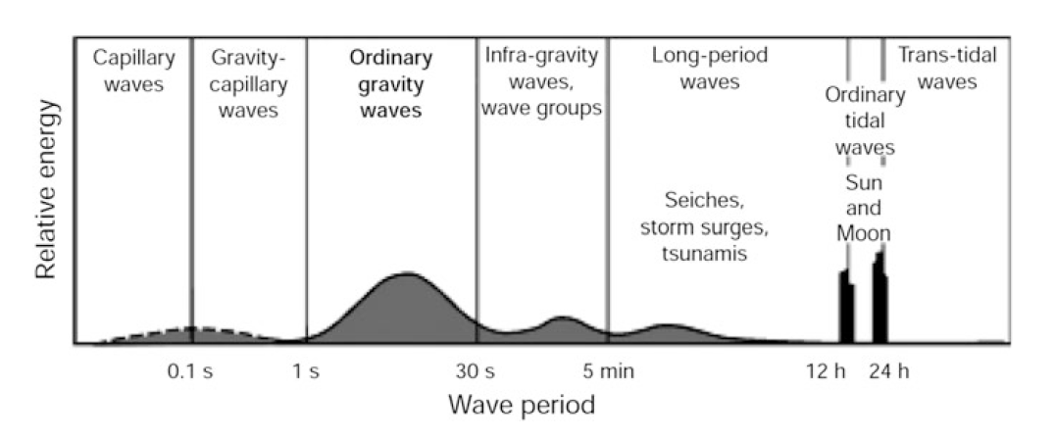
Ocean Waves – Key Temporal Parameter
Types of waves in the ocean by wave period
World Meteorological Organisation: Guide to wave analysis and forecasting (WMO 702), 2nd
edn. WMO (1998)

Slide 10
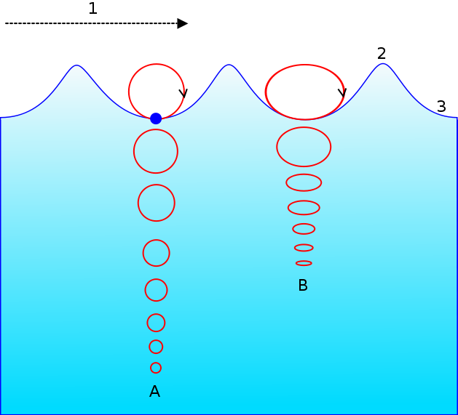
Ocean Waves – Visualization of Dynamics
Motion of a particle in an ocean wave.
A = At deep water.
B = At shallow water
1 = Propagation direction.
2 = Wave crest.
3 = Wave trough.
Wikipedia
"Wave motion-i18n-mod" by Original uploader was Vargklo at en.Wikipedia
Licensed under CC BY-SA 3.0 via Commons

Slide 11
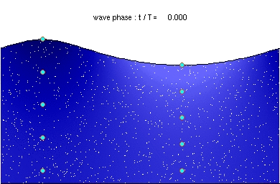
Ocean Waves – Visualization of Dynamics
“Deep water wave” by Kraaiennest – Own work.
Licensed under GFDL via Commons
Notes:
Brittany

Slide 12

Ocean Waves – Visualization of Dynamics
“Deep water wave” by Kraaiennest – Own work.
Licensed under GFDL via Commons
Notes:
Brittany

Slide 13
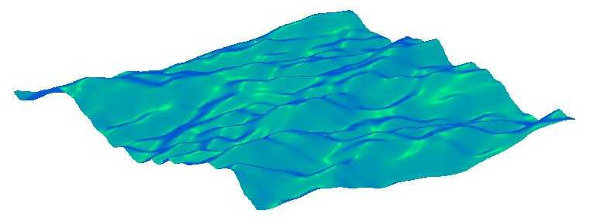
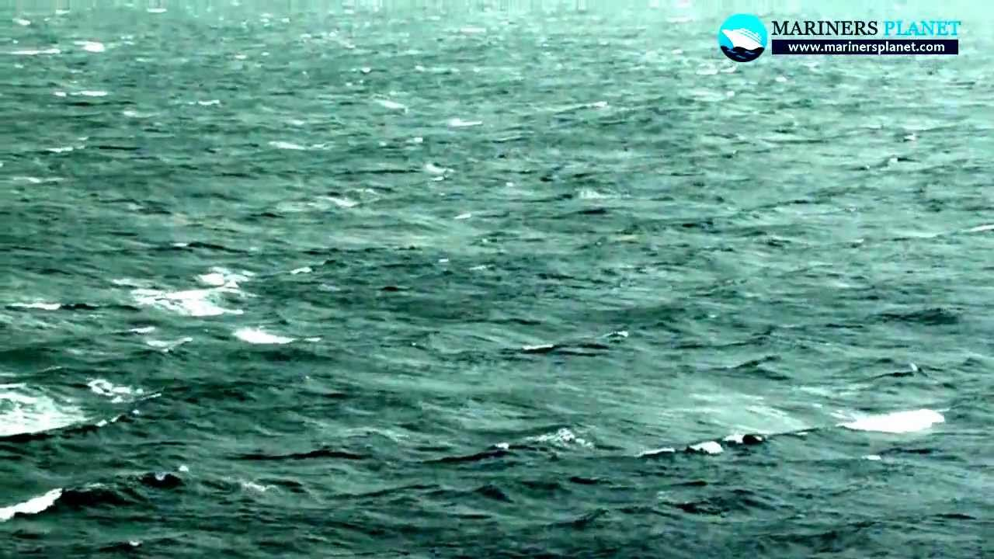
Ocean Waves – Three Dimensions
From WAFO

Slide 14
Wave – Body Interaction

Slide 15
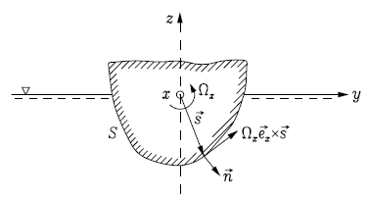
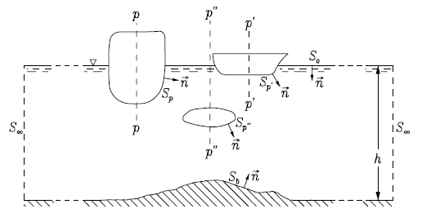
Forces on a Floating Body

Slide 16

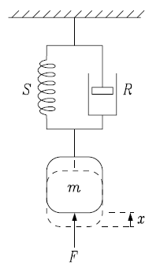
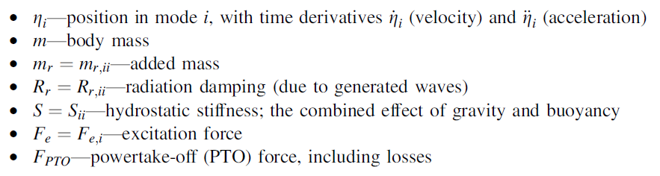
Forces on a Floating Body

Slide 17
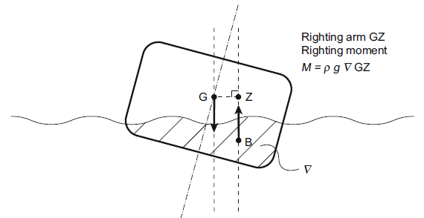
Hydrostatics – Restoring Force
Force as a Function of Displacement
Degrees of Freedom
  Heave – driven by water plane area
  Pitch – driven by water plane area, center of buoyancy and center of gravity
  Surge – Not occurring, neutral
Stability

Slide 18
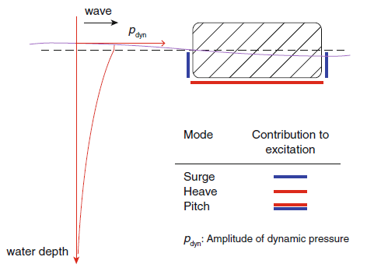
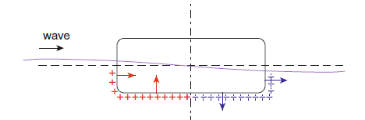
Wave Diffraction – Excitation Force
Force in the body due to the presence of the wave
Incident wave
  Froude Krylov
Scattered wave
Diffraction = Incident + scattered wave
Excitation
Degrees of Freedom

Slide 19
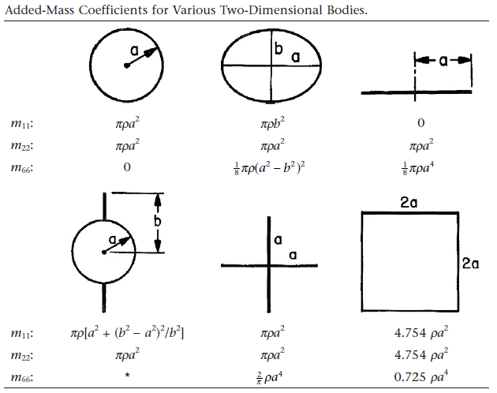
Added Mass – Hydrodynamic Inertia
Force as a function of acceleration
Represents the inertia of the accelerated water mass
Frequency independent when body is deeply submerged
Frequency dependent when body is near water surface
Cross coupling effects between different degrees of freedom
Cross coupling effects between degrees of freedom of different bodies
Newman, Marine Hydrodynamics, 1977

Slide 20
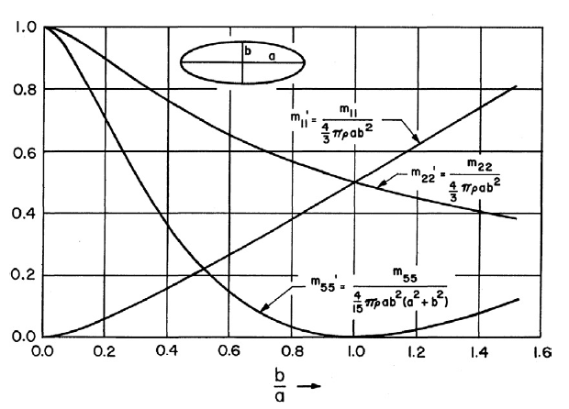
Added Mass – Hydrodynamic Inertia
Force as a function of acceleration
Represents the inertia of the accelerated water mass
Frequency independent when body is deeply submerged
Frequency dependent when body is near water surface
Cross coupling effects between different degrees of freedom
Cross coupling effects between degrees of freedom of different bodies
Newman, Marine Hydrodynamics, 1977

Slide 21
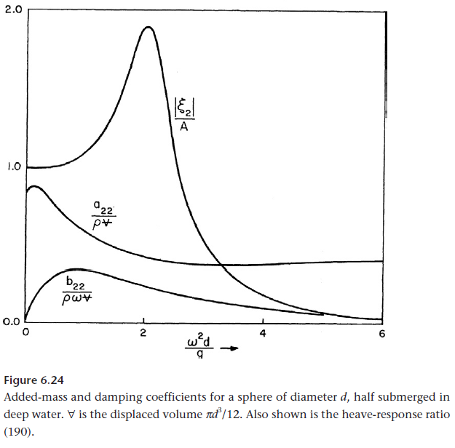
Wave Radiation – Hydrodynamic Damping
Force as a function of velocity
Represents the energy consuming damping due to the radiation of a wave
Frequency dependent
Zero when body is deeply submerged
Cross coupling effects between different degrees of freedom
Cross coupling effects between degrees of freedom of different bodies
Newman, Marine Hydrodynamics, 1977

Slide 22
Wave Energy

Slide 23
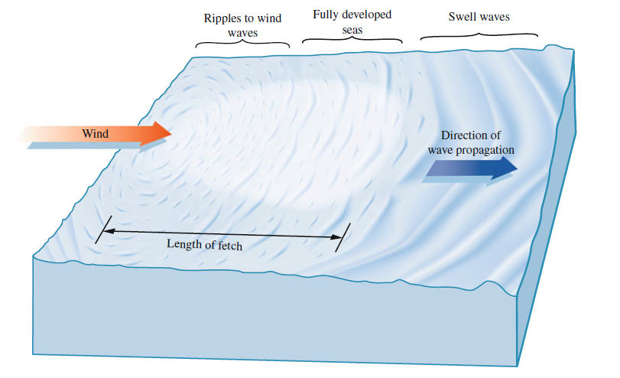
Wave Energy – Propagation
Energy Flux
[kW/m]
Incident Power
Garrison, T.S.: Oceanography: An Invitation to Marine Science, 7th edn. Brooks/Cole,
Belmont, USA (2010)

Slide 24
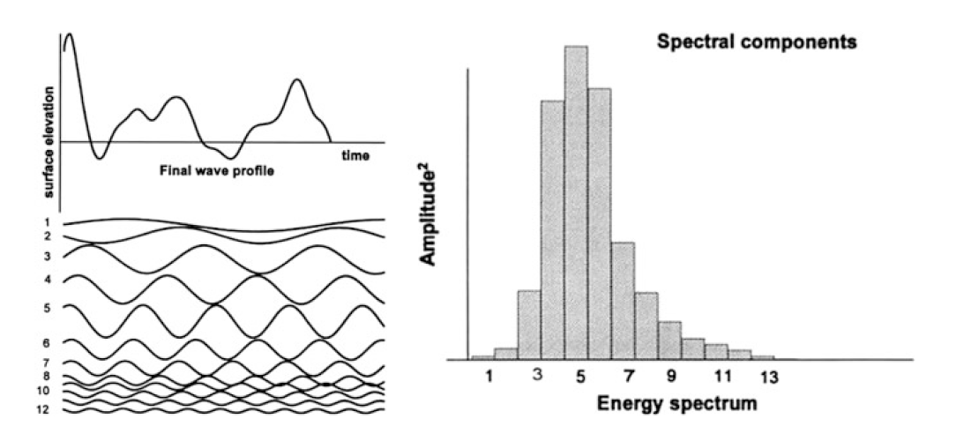
Wave Energy – Time and Frequency Domain
Super-positioning of waves (corresponding to spectral components) to create water
surface elevation (left) and the resulting spectrum (right)
Massel, S.R.: Ocean Surface Waves: Their Physics and Prediction, 2nd edn. World Scientific
Publishing, Singapore (2013)

Slide 25
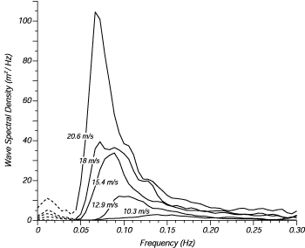
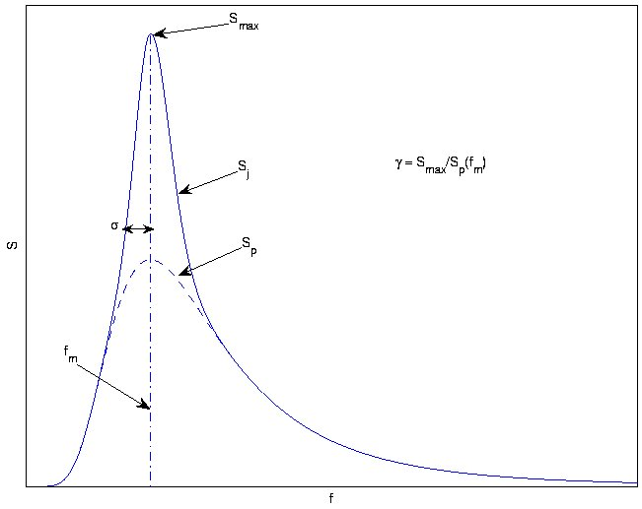
Wave Energy – Spectral Representation
Real spectra (left) and parameterized (right) spectral representation
(JONSWAP and Pierson-Moskowitz spectra) – defining sea states
https://wikiwaves.org/Ocean-Wave_Spectra

Slide 26
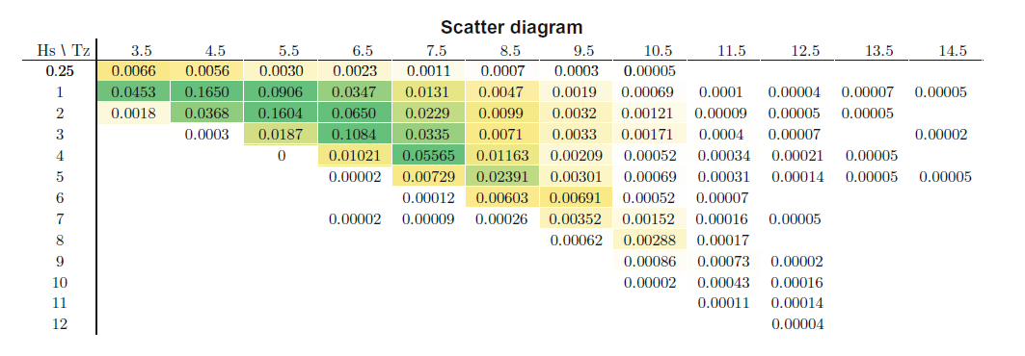
Wave Energy – Distribution of Spectra
Matt Folley

Slide 27
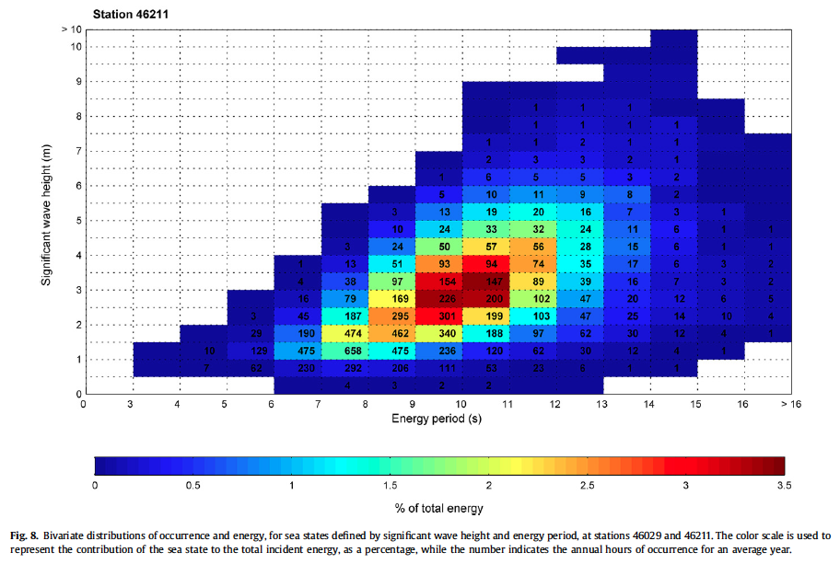
Wave Energy – Distribution of Spectra

Slide 28
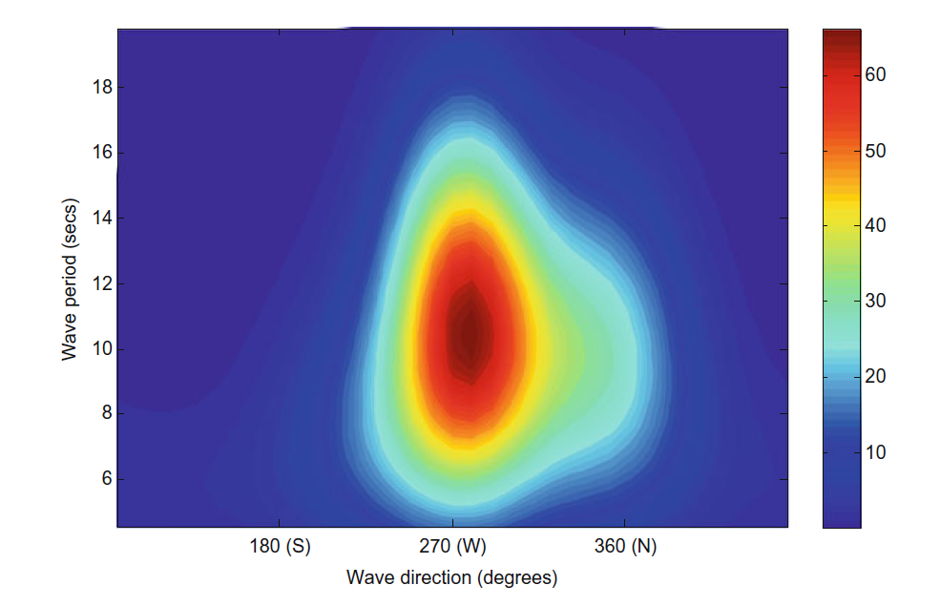
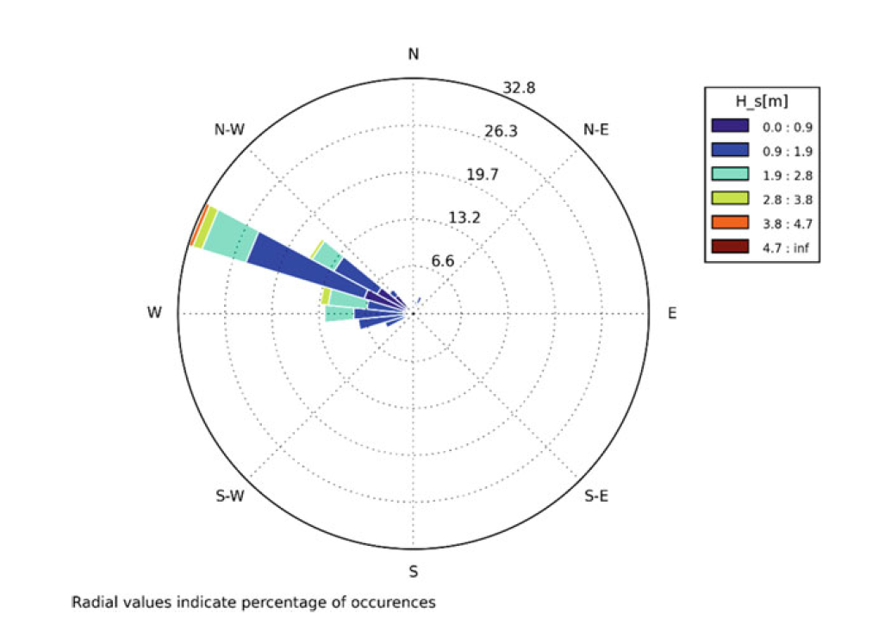
Wave Energy – Distribution of Orientation/Direction
Average directional spectral variance density (m2/Hz/rad) at the European Marine Energy, Centre, Orkney, Scotland
Matt Folley
Matt Folley

Slide 29
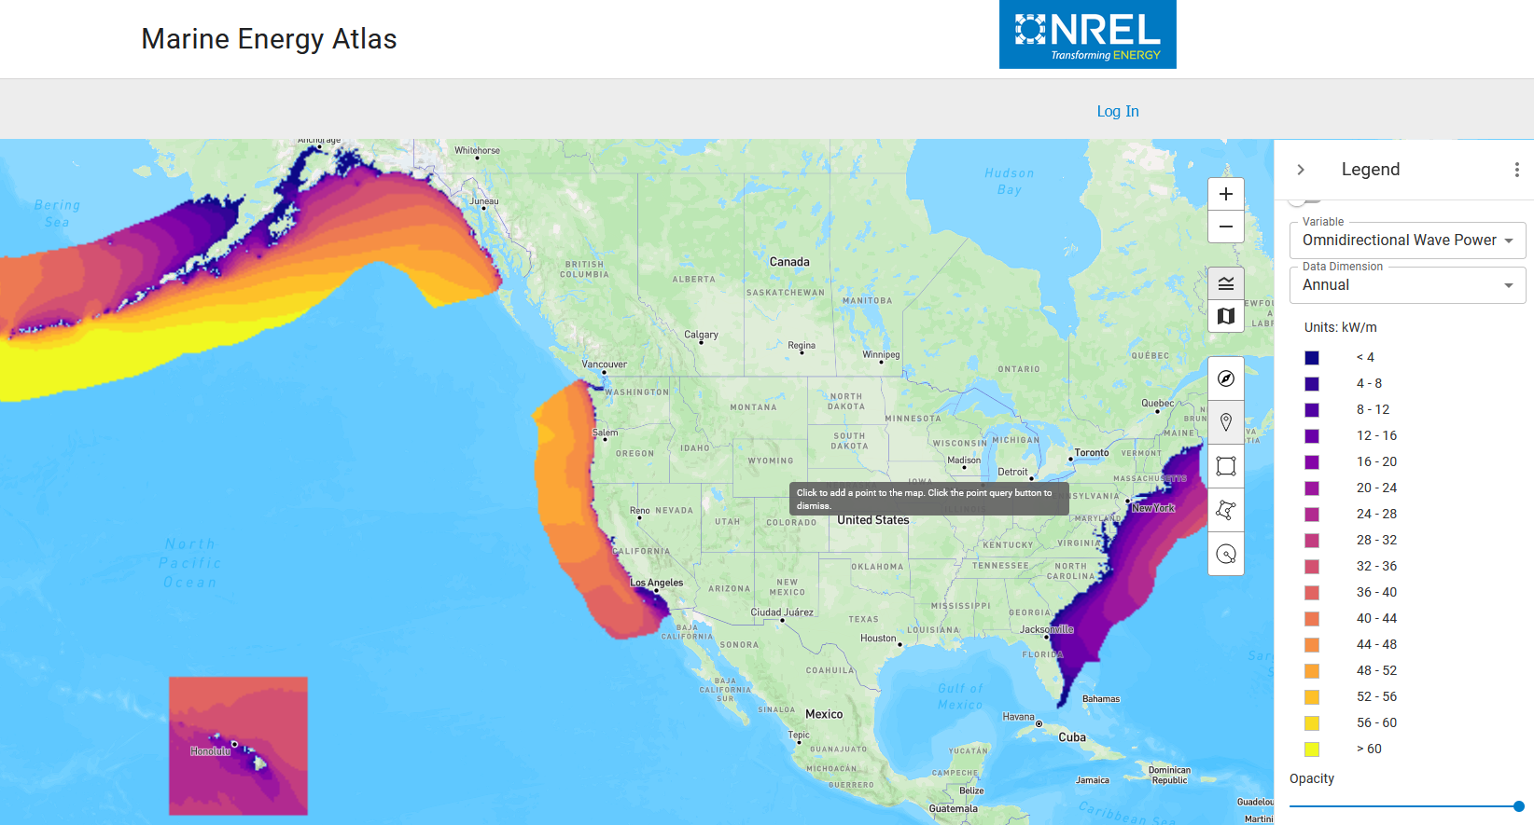
Wave Energy – Resource
https://maps.nrel.gov/marine-energy-atlas/

Slide 30

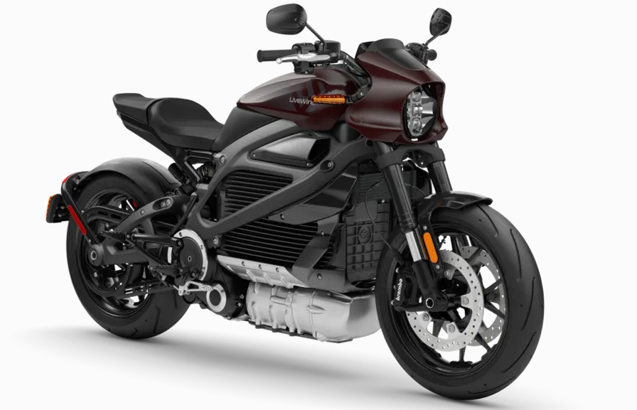
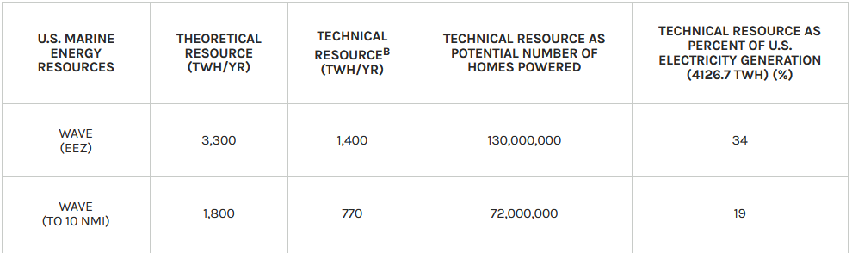
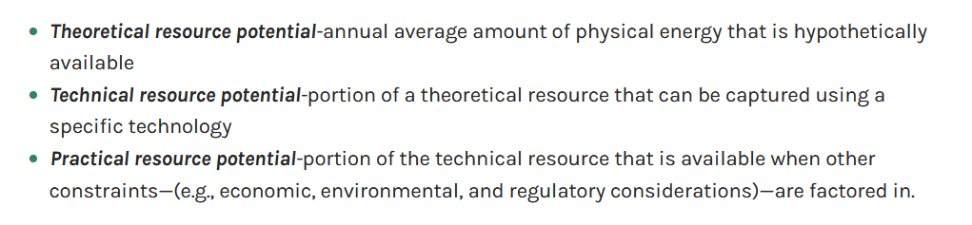
Wave Energy – Resource
33 kW/m =
/(2 m)
https://maps.nrel.gov/marine-energy-atlas/

Slide 31
Wave Energy Conversion

Slide 32
Energy Distribution
Single Mode Sea-State
Bi-Modal Sea-State

Slide 33
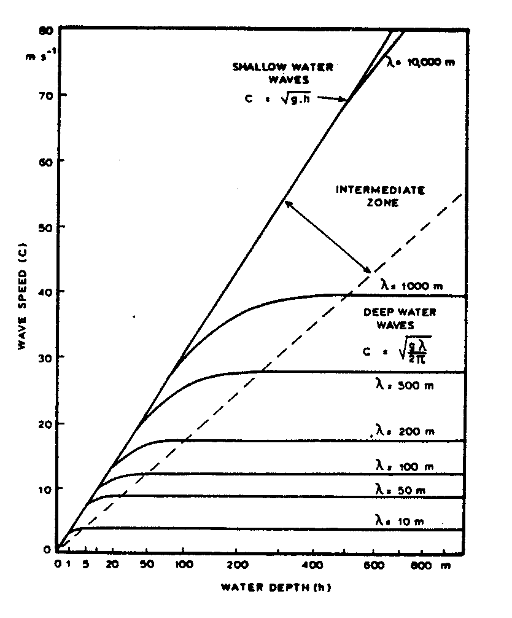
Ocean Wave Dynamics – Dispersion Relation
Quick explanation
Formular
Graph
Meaning
Ref: https://folk.ntnu.no/oivarn/hercules_ntnu/LWTcourse/indexA.htm

Slide 34
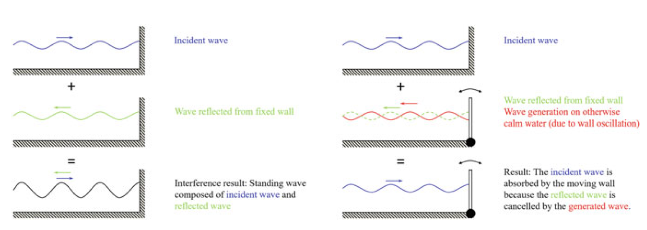
Wave Energy Absorption
Jorgen Hals

Slide 35
Power Takeoff – Damping & Restoring
Power Take-Off Functions
  Provide interaction with the wave absorbers to extract energy from ocean waves and convert to other secondary energy form (e.g., mechanical)
  Convert the secondary energy form to the desired energy form (e.g., electrical)
Power Take-Off Capabilities
  Energy conversion through damping force – in phase with velocity
  Energy storage through restoring force – in phase with displacement

Slide 36
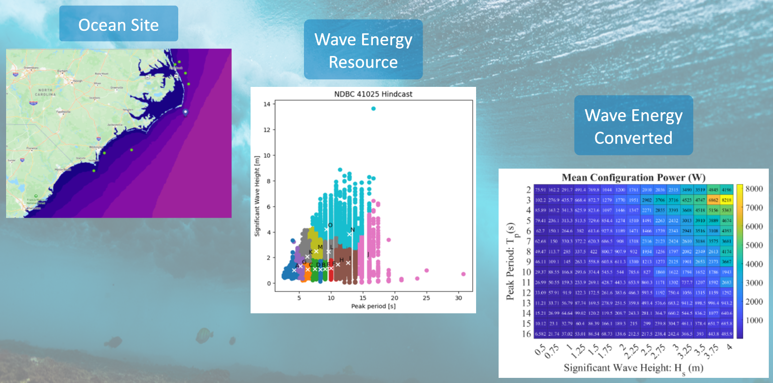
From Wave Power to Power Matrix

Slide 37
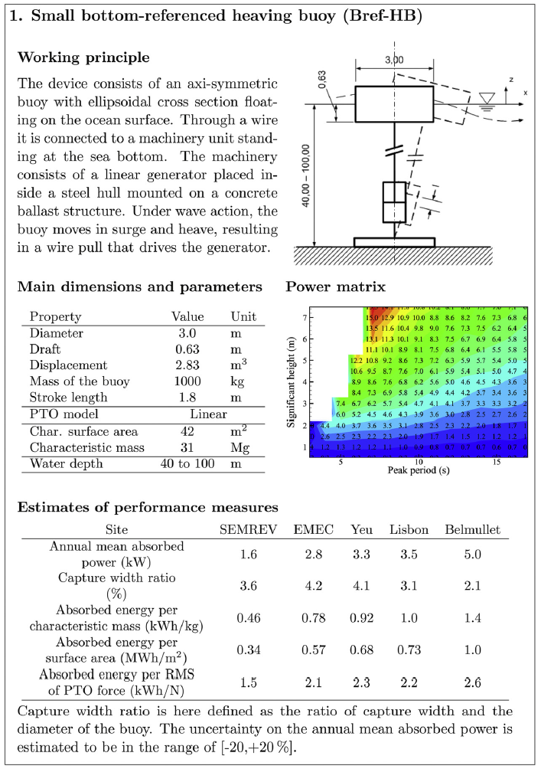
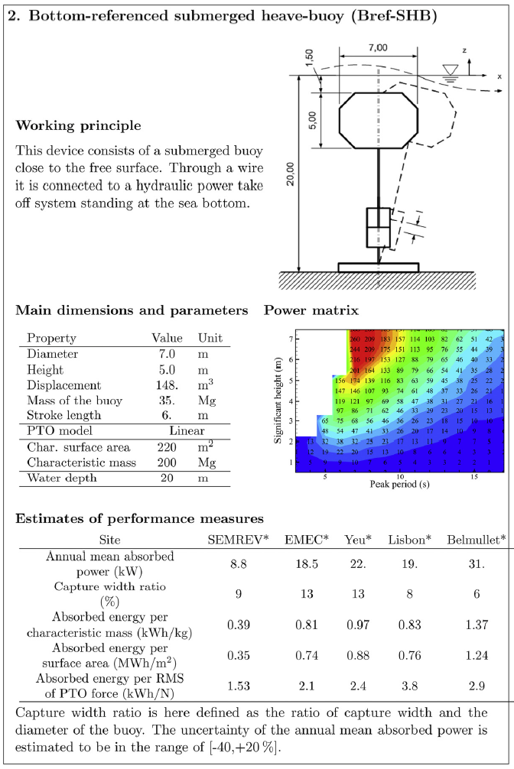
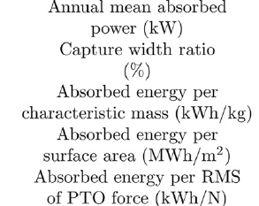
Wave Energy Absorption – Benchmark Study
Quantities of Interest
Performance Metrics

Slide 38
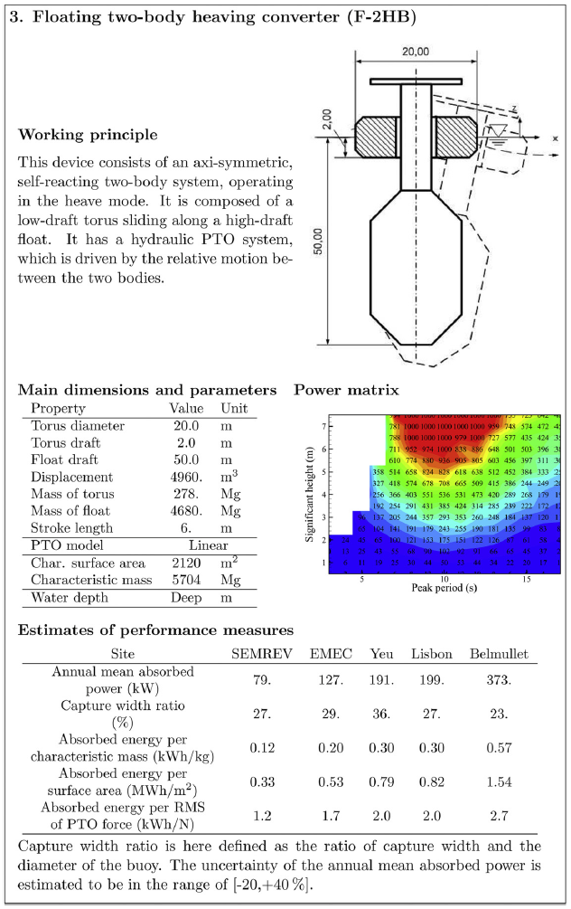
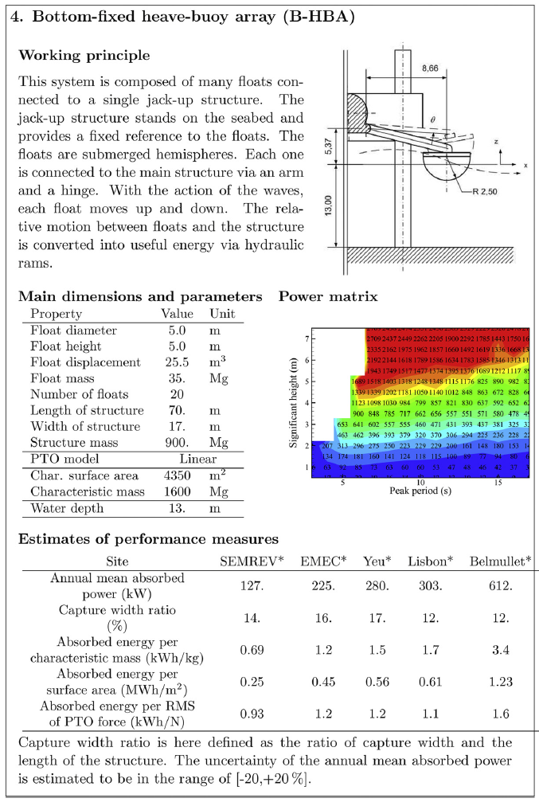
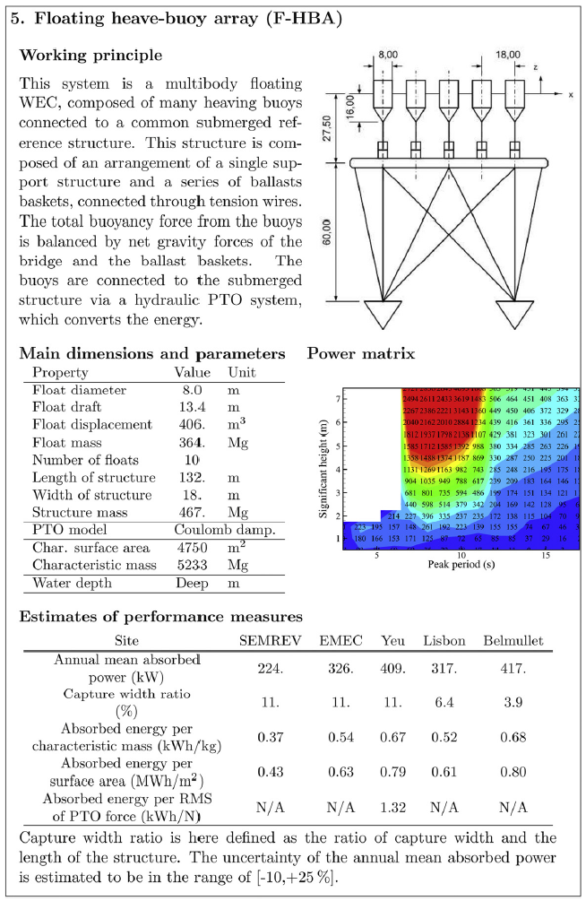
Wave Energy Absorption – Benchmark Study

Slide 39
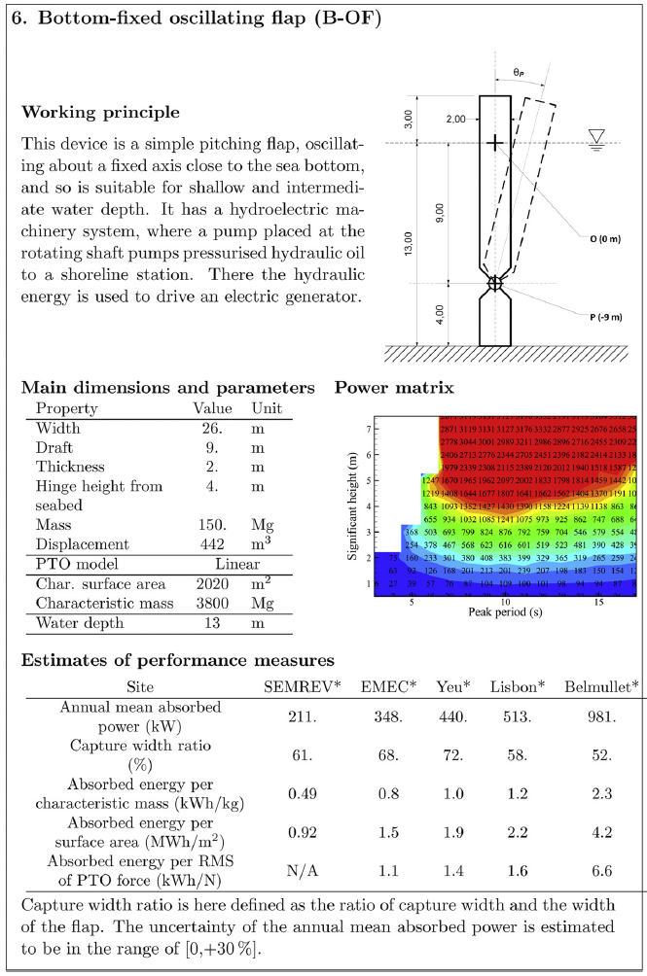
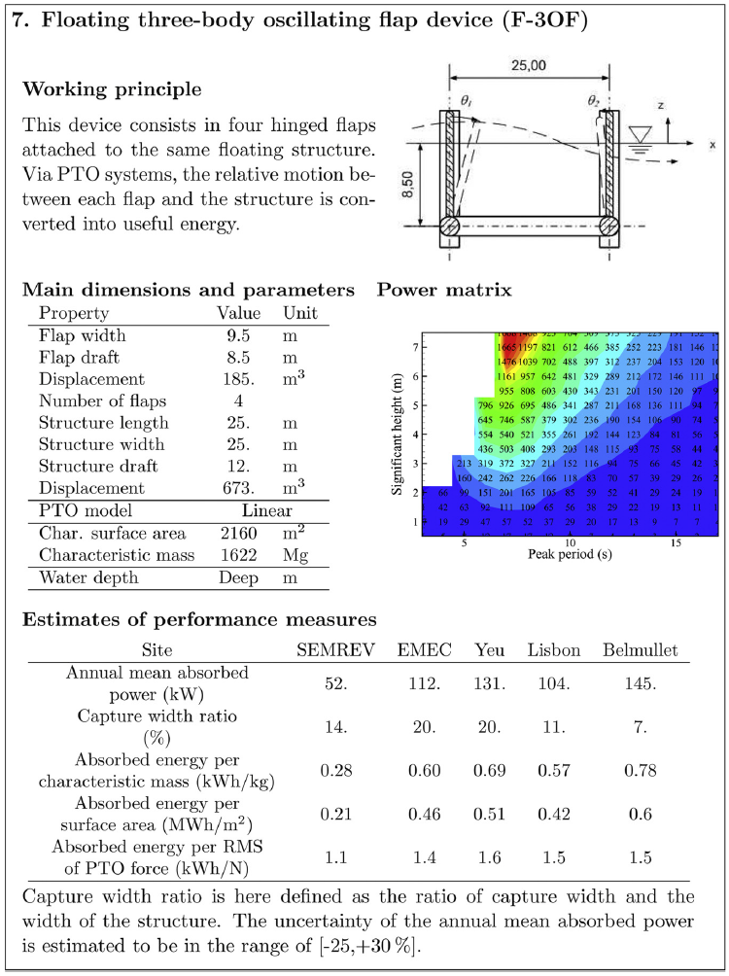
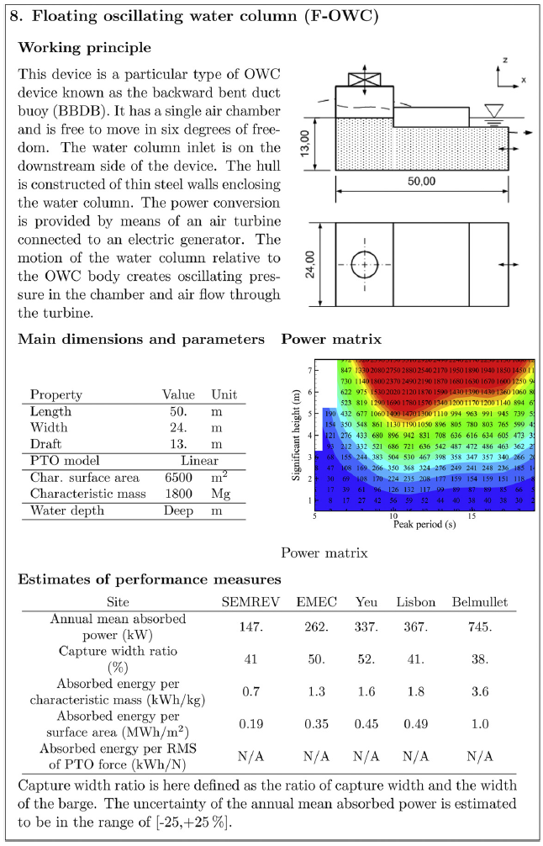
Wave Energy Absorption – Benchmark Study

Slide 40
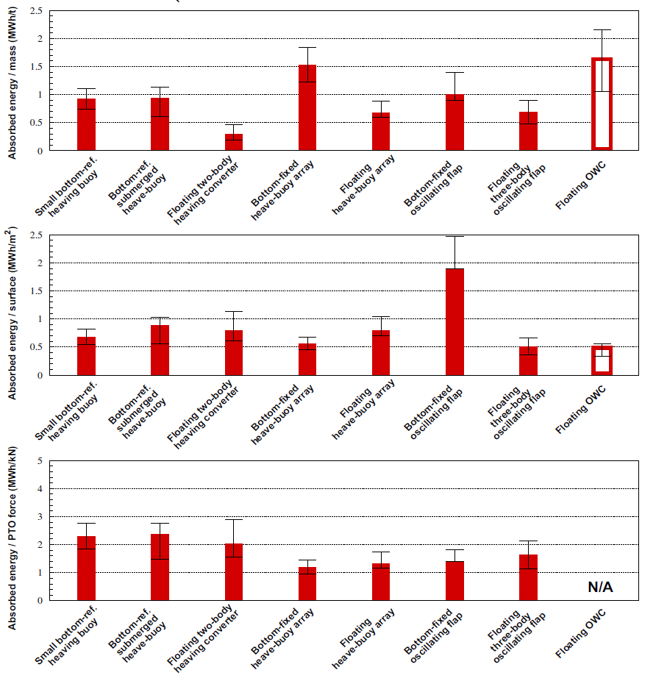
Wave Energy Absorption – Benchmark Study

Slide 41
Technology

Slide 42
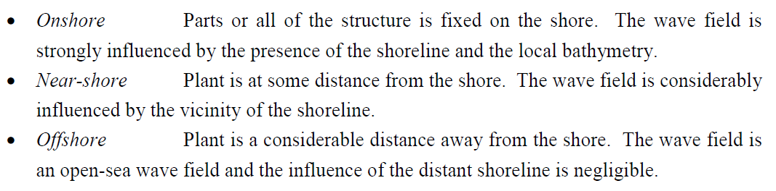
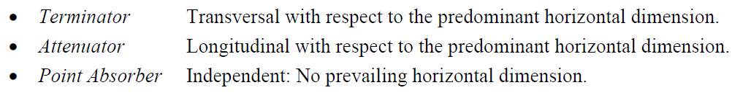
Technology – Concept Classification
Location
Orientation

Slide 43
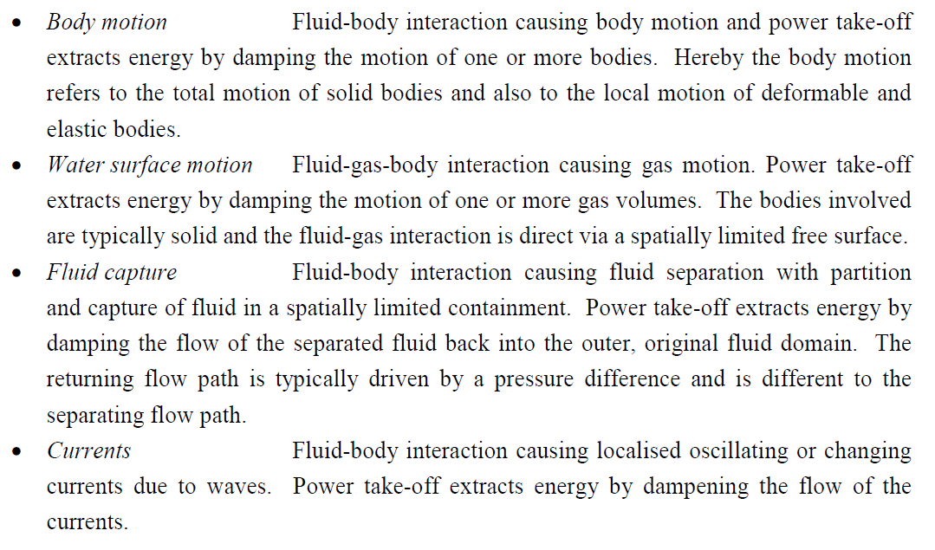
Technology – Concept Classification
Mechanism of Extraction

Slide 44
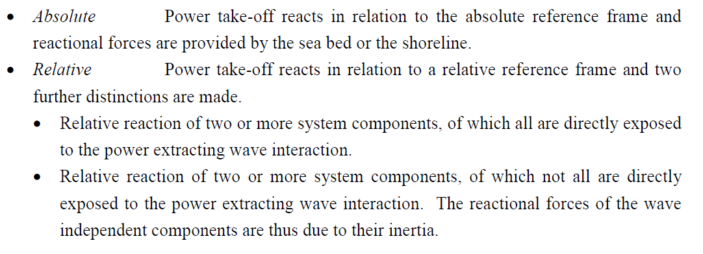
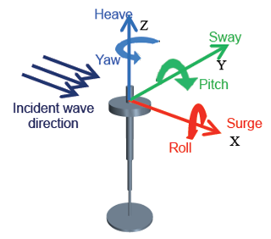
Technology – Concept Classification
Reactional Reference
Motion Degrees of Freedom in Coordinate System

Slide 45
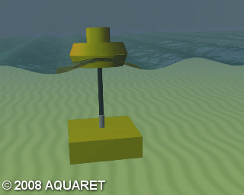
Technology – Concepts

Slide 46

Technology – Concepts

Slide 47

Technology – Concepts

Slide 48

Technology – Concepts

Slide 49

Technology – Concepts

Slide 50

Technology – Energy Conversion
Different paths for wave energy to electricity conversion
A. Têtu

Slide 51
Technology Development Methods

Slide 52




System Modelling and Simulation
Wide variety of system models and simulation tools to be selected for use case
More to come …

Slide 53



Wave Basin Testing and Validation
Fundamental Concept
Survival Testing
Advanced Control Testing
Sophisticated Direct Generation Power Take-Off
Power Absorption Code Validation

Slide 54



Bench and Laboratory Testing and Characterization

Slide 55


Open Water Demonstration – Test Sites
US: Hawaii & Pacific Coast
EU

Slide 56
Technology Development History

Slide 57


Early Developments
First patent is reported to have been filed as early as 1799 by Girard and since then patent numbers are well in the thousands
Early developments in the US include 1898 patent by Wright
First oscillating water column designed by Palme in 1920

Slide 58

Early Developments
First commercial application of wave energy:
In 1940s, Japanese inventor, Yoshio Masuda, lead substantial research and invented, designed and build floating of oscillating water column device to generate power for navigation buoys.
Commercialization in large numbers in Japan from 1965 and later in USA.

Slide 59



Oscillating Water Column Devices

Slide 60



Oscillating Water Column Devices

Slide 61



Oscillating Water Column Devices

Slide 62




Floating Oscillating Water Column Devices

Slide 63




Oscillating Water Column Devices Turbines

Slide 64


Salter Duck

Slide 65


Salter Duck
Survivability
Ref: Salter, S. Wave energy: Nostalgic Ramblings, future hopes and heretical suggestions. J. Ocean Eng. Mar. Energy 2, 399–428 (2016). https://doi.org/10.1007/s40722-016-0057-3

Slide 66



Salter Duck

Slide 67



Salter Duck … Weptos

Slide 68



Pelamis

Slide 69



Pelamis

Slide 70





Pelamis

Slide 71
Challenges & Motivation

Slide 72

Technology – Development Challenges: Cost

Slide 73

Technology – Development Challenges: Risk

Slide 74

Technology – Development Challenges: Time

Slide 75

Technology – Development Challenges: Innovation

Slide 76
Challenges & Motivation & Solutions

Slide 77
Technological Evolution vs Intelligent Design
Technological Evolution
Intelligent Design
Wind Energy
Wave Energy
• Early convergence of concepts,
• Technical feasibility, industrial production and market opportunity at all and growing scales,
• Availability of technological knowhow & experience in theory, design, production & operation of very similar industrial applications,
• Cheap and easy access (onshore) to operating system, allowing gradual failure rate reduction during commercial operations.
• Large spectrum of different converter system concepts,
• Strongly decreased market opportunity at reduced scales,
• Limited transferability of technological experience, design, production and operation of similar industrial applications,
• Expensive and delayed access to operating system (offshore), prohibiting high failure rates from the onset of commercial operations.

Slide 78
Learnings and Leads Solutions
Technology Development Strategy, Methods and Tools
  Development Protocols
  Cost, Time and Risk Reduction
Techno-Economic Assessment
Significant improvement in Modelling, Simulation of Dynamics, Loads and Stresses
System Optimization & Co-Design
Marine Operations Modelling
Novel Power Conversion Systems
Advanced Manufacturing Methods
Identification of Alternative Markets
  Blue Economy
  High Impact Applications
Design Paradigm Shifts

Slide 79





Technology – Possibility for Paradigm Shift?
Pelamis
SBM Offshore

Slide 80
Questions
Notes:
Carrie

