Slide 1
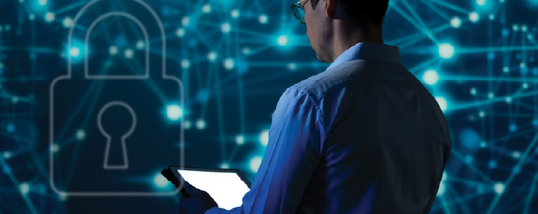


Digitizing Utilities Prize Round 2
November 2023

Slide 2
Agenda
1
Office of Electricity Overview
2
Office of Cybersecurity, Energy Security & Emergency Response Overview
3
American-Made Overview
4
Digitizing Utilities Round 2 Overview
5
Important Dates & Events
6
Submitting to the Prize
7
Utility Partner Support
8
Power Connectors
9
Questions

Slide 3
Office of Electricity (OE) Overview

Slide 4

The Office of Electricity

Slide 5



Transmission Reliability and Renewable Integration (TRRI)
Program Areas
Goal
Improve transmission system visibility and controllability to ensure reliability and resilience given new operational challenges.
Advanced Applications Research and Development
Build sector capability to develop effective visualizations, and to provide more useful alarms and cues for grid operation, planning, and workforce development.
Decision Support Systems for Transmission Operations
Develop new ways of measuring and characterizing the power system to ensure high quality, accurate data for model and tool development.
Reliability Metrics, Standards, and Emerging Issues

Slide 6



Sensors and Data Analytics (SDA)
Program Areas
Goal
Utilizing sensors to improve distribution system visibility and controllability to address new operational challenges
Enhanced Distribution System Resilience and Control
Data Integration and Event Detection
Data analytics for proactive resilience with high frequency data, ML/AI. Creating research data sets to develop applications.
Sensor Valuation, Validation and Standards
Improve system sensing through better sensor placement and improved data acquisition, consistency and validity

Slide 7
Office of Cybersecurity, Energy Security & Emergency Response (CESER) Overview

Slide 8
CESER
Mission
Strengthen the security and resilience of the U.S. energy sector from cyber, physical, and climate-based risks and disruptions.
Evolving Threats
to Energy Infrastructure
Cyber Threats
Climate Risks
Physical Threats
EMP | GMD
Supply Chain
Notes:
The grid of the future will be required to address a multi-threat environment. As physical and virtual threats to our critical energy infrastructure continue to evolve, DOE is using all the tools at our disposal to lock down cybersecurity vulnerabilities of today and tomorrow.
CESER works to ensure these security functions are more resilient and better prepared to identify, prevent, mitigate, and respond to threats.
An integrated approach to the U.S. security mission is vital to successfully secure the nation’s energy system, especially as we embark on a journey to 100% clean energy and as distributed energy resources continue to grow.
Cybersecurity:
Cybersecurity in the energy sector is one of the nation’s most important and complex national security challenges.
Our nation’s energy system has always been a primary target for our adversaries. When you consider how many other critical sectors depend on energy, it's easy to see why: a widespread disruption to energy infrastructure could affect hospitals, water, transportation, emergency services, the financial sector, and government operations.
Climate
Increased frequency and intensity of extreme weather events and potential attacks on electrical infrastructure require careful consideration of physical security.
Physical
Attacks on electric power systems are not new; utilities have faced physical threats ranging from copper theft at substations to ballistic incidents targeting substation equipment.
This threat is evolving and becoming more sophisticated.
Supply Chain:
Cyberattacks on the supply chains of digital components are a major area of national focus for the federal government.
Security by Design
Because these threats will not diminish, it is important that the future electric power system be designed and operated in such a way that it can continue its critical functions after an attack. (Security by Design)

Slide 9
American Made Challenges Overview

Slide 11

Fast track your ideas for the clean energy revolution
$240M+
70+
400+
in cash prizes and support
prizes
Network members

Slide 13
Digitizing Utilities Round 2 Overview

Slide 14

Round 2 Overview
This $1.85M prize connects utilities with interdisciplinary teams of software developers and data experts to transform digital systems and data analytics for utilities in the energy sector.
Recent advances in sensor technologies allow utilities to access fast-streaming data sets, challenging traditional methods of data acquisition, use, and storage. To fully utilize the massive influx of data from these sensors, the electricity sector must undergo a transformation in how it manages data quality, storage, and processing.
The Digitizing Utilities Prize supports competitors as they develop innovative solutions to transform data analytics and system digitization for utilities, such as energy use data, synchrophasor data, weather data, fire assessment data, and more. In Round 2, innovators have the option to focus specifically on addressing cybersecurity threats and risks through demonstrated improvements in risk identification, analysis, prediction, or proactive response for enhanced protection of digital energy infrastructures.

Slide 15

Prize Tracks
Track 1: Utility Digitization/Data Challenge
Competitors will work with their utility partner to identify a data-related challenge and propose a thorough solution by the end of Stage 2.
Track 2: Utility Cybersecurity Challenge
Competitors will work with their utility partner to identify a cybersecurity-related challenge and propose a thorough solution by the end of Stage 2.
Competitors must identify whether their proposed solution applies to Track 1, Track 2, or both within the application. Applicants who choose to compete in both Track 1 and Track 2 are eligible to receive prizes from both tracks.

Slide 16
Prize Structure
Phase 1: Plan
Phase 2: Progress
Form teams and connect with a utility partner to identify a data challenge and propose a solution.
Prizes
Track 1 (Utility Digitization/Data Challenge): Up to 8 cash prizes of $75,000 each
Track 2 (Utility Cybersecurity Challenge): Up to 6 cash prizes of $75,000 each
Work with utility partners for 6 months to develop and refine a software solution that addresses the chosen challenge.
Prizes
Track 1 (Utility Digitization/Data Challenge): Up to 3 cash prizes of $200,000 each
Track 2 (Utility Cybersecurity Challenge): Up to 1 cash prize of $200,000

Slide 17
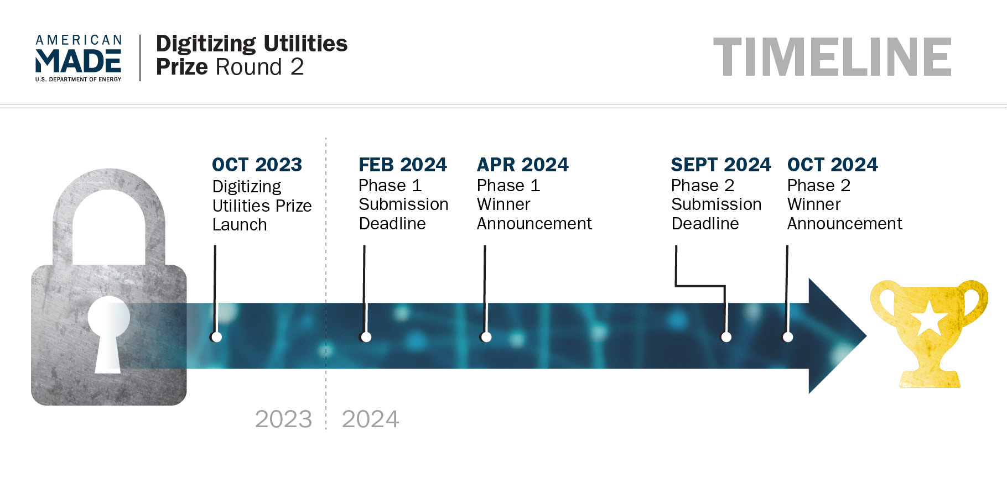

Slide 18

Round 2 Eligibility
Individuals, teams of individuals, private entities (for-profits and nonprofits), and nonfederal government entities (such as states, counties, tribes, municipalities, and academic institutions) are eligible to compete in this prize.
Past competitors of the Digitizing Utilities Prize Round 1 are encouraged to reapply with updated submission materials; however, teams who won any phase of Round 1 are discouraged from submitting the same or similar idea to this round or any future round of the prize.
Private entities shall be incorporated and maintain a primary place of business in the United States.
Academic institutions must be based in the United States.
Individuals competing as part of an incorporated private entity may participate if they are legally allowed to work in the United States.
Refer to the official rules for the complete eligibility requirements.

Slide 19
Submitting to the Prize

Slide 20
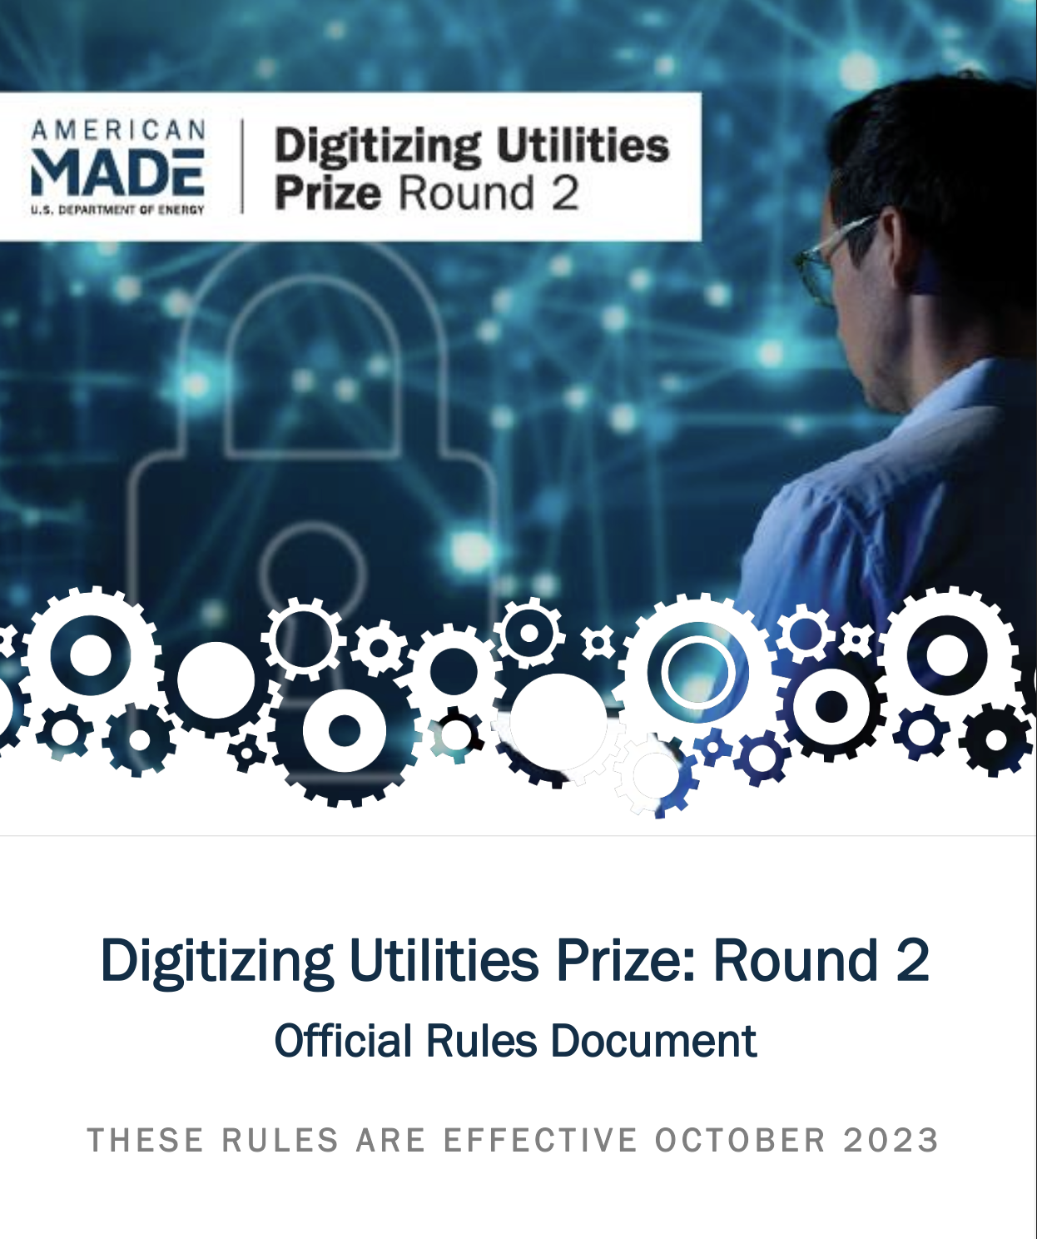
Read the Rules!
Official Rules for the American-Made Digitizing Utilities Prize Round 2
are available online!
https://www.herox.com/DigitizingUtilitiesRound2/resource/1434

Slide 21
Plan Phase Submission
What to submit:
    90-second video (public)
    Cover page
    Narrative that answers four questions
    One summary PowerPoint slide (public)
    Required letters of commitment or support from utility partner

Slide 22

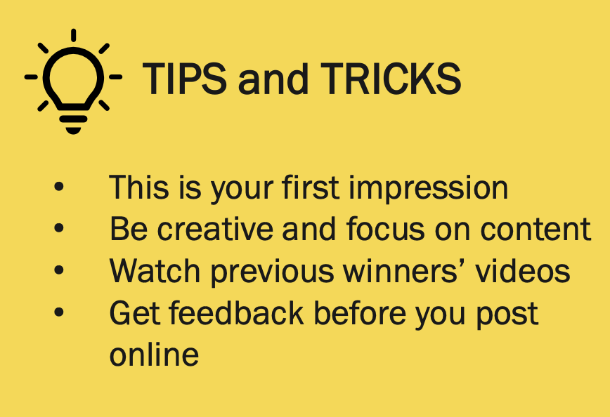
Online Public Video
Suggested content for 90-second video:
  Describe your team and how it is uniquely qualified to solve the selected utility’s problems.
  Describe your proposed solution and why it is the best approach to the utility’s problem.
Judges will be evaluating for similar content.
  While there are no specific scoring criteria for the video, it will be evaluated as part of the entire submission package. The video serves as a first introduction of your team and solution to the reviewers.

Slide 23
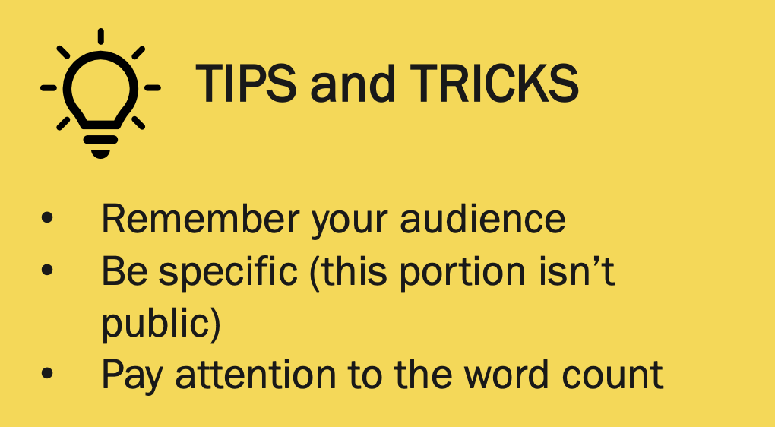
Narrative
1. Team
What is your team’s past experience providing solutions for this or related problems?
2. Solution
What is your solution to the problem?
3. Goals
What are the goals you are aiming to achieve during the Progress Phase?
4. Implementation Plan
How will you measure the success of your approach?
5. Both Tracks Submission
How does your solution simultaneously address both the utility digitization/data challenge and utility cybersecurity challenge?
Word Limit: 2,500 words
(3,250 words if competing in both tracks)
Up to 5 supporting images, figures or graphs

Slide 24
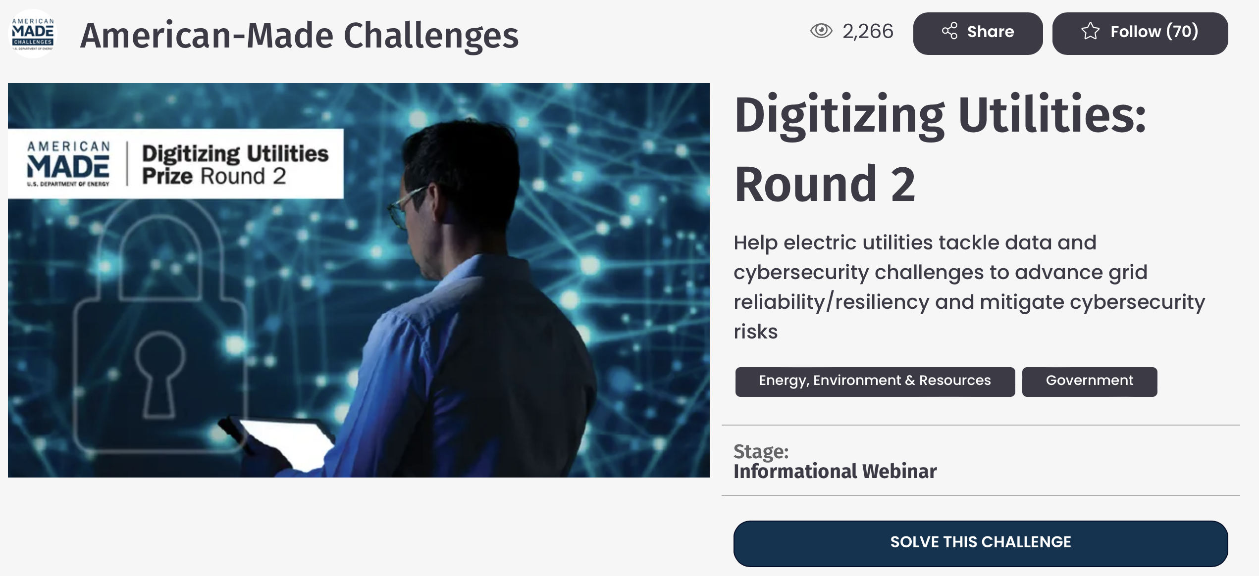
HeroX Submission
Your Plan — Phase Submissions are due by February 26th, 2024, at 5 PM Eastern.
Late submissions will not be accepted!
Submissions can be entered at: https://www.herox.com/DigitizingUtilitiesRound2

Slide 25
Competitor Support

Slide 26
Utility Partner Support
Team Search
Power Connector
HeroX Forum
We will be posting a forum thread shortly.
List the following:
  Name
  Team Partners
  Capabilities
  Areas of Interest
  Experience
Email Us
Feel free to email us with the same information.
We will pass along to interested utilities!
Currently looking to expand our power connector support for a teaming event & webinar!
Teaming event to be held in early/mid-December
Follow the challenge on HeroX for updates!

Slide 27


Power Connectors
Yet2 will be providing mentorship office hours throughout Phase 1.
See the Digitizing Utilities Round 2 HeroX page for the link to sign up!

Slide 28
Next Steps
Follow Round 2 of the Digitizing Utilities Prize on the official prize platform, HeroX.
Read the Official Rules.
Join us for the Utility Teaming event if you don’t already have a utility partner.
Submit your application through HeroX before Feb. 26, 2024, at 5 p.m. ET.

Slide 29
Contact Us
Should you have any questions or need further clarification, please contact us at: digitizingutilitiesprize@nrel.gov

Slide 30
Thank you!

