Slide 1
Innovating Distributed Embedded Energy Prize (InDEEP)
Phase II Kickoff Webinar
November 14, 2023
Notes:
Bill

Slide 2
Agenda
Welcome
WPTO and InDEEP Overview
Prize Phases and Awards
Submission Package and Scoring Criteria
Q&A
Notes:
Bill

Slide 3
Polling Question
Are you new to the prize?
Notes:
Bill

Slide 4
About the DOE’s Water Power Technologies Office (WPTO)
WPTO enables research, development, and testing of emerging technologies to advance marine energy and next-generation hydropower and pumped storage systems for a flexible, reliable grid.
Modernizing the Existing Fleet
New Low-Impact Projects
Ocean Thermal
Pumped Storage Hydropower
Wave
Tidal, River and Ocean Current
Hydropower Program
Marine Energy Program
Notes:
Bill

Slide 5
Innovating Distributed Embedded Energy Prize
$2.3M prize pool
Three phases over two years
19 awards made in Phase I
Incentivize progress in early-stage research
Help solve technical challenges that could be applied to wave energy
Notes:
Carrie

Slide 6
Prize Goals
Leverage WEC innovation to systematically develop DEEC-Tec concepts that could bring value to the ocean wave energy industry
Build a solver community by engaging and facilitating collaboration between diverse innovators in the marine energy industry and related DEEC-Tec disciplines
Encourage development of novel DEEC-Tec with high potential relevance to WECs by supporting an interdisciplinary set of competitors from ideation to design
Refine WEC innovation methods to incorporate ideas beyond the field of wave energy based on feedback from the prize
See the Official Rules Document Section 1.5
WPTO’s desired outcome for InDEEP is an understanding of the landscape of innovators and potential DEEC-Tec solutions that could be applied to wave energy devices.
Notes:
Carrie

Slide 7
Notes:
Carrie

Slide 8
Important Dates (subject to change)
March 22, 2023 Phase I Submission Opened
August 25, 2023 Phase I Submission Closed
November 7, 2023 Phase II Opens
May 7, 2024 Phase II Closes
July 2024 Phase III Opens
January 2025 Phase III Closes
Innovating Distributed Embedded Energy Prize (InDEEP)
Phase II is Open to New and Returning Competitors
November 7, 2023 Phase I Winner Announcements and Awards
July 2024 Phase II Winner Announcements and Awards
March 2025 Phase III Winner Announcements and Awards
Notes:
Carrie

Slide 9
What’s New in Phase II?
Teams will build and laboratory test a single DEEC at the benchtop scale.
Test Report (Required and scored)
TPL Assessment (Required and scored)
New Competitor Support
New scoring scale (0-5)
Live Demonstration (Required and scored)
Notes:
Anna

Slide 10
Questions You May Have About InDEEP:
Why should I participate?
How will I be supported?
Tap into the unrealized power of the ocean’s waves
Be on the forefront of wave energy technology development
Join the clean energy revolution
Innovators inside and outside the marine energy industry will have access to marine energy training and industry experts
Teaming platform will be available to build interdisciplinary teams
Up to 15 teams can each win up $80,000 in cash awards in Phase II
What could I win?
Notes:
Anna

Slide 11
Competitor Support Mechanisms
Training Sessions:
December 2023: Wave energy 2.0 (1.0 recording available)
December 2023: DEEC-Tec 2.0 (1.0 recording available)
January 2024: Innovation methods 2.0 (1.0 recording available)
January 2024: TPL Assessment Tricks and Tips
February 2024: Prize Team Demonstration Example
Patent Search (EFN)
Submission Feedback
Mentorship in Innovation Methods and TPL Assessment (Ramboll and Wave Venture)
Resources available on HeroX
Additional resources linked in Appendix C of the Rules Document
Notes:
Amanda

Slide 12
Polling Question
Are you new to DEEC-Tecs?

Slide 13
Innovation and Design Spaces – Technology Opportunities
Concentrated Energy Conversion
Conventional Technology Approach
Extensively explored Solution Space
Distributed Energy Conversion
Innovative Technology Approach
Underexplored Solution Space
Notes:
Jochem

Slide 14
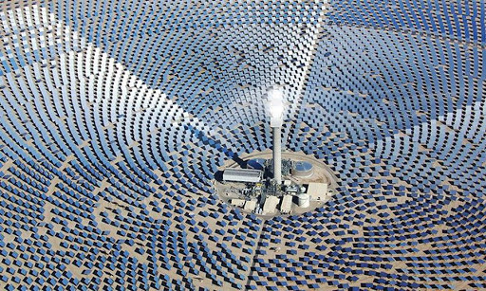
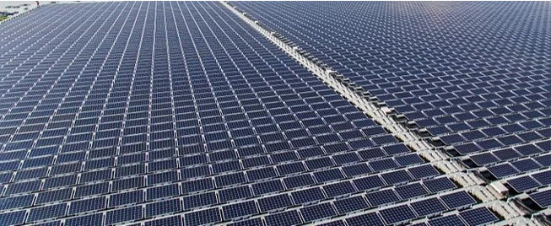
Setting the Stage: Example of Design Paradigm Shift
Concentrated Energy Conversion
Example: Thermal solar power
Energy field interception with direction to focus point for multi-stage & high load power conversion to electricity
Distributed Energy Conversion
Example: Photovoltaic solar power
Energy field interception with local conversion to high aggregation of electricity
Notes:
Jochem

Slide 15
Distributed Embedded Energy Converter Technologies DEEC - Tec
WECs are made from DEEC-Tec Metamaterials
WECs are constructed and fabricated through the assemblage of one or several DEEC-Tec metamaterials types.
Has multiple degrees of freedom enabling an inherent compliant interaction with the various frequencies of ocean waves.
DEEC-Tec Metamaterials
Structural frameworks that are made from the interconnections and combining of many DEECs.
Frameworks making up the metamaterials could be made of different configurations of DEECs; latices, weaves, layers, etc.
“DEEC-Tec Hierarchy Levels” build upon each other to, ultimately, create an ocean wave energy converter (a WEC)
Distributed Embedded Energy Converter (DEEC)
Small energy transducer with ability to interconnect with others; often has characteristic lengths of centimeters rather than tens of meters.
Could leverage any number of physical phenomena for energy conversion; e.g., variable capacitance, Faraday’s Law of Induction, piezoelectric effect, hydraulics, pneumatics.
Notes:
@Blake

Slide 16
Distributed Embedded Energy Converter Technologies DEEC - Tec
WECs are made from DEEC-Tec Metamaterials
WECs are constructed and fabricated through the assemblage of one or several DEEC-Tec metamaterials types.
Has multiple degrees of freedom enabling an inherent compliant interaction with the various frequencies of ocean waves.
Prize, however, only gives focus to:
The innovating of individual DEECs
The innovating of corresponding DEEC-Tec Metamaterials
DEEC-Tec Metamaterials
Structural frameworks that are made from the interconnections and combining of many DEECs.
Frameworks making up the metamaterials could be made of different configurations of DEECs; latices, weaves, layers, etc.
Distributed Embedded Energy Converter (DEEC)
Small energy transducer with ability to interconnect with others; often has characteristic lengths of centimeters rather than tens of meters.
Could leverage any number of physical phenomena for energy conversion; e.g., variable capacitance, Faraday’s Law of Induction, piezoelectric effect, hydraulics, pneumatics.
Notes:
@Blake

Slide 17
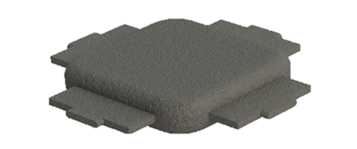
Distributed Embedded Energy Converter Technologies DEEC - Tec
Pictorial representation of an individual DEEC. An energy transducer used to convert one or more form(s) of energy into another (via some form of physical law of energy transfer). An individual DEEC also serves as a structural mechanism for the joining and/or interconnection to other DEECs for the creation of DEEC-Tec metamaterials.
Distributed Embedded Energy Converter (DEEC)
Small energy transducer with ability to interconnect with others; often has characteristic lengths of centimeters rather than tens of meters.
Could leverage any number of physical phenomena for energy conversion; e.g., variable capacitance, Faraday’s Law of Induction, piezoelectric effect, hydraulics, pneumatics.
Notes:
@Blake

Slide 18
Distributed Embedded Energy Converter Technologies DEEC-Tec
Possible Supporting Material Framework
Power Conductors & Interconnects
Individual DEECs
DEEC-Tec Metamaterials
Structural frameworks that are made from the interconnections and combining of many DEECs.
Frameworks making up the metamaterials could be made of different configurations of DEECs; latices, weaves, layers, etc.
A DEEC-Tec Metamaterial example volume with various sectional features removed, along its length, to display typical constituent components of a DEEC-Tec metamaterial.
Notes:
@Blake

Slide 19
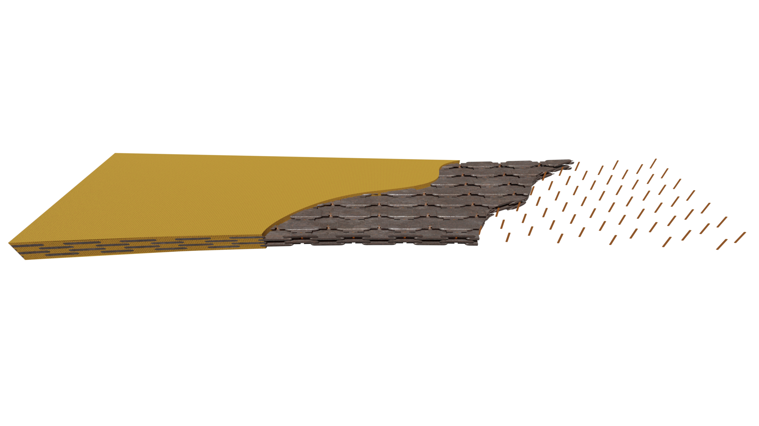
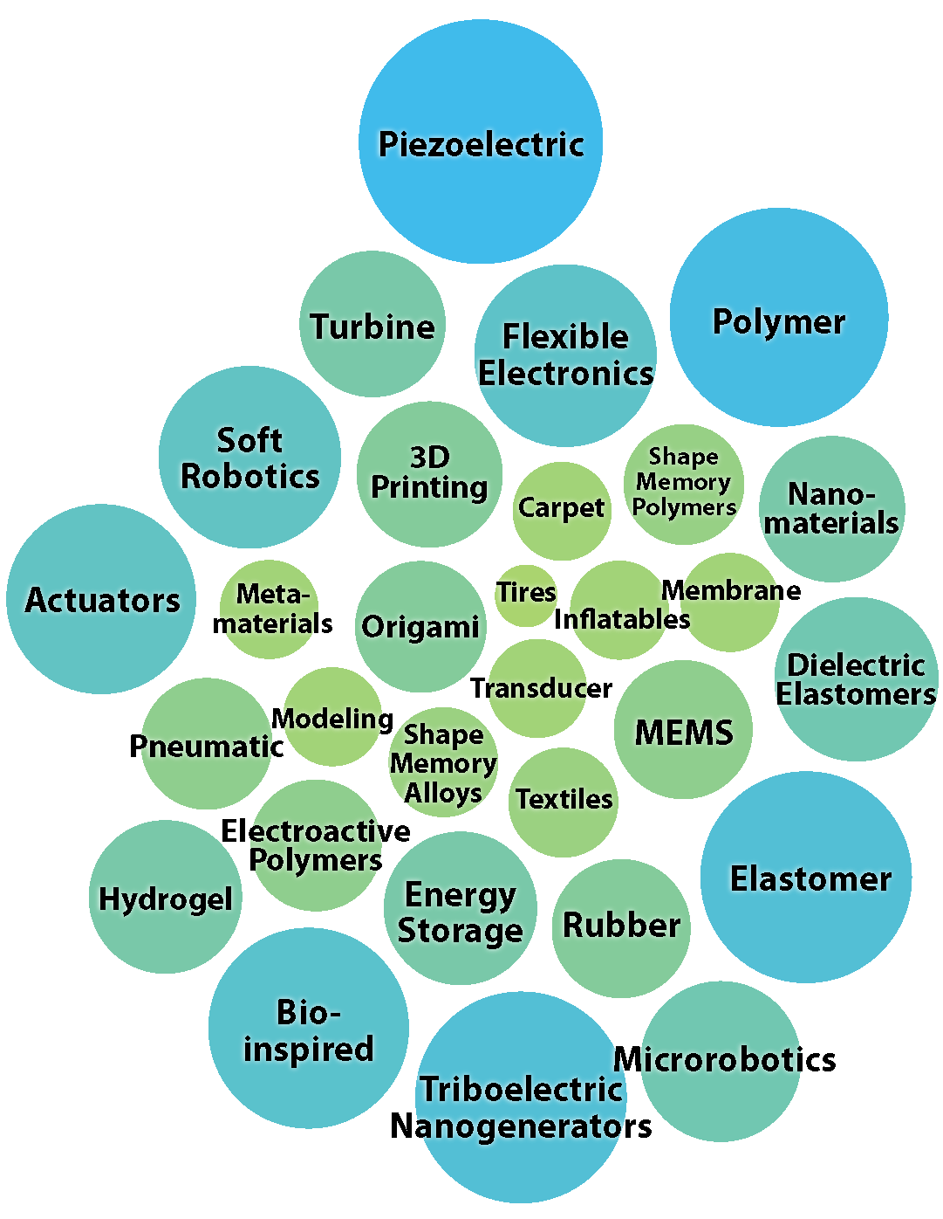
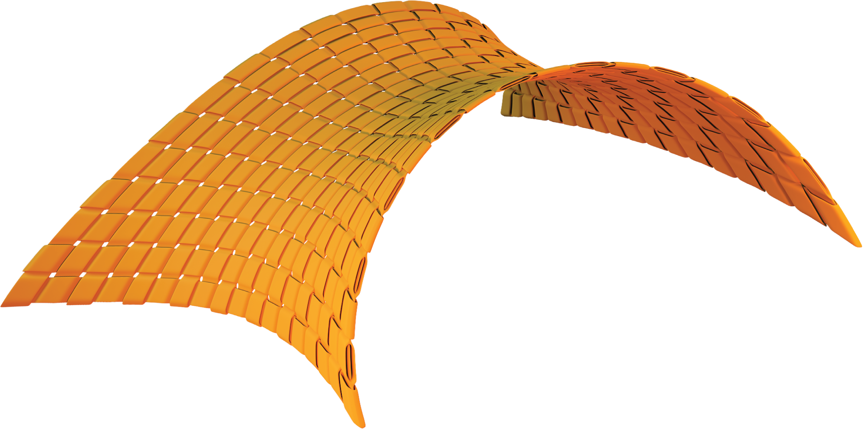
The DEEC - Tec Domain is Vast!
There are many unknown possibilities leveraging any number of technology domains for the innovation and conceptualization of DEECs and DEEC-Tec metamaterials:
?
Structural Vibration
?
?
?
Magnetostriction
?
Variable Capacitance
?
?
?
?
?
?
?
Faraday’s Law of Induction
Notes:
Blake

Slide 20
Submission Package & Scoring Criteria

Slide 21
Submission Requirements
Item | Description | Will Be Made Public | Scored Item
Summary Slide | Individual slide representing public-facing concept and team description. | Yes | No
Phase II TPL Assessment | Read, review, and complete a simplified version of the TPL Assessment. | No | Yes
Technical Narrative | Up to 5,000 words in length. Teams may also include up to 5 supporting drawings, images, or graphics. | No | Yes
Leaderboard Submissions | Continuous engagement activities scored for application period. Opportunities provided on HeroX platform. | Yes | Yes
Test Report | A test report the competitor has completed that includes sufficient detail to replicate the work | No | Yes
Live Virtual DEEC Demonstration | Competitors will be required to attend a virtual meeting with the Prize Administrator demonstrating testing process and validating the test results in the Test Report and Technical Narrative. | No | Yes
Notes:
Amanda

Slide 22
Scoring Criteria
All scored submission components will be scored on how well the competitor addresses the statements in each criterion; each statement will be scored by reviewers on the following 0–5 scale:
0 | 1 | 2 | 3 | 4 | 5
Strongly Disagree/Does Not Address | Disagree | Slightly Disagree | Slightly Agree | Agree | Strongly Agree/Fully Addresses
Notes:
Amanda

Slide 23
Submission Scoring Criteria
Submission Component | Potential Points | % of Total Score
Technical Narrative | 115 | 67%
Phase II TPL Assessment | 20 | 12%
Test Report | 20 | 12%
Leaderboard Submissions | 15 | 9%
Live Virtual DEEC Demonstration | Pass/Fail Qualification
TOTAL | 170 | 100%
Notes:
Amanda

Slide 24
Submission Requirements
Submission Summary Slide
Public-facing, one-slide submission summary. Technically specific details, but can be understood by general audiences.
Phase II TPL Assessment
The competitor must complete a TPL assessment. Designed to help inform the development of a competitor’s concept and measure its potential/promise when commercially ready Not only is this a required submission item, but also the content will be evaluated according to criteria listed in Table 12 of the Official Rules
Notes:
Thomas
Add language on scoring changes – done; added the last bullet item

Slide 25
Phase II TPL Assessment – Question Format
Given
Teams fill in
Question:
Assuming your concept has shown functionality during benchtop testing, what, if any, additional improvements will it need to function in the intended ocean deployment environment?
Question guidance:
This question is intended to motivate an appraisal of anticipated challenges in scaling up the technology to, ultimately, create an ocean wave energy converter. An understanding of the challenges and a plan to address them are sufficient at this stage.
Scoring guidance:
High: DEECs can be designed to have safety margins for extreme load and motion conditions, and fatigue lives equaling or exceeding WEC design life, typically 20-25 years.
Med: DEEC failures can be addressed by building in redundancy and/or designing components to be easily replaceable.
Low: Fundamental breakthroughs are required for DEECs to be able to operate long term (20-25 years).
Score:
Choose an integer from 1 thru 9; 1 being the lowest and 9 the highest
Confidence:
Indicate how confident you are about the score you selected. Choose from high/medium/low.
Justification:
Provide justification or background information to support your score.
Notes:
TPL - Thomas

Slide 26
Submission Requirements
Technical Narrative
Primary description of the solution and proposed concept. Should provide responses to the scoring statements outlined in the evaluation criteria in the rules document. Competitors can use up to 5,000 words and up to five supporting images, figures, or graphs. Template with page number suggestions and a fillable Gantt chart will be provided.
Leaderboard Scoring
Hosted on HeroX, public-facing. Representation of engagement through Phase II. Final scores will contribute directly to the final numerical score a competitor receives on their submission.
Notes:
Amanda

Slide 27
Template for Technical Narrative
Team Information (Team name, team members, and team lead)
A short description of your team/organization that is clear and concise [50-200] words, does not count towards 5,000 word limit]
Up to 5,000 Words to populate the following information
Team Characteristics & Excellence
Innovation Process
Viability of Concept
Planned Development for Phase III
Suggested content will be provided but competitors decide where to focus responses
Notes:
Amanda

Slide 28
Leaderboard Scoring Processing
We anticipate the Leaderboard will be updated weekly
Teams can earn points by leveraging educational tools and support mechanisms provided by Prize administrators to better understand key prize elements. Activities are pre-scored on public-facing leaderboard.
Specific engagement activities will be offered on the HeroX platform directly and updates will be shared on the leaderboard as teams complete these activities
Teams can receive up to 5 points per scoring criteria, for a maximum of 15 additional points
The final scores represented on the public-facing leaderboard will contribute directly to the final numerical score a competitor receives on their submission.
Notes:
Amanda

Slide 29
Wrap Up & Next Steps
Notes:
Amanda

Slide 30
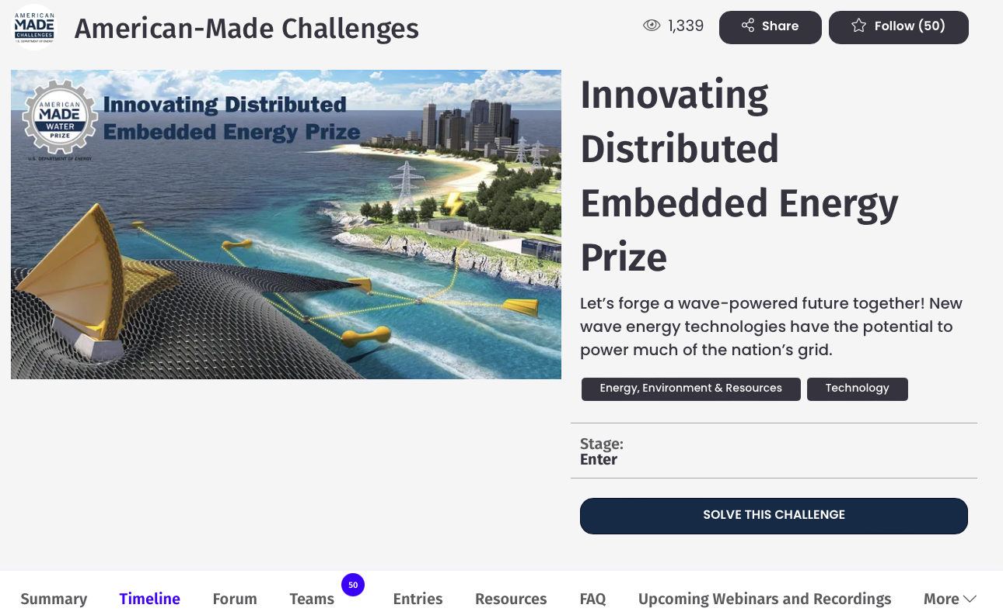
HeroX Platform
Share & follow
the prize
Access valuable resources like the rules and templates!
Communicate with the prize administration team
Submit
your idea!
Stay up-to-date
Build a team
Register for upcoming Webinars and trainings
Notes:
Amanda – add where to see the teams?

Slide 31
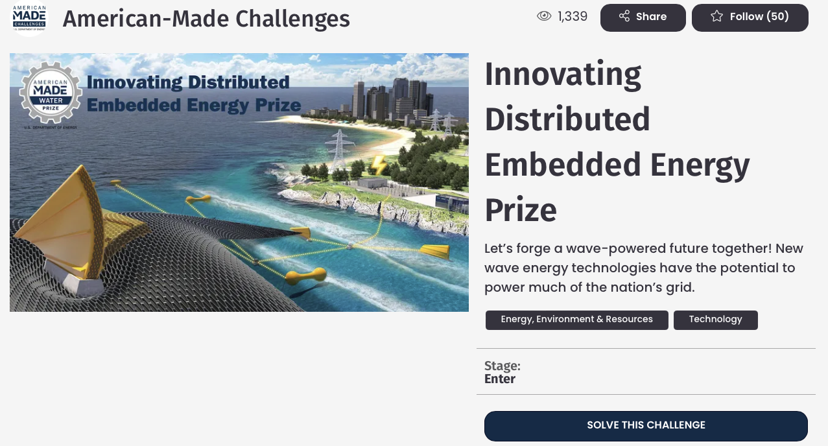
Register and Compete
Visit the HeroX prize page: https://www.herox.com/InDEEP
Choose “Solve this Challenge” (indicates your interest in competing; it is not a commitment—yet)
Sign in or create a HeroX account
Agree to the Terms of Use
Confirm your email address
Accept the Challenge-Specific Agreement
Indicate “Would you like to compete as a team?”
Submit Final Submission materials prior to August 25, 2023
Notes:
Amanda

Slide 32
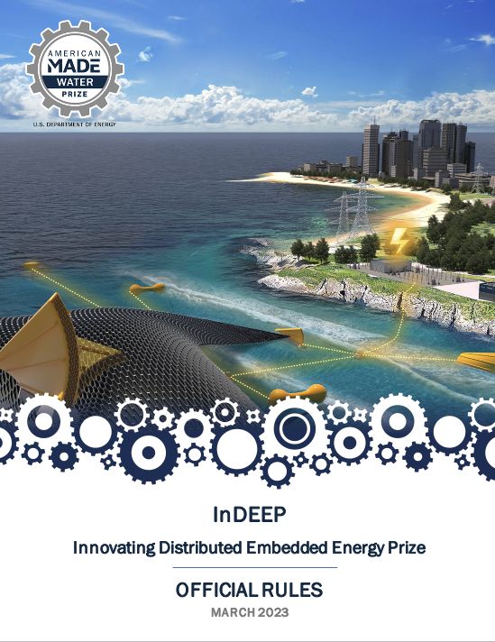
Read the Rules
Topics covered in today’s presentation can all be found in the Official Rules Document.
For a more in-depth look at these topics, please read the rules document, which is available here: https://americanmadechallenges.org/challenges/indeep/docs/InDEEP-Prize-Rules.pdf
SOLVER COMMUNITY
Notes:
Amanda

Slide 33
Polling Question
Is there any support that you don’t see here but would find beneficial?

Slide 34
Thank you & Questions
Notes:
Carrie

Slide 35
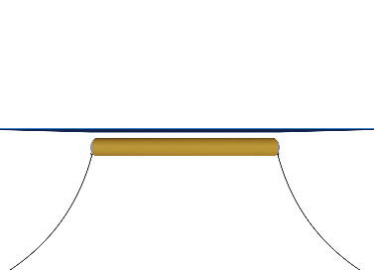
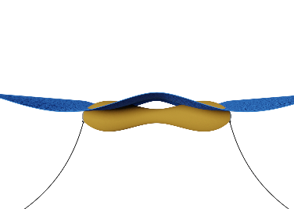
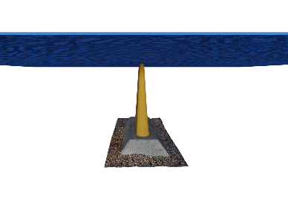
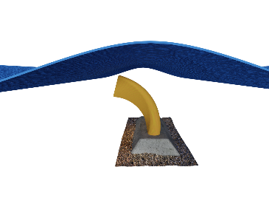
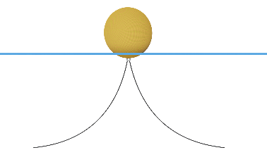
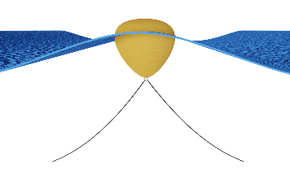
Distributed Embedded Energy Converter Technologies DEEC - Tec
WECs can be Made from DEEC-Tec Metamaterials
WECs can be constructed and fabricated through the assemblage of one or several DEEC-Tec metamaterials types
Has multiple degrees of freedom enabling an inherent compliant interaction with the various frequencies of ocean waves
The DEEC-Tec WECs do not concentrate marine energy into transmission gear box and/or solo power take-off system such as a rotary generator. Instead, DEEC-Tec enables energy conversion throughout a WEC’s structure
No Waves Nondeformed
Waves Actively Deformed
Bulging Line Absorber
Contracting/Bulging
Three example WEC archetypes made from DEEC-Tec metamaterials.
Twisting Flexing Flap
Bending
Twisting
Distending Point Absorber
Contorting
Distending
Example ocean wave energy converter (WEC) archetypes made from DEEC-Tec metamaterials; showcasing their nondeformed and plausible dynamic deformations.
Notes:
@Blake

Slide 36
marine energy | challenges
Marine energy technologies are at an early stage of development due to the fundamental challenges of generating power from a dynamic, low-velocity, and high-density resource while withstanding corrosive marine environments
These challenges are intensified by high costs and lengthy permitting processes associated with in-water testing
To address these challenges, the Marine Energy Program conducts transformative early-stage research that advances the development of reliable, cost-competitive marine energy technologies and reduces barriers to technology deployment

Slide 37
Market Opportunities
DEEC-Tec can be applicable to multiple market areas:
Utility grid ocean wave energy conversion ‘farms’
Near-term market areas such as those in the Blue Economy
Other domains of energy harvesting, including a wide spectrum of advanced robotics
The focus of this prize is on wave energy because:
Wave energy is the most abundant and geographically diverse marine energy resource in the U.S., but is also the most complex and expensive resource to harness energy from
Wave energy converters are still a nascent technology with challenges in supply chain availability and workforce training
The systems engineering approach supported by this prize aims to identify ideas with high technoeconomic potential, accelerating the development of WECs
The prize is intended to be an initial step of WPTO funded research into the potential of DEEC-Tec, intended to be followed by additional funding

Slide 38
Combining Wave-SPARC and DEEC-Tec for the Potential Prize
Wave-SPARC Systems Engineering Methodologies
DEEC Tec Technology Domain
Potential for significant improvements in Wave Energy Conversion Technologies
Solvers in non wave energy technology fields
Specific technology areas that have unique characteristics
Not well studied in marine energy applications
New architype possibilities
Assessment Tools for WECs, including TPL
Structured Innovation Techniques & Tools for WECs
Curiosity of solvers from fields outside ocean wave energy
Notes:
Bill

Slide 39
Wave-SPARC Prize Down-Select Process
Phase II – Core Technology
Individual Distributed Embedded Energy Converter
Collaboration (open to all)
≈ 15 awards @ $50k each
Duration – 90 to 180 days
Phase III – Embedded Technology
Combining Distributed Embedded Energy Converters Competition (open to previous participants)
≈ 5 awards @ $250k each
Duration – 180 days
Phase I - Concept
Training & Concept Paper Development
Awareness and engagement (open to all)
≈ 20 awards @ $15k each
Duration – 90 days
Notes:
Update

Slide 40
Future Arc for Maturing Ocean Distributed Energy Technologies
Before the Prize
Prize
Thriving US Marine Energy Industry
Post Prize
Phase I: Concept
Phase II: Core Technology
Phase III: Embedded Technology
Continue maturing technologies with future WPTO funding opportunities and support:
FOAs (traditional grants and cooperative agreements)
SBIRs/STTRs
Collaborations with National Labs (NREL, PNNL, SNL)
TEAMER Awards (https://teamer-us.org/)
Energy iCorp
UMERC
Potential collaborations with other DOE offices:
Advanced Manufacturing Office
ARPA-E
Office of Clean Energy Demonstration
Tech to Market
Potential collaborations with other Federal partners
Potential use of technologies in outside fields and markets
Energy transduction technology ideas from potential prize participants
Ocean wave energy research
Wave-SPARC systems engineering methodology
Tangible benefits for prize participants:
Prize Purse
Vouchers (Lab, AMC)
Training
Testing
Independent assessments
Intangible benefits for prize participants :
Notoriety / exposure (WPTO and press releases)
Awareness of WPTO needs and portfolio
Awareness of end user / end customer needs
Connections and networks
Marine Energy expertise
Benefits for the WPTO:
Evaluate high technoeconomic potential technologies
Strengthen Wave-SPARC methodology
Notes:
Bill

