Slide 1


Slide 2
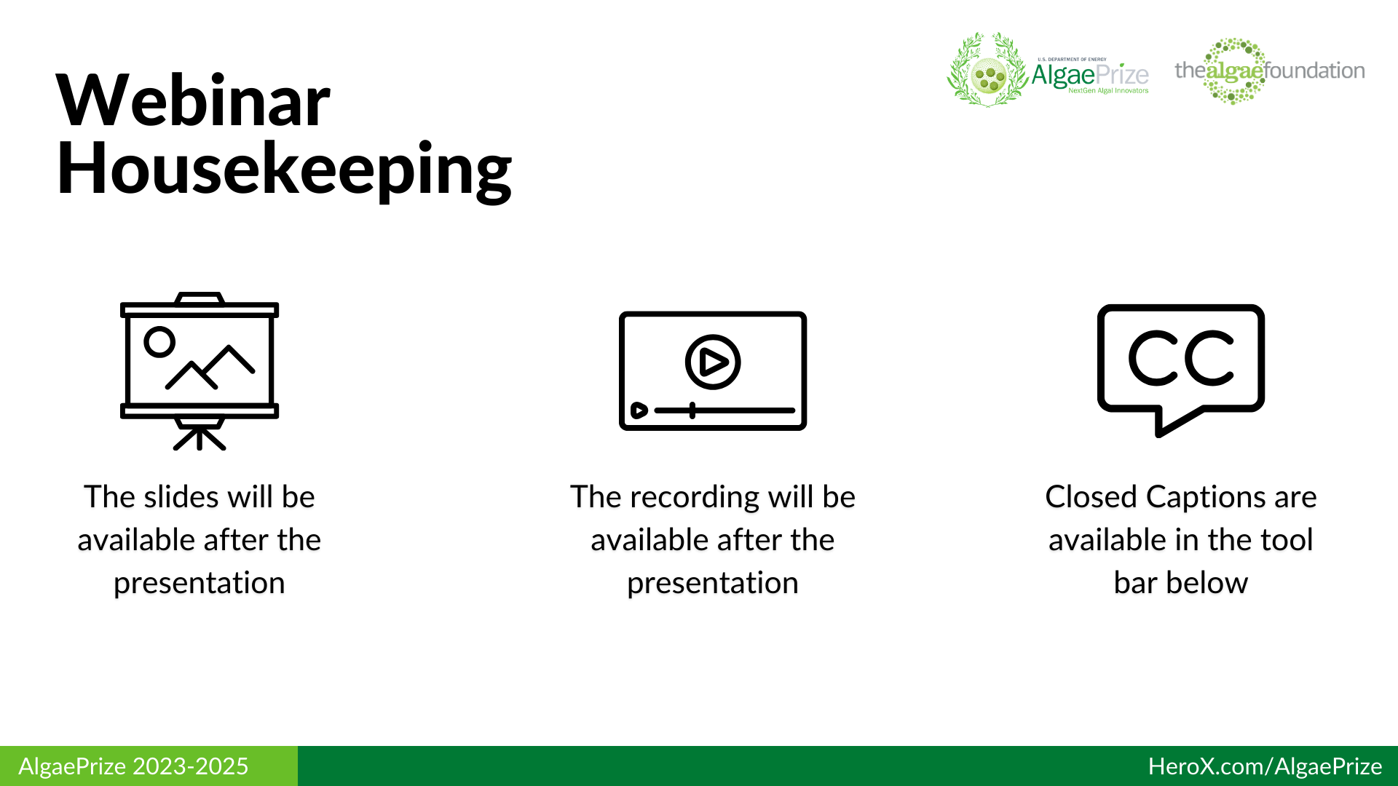
1

Slide 3
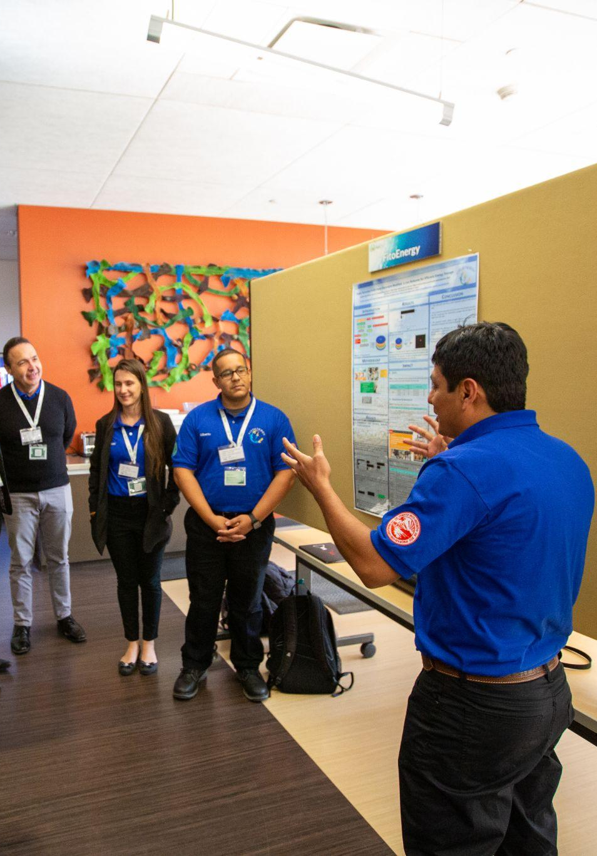
Today’s Agenda
Introduction to AlgaePrize and competition organizers
Competition overview and upcoming deadlines
Synopsis submission best practices
Judging processes and finalist overview
Action Items
Q+A
2

Slide 4
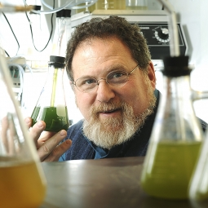
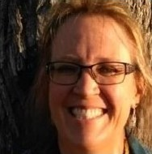
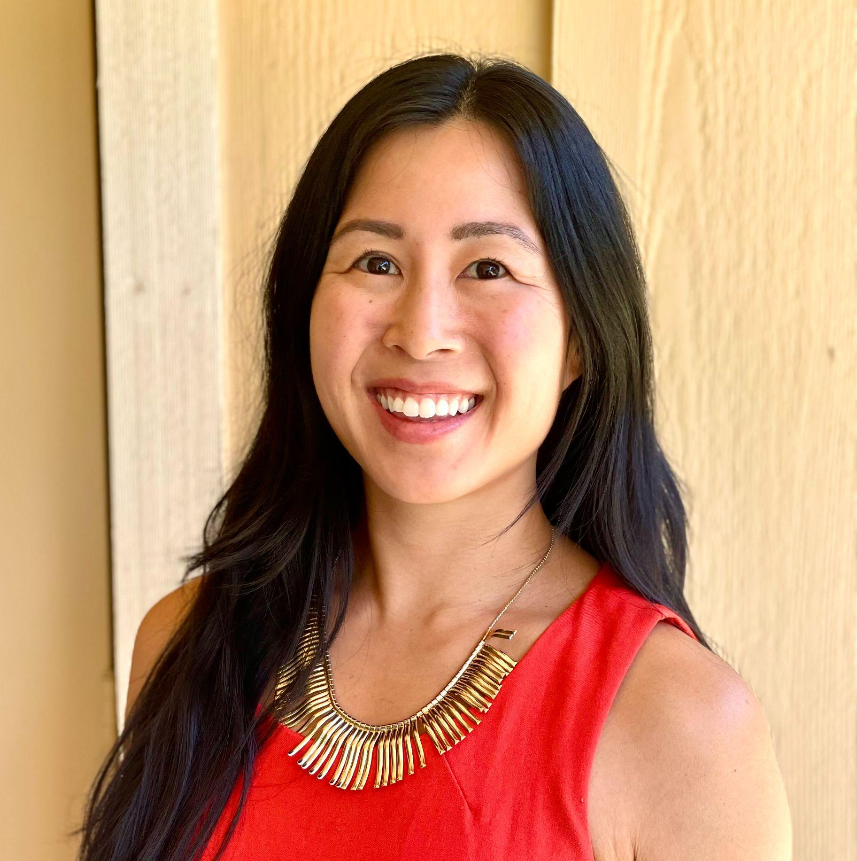
Introductions
Dr. Ira “Ike” Levine
Christy Sterner
Serena Chen
CEO, Algae Foundation
+ Director, AlgaePrize
Technology Manager, Advanced Algal Systems Program, Bioenergy Technologies Office (BETO)
+ Manager, AlgaePrize
Special Program Manager,
Algae Foundation
3

Slide 5
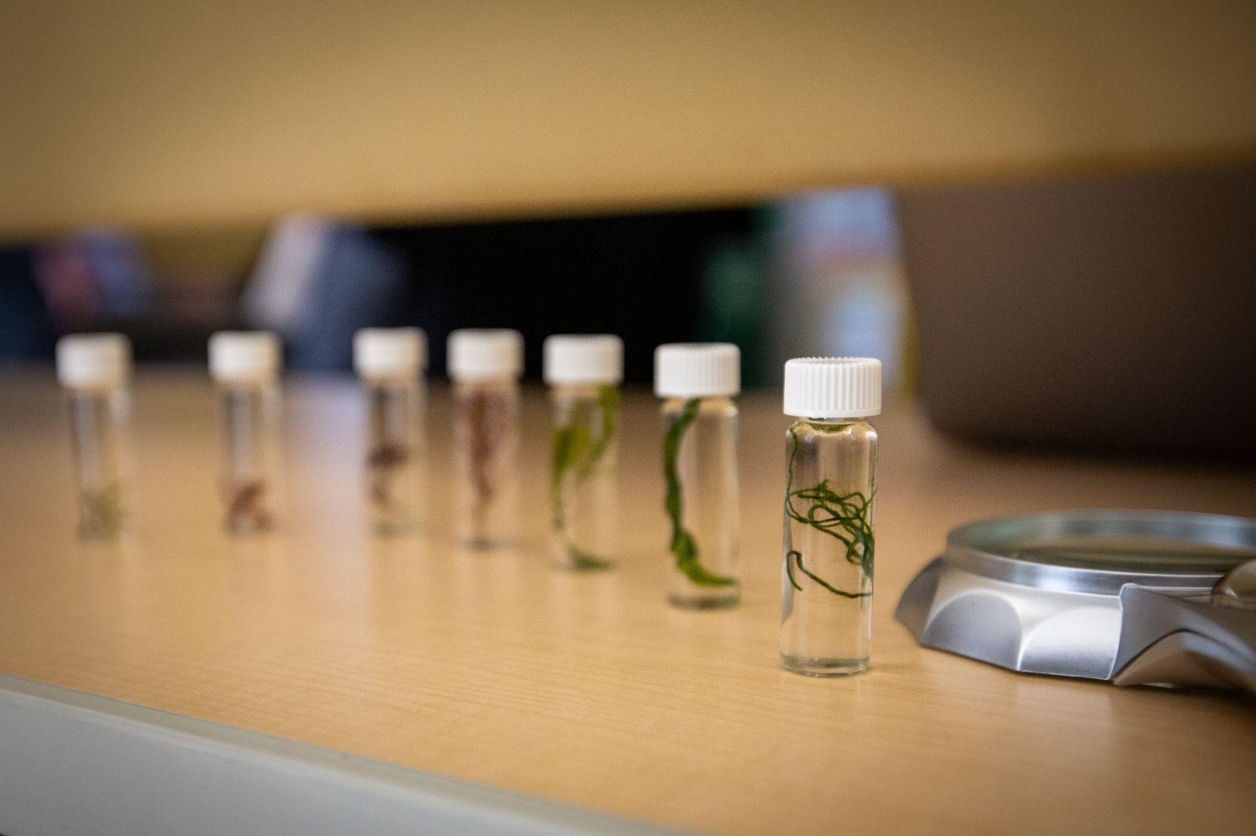
AlgaePrize 2023-2025
The AlgaePrize is a national algal-based competition that challenges students to become the next generation of bioeconomy professionals.
4

Slide 6




Organizers + Roles
AlgaePrize Competition Sponsor
Public Outreach
AlgaePrize Competition Manager
Student + Team Support
Online challenge host
Coordinator of awarded research funds
Host of AlgaePrize Competition Weekend
5

Slide 7

AlgaePrize
Upcoming Deadlines
2023-2025
*Subject to change.
November 29, 2023
Deadline for Team Survey
January 15, 2024
AlgaePrize finalists announced
June 4, 2024 at 12:00pm ET
Deadline for Research Update #1
December 13, 2023 at 12:00pm ET
Deadline for 10-page Research Synopsis
February 5 - 9, 2024
Finalists present their research synopsis to competition organizers
6

Slide 8

10-Page
Research Synopsis
7

Slide 9
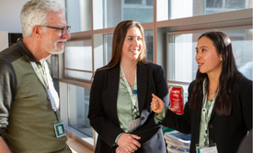
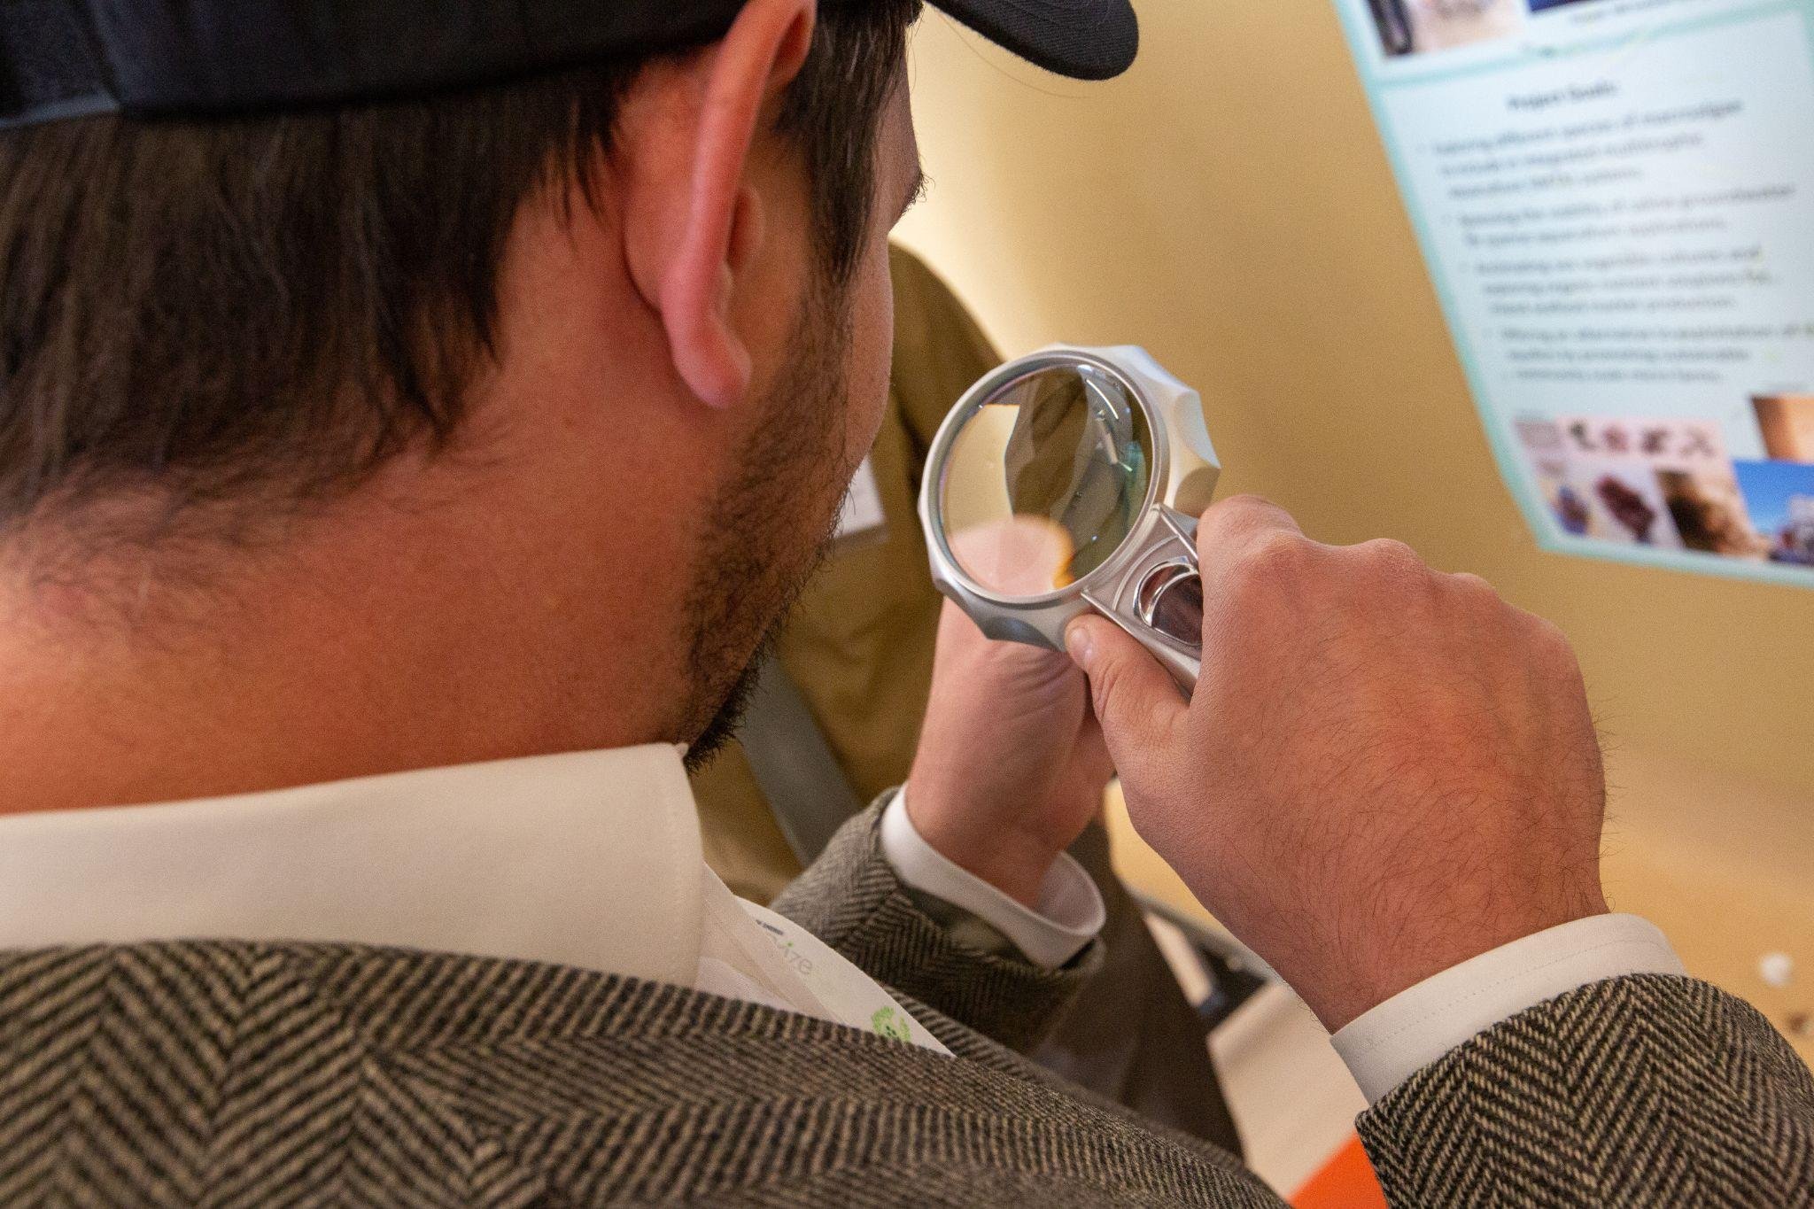
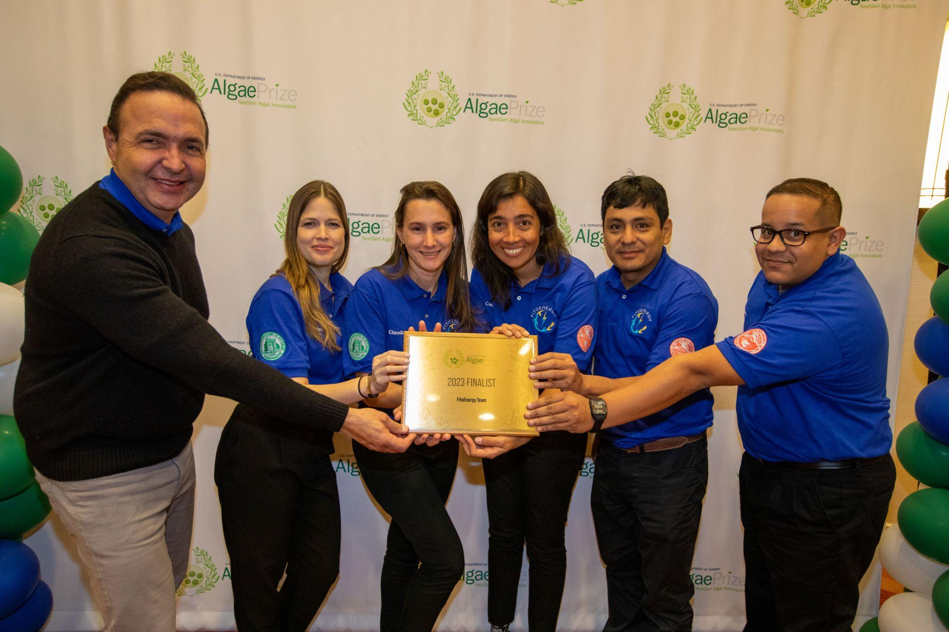
Judging +
Expectations
Judging Scale
The judges will assess the project by agreeing or disagreeing with assigned statements on a 1–6 scale.
Strongly Disagree - Strongly Agree
Novelty
This competition seeks innovations that apply to algae production and processing systems along the entire algae value chain including everything from production through products and analytical tools development.
Technical Feasibility
Submissions should identify credible scientific and engineering pathways to advance the proposed area of interest.​
Impact
The proposed effort should include key improvements, cost targets, and/or life cycle analyses that support the proposed project’s efforts toward commercial adoption.
8

Slide 10
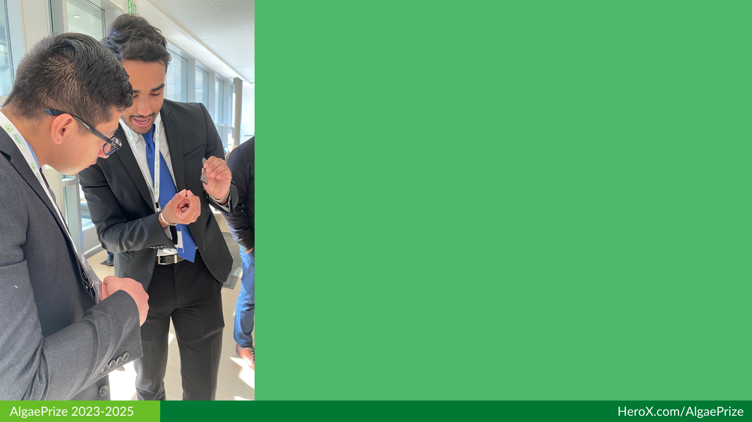
Novelty
Suggested Content:
Describe how the proposed project is innovative in addressing challenges associated with the utilization of and processing of algae.
Describe how the proposed project addresses challenges within the proposed area of interest in a new and novel way compared to the current state of technology (be sure to include which strain you are working with).
Describe how the proposed effort will be incorporated into the overall algae value chain improving and/or enhancing algae’s commercialization potential.
9

Slide 11

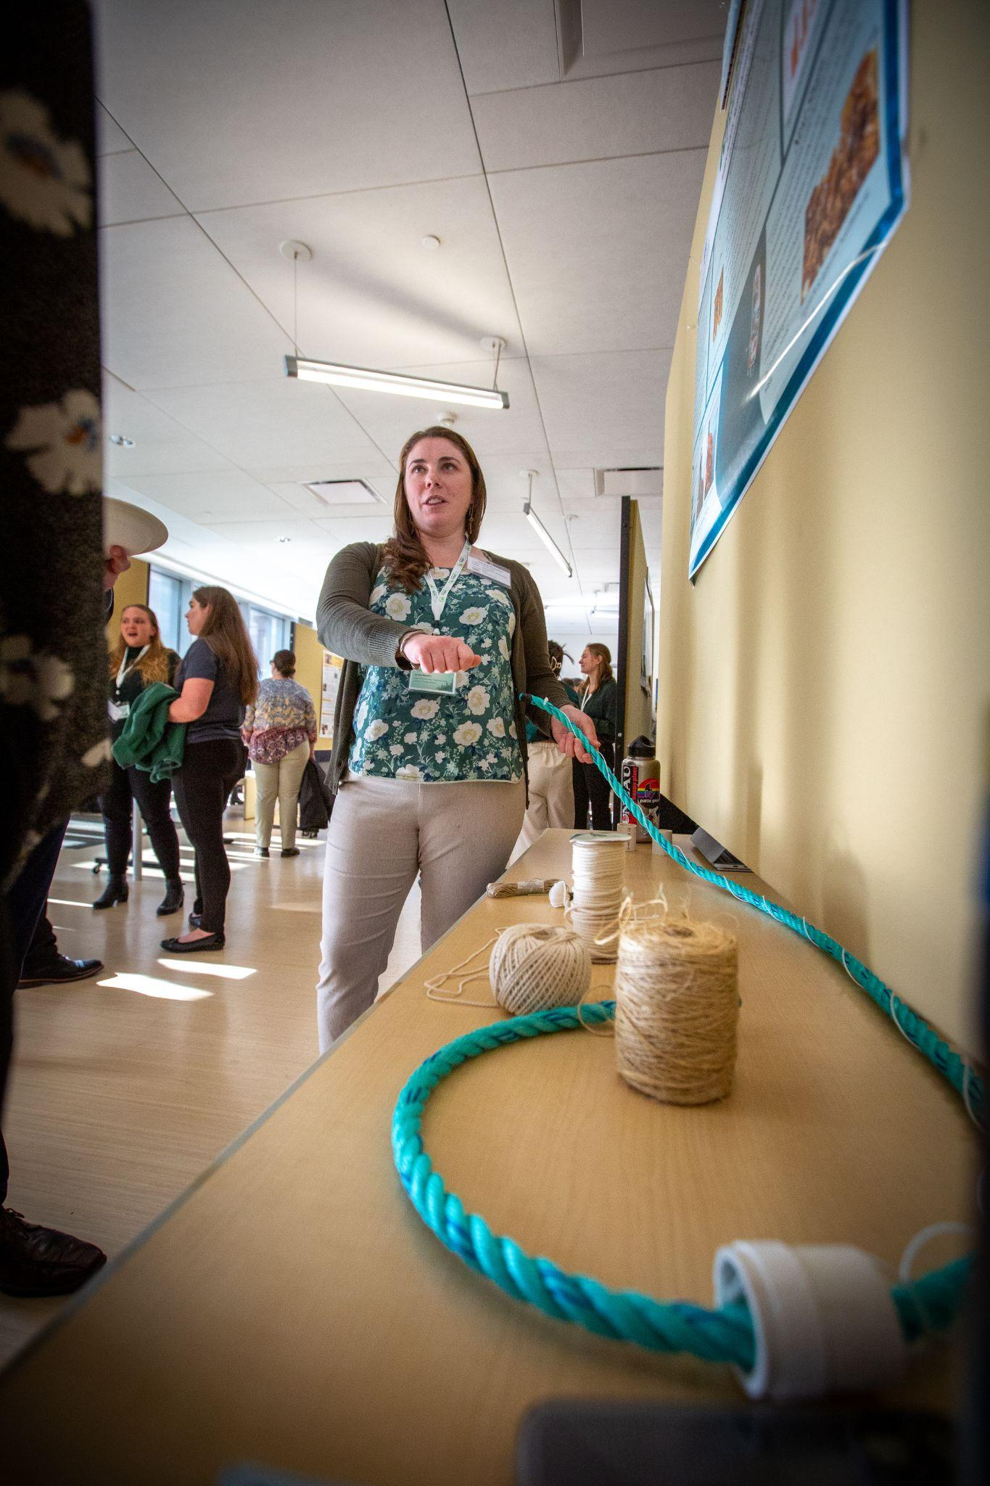
Technical Feasibility
Suggested Content:
Describe the key technical aspects of the proposed project relative to the proposed area of interest.
Describe the supporting body of knowledge, baseline, and goals/metrics that support the proposed effort.
Describe the research approach that will be taken to accomplish the goals and metrics.
Describe risks and associated mitigation strategies associated with the proposed project.
Describe the team’s qualifications.
Describe the resources available for performing and completing the proposed effort (materials and supplies, research and analytical equipment, or facilities, etc.).
10

Slide 12
Impact
Suggested Content:
Describe the anticipated impacts resulting from the proposed project. Include potential key improvements, cost targets, life cycle and environmental benefits, and other impacts as applicable to the proposed effort.)
Describe the commercial applicability of the proposed impacts resulting from the proposed project.
11

Slide 13


Formatting
Requirements
Research Synopsis
Written in English
All additional pages beyond page limits noted will NOT be reviewed
Title Page, Table of Contents, Process Flow Diagrams, and Citation Pages do NOT count towards the page limits
All uploaded files must follow the following filename convention:
[TeamName]_[SchoolNameAbbreviated]_[SubmissionName].pdf
Example: TeamXYZ_SchoolMNO_ResearchSynopsis.pdf
Team Photos
All images must have a minimum resolution of 1920 x 1080 pixels
Submit images as .jpg; .tiff; or .png
Filename convention: TeamXYZ_SchoolMNO_TeamPhoto.jpg
12

Slide 14
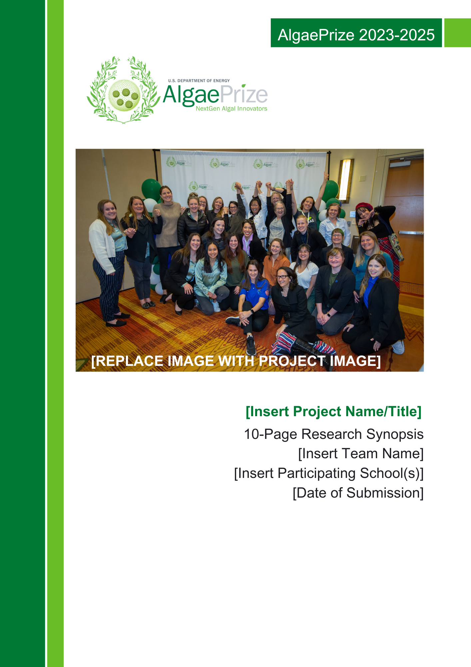
Formatting
Requirements
Research Synopsis
File type: Single, bookmarked PDF with all fonts embedded and 300 dpi minimum resolution
ANSI A 8.5” x 11” paper size
Minimum 11-point font size
Minimum ½” margin on all sides
13

Slide 15
Review the 2023-2025 Official Rules. AlgaePrize 2023-2025 Rulebook.
Take some time to personalize your team's HeroX account. Add remaining team members to your team.
Set a team meeting to begin project planning and assigning roles. The earlier you define roles within the team the smoother the process!
Complete your team survey by Wednesday, November 29, 2023.
Action items
14

Slide 16
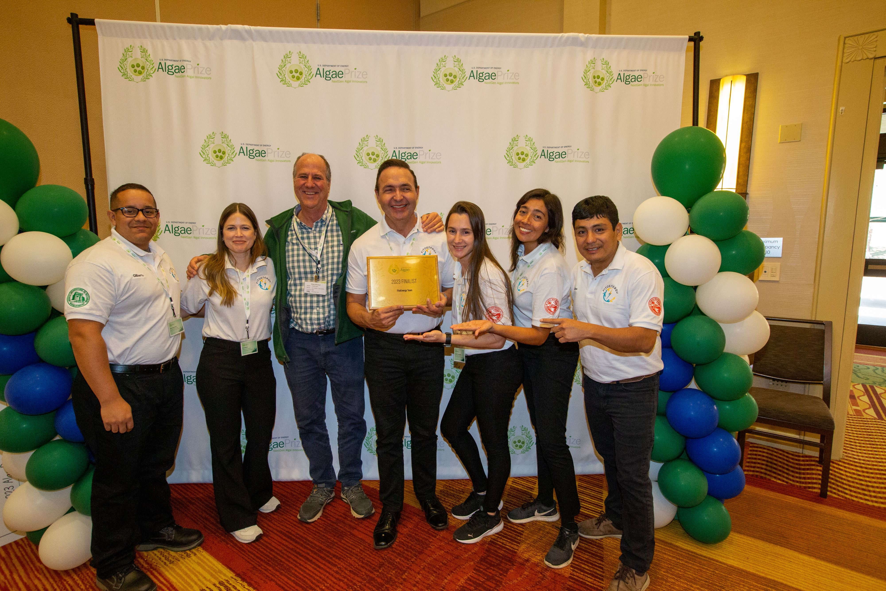



Questions?
We’re Here for You!
HeroX.com/AlgaePrize
AlgaePrize@theAlgaeFoundation.org

