Slide 1
This webinar will be recorded.
American-Made Challenges
CDR Purchase Pilot Prize
Phase 1: Informational Webinar

Slide 2



Tony Feric
ORISE Science, Technology, and Policy Postdoctoral Fellow
Eli Cain
National Renewable Energy Laboratory
Program Manager
Rory Jacobson
Senior Advisor for Deployment, Department of Energy, Office of Fossil Energy and Carbon Management

Slide 3
Agenda
1
American-Made Overview
2
FECM & The CDR Purchase Pilot Prize
3
Submission Elements and Scoring
4
HeroX
5
Next Steps

Slide 4
Housekeeping
This webinar will be recorded.
This webinar is being recorded and will be available on HeroX.
Questions?
  To submit a question, please type it into the Q&A box on the right-hand side of your screen next to the chat box. Will post answers to all questions we receive to HeroX as quickly as possible.
Technical Issues:
  If you experience technical issues, please check your audio settings under the “Audio” tab.
  If you continue experiencing issues, direct message the host

Slide 5

Fast track your ideas for the clean energy revolution
$200M
55+
400+
in cash prizes and support
prizes
Network members

Slide 6

Grants vs. Prizes
Write and submit concept papers
Concept paper review
Begin Performing
Applicants write and submit full applications
Achieve predefined goal
Financial Award Process
Prize Award Process
Complete submission package
Full applications review
Selections and
negotiations
Judges score submissions
Winners receive payment
Begin performing
Prepare and submit reimbursement request
Request reviewed and reimbursement issued

Slide 7

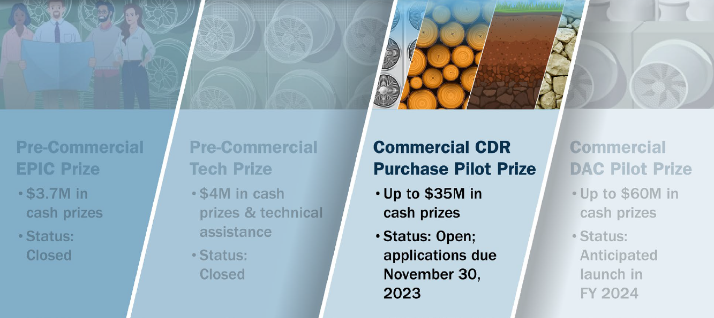
Collective Suite of DAC and CDR Prizes

Slide 8
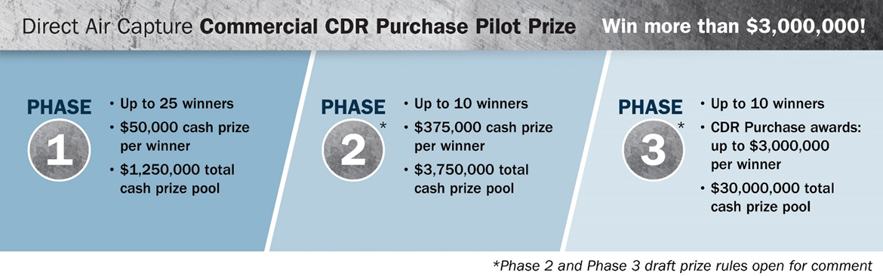
Phase 1 winners will receive $50,000 in prize awards
What is the CDR Purchase Pilot Prize?

Slide 9



FECM Research Priorities
Office of Fossil Energy and Carbon Management
DOE-FE is now DOE-FECM
New name for our office reflects our new vision
President Biden’s goals:
  50% emissions reduction by 2030
  CO₂ emissions-free power sector by 2035
  Net zero emissions economy by no later than 2050
Advancing Justice, Labor, and Engagement
Priorities: Justice, labor, and international and domestic partnerships
Advancing Carbon Management Approaches Toward Deep Decarbonization
Priorities: Point-source carbon capture (PSC), carbon dioxide conversion, carbon dioxide removal (CDR), and reliable carbon transport and storage
Advancing Technologies that Lead to Sustainable Energy Resource
Priorities: Hydrogen with carbon management, domestic critical minerals (CM) production, and methane mitigation

Slide 10
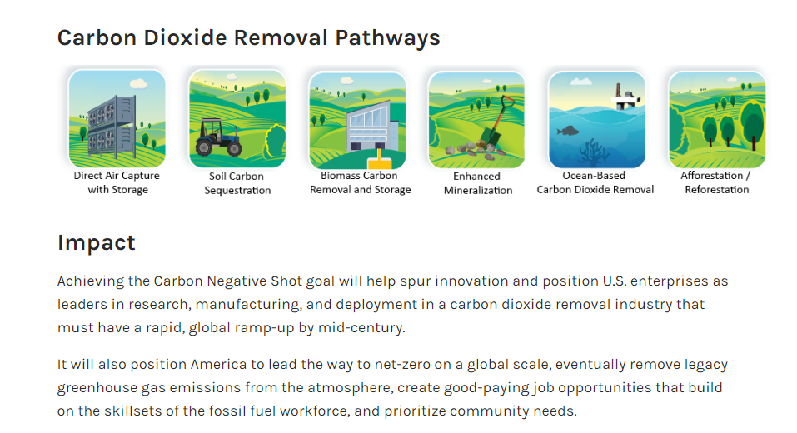
Carbon Dioxide Removal Program
  CDR → natural and engineered approaches to capture CO₂ directly from the atmosphere or oceans coupled with secure storage
      Direct Air Capture (DAC)
      Accelerated Weathering and Mineralization
      Biomass with Carbon Removal and Storage
      Ocean-based CDR
  Key Evaluation Criteria
      Cost
      Additionality
      Permanence
      Net-negativity
      Rigorous Carbon Accounting through lifecycle analysis
      Societal Considerations and Impact
      Monitoring, Reporting and Verification (MRV)
Carbon Dioxide Removal (CDR) Pathways

Slide 11
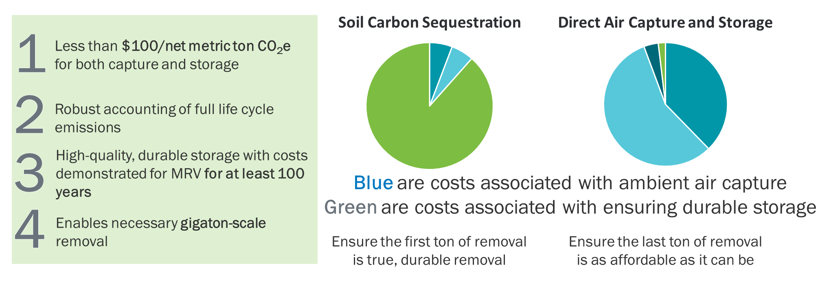
Carbon Negative Shot: Key Performance Elements
Carbon Negative Shot’s key performance elements will guide a responsible industry that is responsive to the climate crisis, such that multiple true, durable removal pathways can be deployed at their most affordable cost at the scale required to address the climate crisis

Slide 12
CDR Purchase Pilot Prize
Market Need:
CDR is needed at the gigatonne scale by mid-century
However, CDR is currently limited by uncertain demand and relatively limited supply
Mechanism:
Competitive purchasing program will advance and accelerate the domestic commercial deployment of CDR
After technology and business development plan evaluation, DOE will develop purchasing contracts with carbon removal credit suppliers
In the final phase of the CDR Purchase Pilot Prize, winners will be scored, selected, and awarded based on carbon removal credits successfully delivered
Intended Outcomes:
Enhance the volume, quality and transparency of CDR credit supply
Benchmark and standardize the required technical rigor, workforce, community benefits, and contracting terms
Showcase the best available purchase contract designs and CDR supply offerings, based on their adherence to evaluation criteria, for a wide variety of CDR pathways and approaches
Incentivize additional demand for CDR purchasing
Establish the government and private sector roles in the CDR market
¹Media in which the concentration of carbon dioxide is less than 1% by volume. 42 U.S.C. 16298d(e)(1)(A).

Slide 13
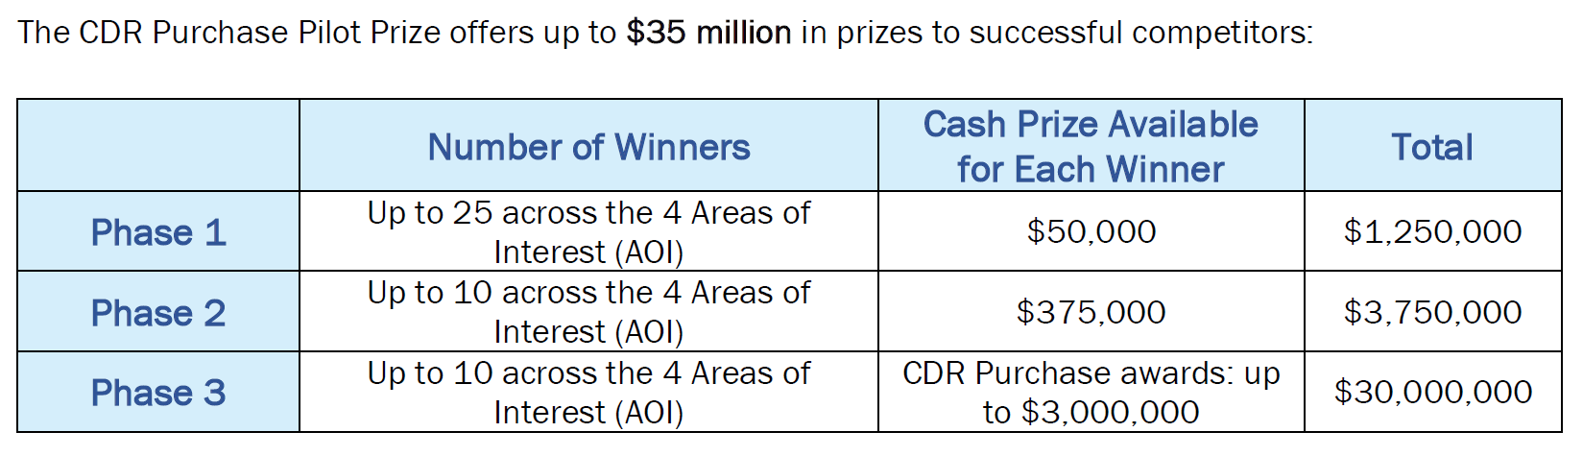
Overview of Eligible CDR Topic Areas
Four Key Areas of Interest:
  AOI 1: Direct Air Capture (DAC)
  AOI 2: Enhanced Mineralization (ex-situ and surficial)
  AOI 3: Biomass Carbon Removal and Sequestration
  AOI 4: Other Planned and Managed Sinks in Terrestrial Ecosystems and the Upper Hydrosphere

Slide 14









Evaluation Criteria
CO₂
Measurement, reporting and verification
Cost
Permanence/Durability
Additionality
Energy Source and Requirements
Societal Considerations and Impacts
Life Cycle Accounting
Plant Capacity

Slide 15
Call for Feedback on Draft Rules
Competitors (CDR Credit Suppliers):
Review rules document Direct Air Capture (DAC) Commercial Prize | American-Made Challenges (americanmadechallenges.org)
Provide feedback on draft rules for Phases 2 and 3 to dacprizes@nrel.gov on or before 10/31/23 (see Appendix 12)
Consider submitting a Concept CDR Credit Proposal (Phase 1) by 11/30/2023
Non-DOE Stakeholders:
Provide feedback on draft rules for Phases 2 and 3 to dacprizes@nrel.gov on or before 10/31/23 (see Appendix 12)
CDR Credit Buyers:
Provide feedback on draft rules for Phases 2 and 3 to dacprizes@nrel.gov on or before 10/31/23 (see Appendix 12)

Slide 16
CDR Purchase Pilot Prize
Overview

Slide 17
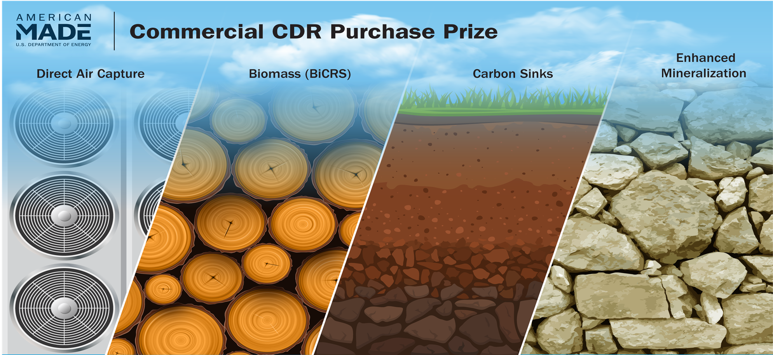
Read the Rules
Official Rules for the CDR Purchase Pilot Prize are online, on the HeroX page
CDR Purchase Prize Official Rules

Slide 18
Program Requirements
Across all phases of the CDR Purchase Pilot Prize, submissions must include the following components:
CDR Offering: proposed technology and anticipated CDR volume
  Competitors are responsible for providing a rationale for including their proposed CDR crediting approach within a given area of interest.
Independently verified removal
Incorporate societal considerations and impacts
Additionality
Secure geologic storage or equivalent
Scalability
Specific submission requirements vary phase by phase

Slide 19
Eligibility
This prize is open to private entities and academic institutions, provided they meet these requirements:
  Private entities must be incorporated in and maintain a primary place of business in the United States with majority domestic ownership and control;
  Academic institutions and non-profit entities must be based in the United States
CDR must be removed and sequestered within the United States, including Tribal Nations, U.S. Territories, or federal or state waters
National Laboratories are not eligible to compete as the lead applicant. But, they may support teams in the competition as long as normal lab partnership procedures are followed
Only winners of Phase 1 are eligible to complete in Phase 2
Only winners of Phase 2 are eligible to compete in Phase 3
See list of ineligible competitors in the Official Rules document

Slide 20
Important Dates
Phase 1
November 30, 2023, 5pm EST: Phase 1: Submission Deadline
Phases 2 & 3
Key dates will be announced when the Official Rules are released

Slide 21
Phase 1 Requirements
CDR Purchase Pilot Prize

Slide 22
Phase 1 Submission Package
Cover Page
CDR Credit Concept Proposal
  Project Overview
  Technology or Project Development
  Network, Team, and Resources
Letters of Commitment and Support (optional)

Slide 23
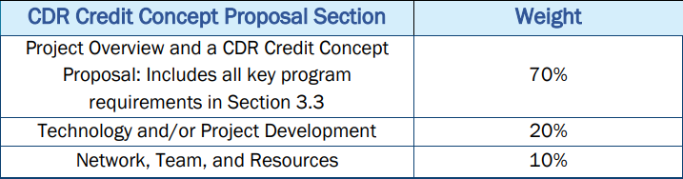
Phase 1 Scoring

Slide 24
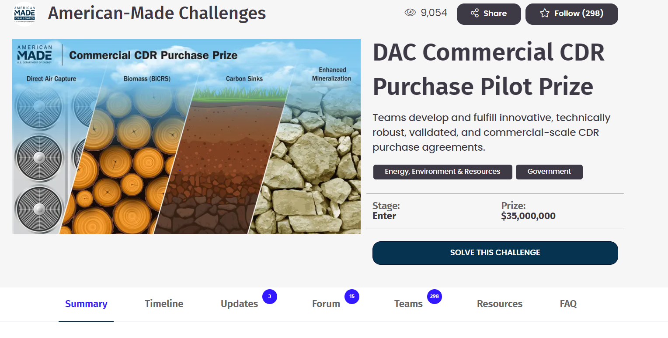
How to Apply

Slide 25
What’s Next?
Follow the challenges on HeroX:
    https://www.herox.com/DAC-commercial
Read the rules:
    DAC Commercial HeroX → Resources Tab
Provide Feedback on Phases 2 & 3
      Information on how to provide feedback is in the Phase 1 Official Rules
Apply by November 30, 2023 5pm EST

Slide 26
Thank you!

