Slide 1
InDEEP Technology Performance Level Assessment Overview
InDEEP Prize Team (NREL, Sandia)
7/5/2023

Slide 2
Agenda
Introduction to the Prize
Why Technology Performance Levels (TPL)?
What is TPL?
What differentiates TPL?
TPL Methodology
How is TPL used in InDEEP?​

Slide 3
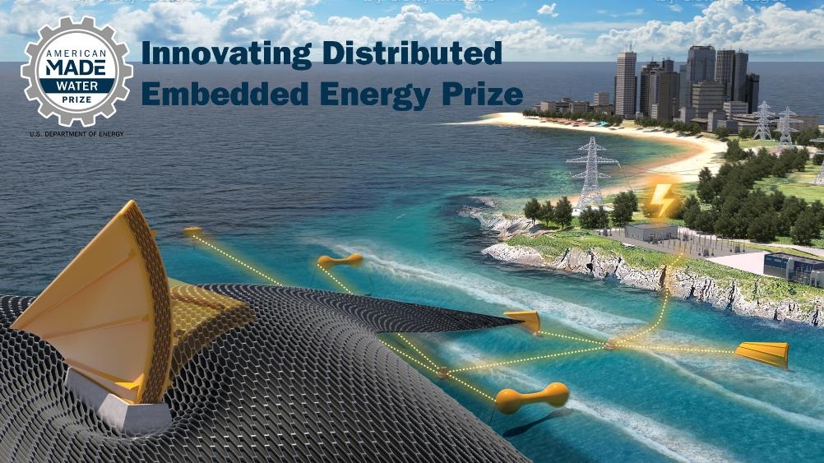
Innovating Distributed Embedded Energy Prize
JEN
$2.3M prize pool
Three phases over two years
Incentivize progress in early-stage research
Help solve technical challenges that could be applied to wave energy

Slide 4

Contributing to Leaderboard Scoring
JEN
For questions about the prize overall, view our recorded conversation on April 12
Participation in this webinar contributes to your final leaderboard score
Make sure to complete the Leaderboard Eligibility Form to receive points for your participation
If you haven’t done this yet, do so now: https://www.herox.com/indeep
WPTO’s desired outcome for InDEEP is an understanding of the landscape of innovators and
potential DEEC-Tec solutions that could be applied to wave energy devices.

Slide 5
Why TPL?
JW
Technology Development Challenges:
Wave energy converter technology development currently has several main challenges:
  Still a multitude of widely diverse technologies being considered today
  No evidence of common convergence in key market segments
  High levelized cost of energy systems (projected)
  WEC technology development is:
    Expensive (> $100M to get to TRL 9)
    High risk (setbacks in prototype testing)
    Slow (10-15 years from TRL 1→9)
    Rigid (retain initial early concept idea)

Slide 6
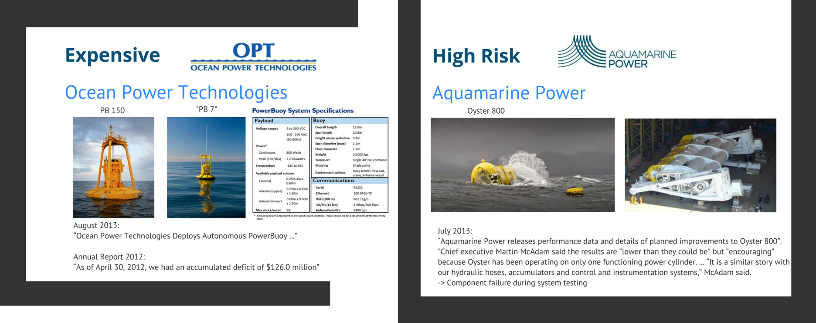
Why TPL?
JW

Slide 7
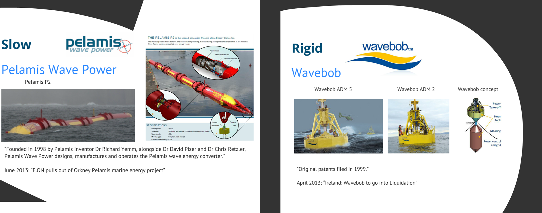
Why TPL?
JW

Slide 8
TPL Development
JW
Concept introduction @ ICOE (Weber)
First
use cases
NI/LS
TPL version 2.0 used in DOE Wave Energy
First version of utility-scale TPL tool released
Extension to CECs,
PBE markets, industry workshops,
etc.
EWTEC
paper
EWTEC
paper
2012 2014 2016 2018 2020 2022
TPL
Defined
TPL Version 1.0
TPL Version 2.0
TPL Version 3.0
TPL Version 4.0
TPL Version 5.0 – web app

Slide 9
What is TPL?
JW
Technology Performance Level (TPL) is an integrated techno-economic technology assessment framework that quantifies the performance potential and economic, environmental, social, and safety impacts of a technology (combined indicator, MCDA)
TPL
Techno-Economic Assessment (TEA) quantifies the economic viability of a technology by comparing its figure of merit against its lifecycle costs
Permitting
(LCA)
Life Cycle Assessment (LCA) quantifies the environmental impacts of a technology over its lifecycle
Technical Performance
Social
Benefits
Economic Feasibility
Global Deployability
Safety & Survivability
Grid
Operations

Slide 10
TPL Metric Definitions
JW
1 | 2 | 3 | 4 | 5 | 6 | 7 | 8 | 9
Low |  |  | Medium |  |  | High
Technology is not economically viable |  |  | Technology features some characteristics for potential economic viability under distinctive market and operational conditions. Technological or conceptual improvements may be required. |  |  | Technology is economically viable and competitive as a renewable energy form
Majority of key performance characteristics & cost drivers do not satisfy and present a barrier to potential economic viability | Some of key performance characteristics & cost drivers do not satisfy potential economic viability | Minority of key performance characteristics & cost drivers do not satisfy potential economic viability | In order to achieve economical viability under distinctive and favorable market and operational conditions some key technology implementation and fundamental conceptual improvements are required. | In order to achieve economical viability under distinctive and favorable market and operational conditions some key technology implementation improvements are required. | Majority of key performance characteristics & cost drivers satisfy potential economical viability under distinctive and favorable market and operational conditions | Competitive with other renewable energy sources given favorable support mechanism | Competitive with other energy sources given sustainable support mechanism | Competitive with other energy sources without special support mechanism

Slide 11
TPL Methodology
JW
Innovation
driven by
Functions
Innovation
implemented by
TRIZ
Mission Statement
Delivering highest positive impact
Functional Requirements
meeting
Capabilities
Context
Stakeholders
Life Cycle Stages
Assessment
driven by
Capabilities
Assessment
implemented by
TPL
Capabilities & Impact
What the system needs to be
Iterate until
consistent
Capability & Impact
& Function Mapping
Determine measures to link capabilities & functions
Functions
What the system needs to do

Slide 12
TPL Methodology
JW
Quantifiable and Scorable Questions
Question and Category Weights
Mathematical expressions
Question wording
Score guidance
Add/remove questions
Question weights
Category and sub-category weights
Geometric mean
Arithmetic mean
Harmonic mean
Additional Considerations:
Extensive stakeholder interviews are conducted to generate meaningful weights for the capability hierarchy and questions using the House of Quality/Quality Functional Deployment methodology
Care was taken to make methodology technology-agnostic and site-agnostic
Can directly incorporate LCA and TEA results into quantifiable questions

Slide 13
TPL for InDEEP

Slide 14
Phase 1 Submission Requirements
TM
​ Item ​ | ​ Description ​ | ​ Will Be Made Public​ | ​ Scored Item ​
Summary Slide ​ | Individual slide representing public-facing concept and team description. ​ | Yes ​ | No ​
Phase I TPL Assessment ​ | Read, review, and complete a simplified version of the TPL Assessment (12 questions) – EMPHASIS ON THOUGHT PROCESS, NOT ABOUT SCORING CONCEPT | No ​ | No ​
Technical Narrative ​ | Up to 5,000 words in length. Teams may also include up to 5 supporting drawings, images, or graphics. ​ | No ​ | Yes ​
Leaderboard Submissions ​ | Continuous engagement activities scored for application period. Opportunities provided on HeroX platform. ​ | Yes ​ | Yes ​
The strengths and weaknesses identified through the TPL assessment should be discussed in the technical narrative, which is scored.

Slide 15
Phase 1 TPL Question Format
TM
Given
Teams fill in
Question:
Assuming your concept has shown functionality during benchtop testing, what, if any, additional improvements will it need to function in the intended ocean deployment environment?
Question guidance:
This question is intended to motivate an appraisal of anticipated challenges in scaling up the technology to, ultimately, create an ocean wave energy converter. An understanding of the challenges and a plan to address them are sufficient at this stage.
Scoring guidance:
High: DEECs can be designed to have safety margins for extreme load and motion conditions, and fatigue lives equaling or exceeding WEC design life, typically 20-25 years.
Med: DEEC failures can be addressed by building in redundancy and/or designing components to be easily replaceable.
Low: Fundamental breakthroughs are required for DEECs to be able to operate long term (20-25 years).
Score:
Choose an integer from 1 thru 9; 1 being the lowest and 9 the highest
Confidence:
Indicate how confident you are about the score you selected. Choose from high/medium/low.
Justification:
Provide justification or background information to support your score.

Slide 16
Phase 1 TPL questions
TM
Q# | TPL Question | Capability
1 | Assuming your concept has shown functionality during benchtop testing, what, if any, additional changes will it need to function in the intended ocean deployment environment? | Cost of Energy, Investment Opportunity, Safety and Function
2 | How difficult are the components to source? Are they made of specialty material (e.g., very high cost, unknown properties for use/environment, or specially made/ordered)? | Cost of Energy
3 | How many conversion steps are there within the DEEC? How many times is the form of the energy significantly changed? What is the design average combined energy conversion efficiency? What are the energy densities, power densities, etc.? | Cost of Energy
4 | Are components custom-manufactured outside of expected or common practices? This could include custom parts, nontypical manufacturing processes, and non-commercial-off-the-shelf components where commercial-off-the-shelf components are common. | Cost of Energy
5 | What expertise is needed from the workforce (dependent on material type, level of tolerances that must be achieved, specialized safety, customized molds)? | Cost of Energy
6 | What are the known failure modes and frequency of failure for DEECs and their components? What is the level of confidence for failure modes and frequency? What are the consequences of failure? | Cost of Energy, Investment Opportunity
Cost of Energy
Investment Opportunity
Social Impacts & Benefits
Safety & Function

Slide 17
Phase 1 TPL questions
TM
Q# | TPL Question | Capability
7 | Are any material types used rare or located only in particular parts of the world? What material types are vulnerable to price fluctuations? | Investment Opportunity
8 | Are new manufacturing capabilities or new workforce expertise needed to manufacture the DEECs? | Investment Opportunity
9 | Are the components recyclable? | Beneficial to Society
10 | Has a safety philosophy been incorporated into the design process? | Safety and Function
11 | Is there a threat to human health and safety during any life cycle stage? | Safety and Function
12 | Can the DEEC operate without external power input? | Safety and Function
Cost of Energy
Investment Opportunity
Social Impacts & Benefits
Safety & Function

Slide 18




Competitor Support Mechanisms
BM
Final live training: what other topics would be helpful for you?
Provide us feedback in the webinar poll (and get points!)
Teaming Platform – ADL Ventures can help with building a team that can best address the TPL capabilities (and get points!)
Submission Feedback
Get leaderboard points: Wave Venture and Ramboll Mentorship in Innovation Methods and TPL Assessment
Resources linked in Appendix C of the Rules Document

Slide 19
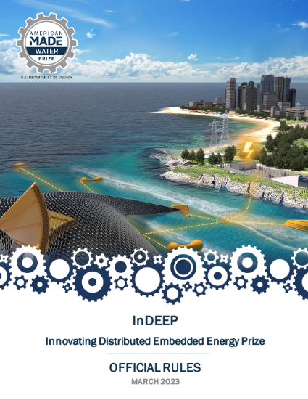
Read the Rules
BM
For a more in-depth look at the prize overall where these topics will be applied, please read the rules document, available here:
https://americanmadechallenges.org/challenges/indeep/docs/InDEEP-Prize-Rules.pdf

Slide 20

Questions?

Slide 21
ADDITIONAL INFORMATION
Reference Materials

Slide 22
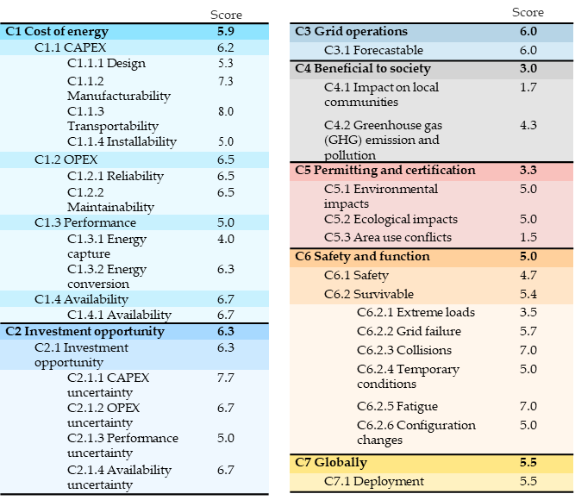
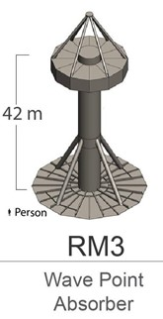
TPL Example
Capabilities:
Cost of Energy
Grid Operations
Safety & Function
Investment Opportunity
Permitting & Certification
Social Impacts & Benefits
Globally Deployable
TPL: 5.4

Slide 23
TPL Benefits
TPL offers the following benefits:
Single, easy-to-understand metric
  Universal language
Accounts for hard-to-define, qualitative design drivers and requirements
Combines TPL and TRL score to obtain a wholistic assessment of a technology's potential
Supports developers by highlighting potentially problematic areas early
Identifies best technology development trajectory – best ROI
Aids funders and investors in deciding which technologies to fund/invest in
Builds upon existing LCA and TEA work, and incorporates results
Creates universal, easy-to-understand language for communicating results
Provides a holistic assessment of technology’s potential
Quantifies trade-offs between economic and environmental metrics
Identifies areas for improvement and best development trajectory
Includes all technology life cycle stages

Slide 24
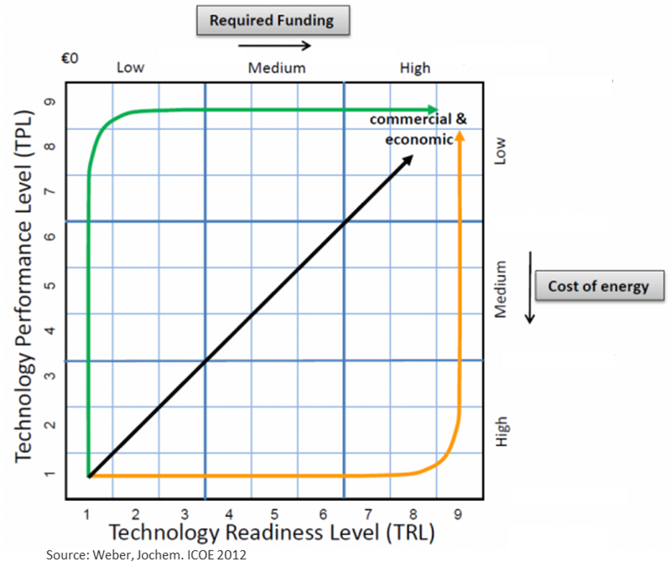
TPL Potential
Development Trajectory:
TPL supports developers by identifying potentially problematic areas early
TPL helps identify the best technology development trajectory
  Which design drivers should be invested in to yield the highest value, performance, or ROI?
  Where should you spend your money?
  Which R&D activities will lead to the best performance trajectory?
As a result, TPL can aid funders and investors in deciding which technologies to fund/invest in

Slide 25
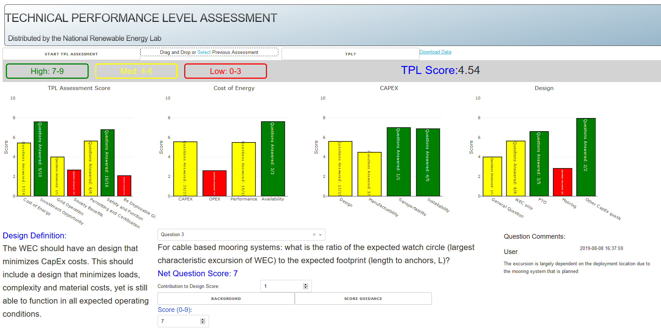
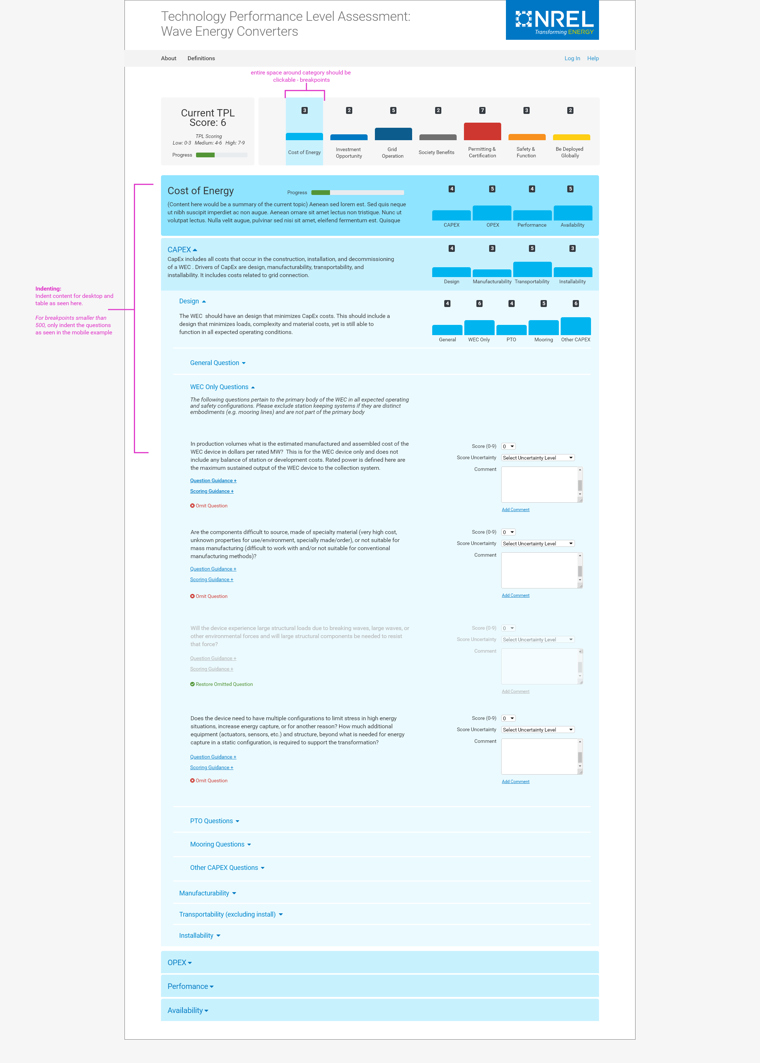
Technology Assessment
Development and Application
Continuous improvement development and release for TPL assessment tool
TPL Assessment: Versions 1.0 to 4.0 over 500 use cases of over 100 technologies
Free TPL Assessments for US and global industry & Internal use in AOP & FOA projects
Version 2.0
Version 4.0
Version 5.0
Version 6.0 – Web based

