Slide 1
THE MENSTRUATION STATION
By: Nova Sportsman

Slide 2
IMAGINE THIS
Notes:
Imagine this, you or someone you know is on their period and has asked you if you could go to the store for them. Now if you don’t necessarily know what you are looking for or just don’t want to walk into the store. Instead you look to your right and see a vending machine, but this isn’t an ordinary vending machine. No. this vending machine dispenses menstruation products. So you walk up, pay very little and you than can choose from a vast selection of products such as pads, tampons, period underwear, diva cups, and menstrual disks. It quick and easy it would take no longer than 2 minutes at most and you can leave knowing that you or the person you got them for doesn’t have to worry about when or how they will get the products they need. This is my solution to the lack of access to menstruation products having a easy way to get these products whether you menstruate or not is a huge opening in the market and would seriously improve quality of life for people on there periods and those around them

Slide 3
GOING UP
My goal is finding a way to make menstrual products more accessible to people have periods. I want to help people get the access they deserve and need no matter who they are, where they come from, and what they identify as and to help stop period poverty as well as getting rid of the stigmatism around periods
Notes:
https://www.thebalancecareers.com/elevator-speech-examples-and-writing-tips-2061976
- my name is nova sportsman and I am a junior at north central high school in Spokane Washington (read slide) If you don’t know what period poverty is it is a lack of access to menstrual products, hygiene facilities, waste management, and education.

Slide 4
PERIOD POVERTY AND MINORITY GROUPS
20% of black women in America have unstable access to period products.
11.5% of black adults in the USA didn’t have a form of health insurance (as of 2018)
Hispanic and Latinx people are more likely to experience period poverty.
58 out of 1000 Native American households live without plumbing.
15% of Navajo people don’t have piped water into their house.
In South Asia menstruating women are seen as unclean, disease spreading, and are forbidden from touching food.
Notes:
Black people in America are more likely to speak out about emotional distress but speaking to a professorial can be hard because (read second point)
Its important to go back to the sanitation part of things (read 4th point)
Even though i would start in the USA period poverty is a global issue 500million people suffer from period poverty that is 1 in 7 people who experience this and not only that a lot of countrys have a that stigmatism around it like (read last point)

Slide 5
THE EFFECTS OF PERIOD POVERTY
39% reported experiencing anxiety and depression
44% of women who experienced period poverty struggled to find employment after completing their education
Women often feel shame about their periods which leads to anxiety about the next cycle and finding products and this anxiety can lead to depression
1-5 low-income women report missing school, work or events due to lack of access
Notes:
Explain what competition exists without putting your company down and explain why you are unique/different from them and how you will fill a gap in the market
https://hellogiggles.com/lifestyle/health-fitness/menstrual-hygiene-products-women-run-companies/
- (read second point) this is due to the fact that these young girls are missing so much school, falling behind and struggling to get caught up again leading to less motovation to do it in general in turn they don’t finish and don’t get a proper education
- there are company's that are doing things to help combat period poverty like Lola that have the products shipped to your house, but not everyone can afford that. I'm idea is different because you can just go to a convenience store and buy the products or if you are at school and don’t have products you can go and get them for a cheep price.
- along with that I would want to help the people who might not be able to afford anything. I would use the left over profits to make "go bags" that have menstruation products in them and give them out for free at shelters or partner with a company that does that.

Slide 6
DATA
When asked if this would help 1-4 said most likely or definitely.
The place where people most wanted to see it most was schools and heavy foot traffic areas.
The majority of people said that the products they would want are pads and tampons
the most asked for brand was Tampax, Playtex sports, and U by Kotex.
When asked how much you would use this 100% of people said they would use it.
When asked on a scale from 1-5 how much this would impact your life on average half said it would
Notes:
https://www.anchortex.com/products/tampons-bulk-packed
I created a survey and posters with qr codes and put them up around my school allowing a vast majority of people from diffrenet back grounds take the survey. It shows(read slide)

Slide 7
REVENUE
Primary customers are people who have periods that don’t have access
Pads w/ wings in bulk cost 21.90 for 280
Regular tampons in bulk are 73.80 for 500
2,500 pad and tampons sold each month
Monthly profit of both overall if put in a school $675
Profit made in one school year $6,075
Lifetime value for average customers $5
Notes:
- lets use my school as an example and lets assume there is 5000 girls at my school and half use pads and half use tampons
- It costs .08 cents per pad bought in bulk if charge .25 there would be .17 profit
- it costs .15 cents per tampon bought in bulk if charge .25 there would be .10 profit
- monthly profit for pads $425
-monthly profit for tampons $250

Slide 8
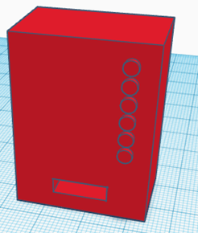
THE MODEL
Notes:
This model was made by my class mate teghan siaz in thinker cad and was printed by our student teacher.

Slide 9
MOVING FORWARD
I want to help people globally combat the effects of period poverty, I would like start in the greater Spokane area and hopefully expand so everybody who needs access can get access because everybody should get the care, they need no matter the circumstance. Also due to recent events, these vending machines can also be modified to be able to fit things like contraceptives and other hygiene products.

Slide 10
IN CONTRIBUTION WITH
Teighan Saiz for producing the model of the vending machine.
Savannah Durtler for supporting research.
Parker Britton for allowing me to have the space to produce this

Slide 11
WORK CITED
Works Cited
“Addressing Period Poverty and Mental Health | U by Kotex®.” Www.ubykotex.com, www.ubykotex.com/en-us/periods/addressing-societal-issues-around-periods/addressing-period-poverty-and-mental-health.
Nast, Condé. “Not Being Able to Afford Tampons Could Hurt Your Mental Health.” Teen Vogue, 19 July 2018, www.teenvogue.com/story/period-poverty-could-have-mental-health-consequences-study-finds. Accessed 29 Apr. 2022.
Sportsman, Nova. “Microsoft Forms - Easily Create Surveys, Quizzes, and Polls.” Www.microsoft.com, 10 Apr. 2022, forms.office.com/pages/designpagev2.aspx?lang=en-US&origin=OfficeDotCom&route=Start&subpage=design&id=fSGa33NnF021d4XclgeCIgRiqfZZsfZDtNwwrluByU5UMkZORjJWWjRZUzFKRTZQSzVQQ0NTUEhXTS4u. Accessed 29 Apr. 2022.
National Alliance on Mental Illness. “African Americans | NAMI: National Alliance on Mental Illness.” Nami.org, 2017, www.nami.org/Your-Journey/Identity-and-Cultural-Dimensions/Black-African-American.
Morales, Laurel. “NPR Choice Page.” Npr.org, 2019, www.npr.org/2019/11/18/779821510/many-native-americans-cant-get-clean-water-report-finds.
Period Poverty: A Growing Public Health Concern. 2021.
“Looking at Period Poverty and Female Hygiene Gaps in the US.” Regis College Online, 19 Aug. 2020, online.regiscollege.edu/blog/period-poverty/.
Smith, Amy. “The State of Period Poverty in the U.S.” Www.nursing.upenn.edu, www.nursing.upenn.edu/details/news.php?id=1545.
“Black Families Are Disproportionately Affected by Period Poverty—Here’s What They Need.” Parents, www.parents.com/kindred/black-families-are-disproportionately-affected-by-period-poverty/. Accessed 24 May 2022.‌

Slide 14
MEET OUR FOUNDER

Slide 15
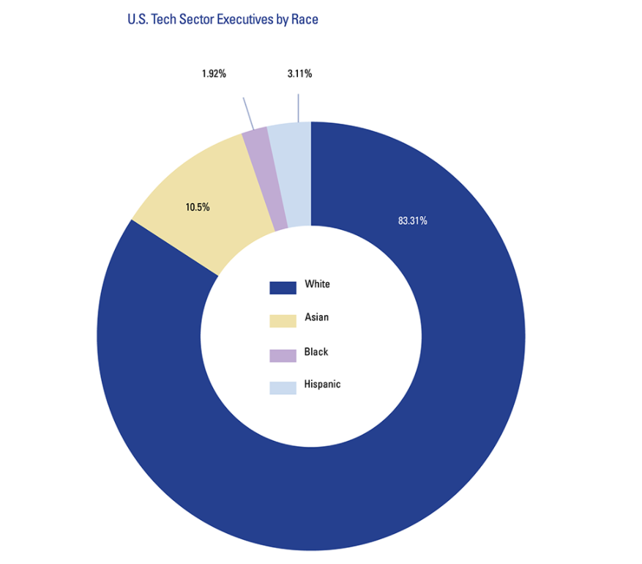
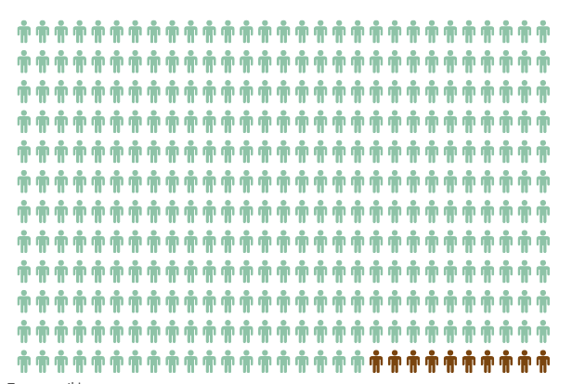
OUR PURPOSE: BRIDGE THE GAP
Disparity in Tech Execs
Disparity in VC Funding
Disparity in VC Representation
Only 1.92% Tech Execs are Black and 3.11% are Latinx
(Open MIC, 2017)
Black/Latinx founders only received 3% of
$147B venture cap deal volume
in the past year
(Reuters, 2020)
Black/Latinx investors make up
less than
4% of the venture capital industry
(BLCK VC, 2021)

Slide 16
Venture for THEM is…
a startup accelerator for Black & Latinx tech companies to help take them to next level through:
Pre-Seed Funding
Diverse Mentors & Coaches
Peer-to-Peer Networking
Personalized Workshops

Slide 17
OUR ACHIEVEMENTS
Our program launched in January 2022, and since then, we have:
Invested $1,500 into five minority-led small businesses
Hosted various virtual webinars for entrepreneurs (50+ attendees)
Gained sponsorship from Thurgood Marshall College Fund, Moet Hennessy, Score 3 Ventures, & HBCUvc
Connected Black entrepreneurs with mentorship from industry leaders

Slide 18
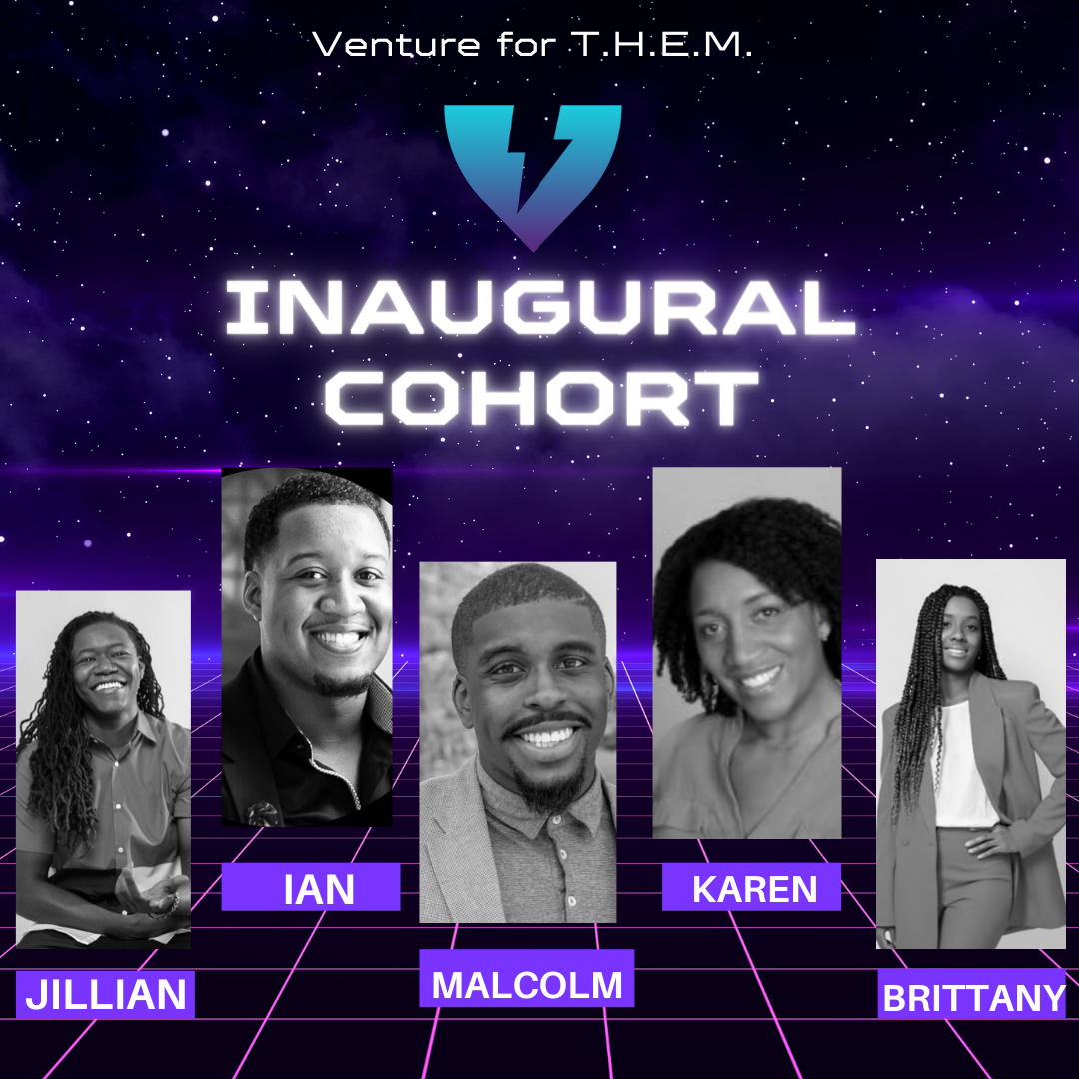

Slide 19
MORE ABOUT OUR
INAUGURAL COHORT
-VR experience for language learning
-Launched a Beta with 10+ schools
-waiting list of 500 educators for their pilot
-Ridesharing for women by women
-20,000+ Downloads
-Based in Atlanta, GA
-Uber Eats for beauty & hair products
-2400+ downloads, 500+ orders
-Member of Hennessy’s NSNSS Inaugural Cohort
-connect parents with wellness professionals
-10,000 downloads, 1,000+ subscribers
-75+ neuropsychologists to support children
-dubbed the “Spotify for Stocks”
-share/copy portfolios like playlists
-Launched last month

Slide 20
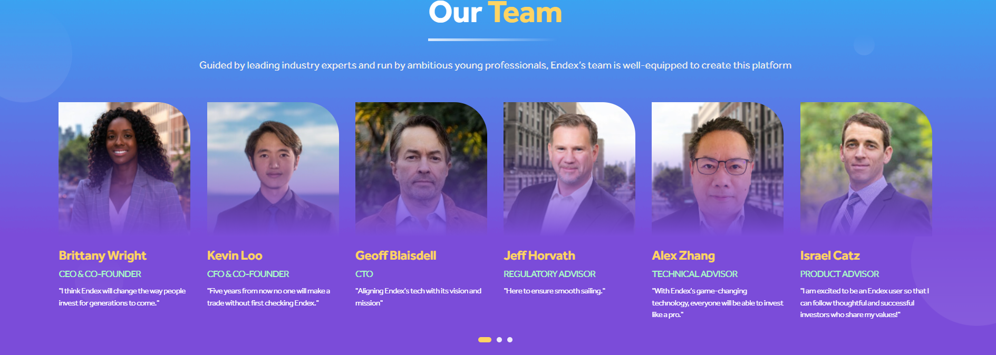
OUR CRITERIA: THREE T’S
TRACTION
TEAM
TIMING

Slide 21
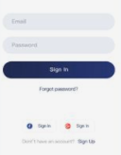
Budget Allocation (Unit Economics)
Below are the current allocations for our awarded $10k grant (from LVMH):
Expense Description | Allocated Funding (Cohort 1)
Pre-Seed Investment for (5) Startups | $7,500 Total ($1,500 per startup x 5)
Cost toward outsourcing coaches | $2,000 Total ($500 per coach x 4)
Zoom Video Conferencing | $180 Total ($15 per month x 12)
Misc. Allocation (Welcome Packages, etc.) | $320 Total
Total | $10,000

Slide 22
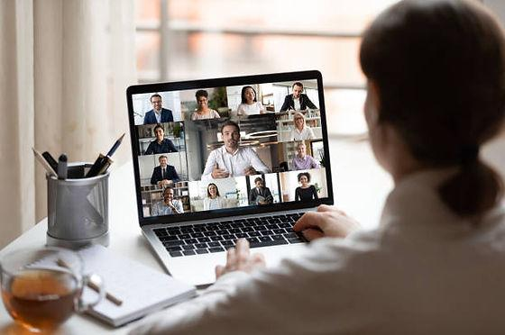
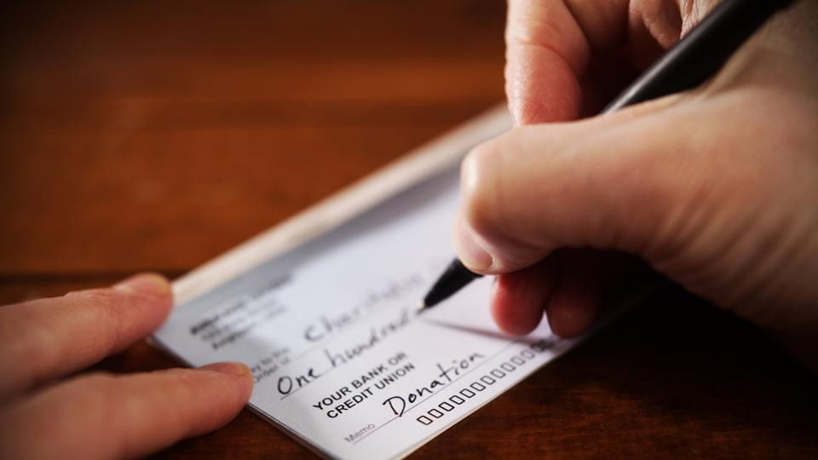
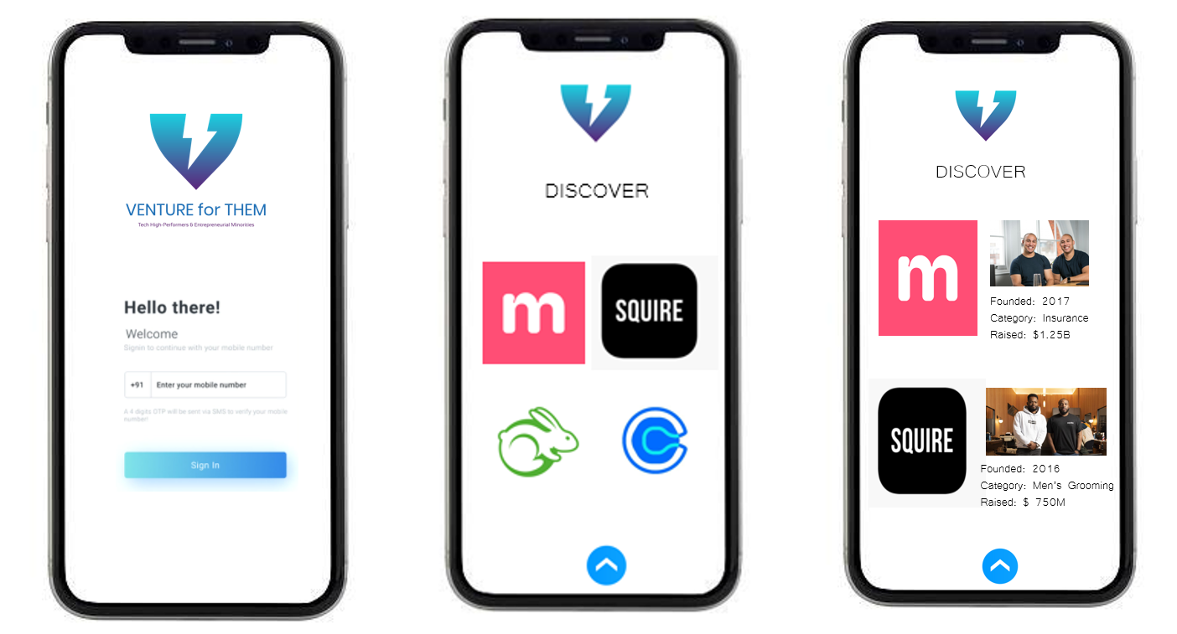
OUR BUSINESS MODEL
PHASE 1
PHASE 2
(January – June)
(July – December)
GRANTS
GRANTS
SCOUTS FOR VCS
WORKSHOPS
FUNDING
MENTORSHIP
MOBILE APP
EQUITY
$100k Investment at 7% Equity

Slide 23
OUR PARTNERS
Within the six months that we’ve been launched, we’ve established partnerships with the following organizations to help create a pipeline for our Fellows to receive additional funding and/or exposure:
Angels/VCs & Accelerators
Corporate Partners

Slide 24
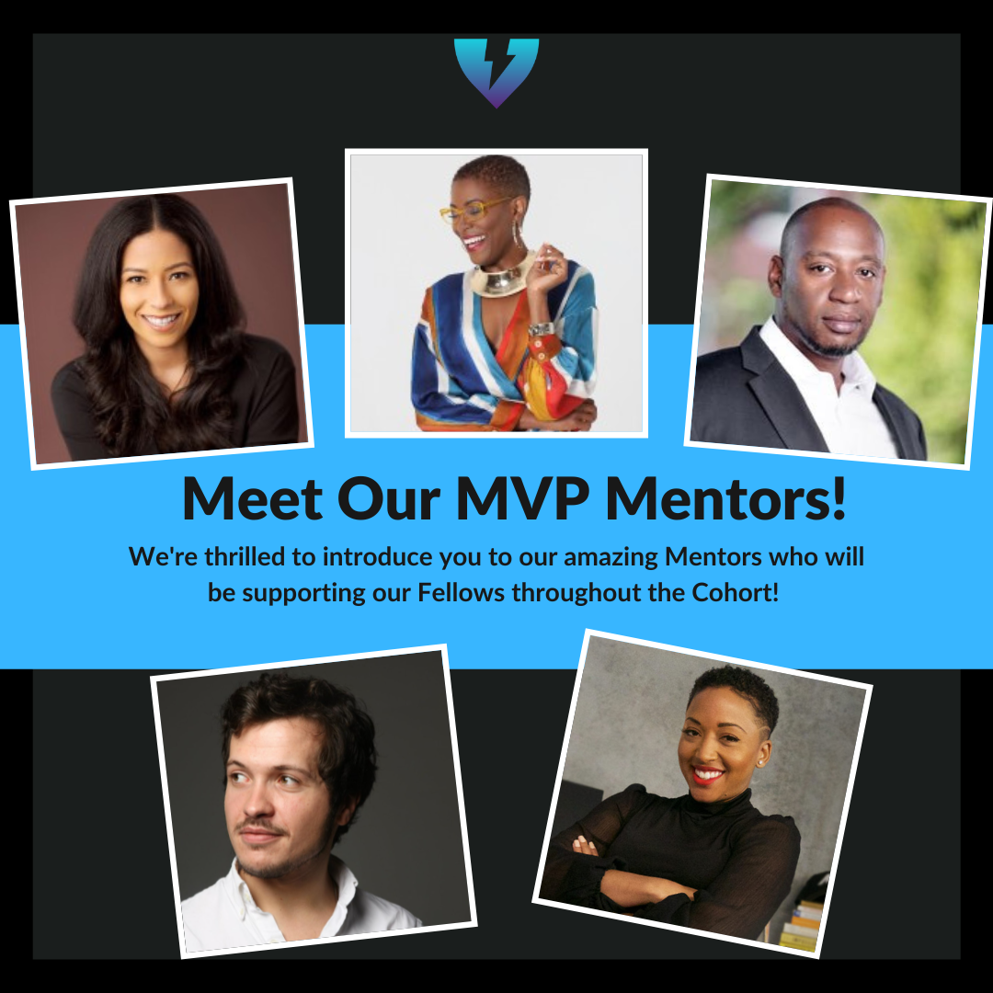
OUR MENTORS

Slide 25
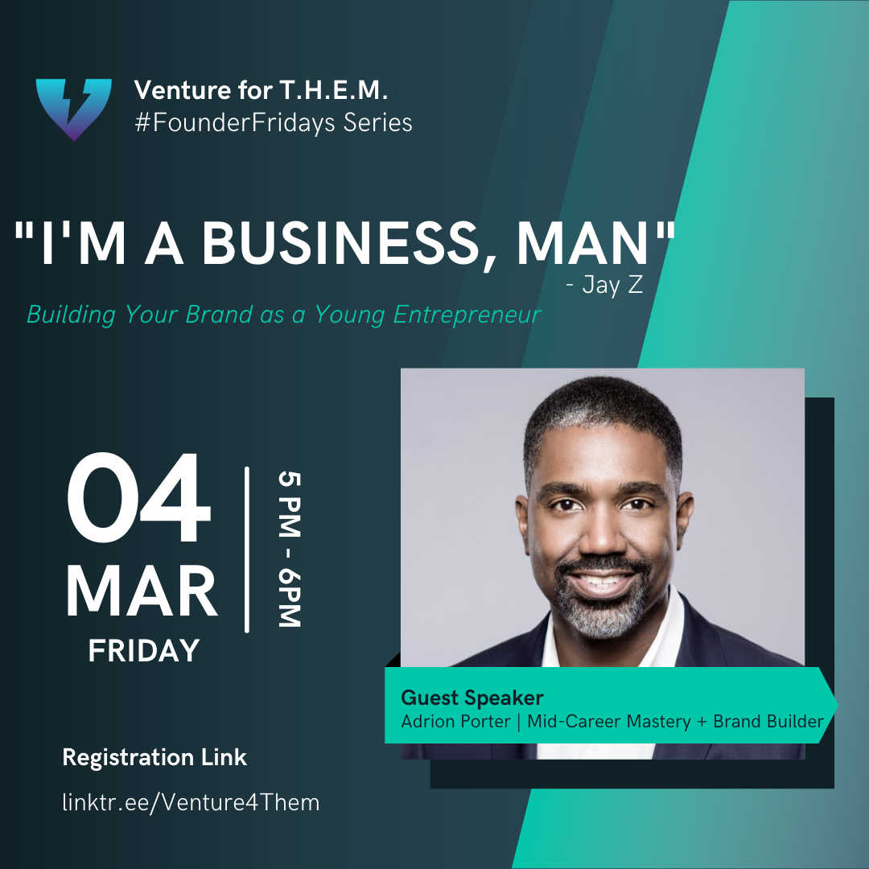
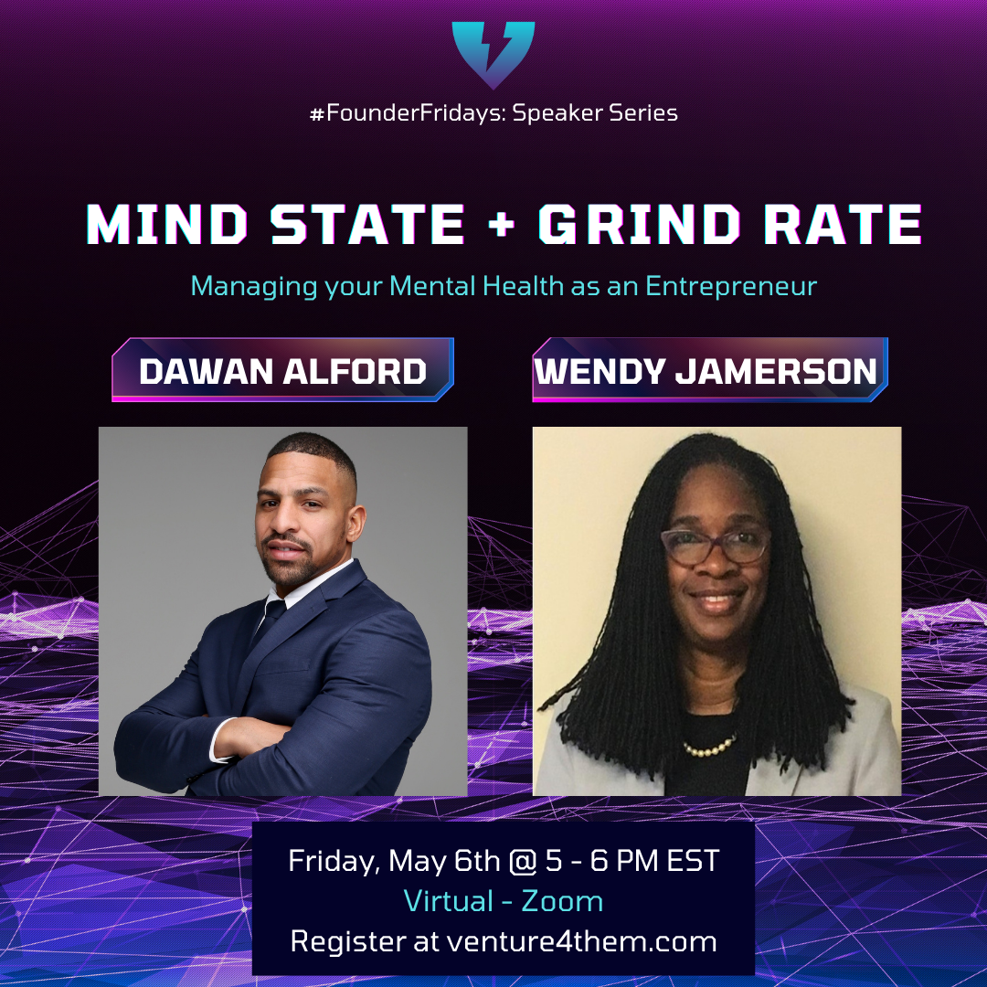
OUR EVENTS
#FounderFridays: Speaker Series
BRAND-BUILDING
FUNDRAISING
W-L BALANCING

Slide 26
OUR EVENTS

Slide 27
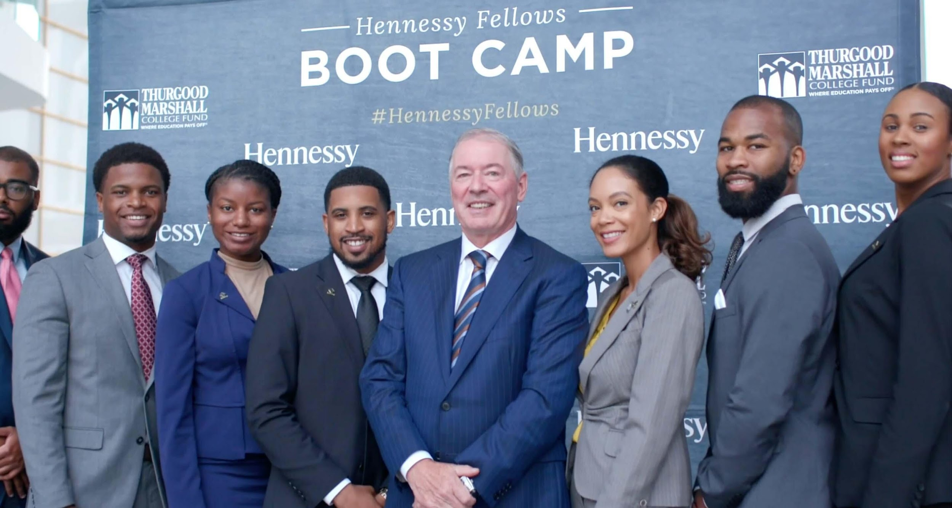
OUR ADVANTAGE
BEACHHEAD MARKET
BRAND ENDORSEMENTS
DESIRE FOR CHANGE
HBCU Students, DMV Startups
LVMH, TMCF, BASE 11, JPMORGAN?
TAKING OUR MISSION GLOBAL!

Slide 28
CLOSING: OUR IMPACT
We are raising a $1M Fund to support Black and Latinx entrepreneurs.
We are primarily doing this through partnerships with corporate sponsors and crowdfunding efforts.
Our ultimate goal is to invest in 50 Black and Latinx-led startups over the span of the next 5 years.
Our efforts aim to create a pipeline of more minority Tech CEOs & Leaders in an ecosystem that truly needs them.
“It’s about fueling an untapped ecosystem so that you may be lucky enough to reap the rewards in years to come” – Arlan Hamilton

Slide 29
We look forward to connecting with you!
Contact Email: kiante@venture4them.com
Social Media: @venture4them

Slide 31
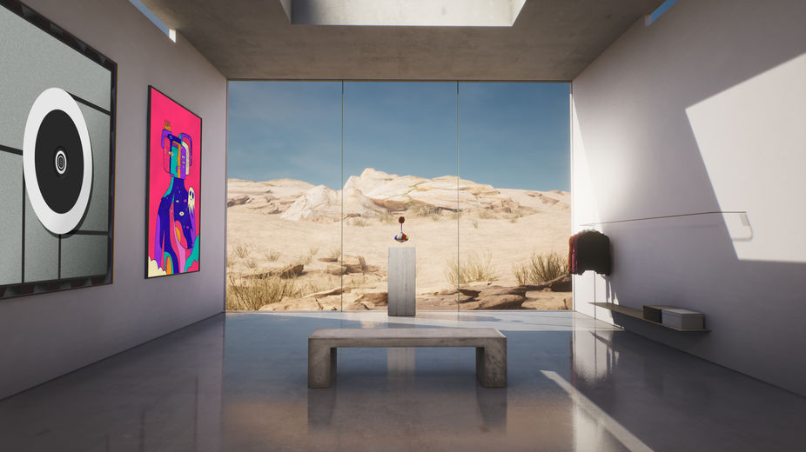
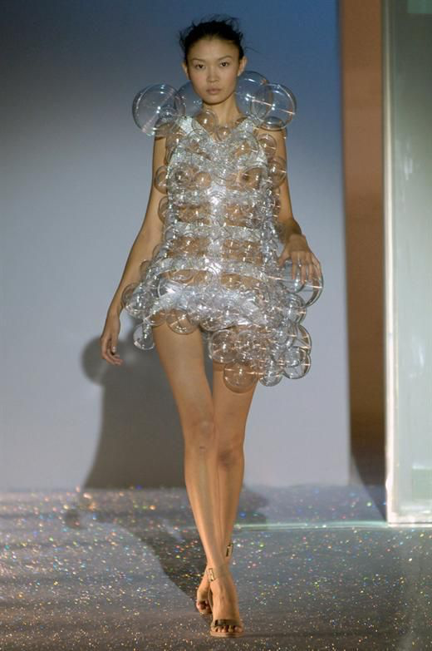
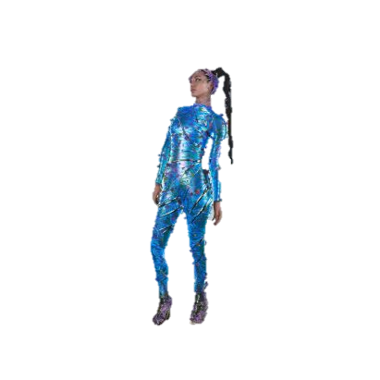

Slide 32
The State of Virtual Fashion
01
53% of fashion brands are investing in the $300bn gaming sector. Yet less than 10% of designers are Black.
02
Crypto-gaming experts predict that the social gaming segment of digital asset investments can add around $10–20 million to the luxury goods market.
03
Researched conducted by Institute of Digital Fashion show that BIPOC, Disabled, and LGBTQ individuals feel underrepresented in virtual spaces.
04
Black owned-fashion brands are unable to keep up with luxury conglomerates like LVMH, L’OREAL, and Kering when it comes to innovation .
Notes:
Business of Fashion and McKinsey expect market for virtual goods to be worth $135bn USD by 2024
One respondent stated” I always seek to represent myself as there is barely any visibility for Black women digitally.”

Slide 33
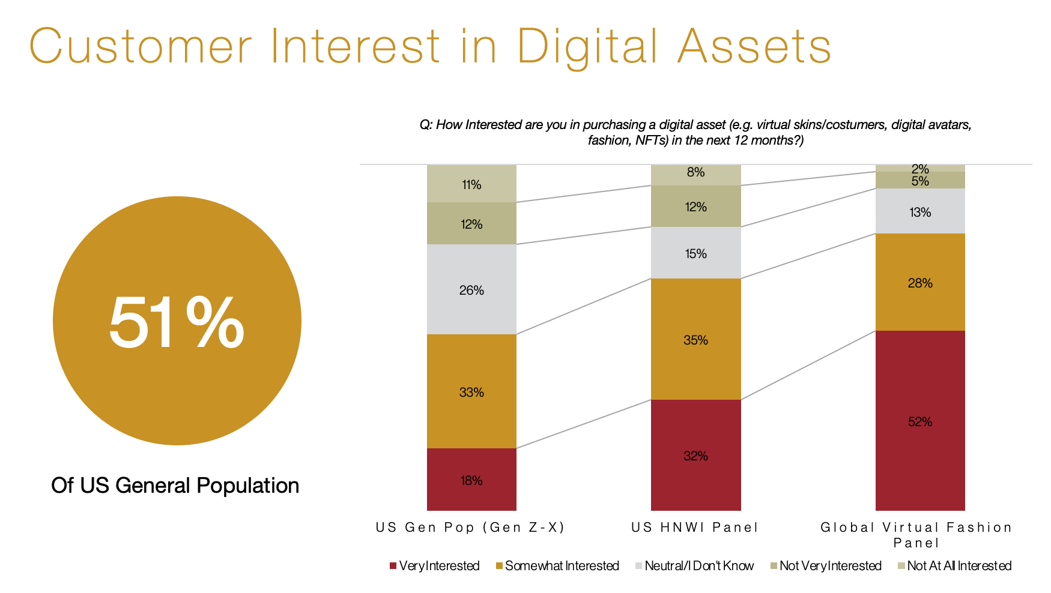

Slide 34
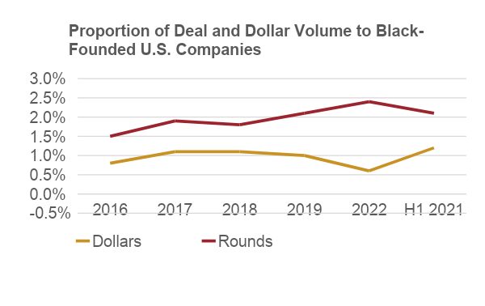
The Problem
We need to create an inclusive metaverse…
But Black Founders received only 1.2% of VC money during the first half of 2021.
Source: Crunchbase
Notes:
LUXURY Brands have community projcst, discords, NFT, hiring temas

Slide 35
The Flex Solution
V/FLEX
A physical and digital, gender-neutral handbag. 35% of profits go towards the B/FLEX Fund.
the handbag
WE/FLEX
An extended online community for those who own a V/FLEX bag. The platform will host virtual networking events, workshops to educate the Black community on advancements in tech and entrepreneurship
the metaverse
B/FLEX
The Black Fashion Lab for Entrepreneurs and Executives is a fund created to support Black founders in the A/VR space
the founders
Notes:
Parity Line: Venture Capital Entrepreneurs
Next Frontier Industry: VR/AR

Slide 36
V/FLEX
V/FLEX…the first handbag to be sold both physically and digitally as an NFT. 35% of profits will go towards B/FLEX, a fund for Black artists and creators.
Empowering you to empower others.
The gender-neutral bag will comply with the UN’s Sustainable Development Goals and be made from sustainable materials. We plan to make the NFT ecofriendly, by encouraging purchases with cryptocurrency that use proof-of-stake networks.
The goal is to use the bag to build community around Black entrepreneurship and empowerment.

Slide 37
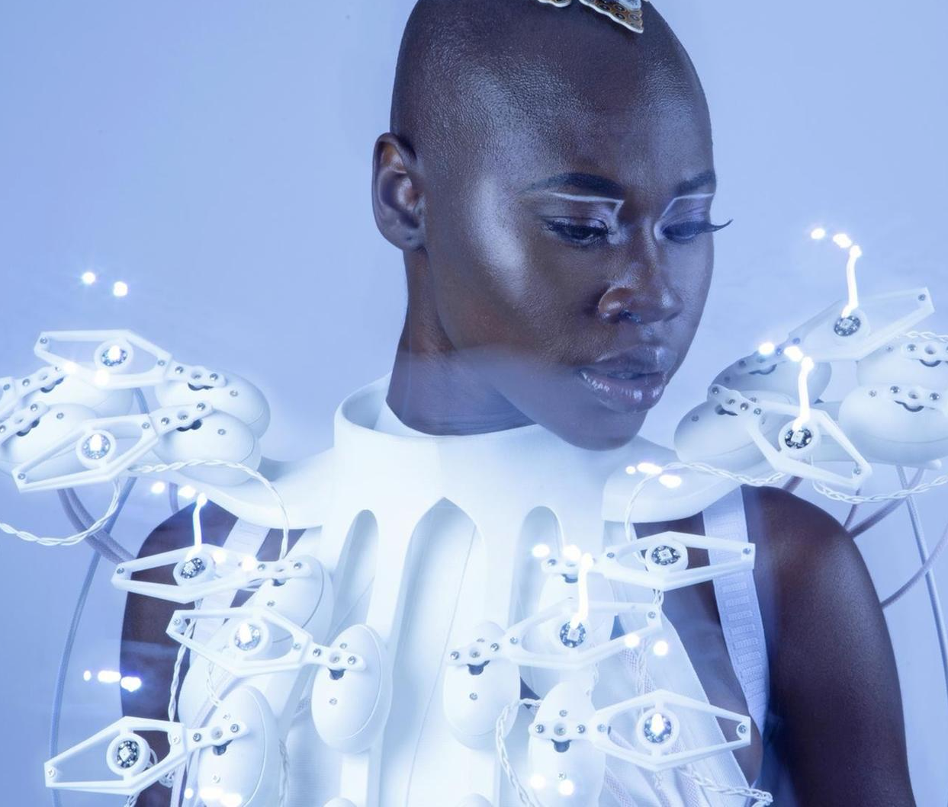
THE COMMUNITY
WE/FLEX
The online community for individuals who purchase a FLEX bag.
Guest speakers, virtual workshops, networking for fashion/tech entrepreneurs
B/FLEX
The fund that supports Black entrepreneurs in the AR/VR Space.
35% of proceeds from the FLEX bag go towards B/FLEX Fund
Notes:
Workshops like the Inside LVMH platform

Slide 38
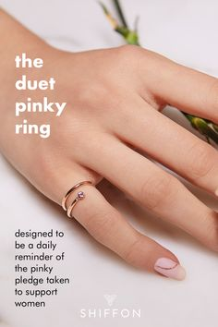
Megan Markle, Michelle Obama, Voting Collection
Supporting vemale femtnres
Case Studies
AMINA IRIS
Founded by Wilgolory Tanjon,
Pays her artisans in Senegal 2x as much as the industry average
Cult Favorite- Fans call themselves “Irises”
On track to make $1.2m in revenue in 2022
SHIFFON CO.
Founded Harvard student, Shilpa Yarlagadda
50% of profits go to Startup Girl Foundation (SGF), which has funded 11 female-founded companies
FOUNDER GYM
Founded by Mandela SH Dixon
#1 online training program specifically designed to help underrepresented tech startup founders raise money to scale their startup
Has trained the most Black female founders to raise $1 million.

Slide 39
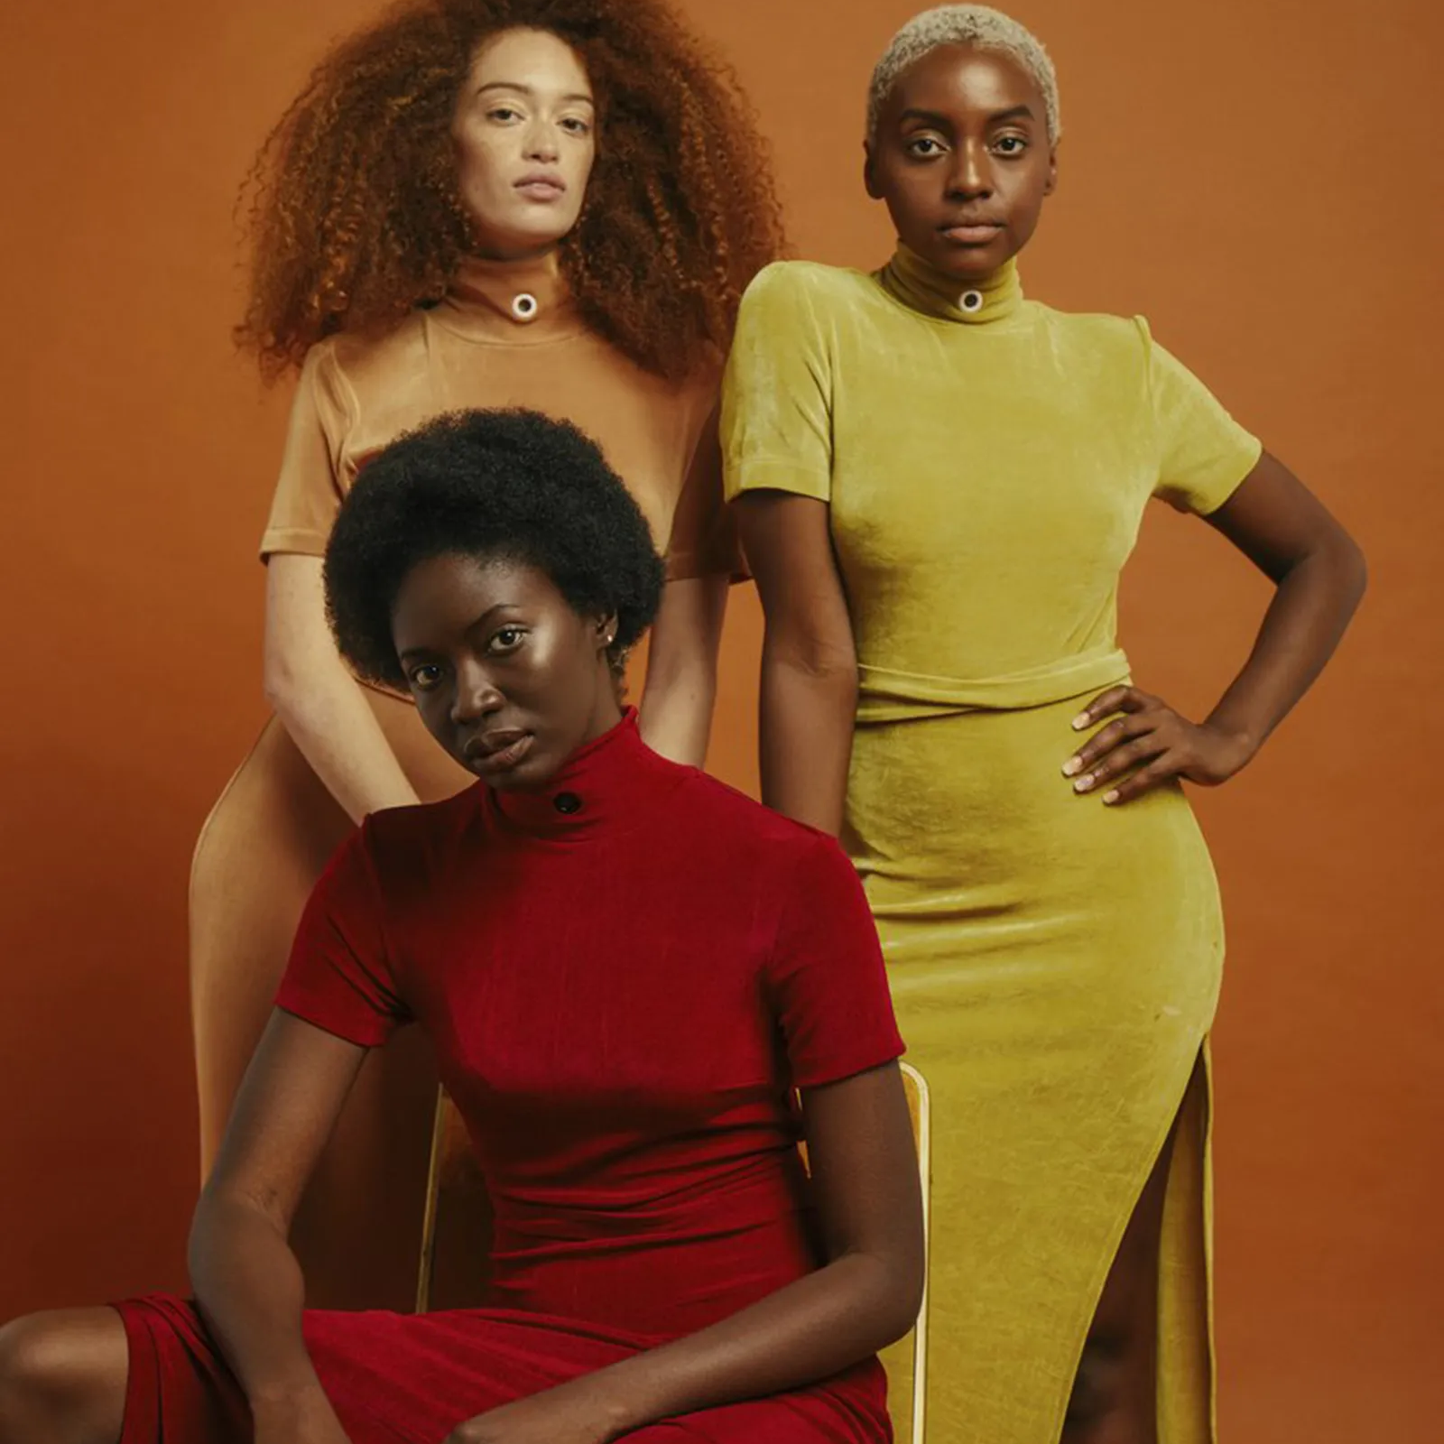
THE PATHWAY
DESIGN
ESTABLISH
INDUSTRY
IMPLEMENTATION
Design and manufacture the V/FLEX bag + build WE/FLEX online space.
Recruit talent to run B/FLEX, registering the company, and setting up the fund.
Build connections with industry partners (CFDA, ELC, 15% Pledge)
Marketing + Launch (Influencers, NYC Launch event)
Fall 2022
Spring 2023
Summer 2023

Slide 40
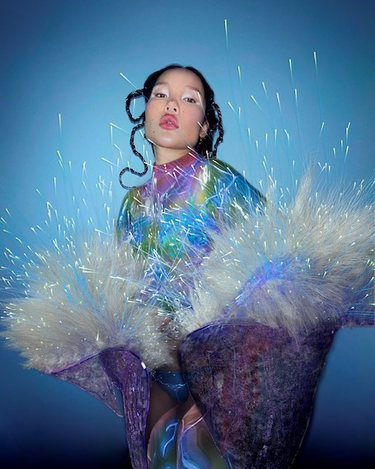
WHY THIS? WHY NOW?
Luxury brands own the market share when it comes to the metaverse…Black designers MUST be there to help make virtual worlds inclusive.
Notes:
Implementation
Design: Designing and manufacturing the V/FLEX bag and creating the WE/FLEX online space.
Organizational Set Up: Recruiting talent to run B/FLEX, registering the company, and setting up the fund.
Marketing: Setting up social media, recruiting influencers, and reaching out to designers to encourage them to apply to the B/FLEX fund.
Black fashion designers are TRENDING
Organizations like Black in Fashion Council, 15% Pledge, and Harlem Fashion Row are connecting Black designers
But WHO is helping Black designers integrate technology into their business models?
RISKS

Slide 41
Jasmine Bacchus
EDUCATION
Brown University, B.A. PPE
University of Oxford, MSc Social Science of the Internet
Harvard Law School, Incoming JD Candidate
AWARDS
Executive Leadership Council Scholar
Inaugural Virgil Abloh “Post-Modern” Scholar
Inaugural Gucci Changemaker
3 x Fashion Scholarship Fund Scholar (Technology/Analytics)
WORK EXPERIENCE
Intern @ Goldman Sachs, Microsoft, BCG, LVMH, Saks Fifth Avenue
Incoming Strategy Intern @ Riot Games (MBA Program)

Slide 42
Next Steps
Capital
Mentorship
Network
Notes:
What is the price point of the bag?

Slide 43
Thank You
@Jasmine.Bacchus
Jbacchus19@gmail.com
Jasminebacchus.com
Jasmine Bacchus
Notes:
What is the price point of the bag?

Slide 45
www.microhavenhomes.com

Slide 46
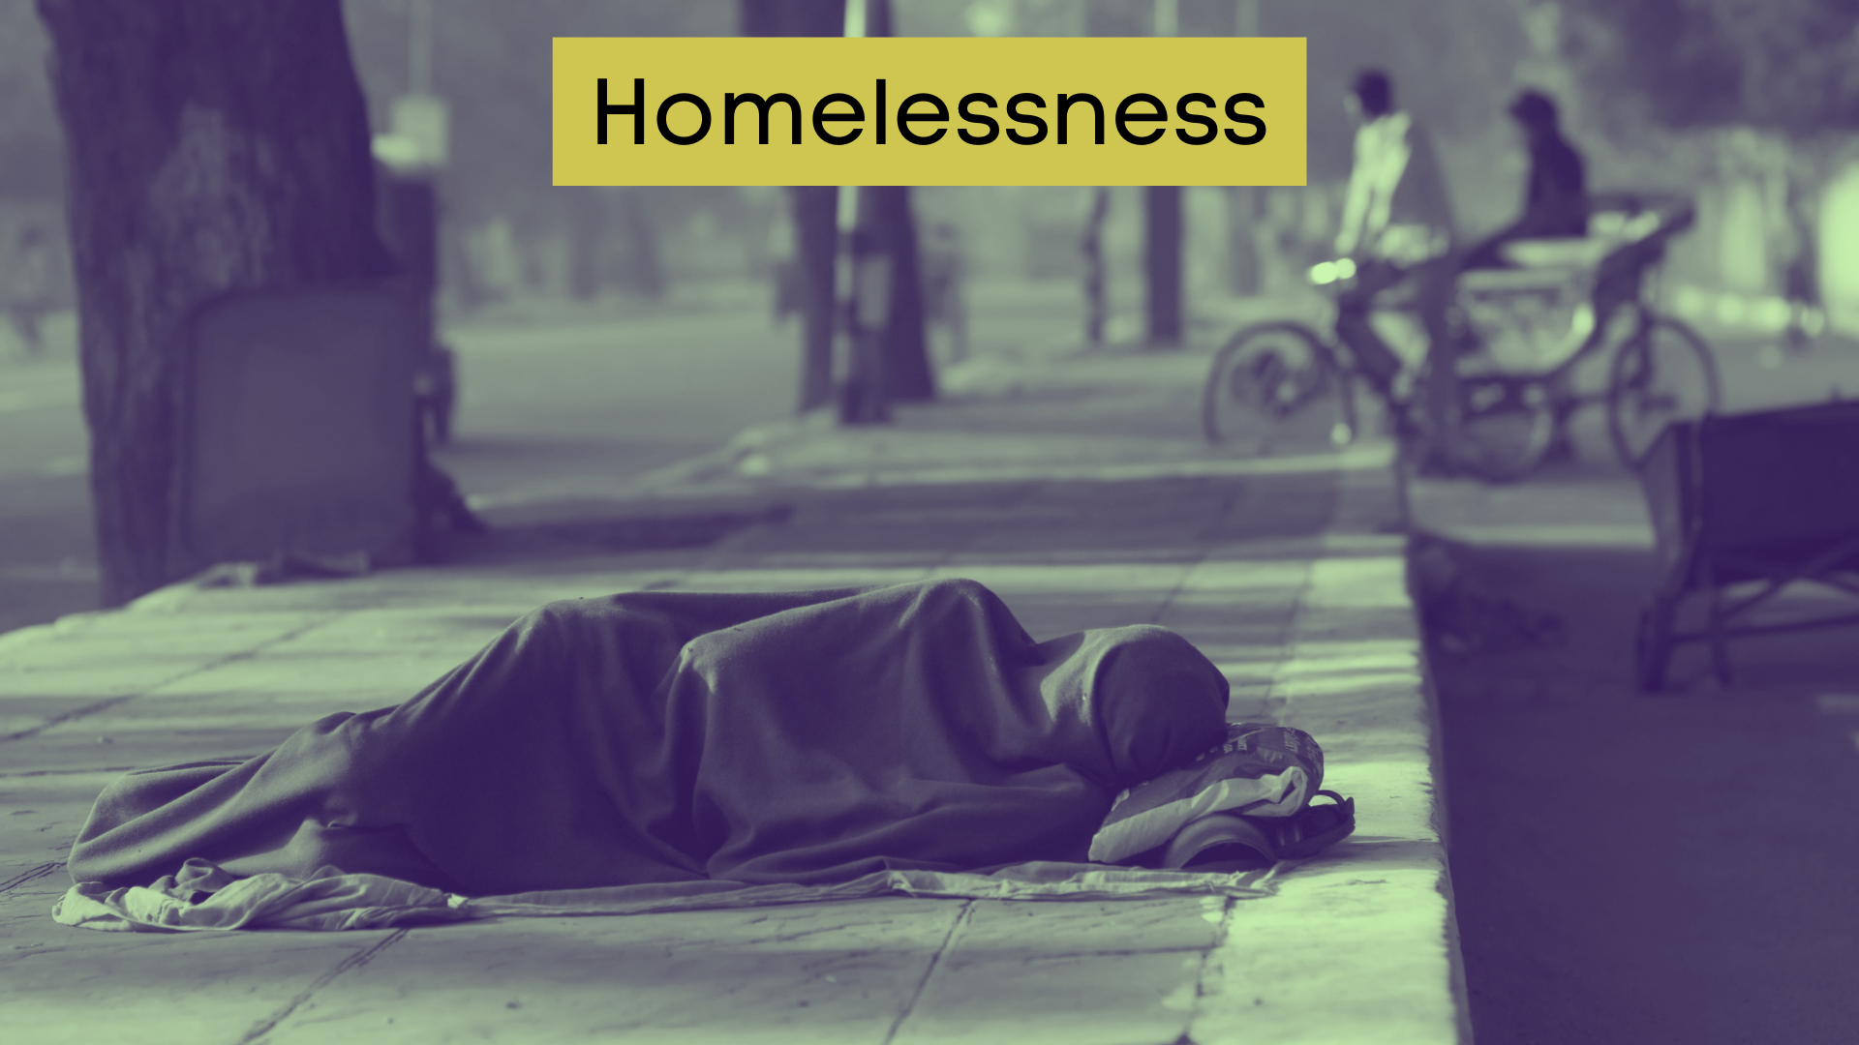
Affects about 600,000 people in America
39% Black People
67% Individuals
Health and safety issues
Costs community $23,000 per person each year
Difficult to fund Permanent Supportive Housing (PSH)

Slide 47
TAM
TAM
Homeless worldwide
1.6 Billion
Global PSH
$12.48 T
SAM
SAM
Homeless in US
600,000
US PSH
$4.68 B
SOM
SOM
Homeless
in Baltimore
2,193
Baltimore PSH
$17 M

Slide 48
Tokenized apartments for fractional ownership
Lower barrier to entry
Prevents fraud
Passive income
Asset liquidity

Slide 49
Permanent Supportive Housing (PSH)
Fractionally owned micro-apartments
$3.57 tokens (21 M tokens available)
Token Market Cap $74,970,000
NOI $200 K per year (CSH)

Slide 50
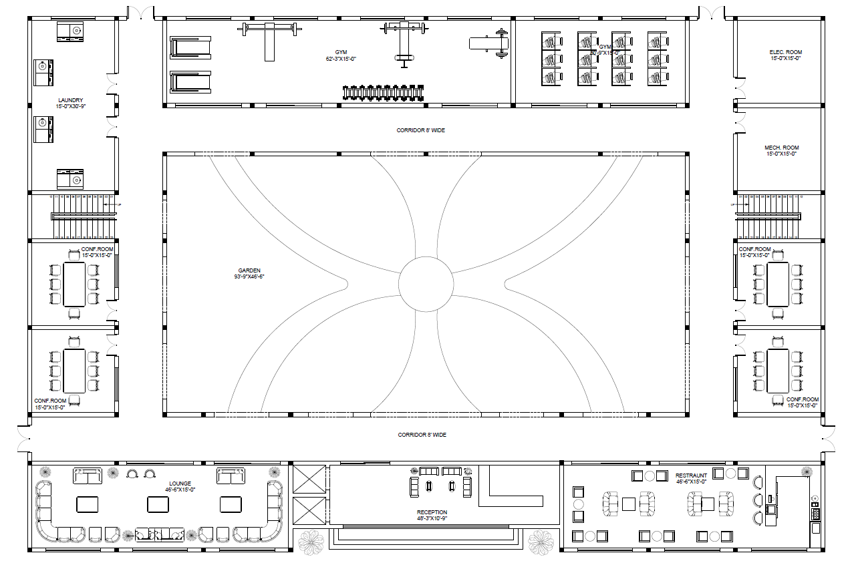

Slide 53
Employment services
Transportation
Mental health services
Healthcare
Substance abuse counseling

Slide 54
Parity Project Innovation Challenge (PPIC)
4 Letters of Intent (LOI)
DigiShares
ZROverse, Inc.
Height Zero Real Estate and Consulting
Ruth Anne Strauss (Realtor)
Whitepaper from Professional Writers

Slide 55
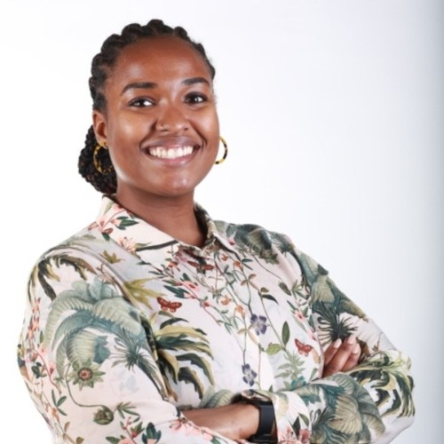
PhD Candidate in Chemistry at UMBC
Military Veteran

Slide 56
Tlee Cooper
CEO, ZROverse, Inc.
Tim Wilson
VC, TEDCO
Luke Cooper
Managing Director, Latimer Ventures
Akshay Bhuva
CEO, Kitchenery

Slide 57
 |  |  | Traditional PSH | Affordable Housing
Tokenized
Publicly Owned
Support Services
Job Training
Permanent Address
Individuals

Slide 58
Task | Year 1 |  |  |  | Year 2 |  |  |  | Year 3 |  |  |  | Year 4
 | Q1 | Q2 | Q3 | Q4 | Q1 | Q2 | Q3 | Q4 | Q1 | Q2 | Q3 | Q4 | Q1 | Q2 | Q3 | Q4
Project Management | $100 K |  |  |  | $100 K |  |  |  | $100 K |  |  |  | $100K
PR Campaign, Social Media, SEO |  | $67.5 K
File LLC in Delaware |  |  | $200
Ensure Compliance with Reg A+ |  |  | $75 K
Build STO Platform |  |  | $18 K
Acquire and Survey Land |  |  | $1 M
Launch and Optimize STO |  |  |  |  | $75 M
Construct Building |  |  |  |  | $30 M
Find Future Tenants |  |  |  |  |  |  |  |  | $20 K
Acquire Tenant Resources |  |  |  |  |  |  |  |  | $2 M
Move Tenants into Building |  |  |  |  |  |  |  |  |  |  |  |  | $10 K
Start Collecting Rent |  |  |  |  |  |  |  |  |  |  |  |  |  |  | $500 K
Net (Yearly) | $1,260,700 |  |  |  | $44,900,000 |  |  |  | $2,120,000 |  |  |  | $390,000
Net (Overall) | $41,909,300

Slide 59
$1.5 M investment
DigiShares: STO platform
Height Zero Real Estate & Consulting: Project management
Bull Blockchain Law: Reg A+
Capital Raise Agency: PR campaign
Ruth Anne Strauss (Realtor): Purchase land

Slide 60
Thank You
www.microhavenhomes.com

