Slide 1
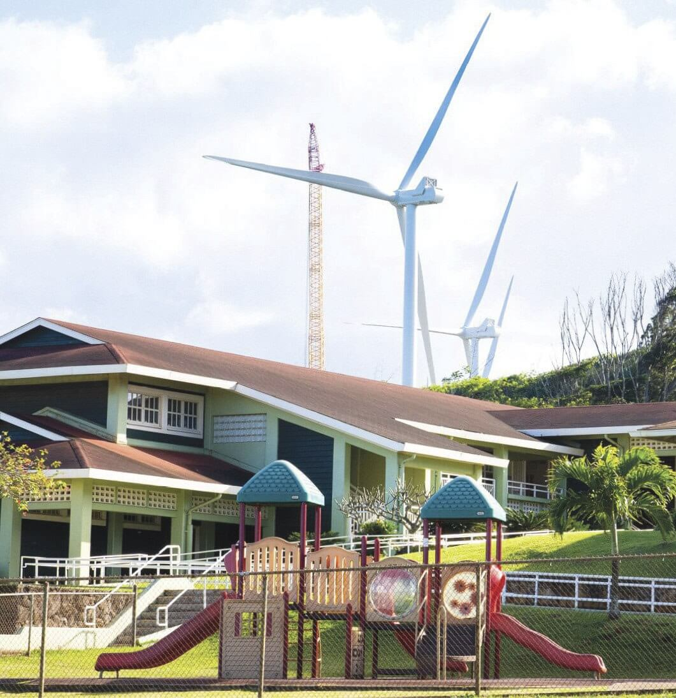
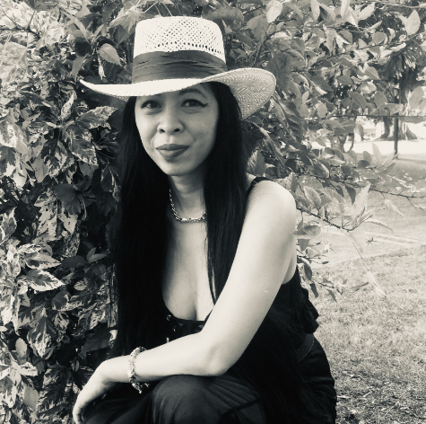
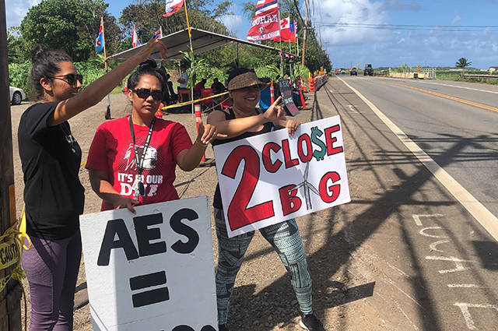
Aloha for Energy Justice
My name is Layla Kilolu and I am an energy and climate justice advocate based in Honolulu, Hawaiʻi. As a Ph.D. student, my research goals are to empower communities through collaborative research that improves their well-being. I also serve as an economist for the State of Hawaiʻi’s Public Utilities Commission, and my mission is to bring energy justice to our underserved communities, specifically addressing the needs of our indigenous people.

