Slide 1

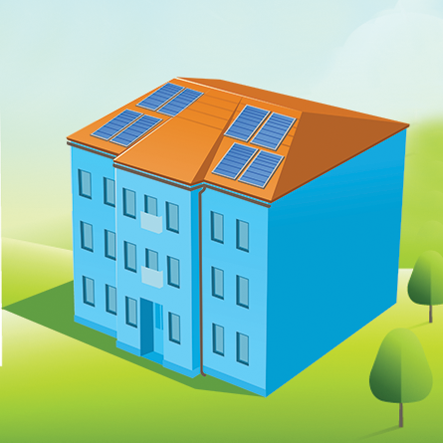

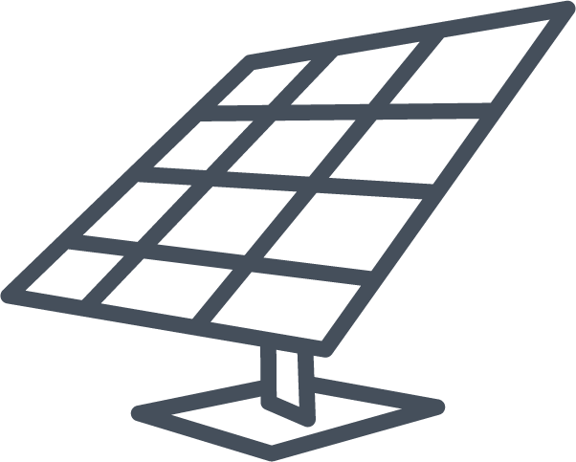



EPICS Basic Income Solar System
Solar Microgrid installed at and near low-income development
Battery system stores electricity for off-peak
Reliable power for residents & customers
Revenues for basic income fund for residents
Notes:
Audience: Funder, policy makers

