Slide 1
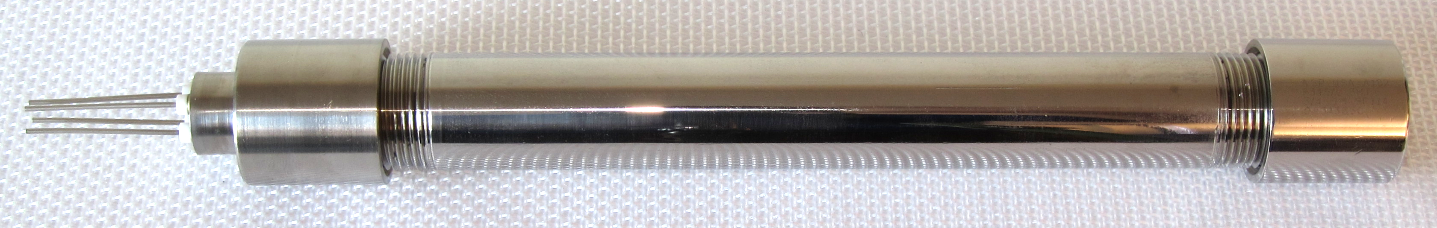
ROGUE - Resonant Oscillatory Generator for Underground Environments
a device for capturing energy in extreme downhole conditions
Challenge: To drill deeper geothermal boreholes, we need electrical power sources that can operate under extreme temperature, pressure, shocks, and vibration.
Solution: an energy-harvesting generator that converts drill string motion into electrical power
Our prototype is
tested to 220°C
constructed from durable materials that will survive many bit trips with minimal wear
built with additively manufactured components
highly modular and scalable, allowing it to power a variety of intelligent drilling instruments across the operating temperature range

