Slide 1
HydRestor™ Phosphate Sequestration & Recovery with Innovative Technology

Slide 2
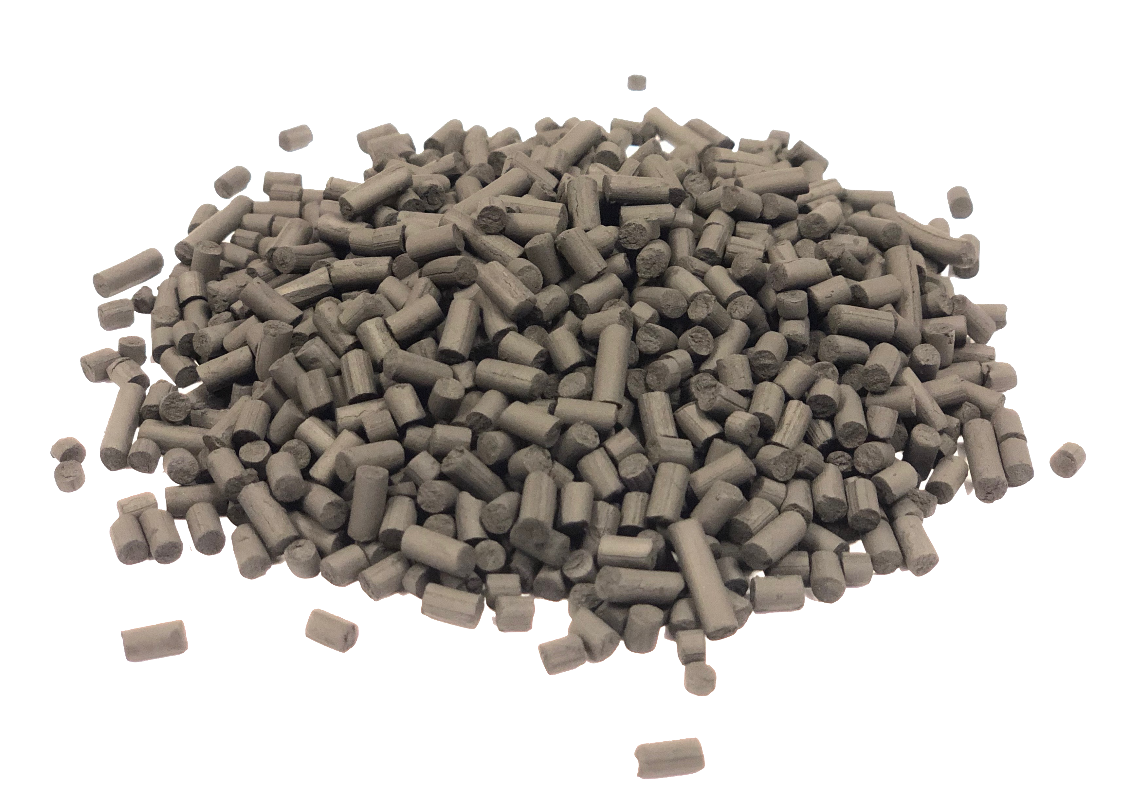
Carbonxt Phosphate Recovery with Engineered Sorbent Pellet*
The Carbonxt engineered sorbent material has been designed to adsorb phosphate in applications and desorb the constituent (release) after its initial use.
After use, can be used as a soil amendment for slow phosphorous release and water retention
Phosphorus recovery technology by Carbonxt
  Easy modular adsorption vessel design with low head-losses
  None of the operational disadvantages of enhanced biological phosphorus removal
  No chemical dosing

Slide 3

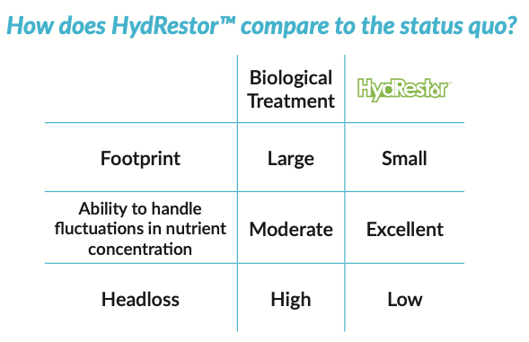
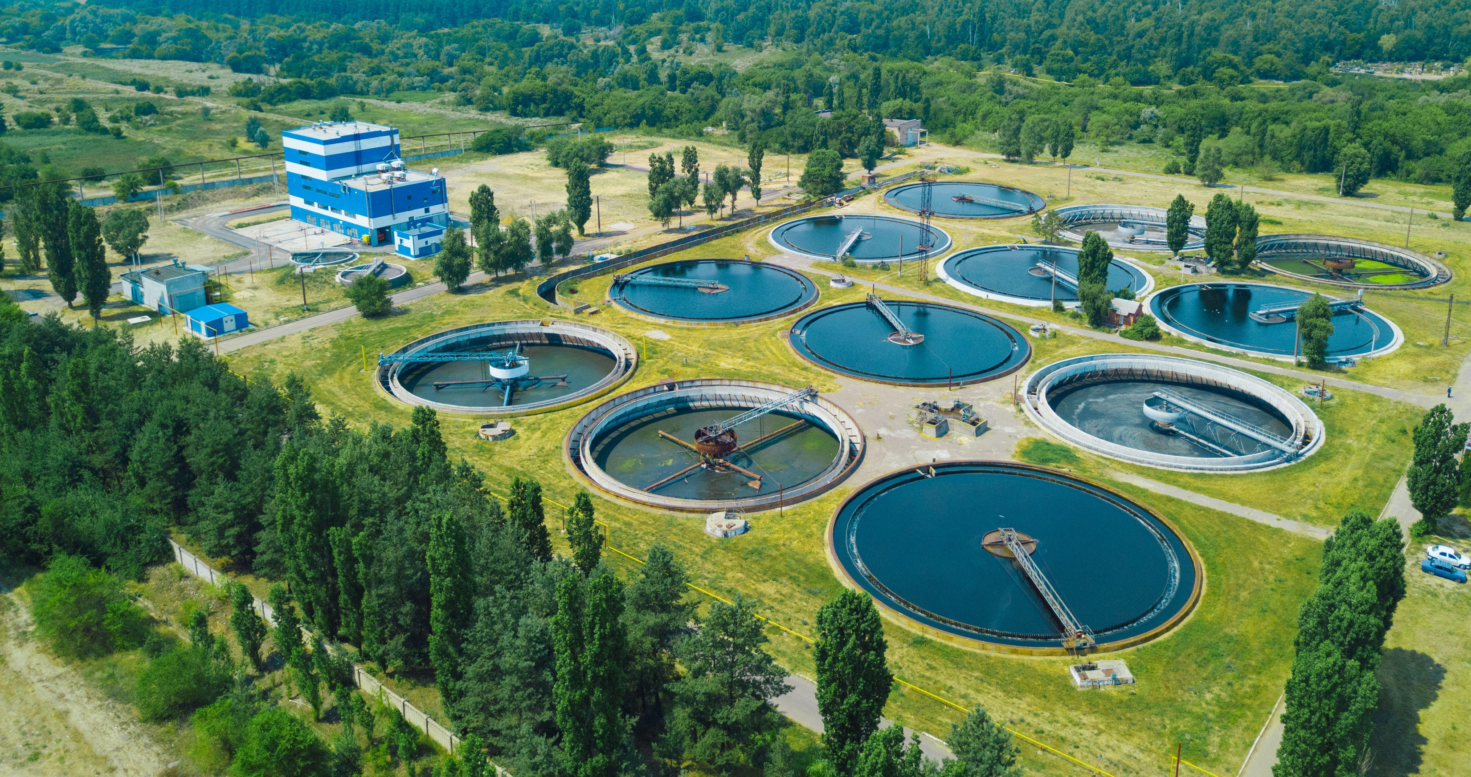
HydRestor™
Addition of exhausted char media to biosolids treatment process
  Increase quantity and quality of biosolids fertilizer process
  Potential increase in biogas yields
  Control of odorous compounds in digestors
Beneficial soil application of exhausted media (as-is)
  Slow release P source
  Soil moisture control
  No negative impact on soil salinity or pH
  Improved symbiotic soil biota for increased crop yields
  Reduce runoff of nutrient and pesticides
Notes:
Need to add visuals.

Slide 4
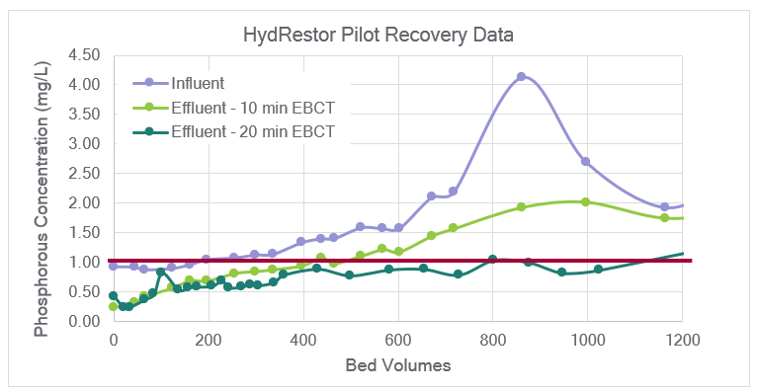
HydRestor™ Pilot Test Data
Pilot testing done with a private utility serving the Lakewood Ranch community in SW Florida that receives up to 19 MGD of reclaimed wastewater from surrounding sources.
Data shows that even with large spikes in phosphorous concentration, HydRestor™ is still able to achieve recovery of phosphorous below regulatory limit.

Slide 5
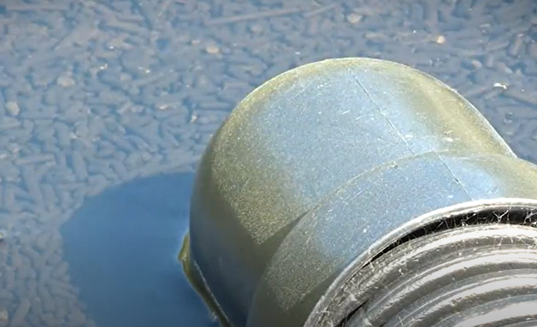
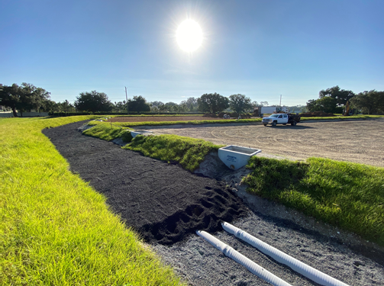
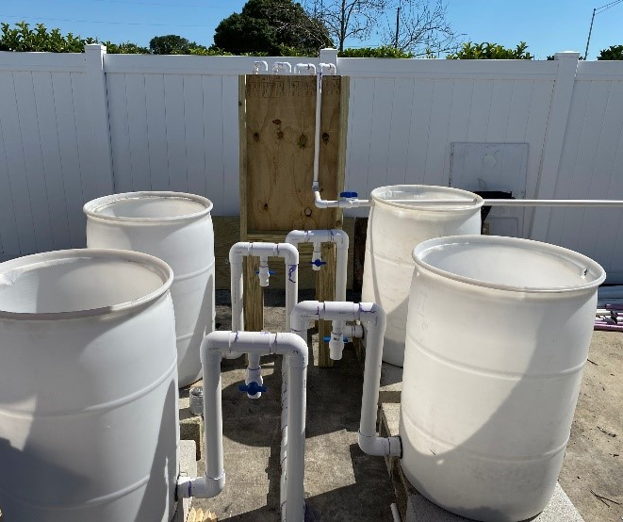
Commercialization Path
Full scale HydRestor™ system currently being implemented.
The construction of a mobile pilot unit will greatly aid in outreach and additional partnerships.
Additional markets being pursued include stormwater runoff, agricultural reuse, hotels and gray water, and fertilizer and mining operations, and more.

