Slide 1

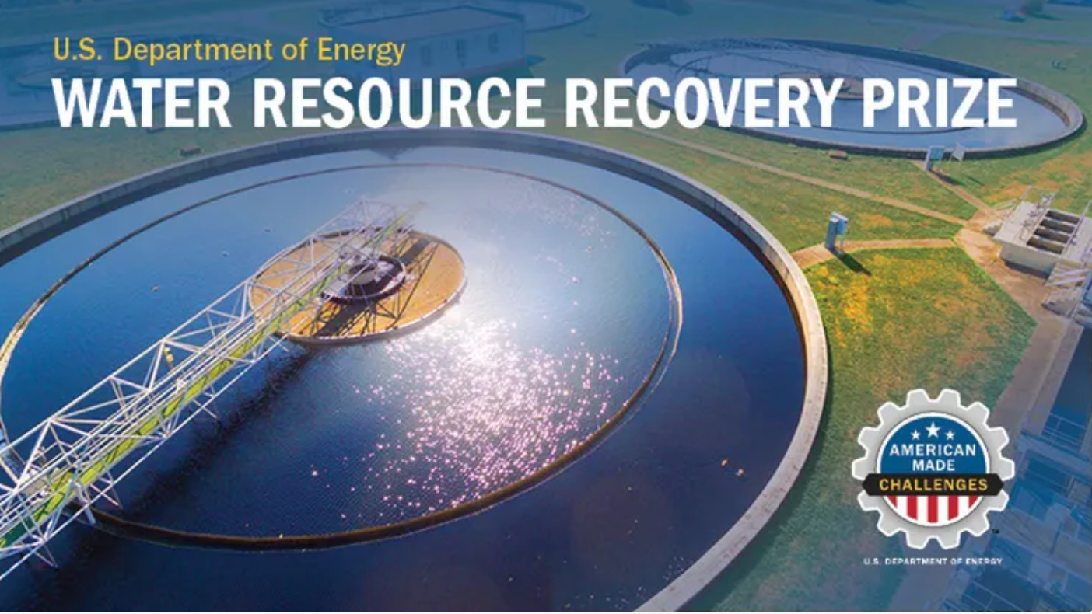
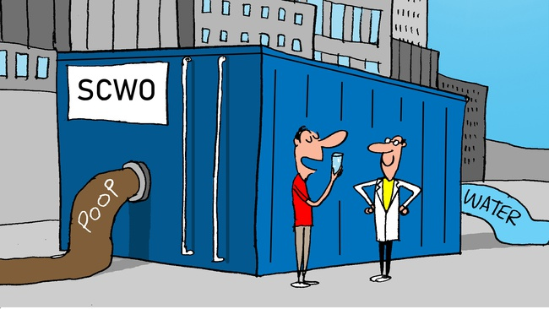
Project Name: 374Water at OWASA Mason Farm WWTP, Chapel Hill, NC
Tagline: Resource Recovery with Supercritical Water Oxidation
Key Project Members:
Kobe Nagar, CEO, 374Water
Marc Deshusses, PhD., CTO, 374Water
Doug Hatler, CRO, 374Water
Mohammad Abu-Orf PhD., Hazen & Sawyer
Simon Lobdell, P.E., OWASA
Partner Wastewater Resource Recovery Facility:
Orange Water and Sewer Authority – Mason Farm WWRF
170 Old Mason Farm Rd, Chapel Hill, NC 27517
Notes:
374Water, Inc. is a social impact, cleantech company located in Durham, North Carolina. We are commercializing a new approach to supercritical water oxidation that will treat wastewater sludge and biosolids.

Slide 2
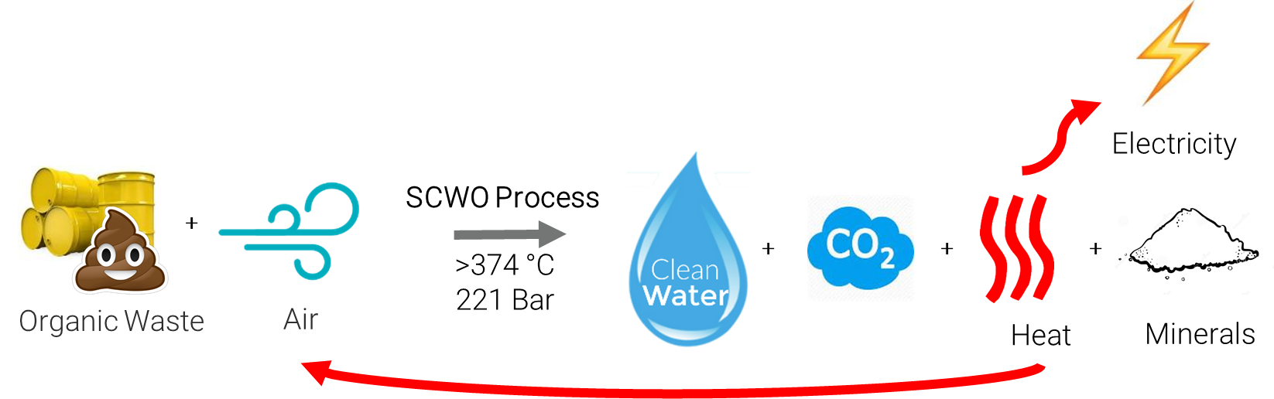
Problem and Solution
Problem
Solution
OWASA Mason Farm plant treats 8.2 MGD using activated sludge and anaerobic digestion.
It can produce as much as 6.7 dry tons of solids per day which are hauled offsite for land application or disposal
Biogas produced during sludge processing is burned on-site for heat generation.
The above is energy intensive and resources little of resource potential of the wastewater sludge and biosolids
Two (2) - 30 wet ton per day 374Water SCWO units would replace anaerobic digestion.
The anaerobic digestion equipment and structures would be retired and bypassed.
Solids would be dewatered to 13% using existing equipment and then fed to the SCWO units.
A net financial benefit of $597,000 annually could be achieved through Resource Recovery with SCWO

Slide 3
Recovered Resources and Estimated Value
Recovered Resource | Annual Quantity | Estimated Unit Value | Estimated Annual Value
Distilled water | 3,100,000 gals. | $0.1 | $310,000
Treated water | 1,800,000 gals. | $0 | $0
Phosphorus in the minerals, (19.3% as P2O5) | 130 tons | $100 | $130,000
Heat | 7000 MWhth | $0.02 / kWh | $140,000
Electricity | 170 MWhe | $0.10 / kWh | $17,000
Net Economic Benefit |  |  | $597,000
¹8000 operating hours per year

Slide 4
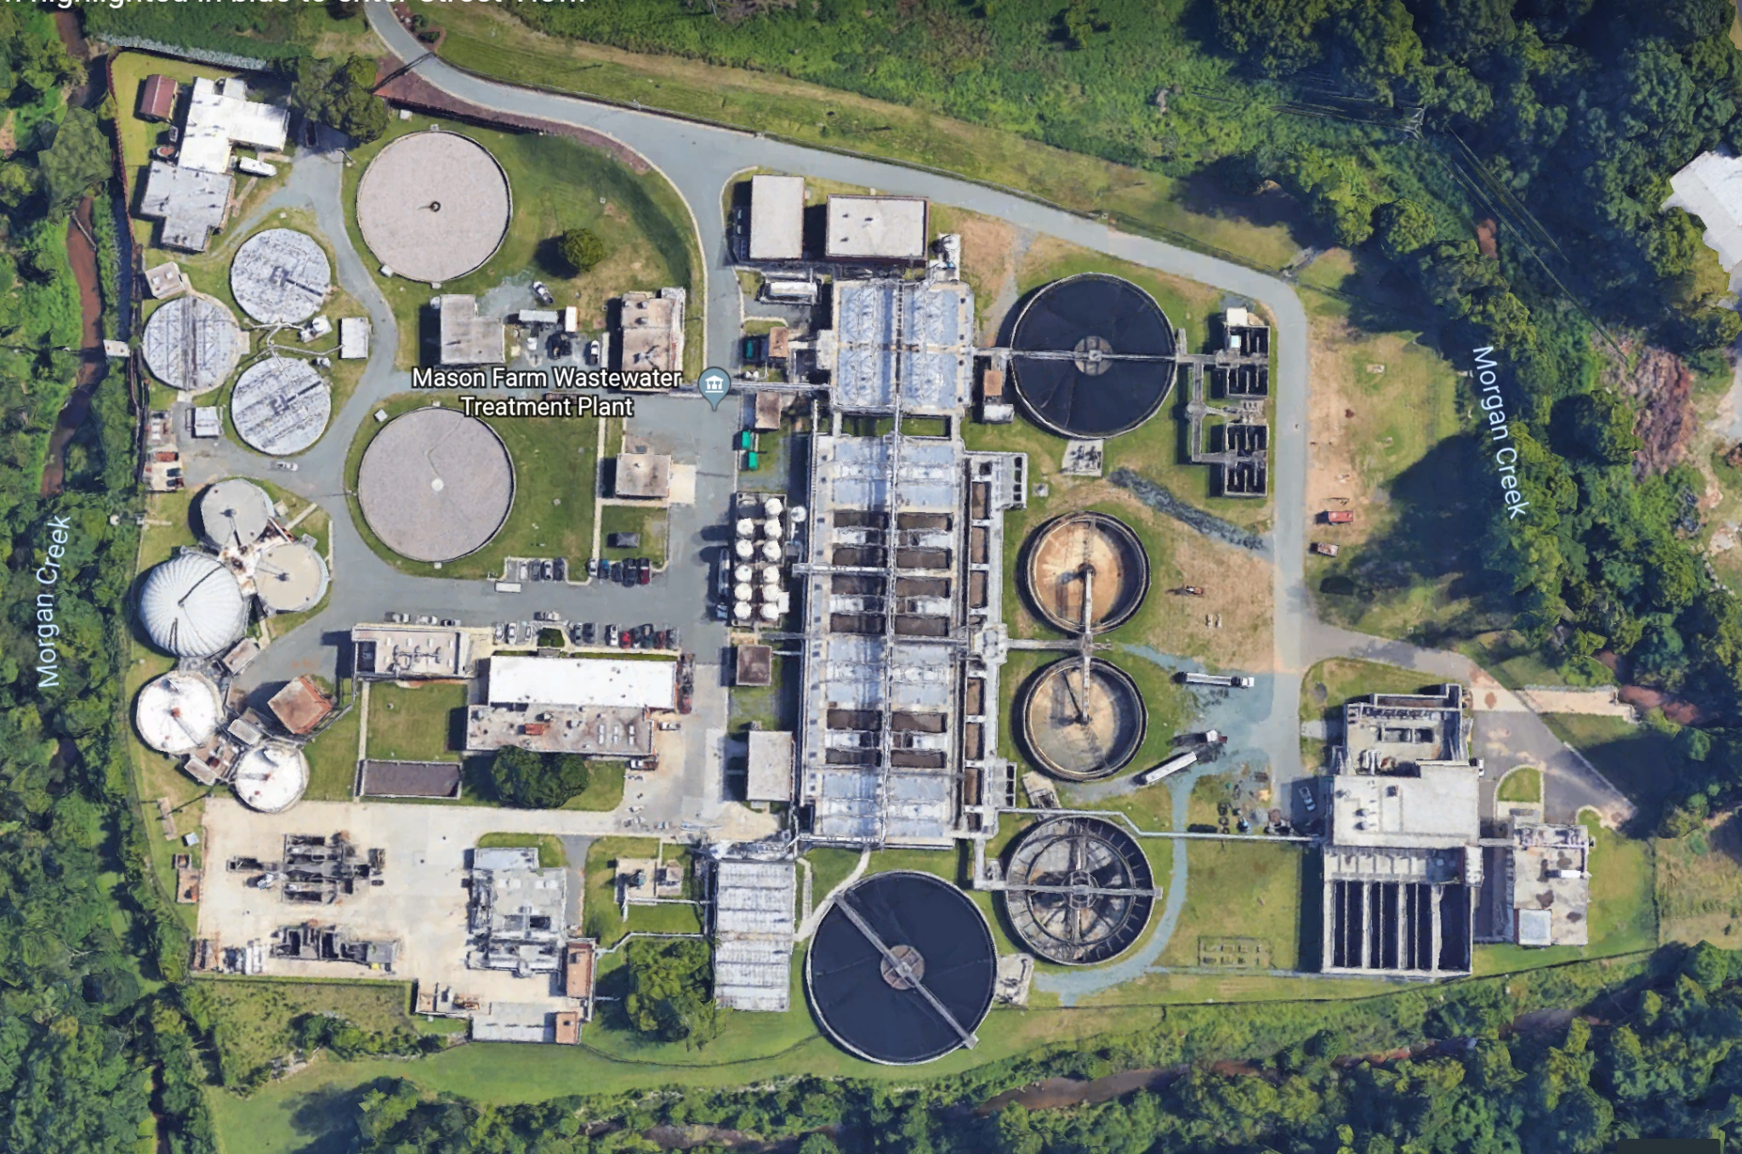
OWASA (Chapel Hill, NC) WWTP to WRRF
Not in use / extra capacity
Nix 30 unit
Two (2) - Nix30 Units
to Replace the
Anaerobic Digestion
X
X
X
X
X
X
X
X
X
X
X
X
X
X
Digesters & fermenters
Steam
Boilers
Sludge Storage
Reduce dewatering
Eliminate post AD
Ammonia treatment

Slide 5
Key Benefits and Value Proposition
Item | Today | With AirSCWO
Sludge treatment capacity | 2,050 ton (dry)/year | 2,600 ton (dry)/year
Sludge treatment process | 4 Anaerobic digesters + off-site hauling of biosolids | Two Nix30 units on-site treatment (30 wet tons/day each up to 15% dry solids)
Processing time | 25-28 days | 30 minutes
Land allocation | 130,000 sq. ft (Excluding land application) | 7,500 sq. ft.
Unit cost | $14M | $10M
CAPEX - yearly (20 yrs., 7%) | $1.3M/year | $850k/year
OPEX - yearly | $1M/year | $300k/year
Total cost per year | $2.3M/year | $1.15M/year
Cost per wet ton | >$170/ton | ~$65/ton

Slide 6
Conclusions
OWASA Mason Farm can transform to a Water Resource Recovery Facility using SCWO. In doing so OWASA would realize the following benefits
  Estimated savings of $1.1M per year
  Eliminate the need for off-site hauling and disposal of biosolids
  Replace energy intensive anaerobic digesters with an energy efficient resource recovery system
  Recover phosphorus and distilled water and sell it on the open market
  Use less chemicals for dewatering
  Free up space at the constrained Mason Farm site
  Convert ammonium to nitrogen gas avoiding further nitrogen treatment
  Improve public health by eliminating pathogens, PFAS, drugs and microplastics
  Reduce their carbon footprint

