Slide 1
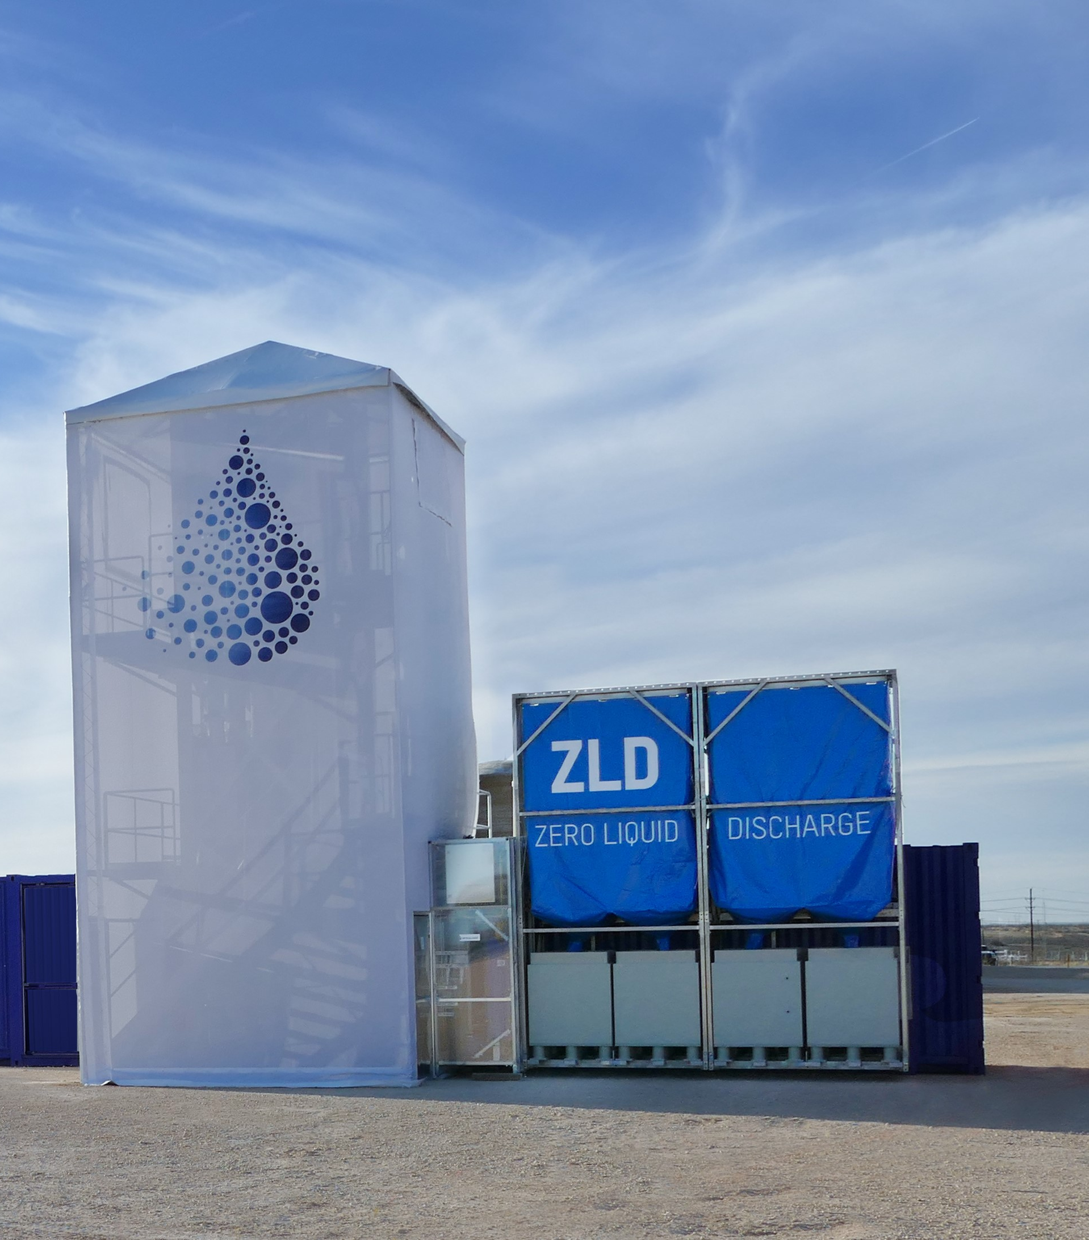
Crystal Clearwater Resources
(CCR)
Tomorrow’s Technology, Today
Proposal to team up with Ramona's San Vicente Wastewater Treatment Plant (SVWTP) for the American Made Solar Desalination Challenge
Innovative | Clean-Tech | A New Approach

Slide 2

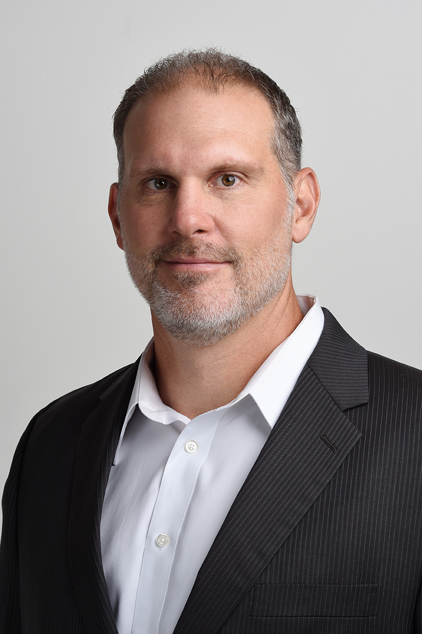
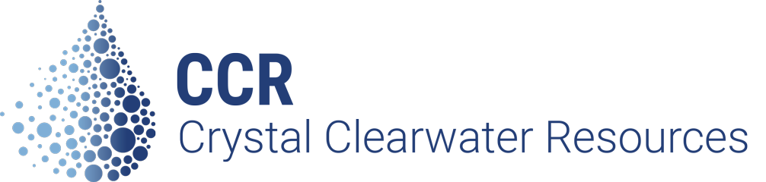

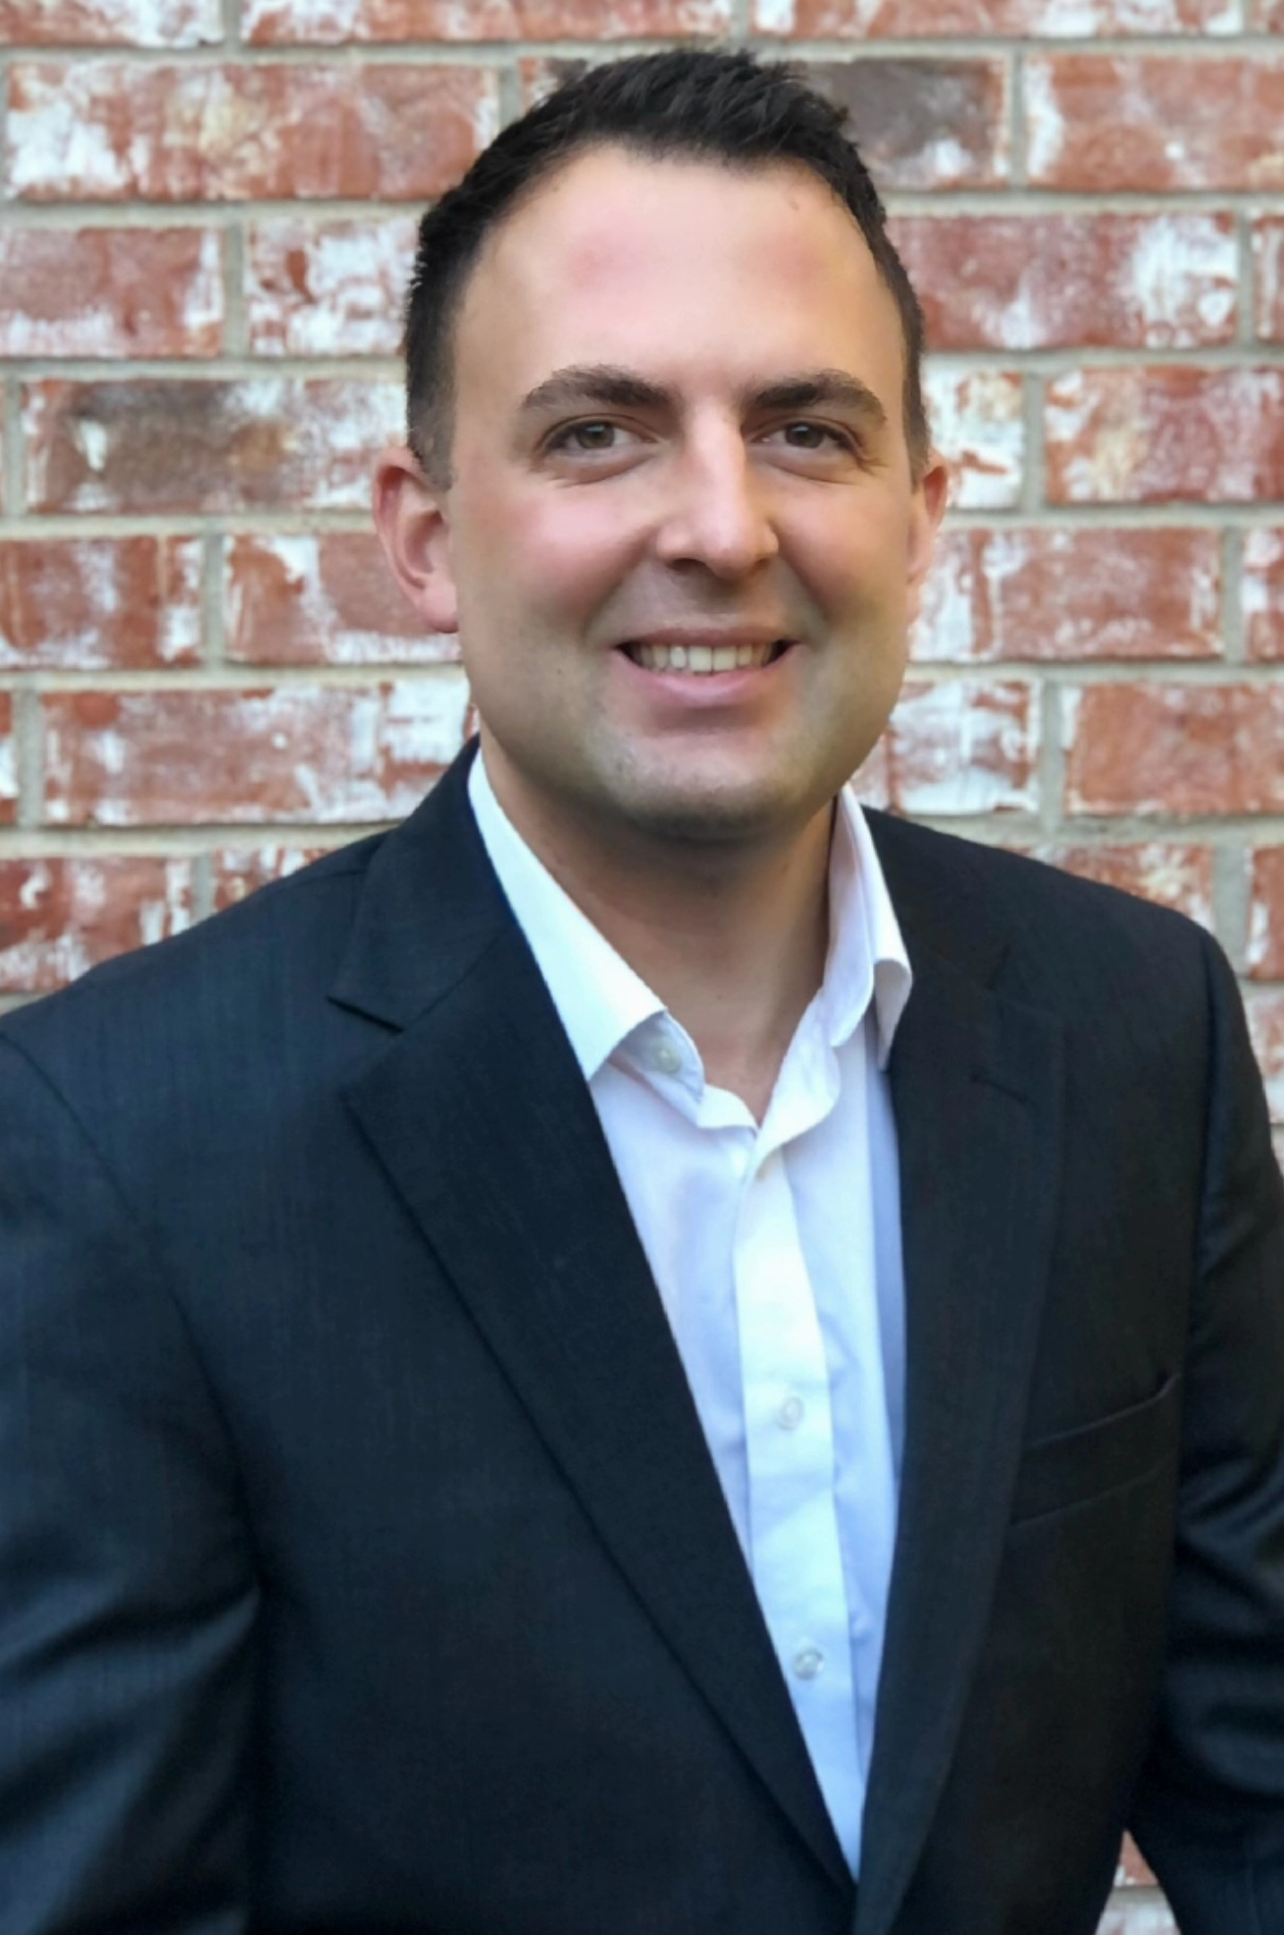
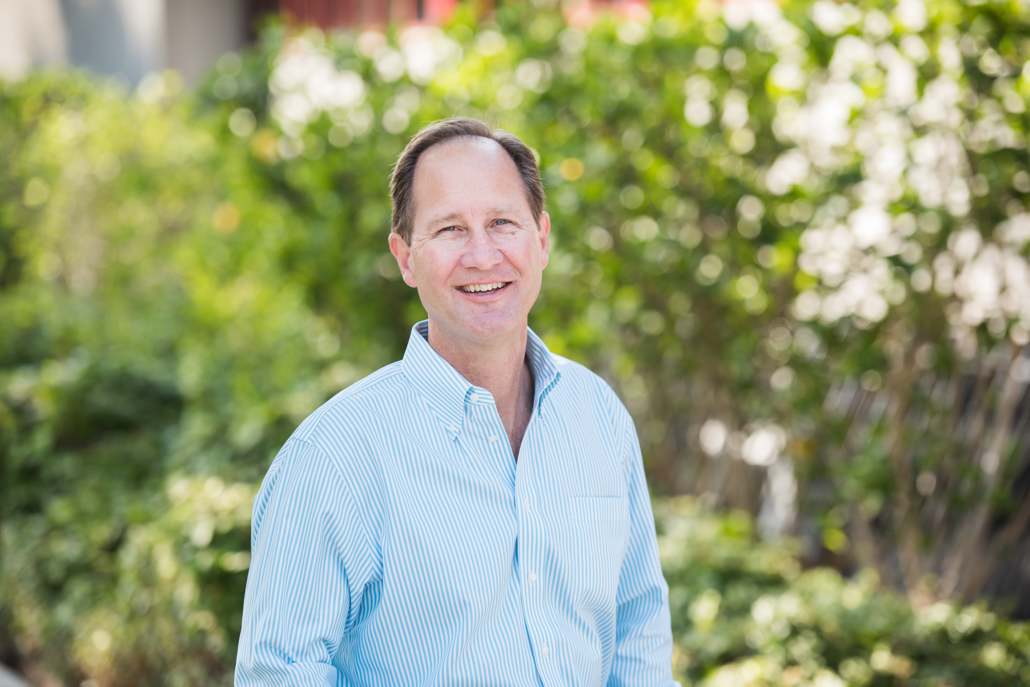

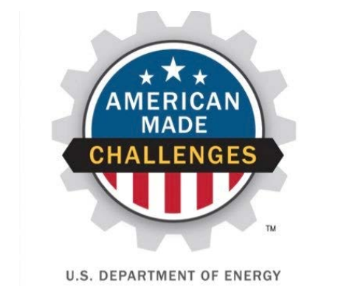
The Team
Apoorva Sharma
Casey McKinne
Chief Operations Officer, CCR
VP of Operations, CCR
Ambrose Lessard
Bob Ohlund
VP of Engineering, CCR
VP of Infrastructure, Dudek

Slide 3
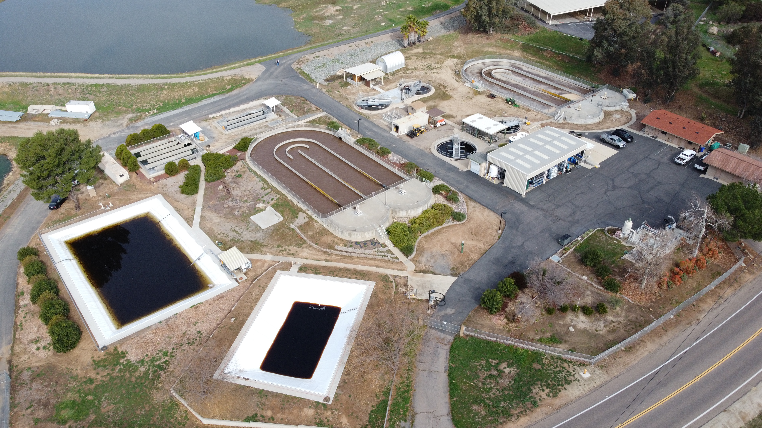
The Problem and Solution
The LTDis® technology addresses the increasing issues associated with brine disposal and the decreasing availability of fresh water
The LTDis® technology can increase the amount of reusable water supply and decrease the amount of waste needing to be disposed at the San Vicente Wastewater Treatment Plant.

Slide 4




Recovered Resources
Resources recovered:
  Reduced power costs and highly quality water with the option to recover minerals like salt and phosphates
CCR LTDis® technology will utilize a natural gas powered microturbine to cogenerate heat and power
  There will be a 90% reduction in wastewater volumes leading volume of water recovered for beneficial purposes
  An 80% reduction in truck traffic with associated fuel costs, and a reduction in carbon emissions by ~ 30 metric tons of CO_{2e} equivalent/year
  Approximately $120,000 worth of power generated for the SVWTP facility
The increased water recovery from the LTDis® technology can be monetized by the Ramona facility.

Slide 5
Business Case
The primary benefits to implementing the LTDis system include:
80-90% reduction in disposal costs
90% increase in high quality (< 250 ppm) reusable water
80-90% reduction in truck volume resulting in lower carbon footprint
The technology is easily transferable to other facilities
Are modular and can be configured to meet customer requirements
Can operate using a wide range of heat sources include solar thermal (heat), solar PV (power) and waste heat if available
Can handle variable quality wastewater streams
Costs/Gains | Amount
Total Annualized Cost (CAPEX+OPEX) over 15 years life | $219,395
Total Resources Recovery Value | $140,571
Total Net Gain to RMWD | -$78,824
Existing RMWD Brine Disposal Costs | $100,000
Savings to RMWD | $21,176
Net Savings (%) | 21

Slide 6
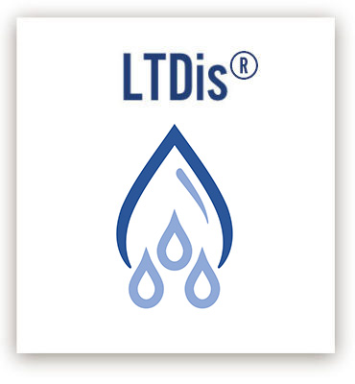
Conclusions
LTDis® is a step-change technology that will change the way water resource recovery systems will operate. It provides a more efficient, and environmentally friendly solution for tomorrow.

