Slide 1
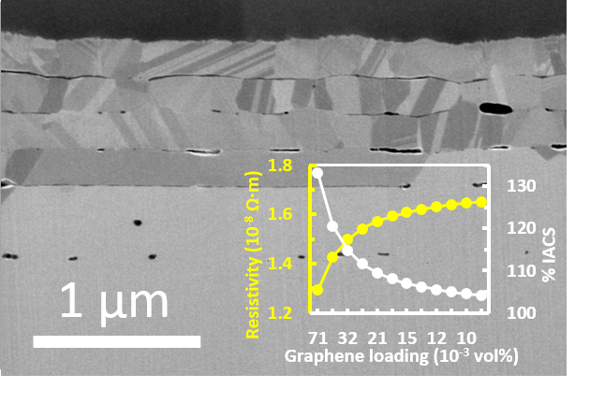
Team Name: | ISU-MSE Multilayers
Primary Submitter Name: | Jun Cui
City and State: | Ames, Iowa
Member Names (including partners and affiliates): | Chaochao Pan Anand Gaur Maria Lebedeva
Submission Title: | Copper-graphene multilayer with 133% IACS
Optional Image
Description of Material
Graphene/copper composite
Layered structures
Potential to achieve 133% IACS
Fabrication Approach
10 layers of composite foil is created by alternate CVD deposition of graphene and PVD deposition of copper on a copper foil substrate
Bulk sample is created by rolling the 10-layer foil into a rod, then hot press to densify
Potential Impact
A motor winding wire 33% more conductive than copper will make induction motor as efficient as permanent magnet motor. If successfully developed, the ultra-conductive copper technology will remove rare earth permanent magnet as the major barrier for a sustainable growth in EV uses.
*A Public Document
Notes:
Public PowerPoint Summary Slide
Make a public-facing, one-slide summary using PowerPoint containing technically specific details that can be understood by most people. The slide will be made public and should include (1) the competitor or team name and team leader, (2) submission title, (3) description of material, (4) fabrication approach, and (5) potential impact. Please make any text readable in a standard printout and conference room projection. Please refer to the official CABLE Prize Rules Document for full requirements: https://americanmadechallenges.org/cable/docs/rules/CABLE_Prize_Official_Rules.pdf

