Slide 1
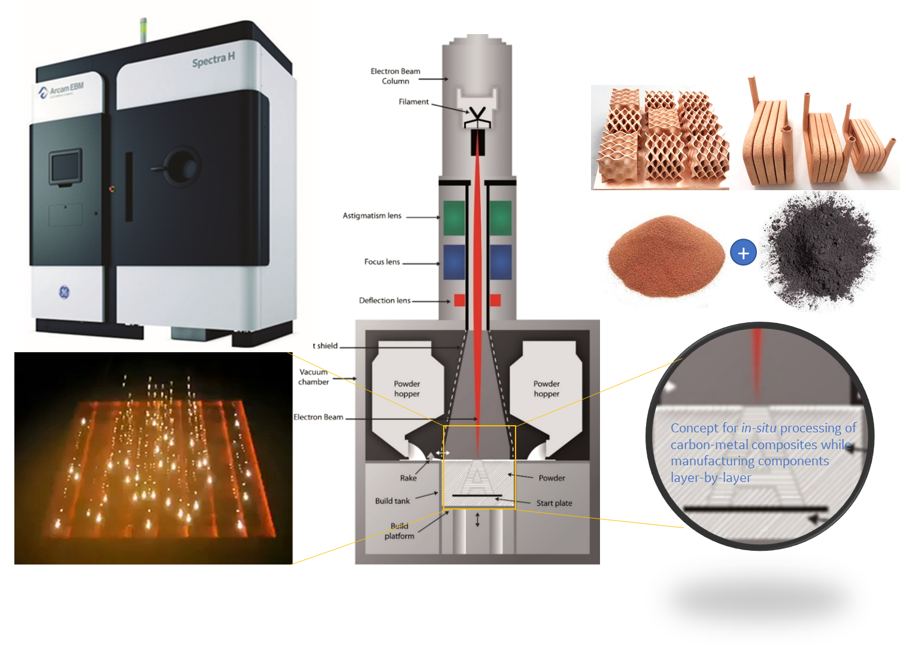
Team Name: | GE Research
Primary Submitter Name: | Dr. Mohamed Rahmane
City and State: | Niskayuna, NY
Member Names (including partners and affiliates): | Dr. Andrey Meshkov (GE Research) Dr. Vandana Rallabandi (GE Research)
Submission Title: | Electron Beam Melting (EBM) Additive Manufacturing (AM) of Ultra-Conductive Components With in-situ Processed Carbon-Metal Composites
Description of Material
Carbon-metal composites, where carbon is introduced in various forms, including powder of graphite or carbon black, or nanostructures forms, such as carbon nanotubes or graphene. The metal is copper or aluminum, with >99.9% purity, in the form of powder, 45-100 microns particle size. A range of Carbon-Metal mixtures (0 to 8 wt% C) will be investigated.
Fabrication Approach
Electron Beam Melting (EBM) Additive Manufacturing: Carbon-metal powders, with a certain particle size distribution and carbon/metal ratio, will be mixed and tested for flowability. EBM will be used for simultaneously processing the ultra-conductive composite in-situ, while manufacturing actual components. Initial tests will be done on simple part geometries to demonstrate the concept with enhanced-electrical conductivity.
Potential Impact
Breakthrough reduction in thermal losses in electrical and thermal systems (Inductors, transformers, filters, rotating electric machines and batteries), with a cost-effective and scalable manufacturing solution.
Lightweight high-performance Electric Drives for transportation (EV and commercial Aviation),
e.g., >3X increase in Power density of electric motors.
Reduced CO2 emission through broader electrification of transportation
*A Public Document

