Slide 1

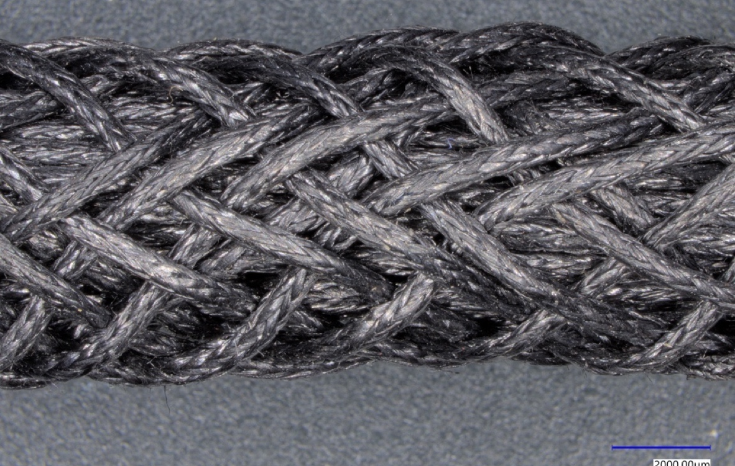
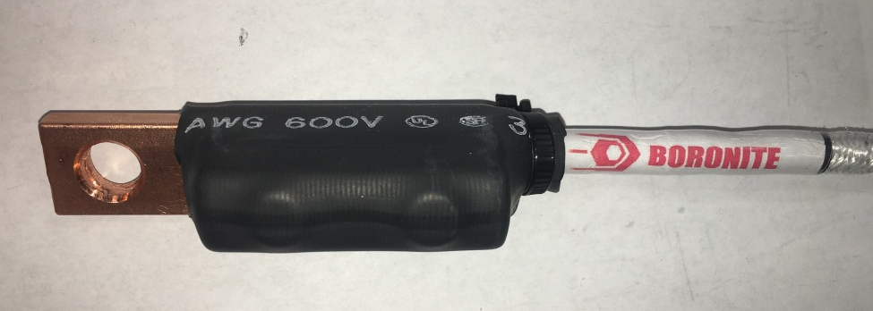
Team Name: | SuperWire
Primary Submitter Name: | American Boronite Corporation
City and State: | Burlington, MA 01803-4907
Member Names (Key Individuals) | David Lashmore, Pavel Bystricky, Ivka Kalus, Laura Cunningham, Andrew Theori (Boronite), Mike Matuszewski (Minnesota Wire)
Submission Title: | A Manufacturing Strategy for CNT Power Cables
Optional Image
Description of Material Very high fraction CNT-metal composite cable. Multiple braids to meet customer capacity needs. Very lightweight, high strength, fatigue and high temperature resistance, potential to exceed copper conductivity.
Potential Impact Cables from 38 gauge to 0000 size are possible with this approach. A 1.2m long, 6.7mm diameter cable has been fabricated insulated, terminated and is being tested. Immediate impact: aircraft wiring – reduced pollution, traction motors or generators where the copper armature is moving and power lines where weight is critical.
Manufacturing Approach Continuous CNT yarn braided structure infiltrated with copper alloy using patent pending high temperature process (aluminum can also be used).
(1) Manufacturing process enables high speed mass production (2) Reduces cost. (3) Eliminates cable hot spots, (4) Exceeds copper current carrying capacity. Lots of room to further improve properties.
*A Public Document
Notes:
Public PowerPoint Summary Slide
Make a public-facing, one-slide summary using PowerPoint containing technically specific details that can be understood by most people. The slide will be made public and should include (1) the competitor or team name and team leader, (2) submission title, (3) description of material, (4) fabrication approach, and (5) potential impact. Please make any text readable in a standard printout and conference room projection. Please refer to the official CABLE Prize Rules Document for full requirements: https://americanmadechallenges.org/cable/docs/rules/CABLE_Prize_Official_Rules.pdf

