Slide 1
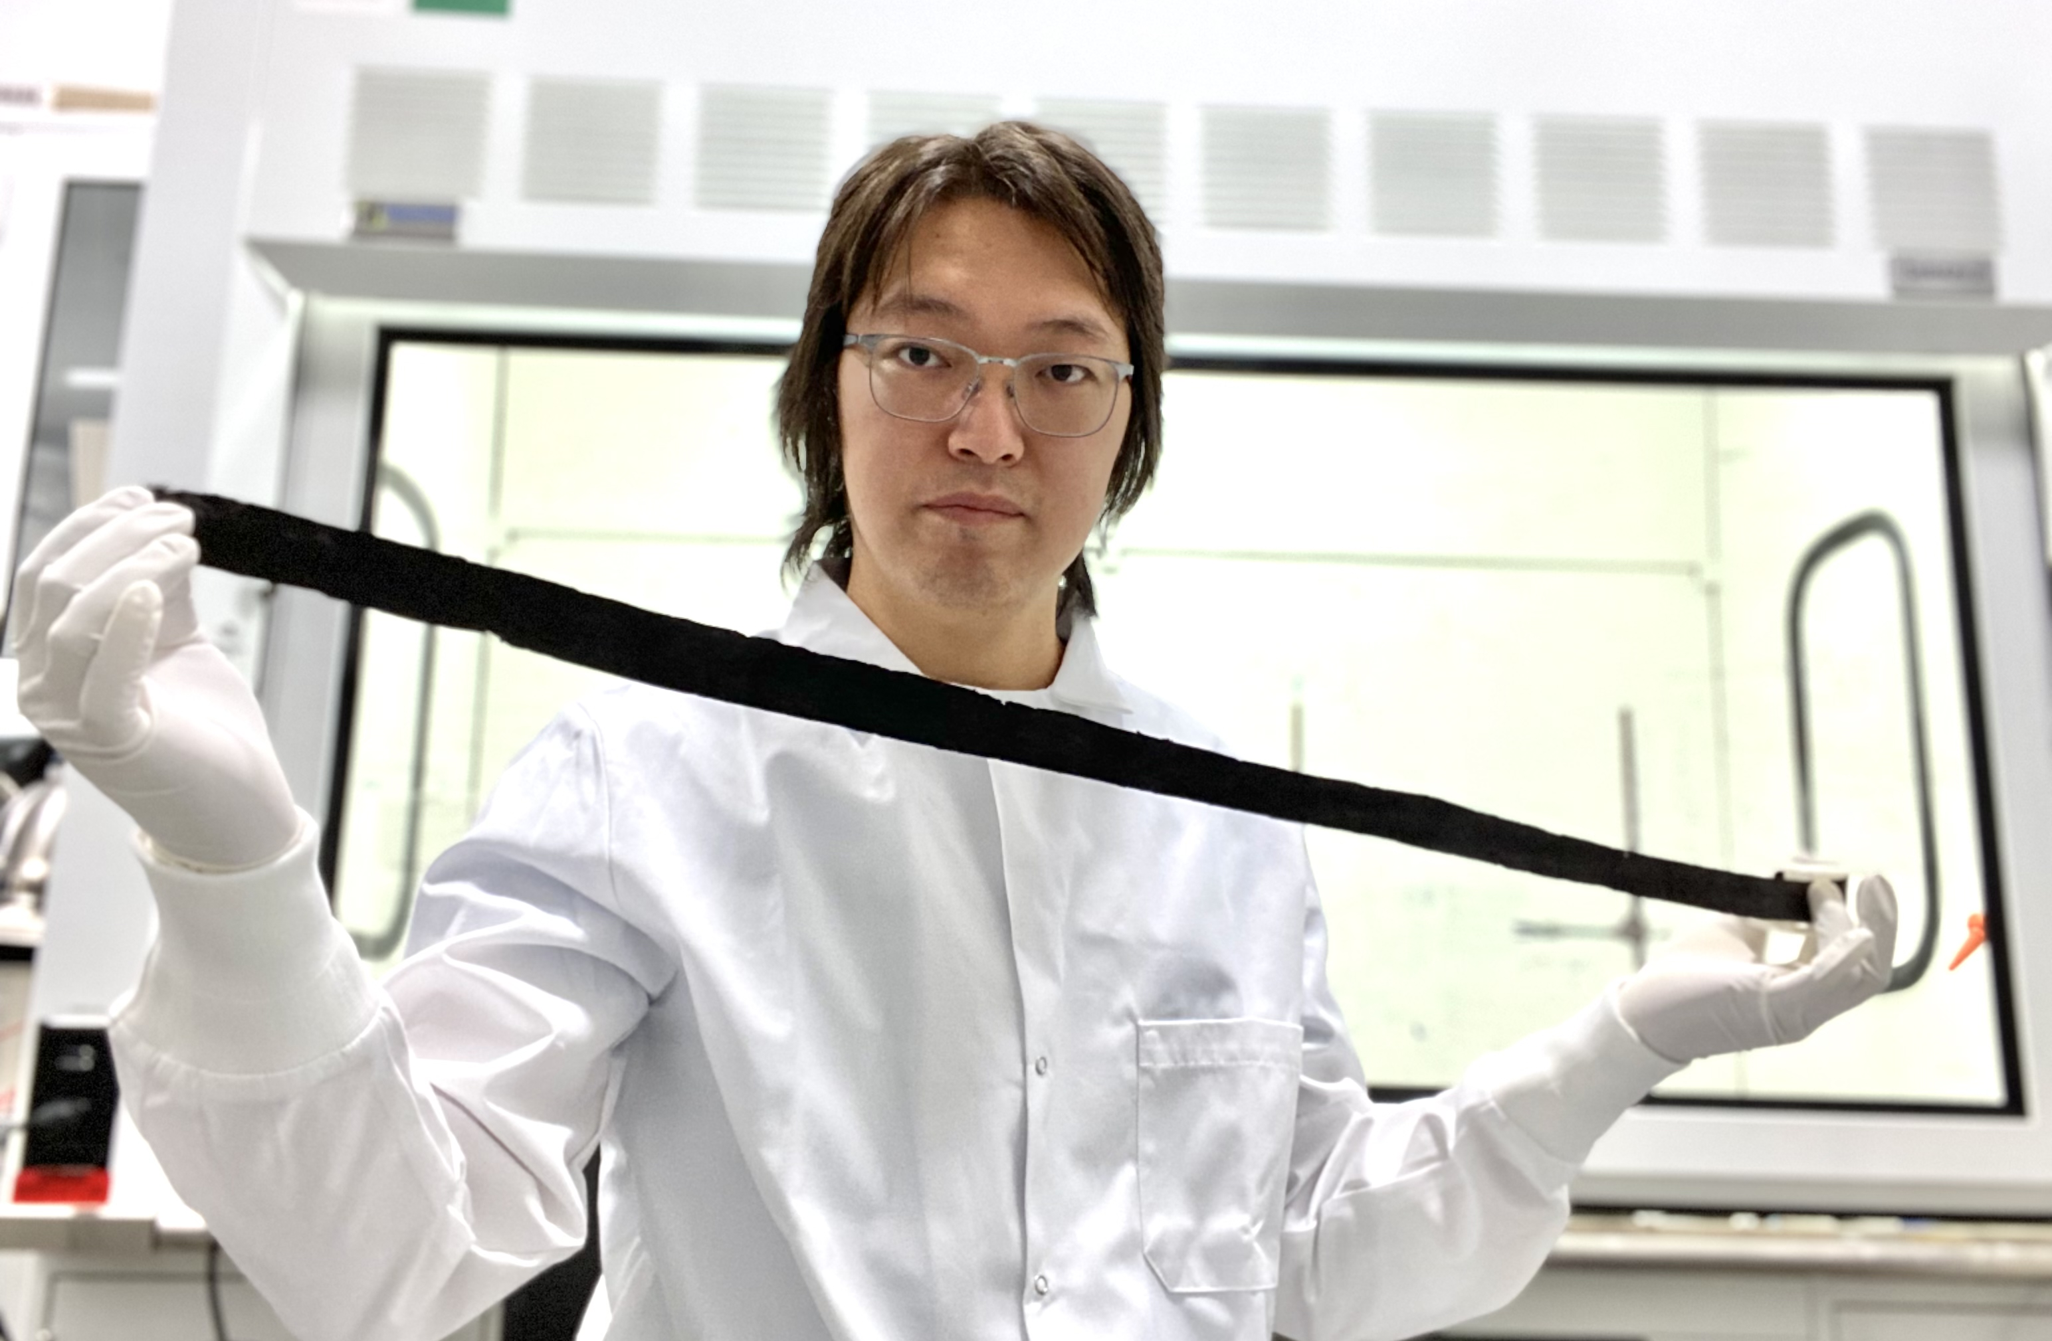
Team Name: | [University of Illinois at Urbana-Champaign]
Primary Submitter Name: | Joseph Lyding
City and State: | Urbana, Illinois
Member Names (including partners and affiliates): | Professor Joseph Lyding Dr. Gang Wang Brendan Wolan
Submission Title: | 3D printed metallic carbon nanotube cables
Optional Image
Description of Material
Pure carbon nanotube materials are being utilized in this project. To maximize electrical conductivity only metallic single wall nanotubes will be used.
Our 3D printed material already exceeds copper’s thermal conductivity at 1/15 copper’s density.
Fabrication Approach
Nanotubes treated with surfactant are 3D printed into a coagulation bath to create coatings or free-standing ribbons such as the 1g, 1m long ribbon shown in the photo.
Potential Impact
The price of carbon nanotubes is decreasing rapidly and the energy needed for production is already about two orders of magnitude lower than copper.
Carbon nanotube-based cables show great promise as high-conductivity, low-density, mechanically strong, and chemically inert replacements for copper cable.
*A Public Document
Notes:
Public PowerPoint Summary Slide
Make a public-facing, one-slide summary using PowerPoint containing technically specific details that can be understood by most people. The slide will be made public and should include (1) the competitor or team name and team leader, (2) submission title, (3) description of material, (4) fabrication approach, and (5) potential impact. Please make any text readable in a standard printout and conference room projection. Please refer to the official CABLE Prize Rules Document for full requirements: https://americanmadechallenges.org/cable/docs/rules/CABLE_Prize_Official_Rules.pdf

