Slide 1
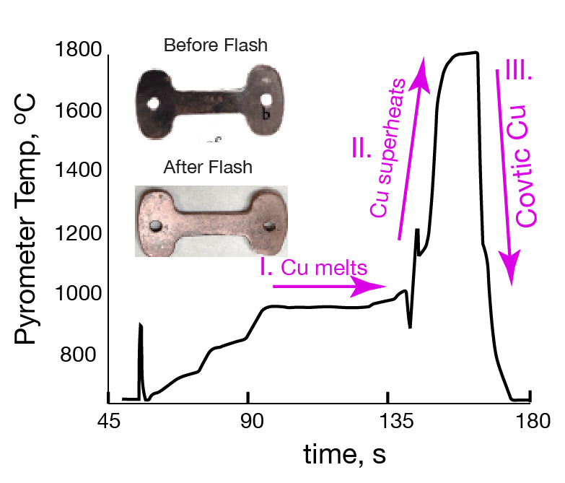
Team Name: | [Team Name Here]
Primary Submitter Name: | Rishi Raj
City and State: | Boulder, Colorado
Member Names (including partners and affiliates): | Rishi Raj
Submission Title: | Flash Induce Infusion of Carbon into Copper
Description of Material
As shown in the figure on the top right we obtain copper infused with nano-carbon, as in Covetic-Copper where carbon is incorporated into the metal, even when, it is thermodynamically insoluble, rendering high conductivity to the metal.
Fabrication Approach
Carbon is incorporated by a novel method called reactive flash sintering/synthesis an electric current is passed through the dog-bone shaped sample at increasing rate until covetic-copper is obtained, as shown by the temperature vs. time curve. Note the process time < 150 s.
Potential Impact
•The “electrification” of the economy will continue to accelerate for decades, continuing a need for low resistive losses in the transport of electricity.
•For example, a 5% increase in conductivity of Cu can save 200 GWh of energy per year in 3*10⁵ cars. The total one-time cost of flash is only 28 GWh.
*A Public Document
Notes:
Public PowerPoint Summary Slide
Make a public-facing, one-slide summary using PowerPoint containing technically specific details that can be understood by most people. The slide will be made public and should include (1) the competitor or team name and team leader, (2) submission title, (3) description of material, (4) fabrication approach, and (5) potential impact. Please make any text readable in a standard printout and conference room projection. Please refer to the official CABLE Prize Rules Document for full requirements: https://americanmadechallenges.org/cable/docs/rules/CABLE_Prize_Official_Rules.pdf

