Slide 1
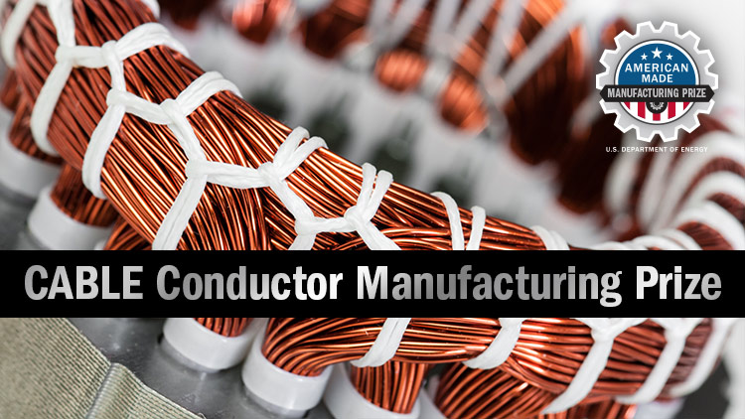
Cable Prize Stage 1
Title
Team name: Chemventive
Team leader: Dr. John Newport
, (3) ai optimized crystal metal alloy structure either cu, or Al with alloying elements
(4)Thermal electric With magnetic z-pinch field alignment with a cost that is less than 10% of the base material cost
(5) direct conductivity improvement yields an equal % reduction in greenhouse gases
Please make any text readable in a standard printout and conference room projection.

Slide 2
