Slide 1
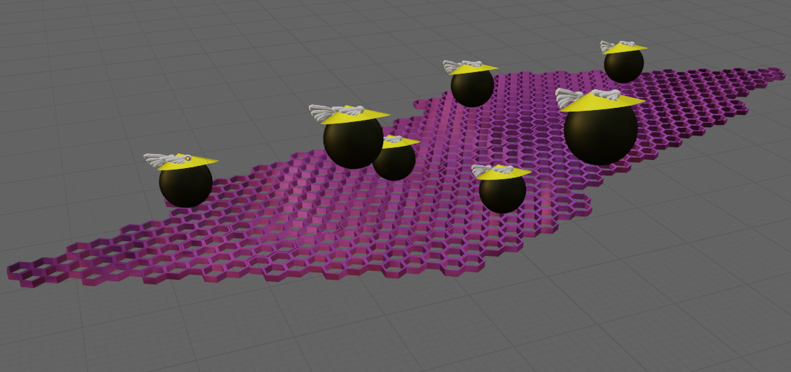
Team Name: | Fast Track
Primary Submitter Name: | T Plates Global LLC
City and State: | Oceanside, CA
Member Names (including partners and affiliates): | The Haartz Corporation Pacific Conveyor Systems T Plates Global LLC
Submission Title: | Pi Electrons: Build it and they will run
Optional Image
Description of Material
Potassium-doped, zigzag-edged, turbostratic graphene nanoribbons are produced from plastic waste
A spatially dense and aligned conductive nanostructure is deposited on polymer film. Exceptional specific conductivity is achieved.
Conductive film is twisted into wire shape or used flat for space efficiency.
Fabrication Approach
Modified turbostratic graphene is produced from waste plastic in an energy efficient Joule heating process.
In a roll-to-roll dip coating technique, a polymer film is the substrate for an aligned deposition of nanoparticles.
Stable colloid suspensions allow van der Waal adhesion of well-controlled density and spatial positioning.
Potential Impact
Substantial cost and efficiency improvements accrue to the transportation industry from reducing vehicle weight through improved specific conductivity
Reduced carbon emissions result from more efficient transportation
Example: The US airline industry could save $4 million/year in fuel and reduce carbon emissions by 23 million kg/year.
*A Public Document
Notes:
Public PowerPoint Summary Slide
Make a public-facing, one-slide summary using PowerPoint containing technically specific details that can be understood by most people. The slide will be made public and should include (1) the competitor or team name and team leader, (2) submission title, (3) description of material, (4) fabrication approach, and (5) potential impact. Please make any text readable in a standard printout and conference room projection. Please refer to the official CABLE Prize Rules Document for full requirements: https://americanmadechallenges.org/cable/docs/rules/CABLE_Prize_Official_Rules.pdf

