Slide 1
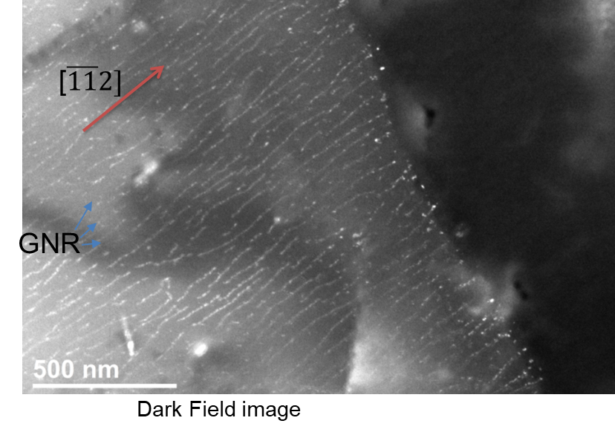
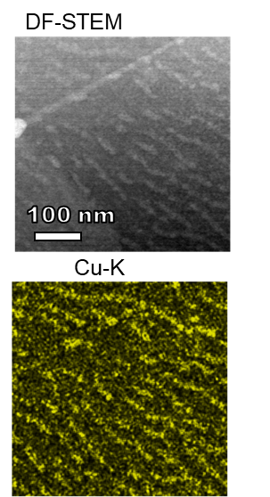
Team Name: | University of Maryland Nanocarbon-Metal Composites Team
Primary Submitter Name: | Lourdes Salamanca-Riba, University of Maryland
City and State: | College Park, MD
Member Names (including partners and affiliates): | Oded Rabin, University of Maryland
Submission Title: | Nano Carbon-Aluminum-Copper composites with High Electrical Conductivity for Power Transmission Lines
Graphene nanoribbons (top) and
copper nanoribbons (right) (from Hitachi)
Description of Material
Al 1350 containing Graphene nanoribbons and copper nanoribbons.
Copper nanoribbons create a continuous path for electrons across grain boundaries
Graphene nanoribbons increase strength
Fabrication Approach
Al 1350 is mixed with particles of activated carbon and copper
The mixture is heated in an induction furnace until the aluminum is melted
The Al/C/Cu mixture is stirred for five minutes
A current is applied to the mixture via a graphite rod and a graphite crucible as cathode and anode.
The current induces growth of graphene nanoribbons and copper nanoribbons
Potential Impact
The composites will have high electrical conductivity of 39 MS/m and high strength
The composites will replace current aluminum cables in power transmission lines and other conductors in airplanes, cars and other modes of transportations where weight is an issue
The lighter conductors will reduce fuel consumption
*A Public Document
Notes:
Public PowerPoint Summary Slide
Make a public-facing, one-slide summary using PowerPoint containing technically specific details that can be understood by most people. The slide will be made public and should include (1) the competitor or team name and team leader, (2) submission title, (3) description of material, (4) fabrication approach, and (5) potential impact. Please make any text readable in a standard printout and conference room projection. Please refer to the official CABLE Prize Rules Document for full requirements: https://americanmadechallenges.org/cable/docs/rules/CABLE_Prize_Official_Rules.pdf

