Slide 1
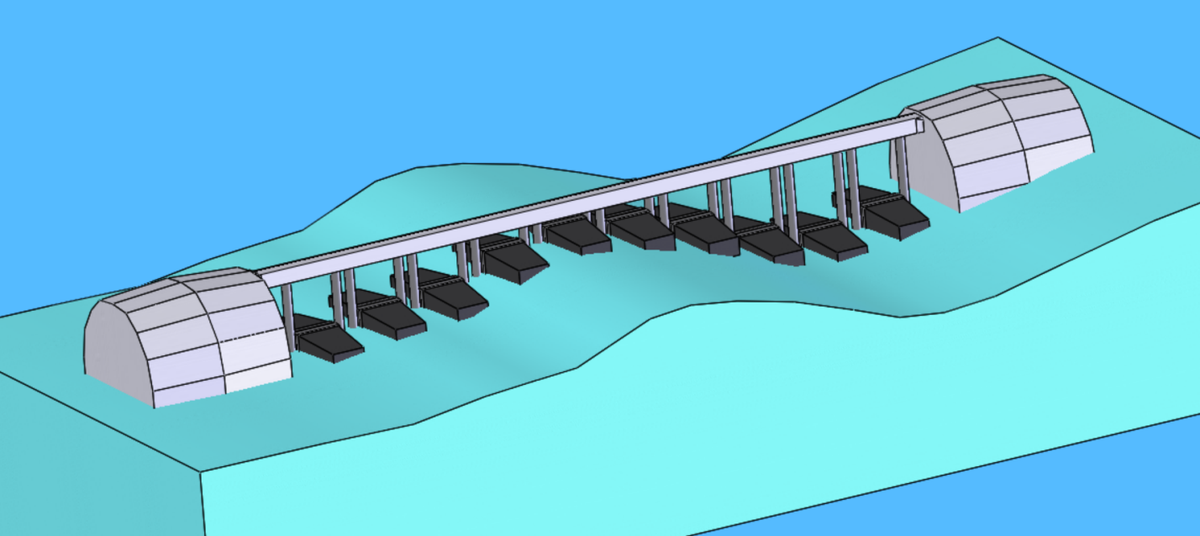
Maiden Wave Energy LLC
Self propelled, autonomous, surface WEC powered device that can produce energy from the up and down motion of the waves. Our device is configured for high ruggedness and durability in the toughest of sea conditions. We utilize a winch to deploy a CTD and safely dock it in a berth internal of our device for transport.
Solomon D. Spector, Inventor
Jon M. Richter, Legal Agreements
Joshua R. Reid, Business Development
Michael J. Benton, Materials Engineering, Express Testing, Inc.
Patrick H. Scanlon, Metal Fabrication
175kg
1 body (with a capsule on a winch lowered below it)
Multi-Point Absorber
6,860 mm
606 Wh
350 watts
Our winch-lowerable capsule is intended to meet the 30m depth requirement

