Slide 1
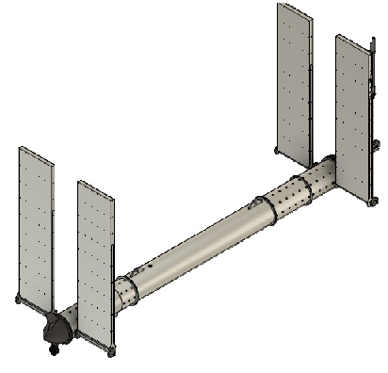
Wave Powered Oceanographic Gliders
The proposed single body device is an Autonomous Underwater Glider (AUG), which uses much lower energy than most other underwater vehicles and can cover extended areas without large consumption of energy.
The approach to wave energy absorption is based on the oscillating surge wave energy converter (OSWEC) principle. In propulsion we have added a propeller to supplement gliding functionality and increase maximum speed.
Dr. Davis Moye (Moye Consultants, USA)
Dr. Ronan Costello (Wave Venture Ltd, UK)
Ben Kennedy (Wave Venture Ltd, UK)
Dr. Simone Giorgi (Wave Venture Ltd, UK)
250 kg
212 W
Floating oscillating wave surge converter
5067 mm
960 Wh
212 W
30m

