Slide 1
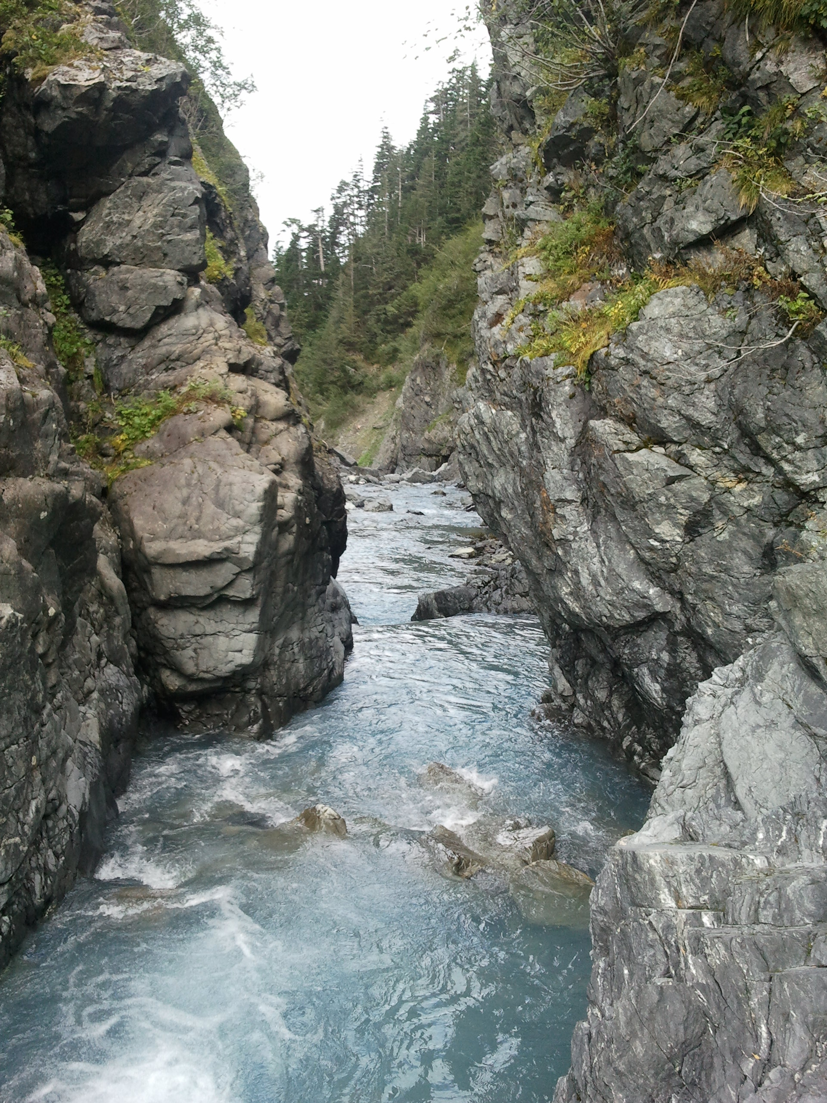
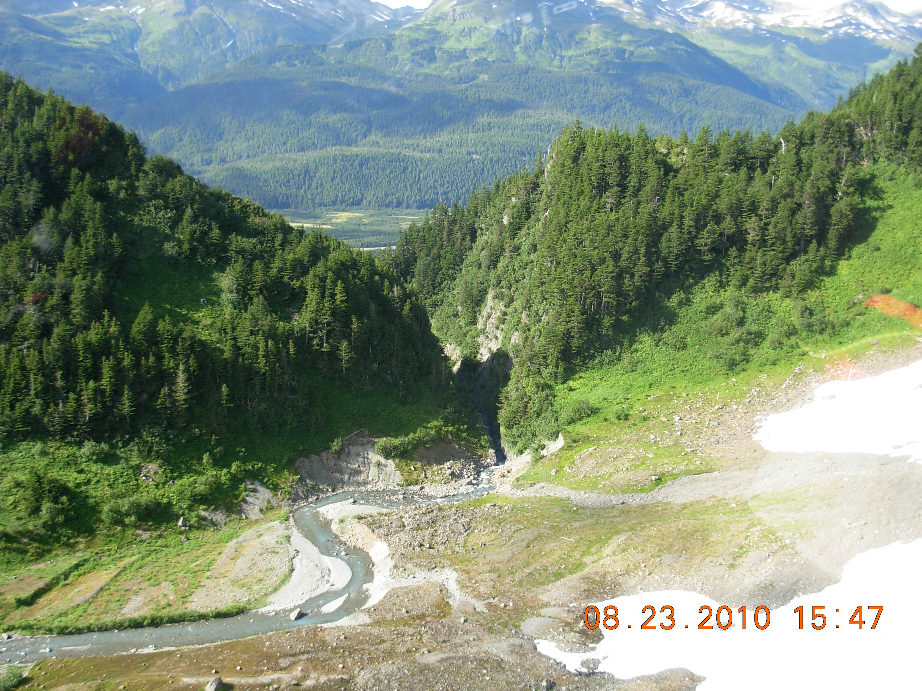
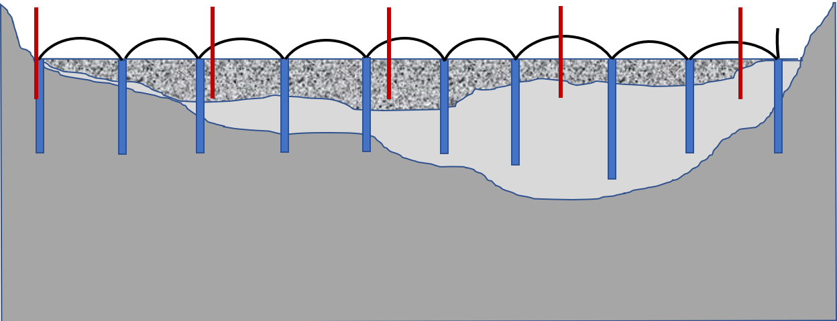

Groundbreaking Hydro Prize Summary Slide
Challenges: Uncertainty of subsurface geology, water management, and mobilizing equipment and materials to build a conventional steel reinforced concrete or earth fill dam are costly, risky, and time consuming
ColdFeat Adaptive Hydropower Foundation
Detail A
Solution: Anchors are driven into stream bed with a length exposed for dam anchoring. Steel freeze pipes are core-drilled into existing streambed. Freezing brine circulates through tubes in freeze pipes to freeze materials into a solid dam foundation.
Photo 8-28-10 by Clay Koplin – Snyder Falls Creek basin near Cordova, Alaska where inaccessibility, mixed and uncertain geology, foundation design and construction challenges killed hydro project feasibility. Beavers use local materials to build dams on site. Glaciers occasionally block rivers to form ice dams. Alaskan oil companies use freezing technologies to keep permafrost frozen, and to build new frozen roads and structures. The ColdFeat concept draws from these observations to offer a frozen ground hydropower foundation solution from local materials already on site.
A
Low Head Dam
Graded glacial till, frozen
B
Detail B
Freezing brine tubes
streambed
Foundation & Dam Anchors
Freeze Pipes
Undisturbed glacial till, frozen
Frozen Solid Dam Foundation
Bedrock
ColdFeat Solution

