Slide 1
GroundBreaking
Hydro
Subtitle

Slide 2
Metabolic Studio LA Noria Project
Design is over 200 years old
LA River is a Mystical and Enchanting place
Renaissances and Repurposing the Vividness of this Mystical River

Slide 3
Title and Content Layout with Chart

Slide 4
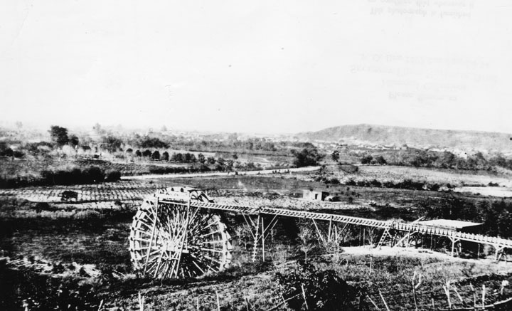
Zanga Madre and the
La Noria along the LA River
Caption
This Photo by Unknown Author is licensed under CC BY-SA

Slide 5
Two Content Layout with Table
First bullet point here
Second bullet point here
Third bullet point here
Class | Group A | Group B
Class 1 | 82 | 95
Class 2 | 76 | 88
Class 3 | 84 | 90

Slide 6
Two Content Layout with SmartArt
First bullet point here
Second bullet point here
Third bullet point here
Group A
Group B
Group C

Slide 7
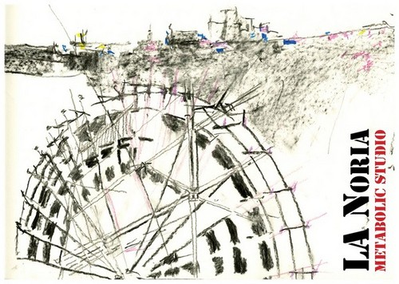
A few Generations of Energy Harvester along Rivers

Slide 8
Add a Slide Title - 2
Pelton Wheel circa 1800
Francis Turbine circa 1800

Slide 9
Add a Slide Title - 3

Slide 11
Add a Slide Title - 4

