Slide 1
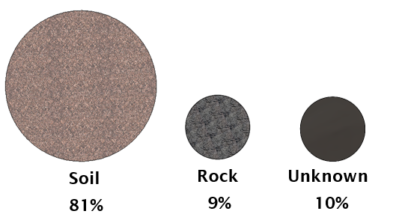
Groundbreaking Hydro Prize Competition, DOE Water Power Technologies Office
submitted 1/31/21
Terra-Modulor™: A prefabricated, modular hydropower foundation for a wide range of soils and subsurfaces
GZA GeoEnvironmental, Inc. (Norwood, MA): Chad Cox, PE/ Bin Wang, PE
Littoral Power Systems, Inc. (New Bedford, MA): David Duquette/ Alex Matathia
Standard modular hydropower is poised to accelerate the growth of clean, low-head hydropower in the US … but most of the most promising sites have soil riverbed conditions.
When building hydro plants, traditional methods for dealing with soil riverbeds are expensive and time-consuming.
In order to prosecute these sites inexpensively, we have developed a low-cost, rapidly deployable, prefabricated foundation system.
Source: ORNL NSD Report 2014

