Slide 1
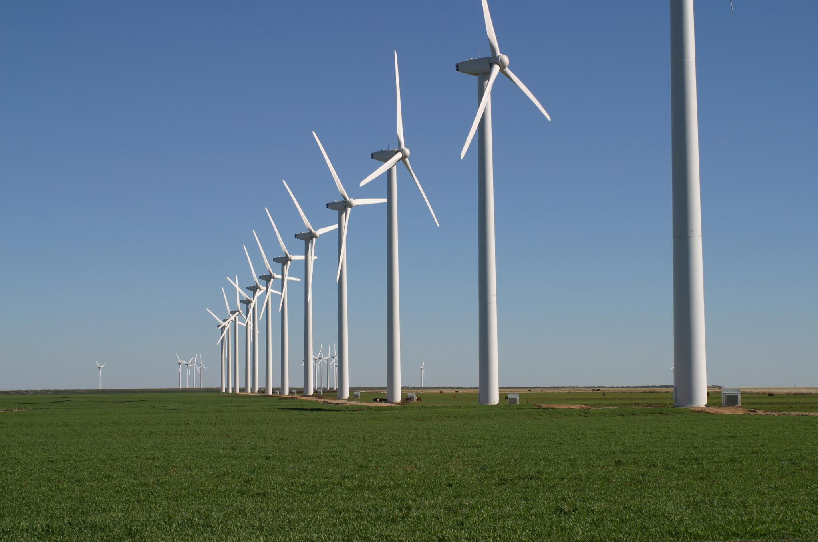


HydroChute: converting Drag into clean Energy
4 US Patents
Patented in Japan, China, UK, France, Germany, Australia, Singapore, Russia and Saudi Arabia
Multiple International patents pending
Patented bidirectional rotation converters
Published with American Institute of Aeronautics and Astronautics
Extensive Board of Advisors, with 4 PHDs
Privately test facility and flow channel
Demonstrable prototype with load testing and data collecting equipment
Electricity and hydraulic pressure quantified
Preparing for third party validations
Preparing for partnerships and market entry
Website under development
Visualization and prototype demo Videos on Vimeo and Website
Intermittent, Unreliable Kinetic Energy
Consistent, Reliable, Potential and Kinetic Energy
HYPER-CHUTE SYSTEMS, LLC 2017 All rights reserved
Notes:
AS FOR THE STATUS OF OUR PROJECT
3 US PATENTS 4TH EARLIER THIS MONTH NATIONAL PATENT FILING PHASE LAST MONTH
POC PROTOTYPE WITH LOAD TESTING WITH DATA COLLECTING EQUIP ALL WHICH IS PORTABLE, AND ATTACHES TOW TESTING,
50 HRS ACTUAL ON WATER TOW TEST TIME ACHIEVED SELF-CYCLING UNCONTROLLED ENVIRONMENT
ABLE TO CAPTURE A SHORT VIDEO NOW THAT OUR
THEORETICAL PHYSICS VERIFIED, WE UPGRADING TO A PRIVATE, CONTROLLED ENVIRONMENT, TEST FACILITY
GREATLY ADVANCE R&D TO ALLOW FOR DEMONSTRATIONS & PREPARATIONS FOR THIRD PARTY TECHNOLOGICAL VALIDATIONS
BUILDING WEBSITE AND VISUALIZATION VIDEO ON VIMEO!

