Slide 1

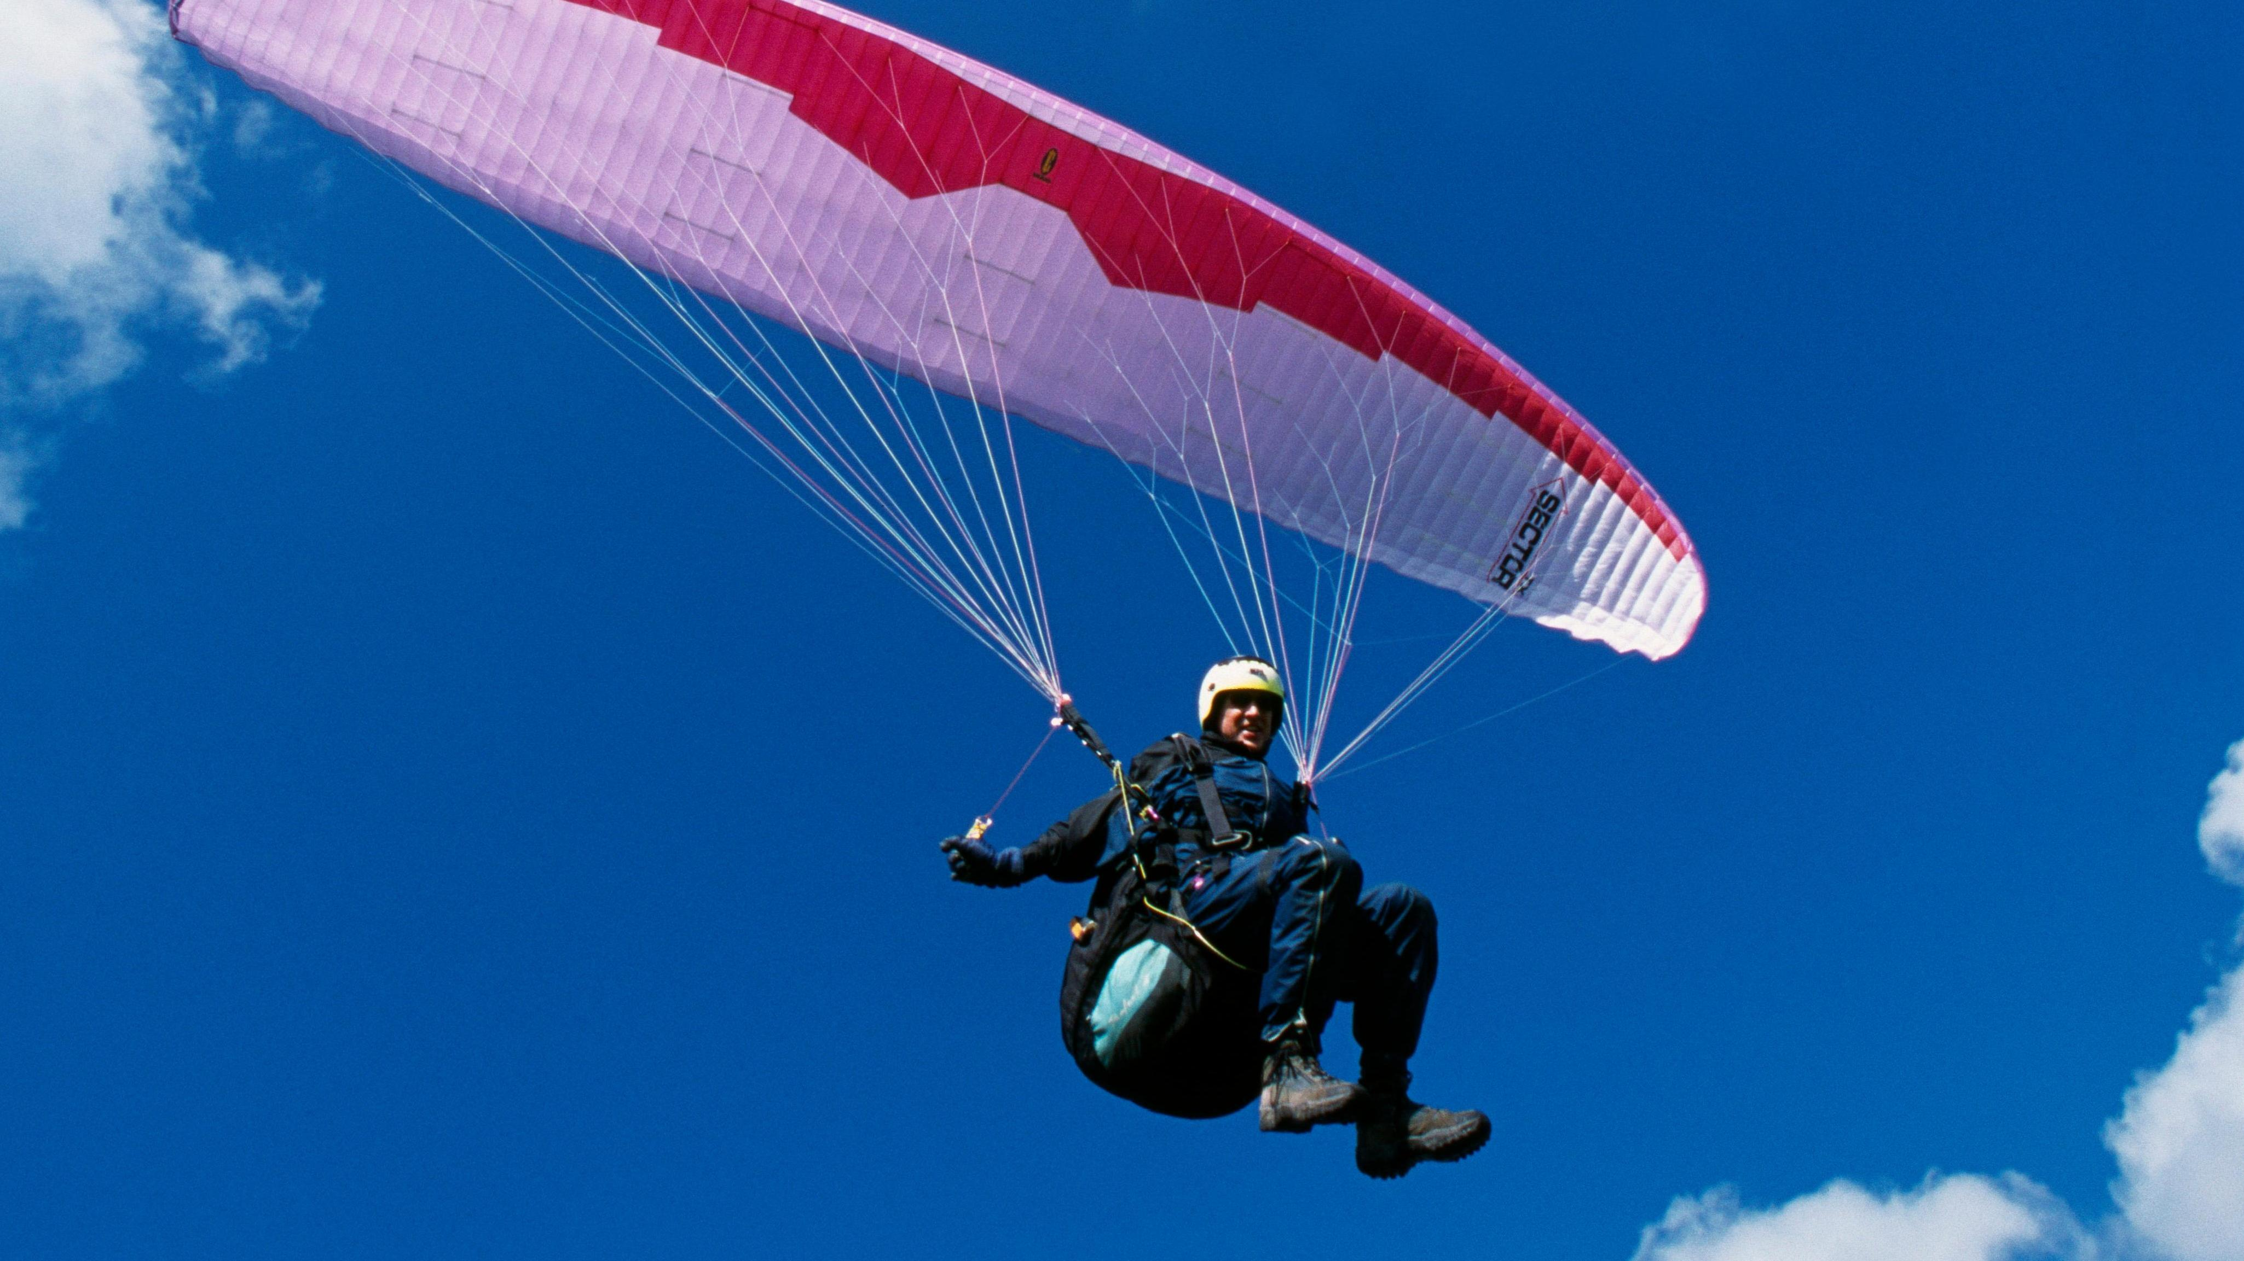

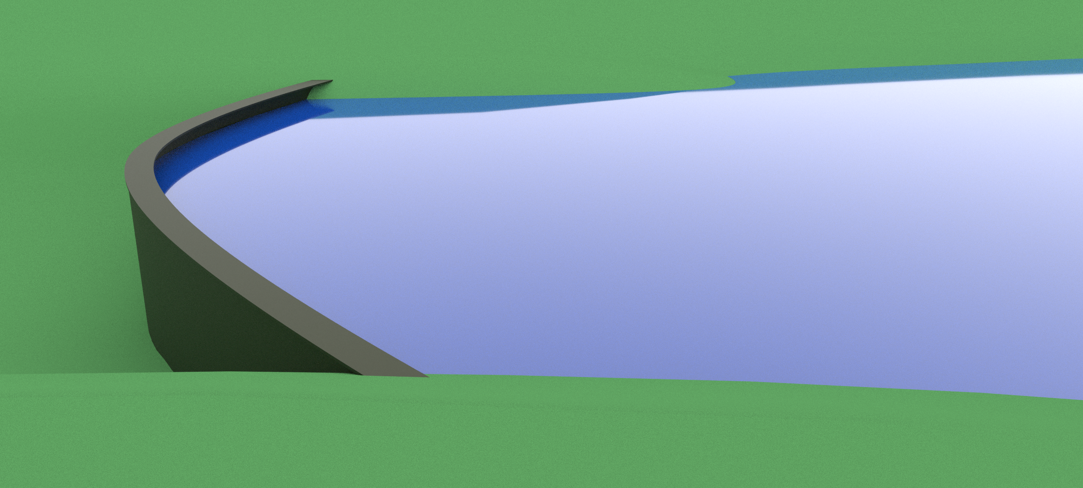
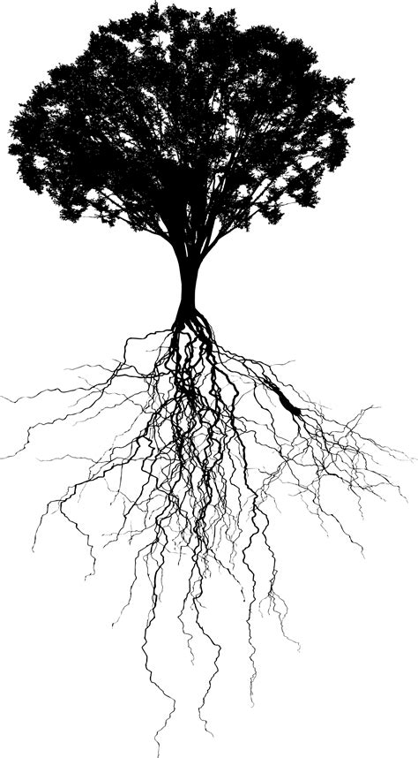
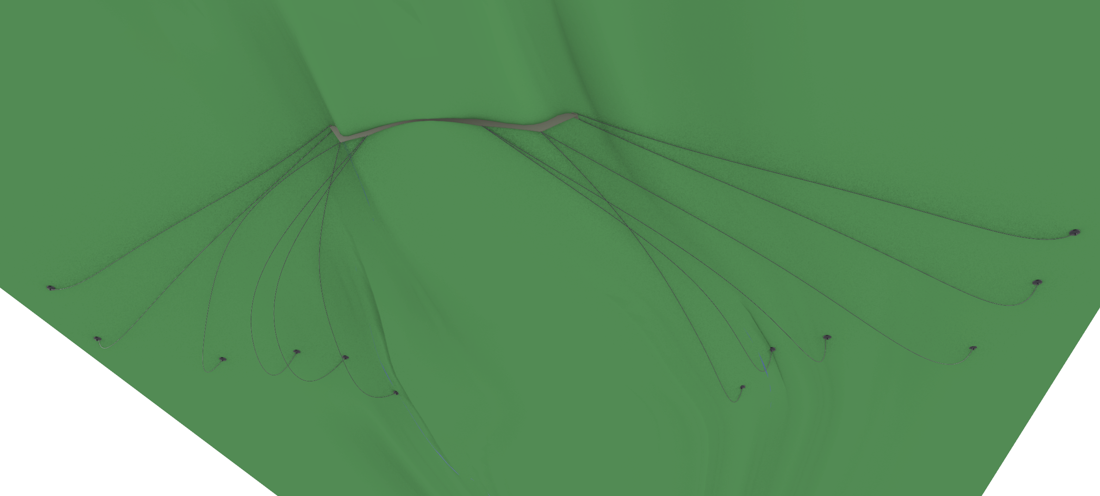
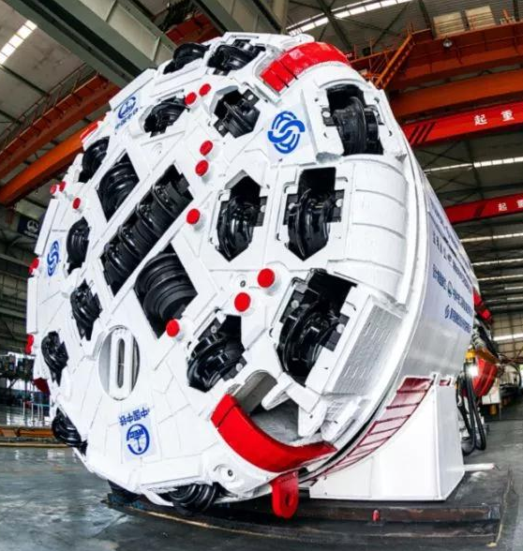
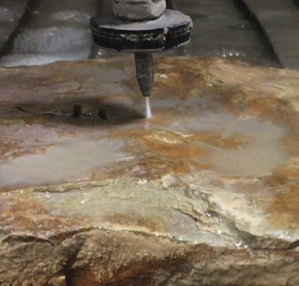
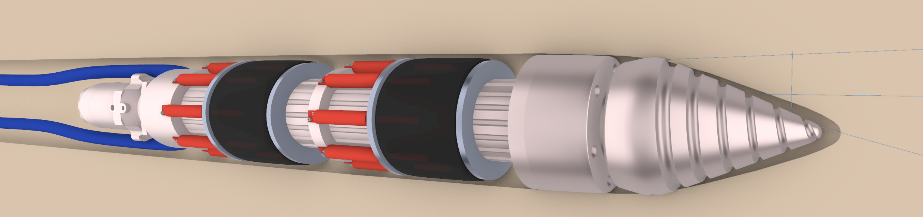
Start with the paraglider idea, think deep root anchor structure of a tree, add in a waterjet granite cutter into a tunnel boring machine but not that big. Design a robot waterjet drill that moves like an earth worm and create an underground steel cable tension root system that holds a steel parachute type dam in place.

