Slide 1
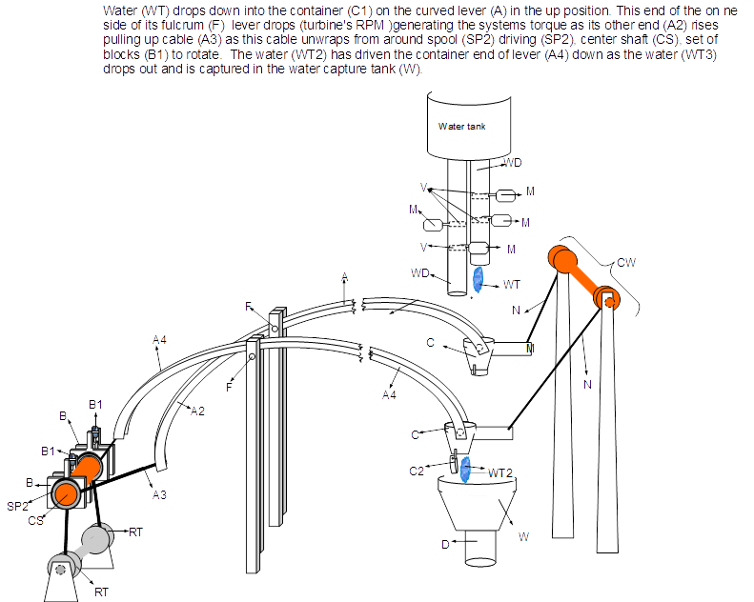
2 cylinders of our Lee Drive 4 Hydroelectric multiple cylinder low head turbine MW energy system

