Slide 1


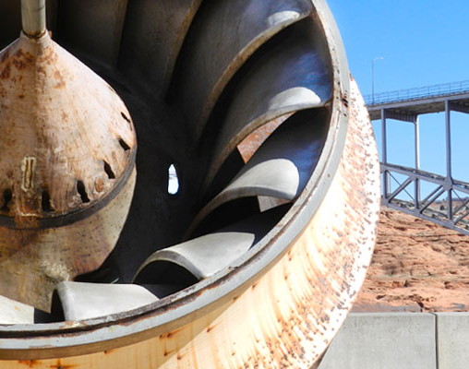
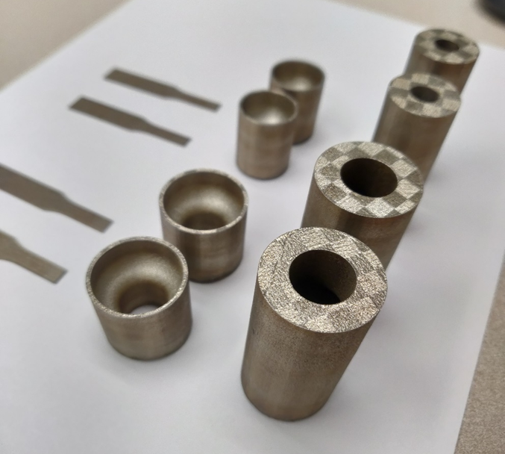
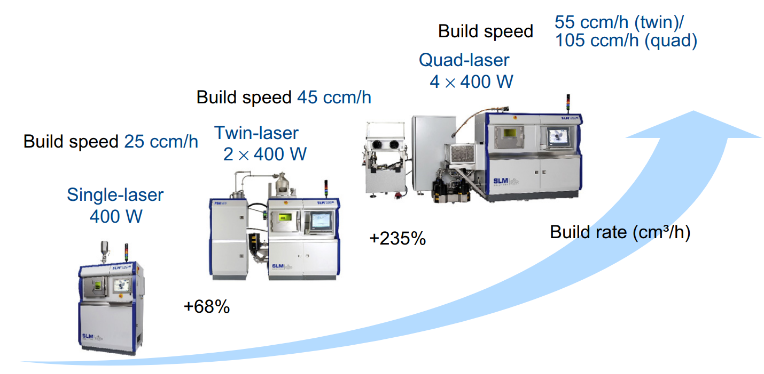
3D Printing of Replacement Parts for Corrosive Environments: Towards Reducing Cost and Lead Time of Hydroelectric Components : Bruno Azeredo, Venkata Krishnan Sampath, ASU
Objective: (a) Decrease lead time and costs associated with replacement of critical components, pipes, and parts under low pressures (100-200 psi), and (b) combat corrosive environments via 3D printing of stainless steel (i.e. 304 and 316) parts via Selective Laser Melting (SLM). Background: Metal AM has been widely successful in industries requiring small production scales (<100 units) (e.g. Aerospace) for parts of highly complex geometry and added value. Problem Statement: To replace metal parts for hydroelectric system components exposed to corrosive environmental conditions such as fresh water and saline water. At a minimum, pipes must withstand 100 psi of operational pressure. Innovation: The narrative is backed by our group’s work on 3D printing and in corrosion science to develop process recipes for specific needs of US hydropower industry. Our work showed that the corrosion resistance of 3D printed stainless steel is better than conventional steel, along with less lead time, we propose the use of 3D printed steel for hydropower components in corrosive environments.
Questions
Maintenance Team
Pipe is corroded and leaking, what’s the lead time on this part’s replacement?
How long can this line be shutdown before I am in trouble?
How much does it cost me while I am waiting for a new part?
How long will the manufacturer take to make this legacy piping part?
Improving capacity and build speed of generations of Metal 3D printers
Selective laser melting printed stainless steel 316L by our group

