Slide 1
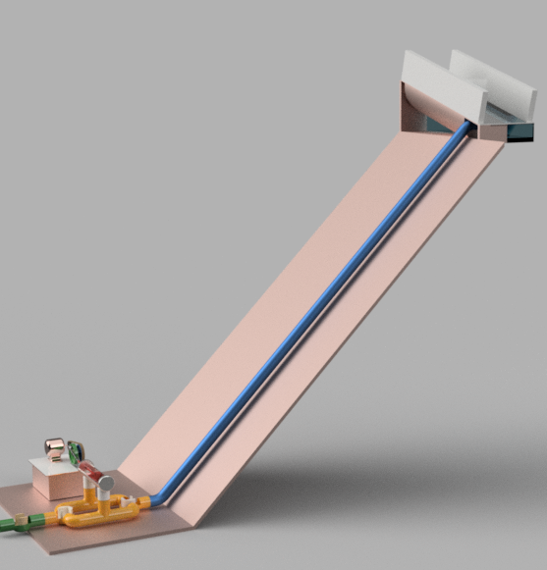
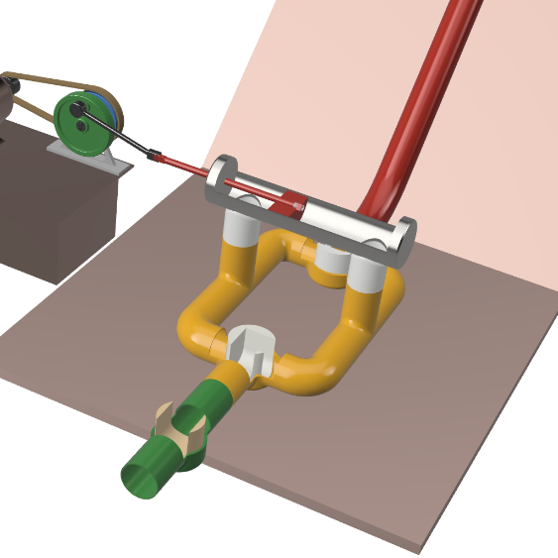
NATURE-ELECTRIC
the power plant for sediment laden raw river water
A simple to build, piston based water-power plant with debris rejecting water intake
Debris roll-off Intake
HIGHLIGHTS:
At 10% v/v sediment content, generates ~11% more power,
No spend on sediment exclusion system
No wasting water for flushing sediment
No precision engineering costs
Reduced construction and Cost and time
Penstock
D C Power Generator
ENGINEERING:
Fast moving turbine replaced by Slow Piston
Slow movement of system saves abrasion
Sediment kept away from moving parts
Useful for wide range of Head and Discharge
Sediment transport principles followed for longevity
Precise control on Power Output quality
Debris rejecting Intake
Piston PowerPlant
SOCIAL REWARDS:
Power for remote hilly and shady locations
Easy, fast and cheap to install even in remote location
Local workshop can build and maintain the wearing mechanics
DIY for home use and Good for Small projects
Generation control Valve

