Slide 1

Project Name: Let Fish Go Home
Technology Area: Not be categorized in the list categories
An Innovative Technical Solution by BaoMin Shen from Islandsurvival

Slide 2
content
Impact
Innovation
Feasibility

Slide 3
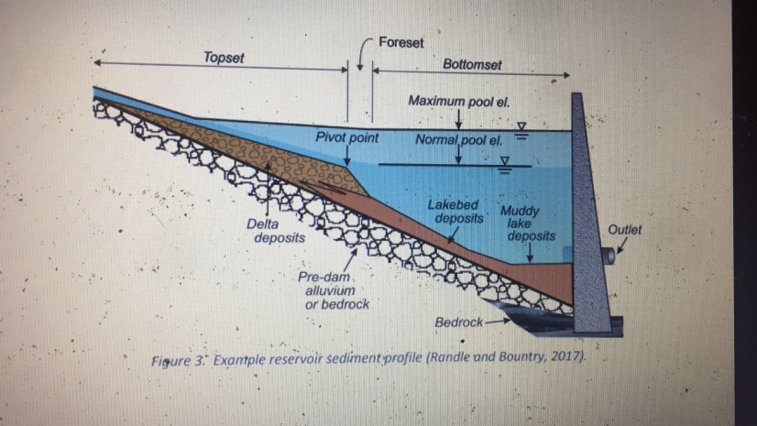
impact
Description of the problem:
  The most important reason why hydropower stations are not popular is to cut off rivers and build dams.
  The environmental cost is high, and the cost of persuading the authorities and environmental protection accounts for more than 10%.
  In addition, the later expenses for species protection will also be a big expense,
  The sedimentation of sediment and floating objects are big problems!
  Long term cost of more than 16% per kilowatt hour

Slide 4
impact
In order to solve the fish migration problem, it is designed to build the embankment along the river instead of digging the original river.
This technology may bring incalculable turnaround for the survival of hydropower industry and reduce the cost of electricity by at least 20%

Slide 5
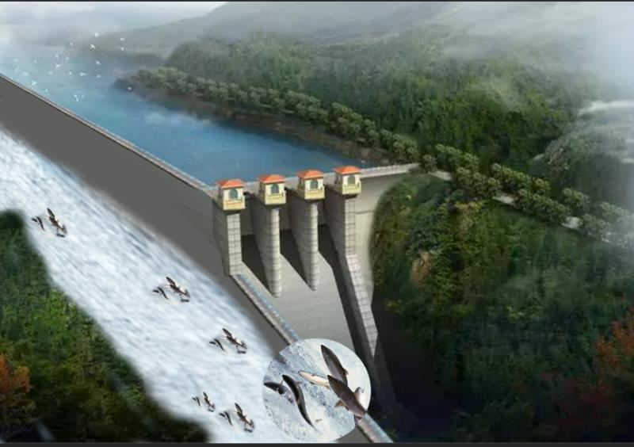
Innovation
In our design
the original river is not to be excavated, but a dike is built on one side of the bank!
The reservoir body is formed by building a "dike" downstream of the current.
With this solution, the dam is no longer the enemy of nature! This is an idea to build a hydropower station without cutting off the river. Let the reservoir coexist with the river.
For a dam with height of 30 meters, a 2000 meters side river can solve the problems in the history of human hydropower construction!

Slide 6
Feasibility
Existing construction technology + Innovative construction technology
Much lower total cost (including construction and maintenance cost) in comparison to the traditional dam
There is no need to maintain the sediment and the floating object.
Close the water intake and then the facility can be out of active service.
The key is to find a reliable and ambitious developer and initial capital. It is recommended to build a small model and test it in the hydropower laboratory experimental center firstly.

Slide 7
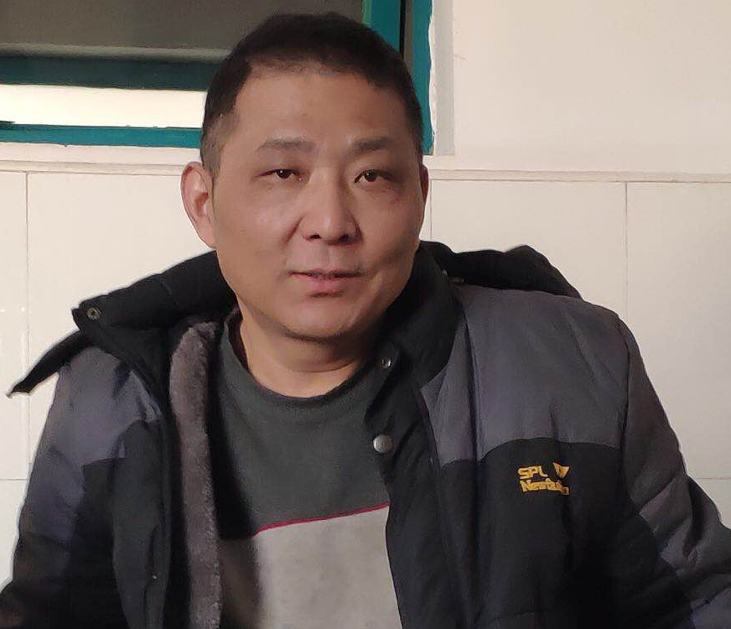
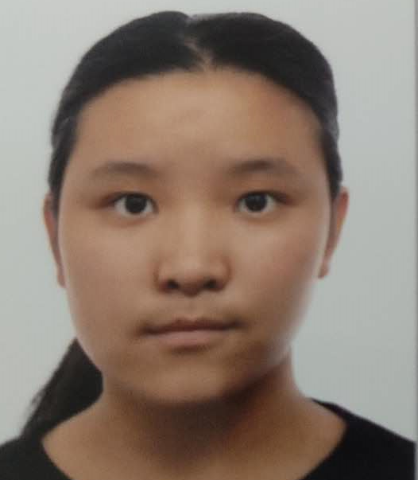
Project team main members
Shen, Bomin, CEO of Islandsurvival
Shen, Shingwun, Technician of Islandsurvival

