Slide 1
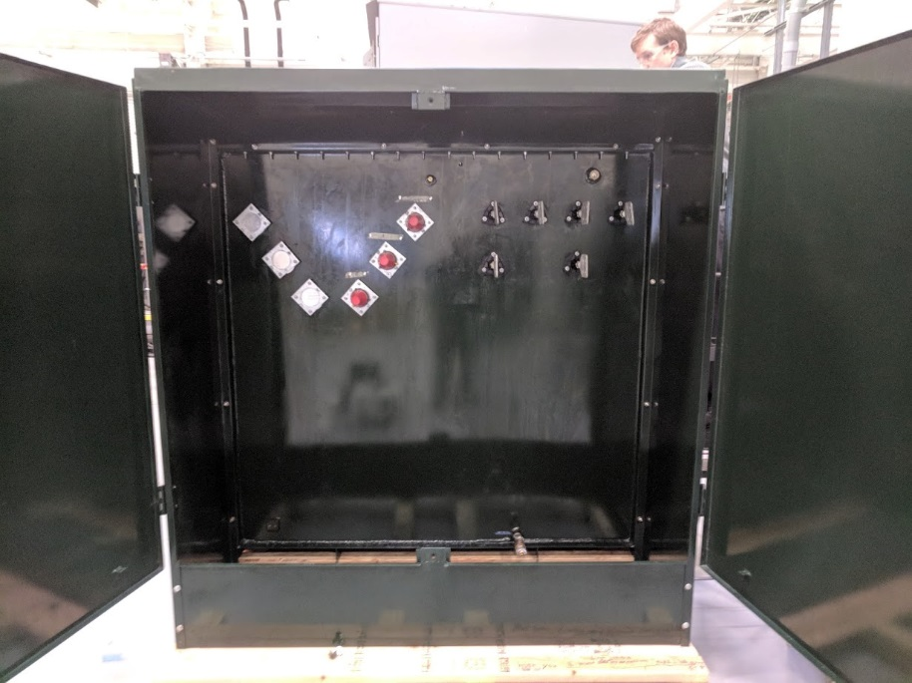

Highly integrated solar to hydrogen
Resilient Power Router
10x less area
8x less site labor
1 grid tie vs 3-4
No transformer costs
Lower harmonics
No building
1 drop in container is better than 11
>15kV
Inverter +
STATCOM

