Slide 1

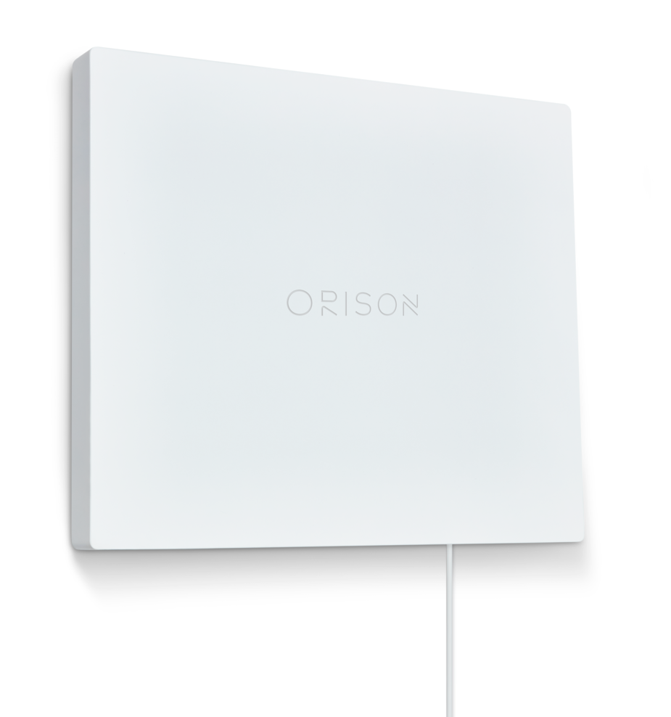
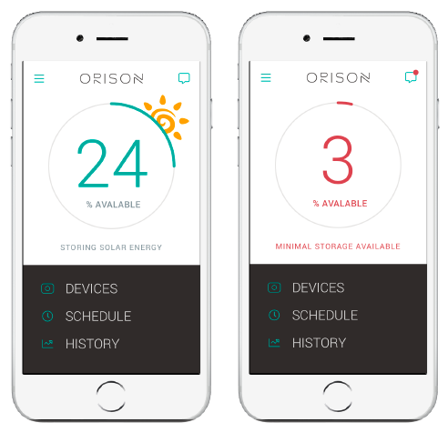
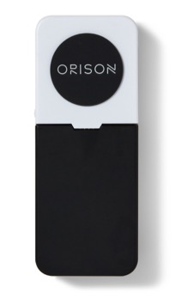
The Orison Home Battery System
Orison’s mission: Put energy control into the hands of all energy consumers, while allowing them to have personal energy security, freedom and choice. And, enable the rapid adoption of clean, renewable energy.
We’re making this possible with just three core components. Expand your storage capacity for less with the Orison Panel+ expansion units.
Energy Monitor
Measures current on each breaker
Panel
2.2 kWh Scalable Battery
App
Smart Analytics & Visualization

