Slide 1


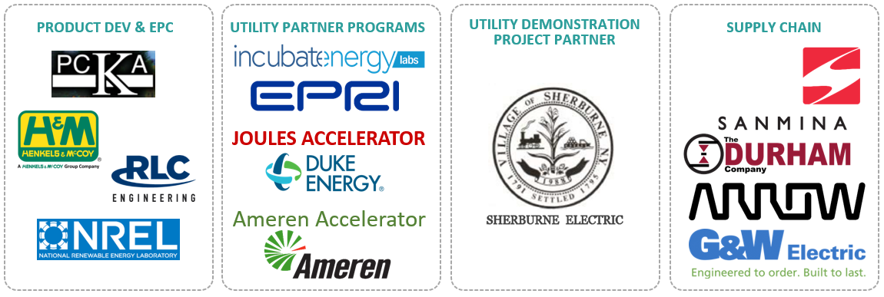
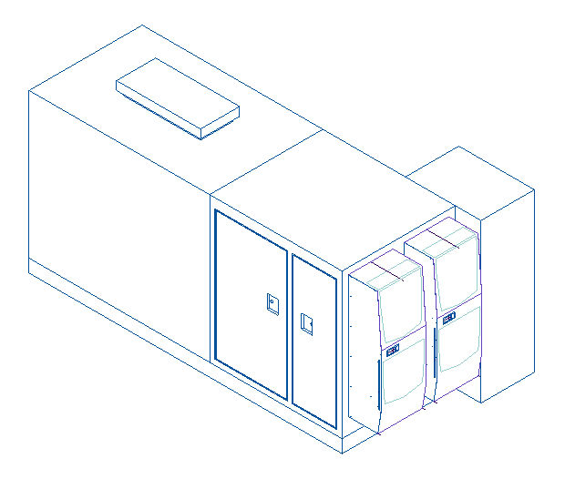
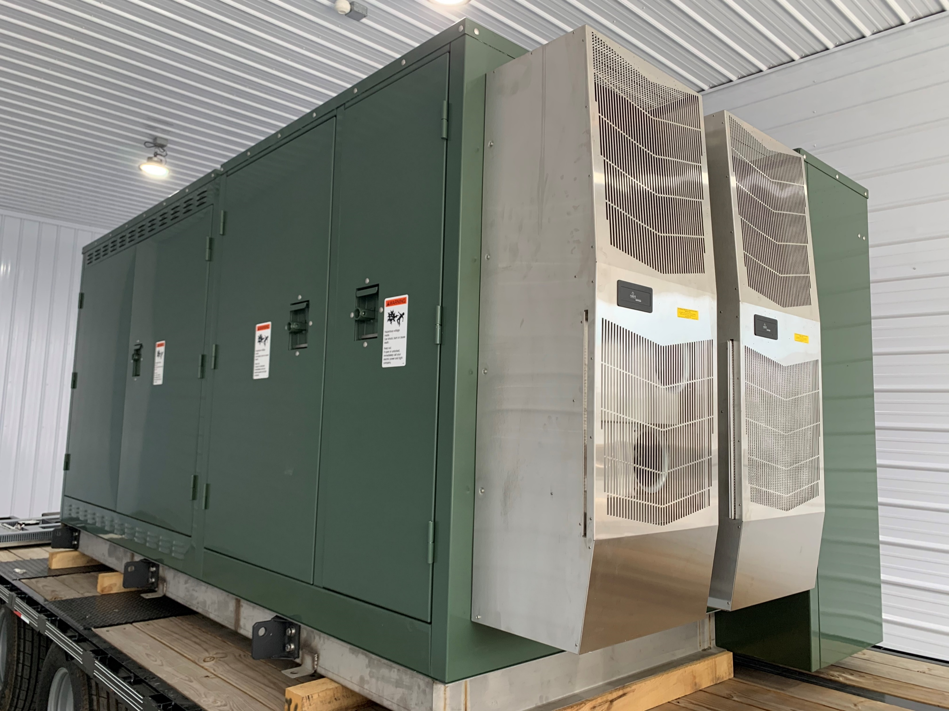
The Phase-EQ: Increasing the Solar Hosting Capacity of the Grid
Switched Source LLC Vestal, NY
Opportunity/Technology Summary
Next generation of Distribution Automation using medium voltage Power Flow Control Technology, $1M+ ROI per device deployed
Equipment is targeting Distribution Automation / Distribution Modernization Market, $1 Trillion in spending expected 2020-2030
Core IP has been developed into Minimum Viable Product with support from American Made Solar and NYSERDA
STAGE | MILESTONE | STATUS | RESULTS
SET! | Develop System-Level Simulation Models | 100% | Models complete, show 2x solar hosting increase!
GO! | Dispatch Algorithm/Software Development | 100% | Algorithms established for Voltage Optimization and Solar Integration
 | System Impact Studies | 100% | Detailed system results for real utility circuits in CYME
 | Phase-EQ Prototype Build | 100% | Unit shipped 7/15/2020
AFTER GO! | Performance Testing | 25% | Controls currently being tested in Switched Source lab
 | Pilot Project with Partner Utility | 25% | Demonstration Agreement executed
Commercialization Summary
Switched Source has developed diversified partners and stakeholders to assist technology manufacturing, development and demonstration:
Beta Unit built during GO! Phase
Increases solar hosting on distribution circuits by up to 100%

