Slide 1
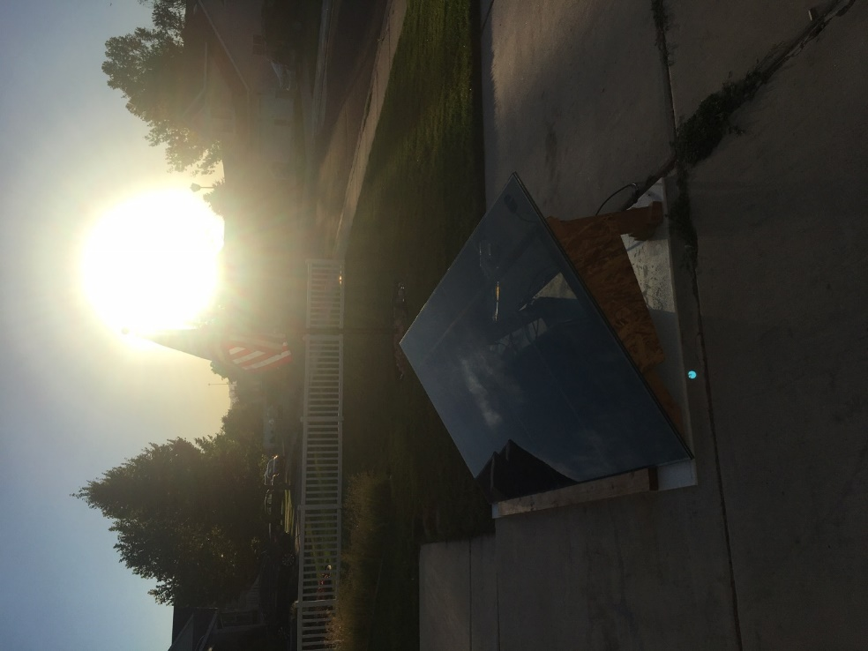
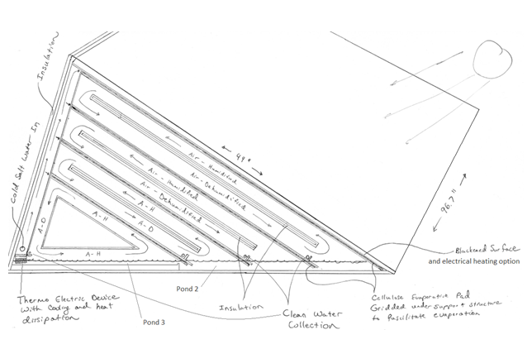
Solar Spring
- Immediate application of solar-thermal heat in desal unit / minimizes heat losses and land requirements
- Solar heat received directly through transparent PV panel onto blackened cellulosic evaporation pad, and indirectly onto pad by photovoltaic-thermal principle
- Staged natural-circulation humidification-dehumidification cycles / countercurrent flow
- Thermal gradient for driving condensation sustained by thermoelecrics, permitting longer fluid residence times and desalination up to and potentially including crystallization
- Mineral extraction and recovery
- Favorable scale-down economics

