Slide 1


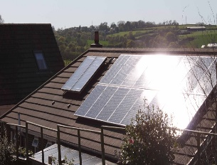
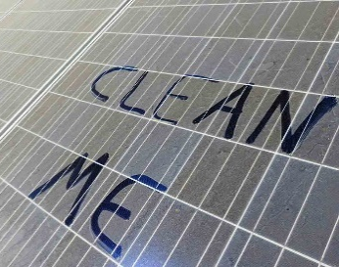
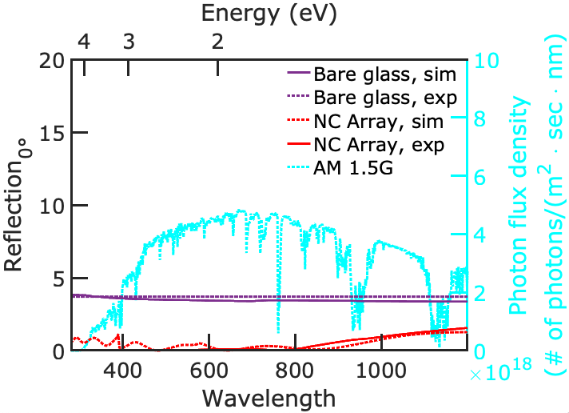
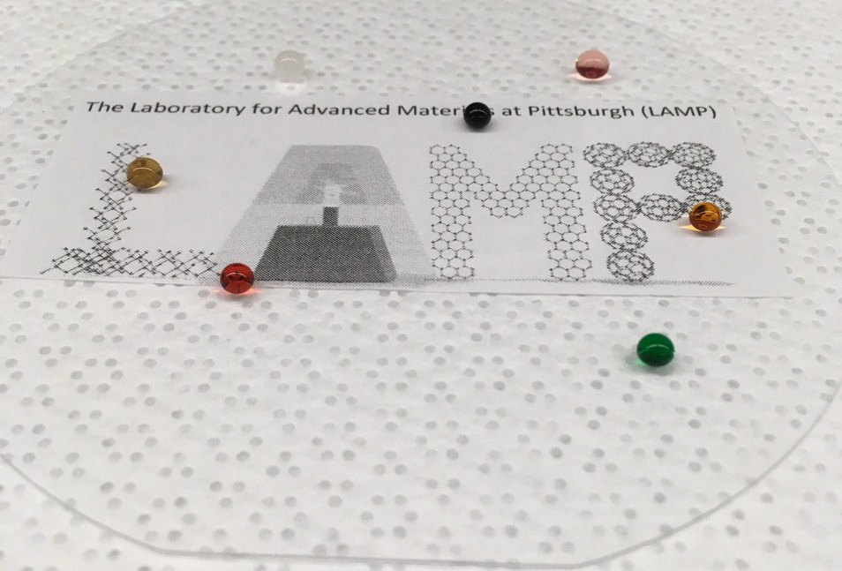
Durable Antireflective, Anti-Soiling, and Self-Cleaning Glass for Solar Modules
Efficiency Loss Issues
Ready! Goals Met
Reflection at the air/glass interface due to an instantaneous change in the index of refraction
Performance Metrics | Units | Goals | Actual
Scalable Fabrication | Area | > 10 cm x 10 cm | 10 cm x 10 cm
Broadband Antireflection | % Reflection (wavelengths 400 to 1100 nm) | < 1 | 0.4%
Broad Angle Antireflection | % Reflection at 45° | < 2 | 4.9% at 65°
Static Water Contact Angle | Degrees | > 155 | 162.1 ± 2.0°
Water Contact Angle Hysteresis | Degrees | < 5 | 3.2 ± 0.7°
Self-Cleaning Tests | % Decrease in Transmission | < 5 | < 1
Cost | $/m² | < 20 | ≈ 20
Mechanical Durability (ASTM D1044 Abrasion Tests) | % Change in Optical and Wetting Properties | < 10 | < 5
Soiling from particulates/pollutants lead to as much as ~60% efficiency loss!
Antireflection
Proposed Work
Anti-Soiling and Self-Cleaning
Improve scalability of processing to > 20 cm x 20 cm areas
Demonstrated less than 5% decrease in transmission with soiling
Demonstrate silicon minimodule environmental durability
Milk
Blood
Coffee
Ethylene Glycol
Orange Juice
Cranberry Juice
Water
Key Personnel/Organizations
Superomniphobic glass repellent to a wide array of liquids and particles
Particulates adhere weakly to surface and are easily removed by dew condensation
Demonstrated broad angle (0.4% at 0° incidence) and broadband antireflection (4.9% at 65°)
Irregular like nanostructures on the glasswing butterfly
Corning
Dr. Carl E. Crossland
Pitt
Dr. Paul W. Leu
Sajad Haghanifar
Sooraj Sharma
Benjamin Bailey
NETL
Dr. Paul Ohodnicki
Dr. Bryan D. Morreale

