Slide 1

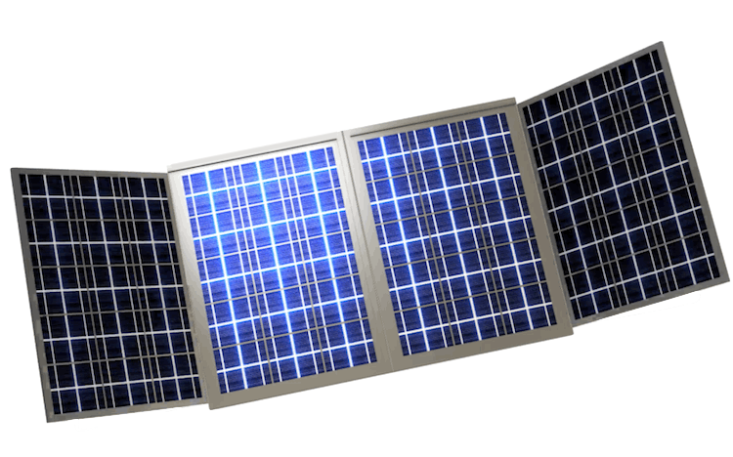
JuiceBox 3.0 Highlights:
JuiceBox Telescoping Solar Array: most compact high-output solar array on market
ShineNet WiFi hotspot provides access to pre-loaded recovery info and live monitoring panel
+ internet where available/needed
ShineNet available in 108 languages. Content is relevant for all potential users and updated over-the-air before deployment.
Internationally compatible outlets
Ultra low-power cooking & heating system inspired by truckers
100+ proofs-of-concept deployed to homeless Americans (JuiceBox 1.0 and 2.0) in field for 3+ years.
8lbs. Laptop-sized. Waterproof. Shock resistant. Deployable LEDs.
Meet JuiceBox 3.0
Portable, durable, American-made solar microgrid for natural disaster victims, homeless families, refugees, and off-grid healthcare workers.
Compact. Stockpile-ready. Backpack-transportable. User-friendly. Internationally compatible. Ready for government and nonprofit use.
Created by Claremont Colleges students in 8 U.S. cities.
Backed by businesses, nonprofits & governments.
Made in America.
www.shinewithus.org
JuiceBox will help speed natural disaster and homelessness recovery and limit the lasting economic, educational, & societal damage of these issues on Americans. JuiceBox also has applications worldwide.

