Slide 1
Agri-Tech Producers, LLC
Our Patented Combined Remediation Biomass and Bio-Product Production (CRBBP) Process
Cost-Effectively:
Removes Phosphorus From Watershed Farmland
Protects Water Bodies From Harmful Algae Blooms
Enhances Wastewater Treatment Plant Spray Fields
Treats Brownfield Sites
Reduces Power Plant Environmental Impacts
Captures Large Amounts of Atmospheric CO 2, and
Makes Cost-Advantaged Bio-Products
Presented to the South Carolina Dept. of Health & Environmental Services
By: Joseph J. James, President, Agri-Tech Producers, LLC (ATP)
(803) 413-6801 - josephjjames@bellsouth.net

Slide 2
Global
Challenges & Opportunities
Challenges:
Global Warming: Cost-effective CO 2 capture, carbon re-use & sequestration mechanisms are needed.
Contaminated Soil and Water: Cost-effective ways to remediate and protect soil and water are needed.
Opportunities:
CRBBP Process: Provides less costly remediation, CO2 capture, and re-uses/sequesters captured carbon in ATP’s cost-advantaged bio-products.
Industry Opportunity: Industry can make more fuel-efficient vehicles and planes from superior, cost-advantaged and environmentally beneficial materials.

Slide 3
ATP’s CRBBP Process
We plant and then sequentially multi-task bio-crops and their resulting biomass, to do good things, for people and the planet, less expensively.

Slide 4
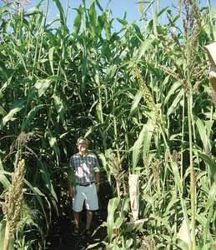
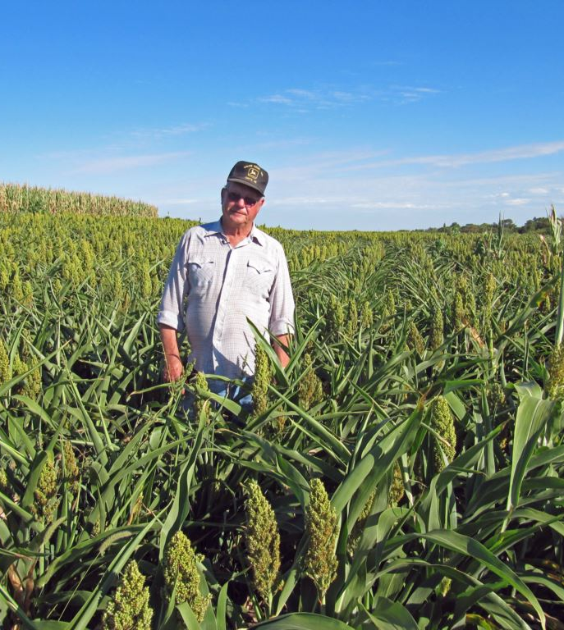
Bio-Crops Are Bred to Grow Fast, Big and to Do Good Things!!!
Standard Sorghum
Biomass Sorghum

Slide 5
What is Biomass?
Biomass is anything living, or that has lived, such as plants, trees, and animals.

Slide 6
Our Patented/Cost-Effective
Torrefaction Process
ATP’s patented and cost-effective Torrefaction Process, heats plant or wood material (Biomass), in a low-oxygen environment, which evaporates away the water, Volatile Organic Compounds (VOC’s), & Hemicellulose (HC).
The VOC/HC gases are Captured and Combusted by our Torrefaction Units to cost-effectively and with minimal environmental impact, generate all required Process Heat.
Torrefied Biomass can be used to make a variety of Bio-Products: e.g. Fillers, used to make better-performing, circular economy Plastics; a clean and renewable Bio-Coal, co-fire fuel: and Biochar, to make poor soils more productive.

Slide 7
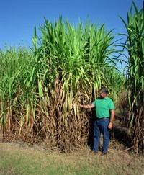
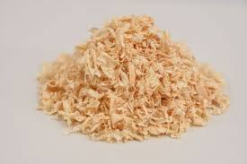
ATP’s CRBBP Process
Remediation & CO2 Capture
Plant Bio-Crops
Harvest/Shred
Bio-Crops
Make
Bio-Products
Bedding
Biochar*
Fillers*
Bio-Coal*
Re-Use & Sequester Carbon
* Made Using ATP’s Torrefaction Process

Slide 8
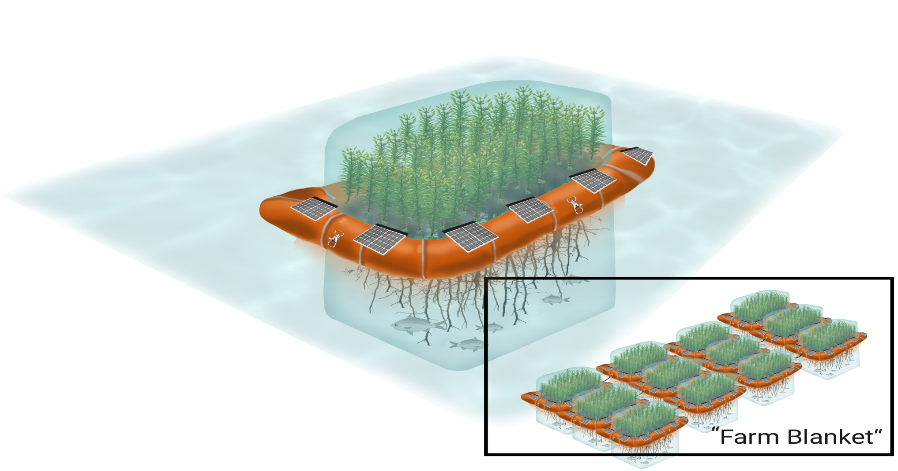
CRBBP Process: Floating Bio-Greenhouses (FBG’s) Can Treat Power Plant Coal Ash Ponds

Slide 9
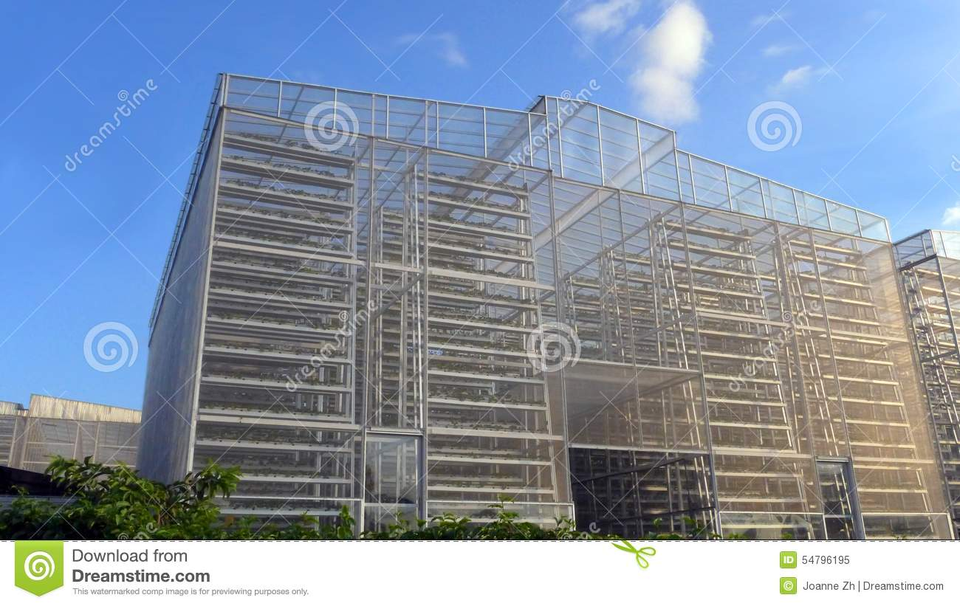
CRBBP Process: Vertical Bio-Crop Farms (VBF’s) Extract CO 2 From Power Plant Flue Gasses

Slide 10
CRBBP Process: Multi-Tasking
Reduces Costs, Per Task ($C/T)
For 1 Task, C/T = $C/Task 1
For 3 Tasks, C/T = $C/(T1+T2+T3)
8
8
For Tasks, C/T = $C/(T1…T ) = $0
Bio-Crop Production Costs = $C

Slide 11
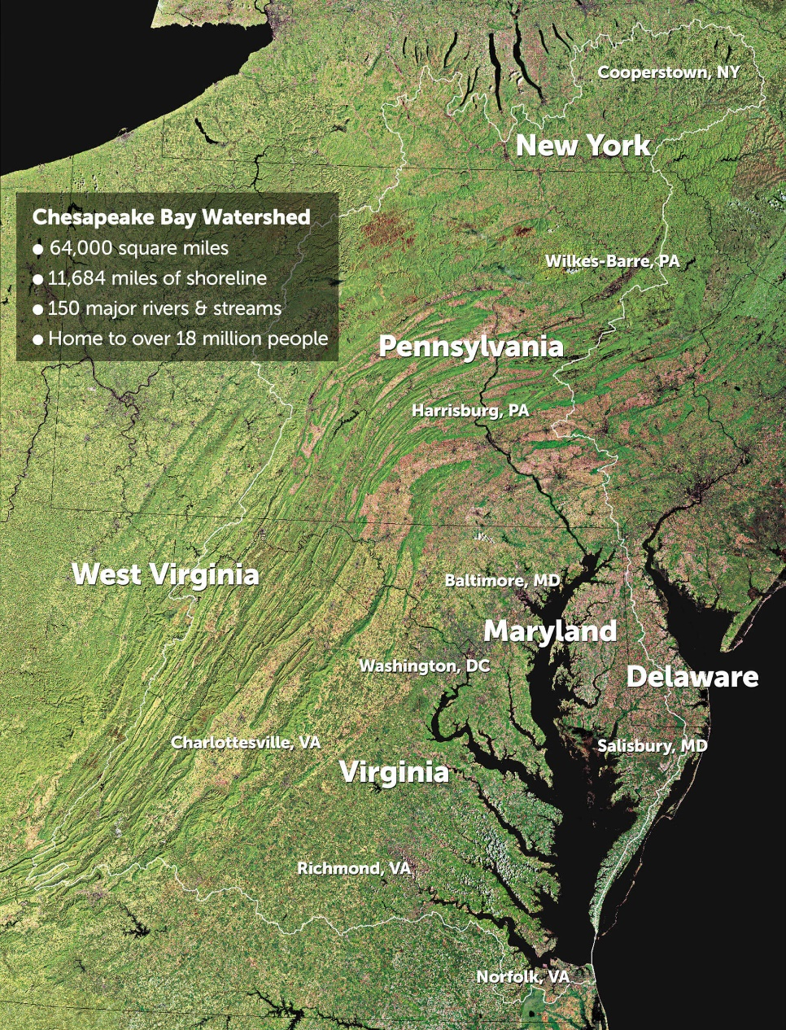
Our 1st CRBBP Process Demo: Protecting the Chesapeake Bay
Our CRBBP Process cost-effectively extracted excess phosphorus from Chesapeake Bay watershed farmland, to protect the Bay’s aquatic life.

Slide 12
CRBBP Process Bio-Products
    Fillers: Bio-based filler powders help make stronger, lighter and more heat & water-resistant plastics.
    Value: $400-$600/ton
    Bio-Coal: A clean/renewable fuel, made, in part, from flue gas of the power plants in which they are co-fired.
    Value: $200/ton
    Poultry House Bedding: Locally-produced , cost-advantaged, and better-performing bedding.
    Value: $75 - $95/ton.
    Biochar Soil Amendments: Increase the productivity and water-efficiency of poor soils.
    Value: $250-$500/ton

Slide 13
Size of Bio-Product Markets
    Circular Economy Fillers: The $380 billion US plastics market
    Bio-Coal: The 6.2 billion TPY, global coal market
    Poultry House Bedding: The $48.3 billion US poultry market
    Biochar: The $8 billion US garden consumables market

Slide 14
CRBBP Process Collaborators
Industry: Bio-Crop Seed Companies, Farmers, Manufacturers, Etc.
US Government: EPA, USDA: NRCS, Rural Development, USCP
States: MD, OH, PA, SC, VA
Universities: Univ. of Akron, Clemson, NC State, Penn State, UMD, VA Tech

Slide 15
CRBBP Process Benefits
    ATP’s CRBBP Process will cost-effectively:
    Remediate impacted soil and water
    Reduce Algae Blooms in Water Bodies
    Reduce atmospheric CO2 levels
    Reuse/sequester captured carbon in various environmentally beneficial bio-products
    Produce circular economy plastics, which will: - Enhance vehicle and plane fuel-efficiency - Reduce plastic pollution
    Produce biochars, which will enhance farm and garden productivity

Slide 16
ATP’s Founder
ATP's Founder, Joe James, is a former, 33-year economic development professional, who has been a biomass leader in the Southeast US, since 2004.
He invented and patented the CRBBP Process and recently completed a 6-year term on the federal Biomass R&D Technical Advisory Committee.
Mr. James received a BS in Science, from Union College, and has studied Law and Business Administration at New York University.
Among his several awards is the 2008 Purpose Prize, for his work to reduce rural poverty, by working to bring poor, rural communities of color into the nation’s Green Economy.

Slide 17
Key Milestones Achieved
  Our CRBBP Process was invented in the spring of 2016.
  We have successfully planted our bio-crops in Chesapeake Bay watershed farm soils, in eastern Maryland and Pennsylvania, to extract excess phosphorus and protect fish and other aquatic life in the Bay.
  The patent for our CRBBP Process was issued in October 2018.
  We are executing plans to conduct new CRBBP Process plantings, this spring, in phosphorus-impacted farmland in Virginia’s Chesapeake Bay watershed and Lake Erie’s western Ohio watershed, to reduce harmful algae blooms. We also intend to plant in the spray field of a rural, South Carolina wastewater treatment plant, to increase water quality and thru put, while keeping operating and capital costs low.

Slide 18
Next Steps
In the next 12-24 months:
  We hope to triple the CRBBP Process acreage planted, from 40 to 120 acres, including acreage dedicated to power plant CO 2 capture and coal ash remediation;
  To develop pilot torrefaction processing plant, in Allendale, South Carolina and to make and beta test certain bio-products, like “Circular Economy” plastics and composites.
  And, in the 1st quarter of 2020, we hope to make our first bio-product sales.

Slide 19
ATP’s CRBBP Process
We plant and then sequentially multi-task bio-crops and their resulting biomass, to do good things, for people and the planet, less expensively.

