Slide 1
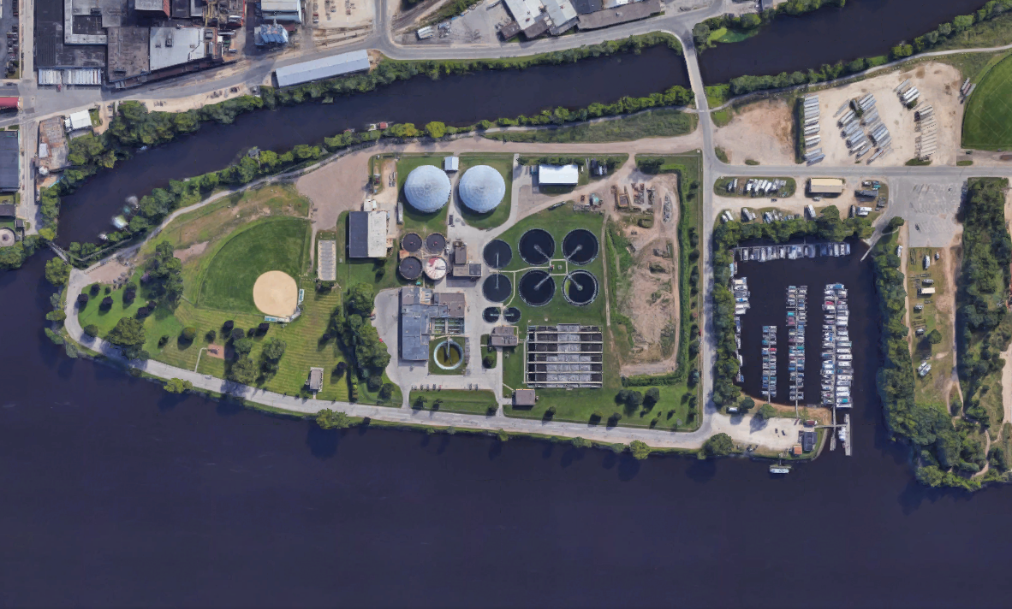
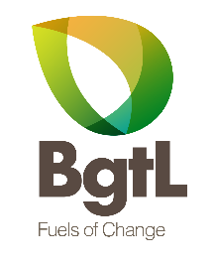
May 2020
Liquid Fuel Production from Biosolid Waste
Wastewater treatment plants (“WWTP”) face an increasing problem in the rising cost of treatment and disposal of biosolids, which are wastes removed during the water purification process. BGTL, INC. has developed a first-of-its kind system to address this problem, one that can not only significantly reduce treatment costs but also create a substantial revenue stream through conversion of the biosolid waste into highly valuable fuel products for local consumption.

