Slide 1
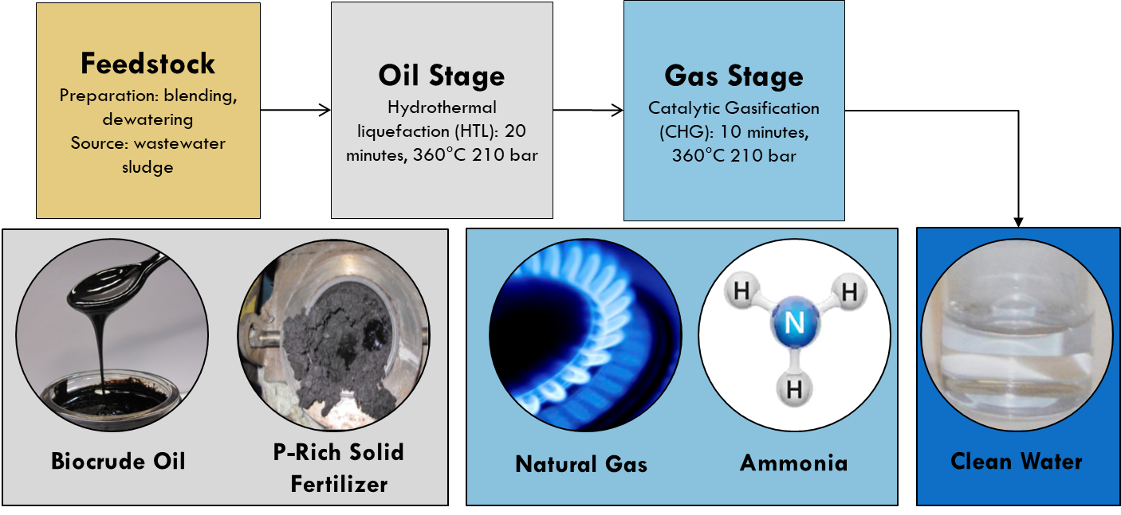
Water Resource Recovery Prize: Genifuel Not Waste
Recovery of the energy embedded in wastewater is a critical element to making WRRF’s energy-positive. Furthermore avoiding the costs and challenges associated with solids handling would significantly improve the economics at WRRFs. Small and medium sized WRRFs would disproportionately benefit from Genifuel’s advancement taking a logistical cost and turning it into saleable, valuable fuel product.
Complete handling of sludge disposal
Production of biocrude and renewable natural gas
Significantly reduced regulatory burden: no odor, no pathogens, no emerging contaminants
Nutrient recovery
Superior to incinerator or anaerobic digester as baseline comparison
highlights
objective
>85% of feedstock carbon to oil and gas
15% of produced energy runs the process
98% recovery of phosphorus
90% recovery of nitrogen
Biogas without sulfur or siloxanes
50% more energy production than anaerobic digestion
No solids subject to 503 regulations
recovery metrics
the process
fuel not waste

